Slide 1
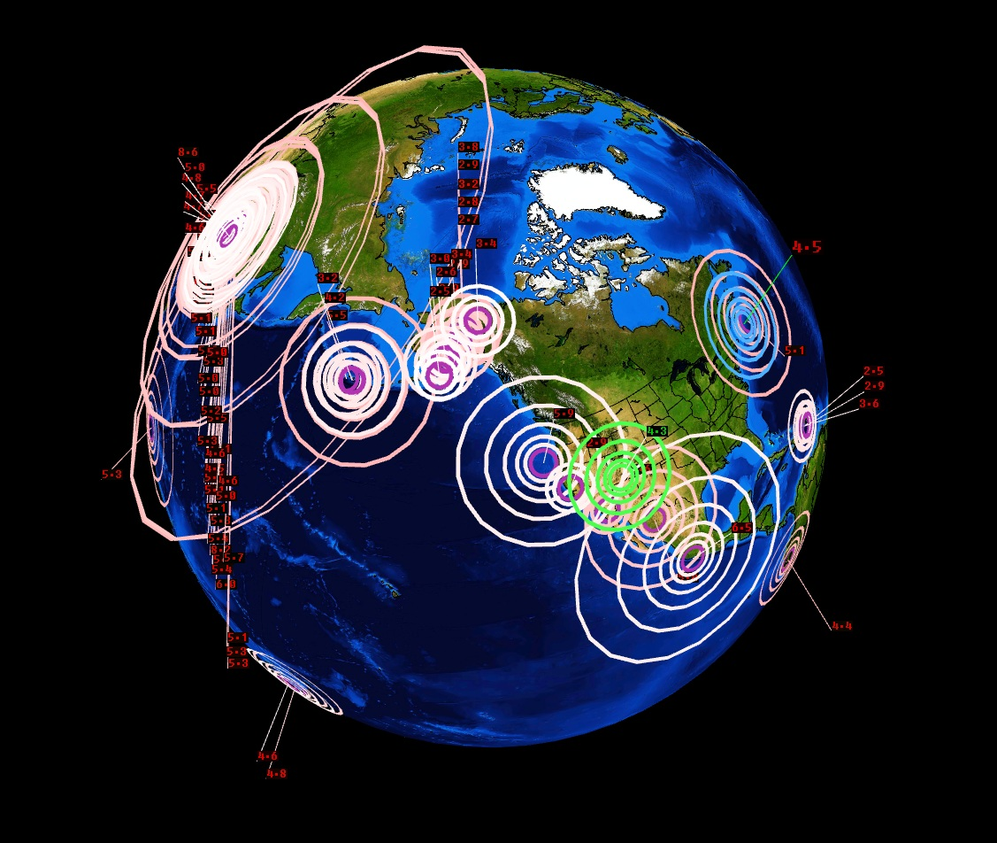
Tectonics in the USA
LO: Explain the threat posed by plate tectonics in the USA

Slide 2
How do plate tectonics impact the United States of America?

Slide 3
Objectives
What: Learning about where earthquakes happen in the USA and why it occurs in these areas.
Why: So that we can understand the pattern of risk for tectonic hazards in the USA.
How: Exploring earthquake hazards through understanding the effects and considering how the threat can be managed.

Slide 4
What are the patterns in the USA?

Slide 5
Where do earthquakes happen?
http://earthquake.usgs.gov/earthquakes/

Slide 6
Earthquakes in the USA

Slide 7
Earthquake Risk USA

Slide 8
Earthquake Risk USA

Slide 9
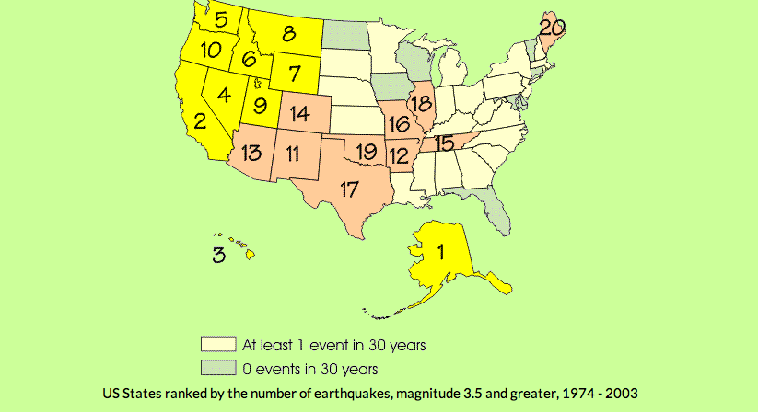
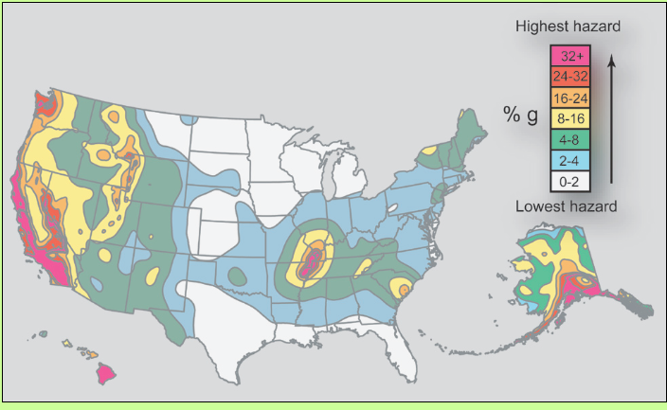
Earthquake Risk USA

Slide 10
In what ways do the plates move?
3 types of plate movements:
Convergent: Plates move together. Can be split into destructive (oceanic and continental crust or oceanic and oceanic) and collision (continental and continental)
Divergent: Plates move apart from each other. Can also be called a constructive margin.
Conservative: Plates slide past each other. Can also be called a transform margin.
http://www.youtube.com/watch?v=ifke1GsjNN0

Slide 11
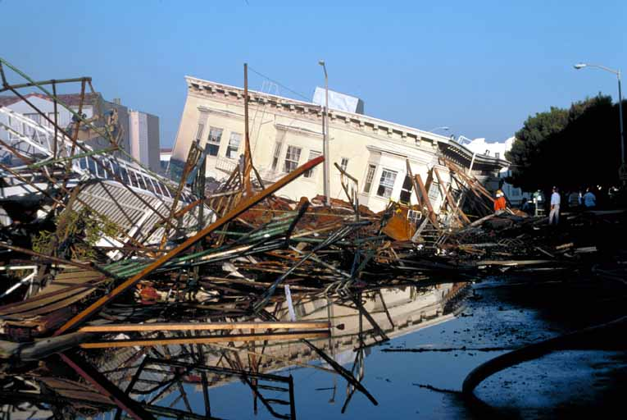
The earthquake risk in California

Slide 12
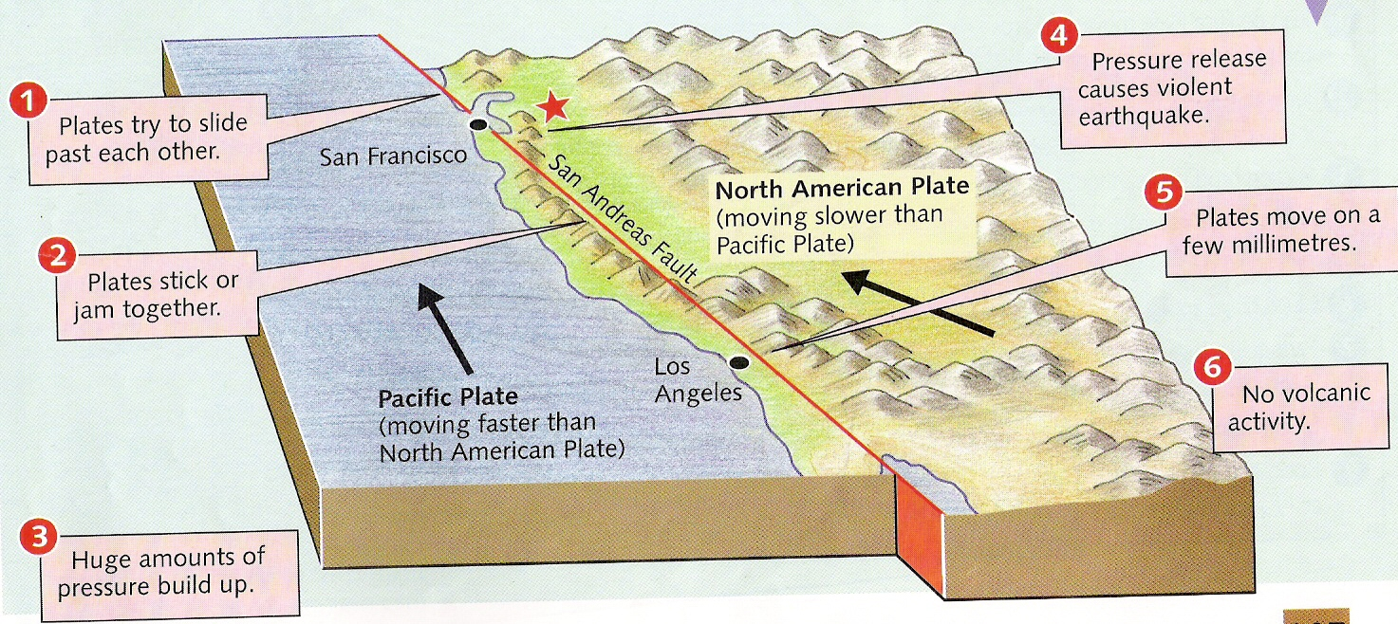
Conservative plate boundary
READ MORE HERE

Slide 13
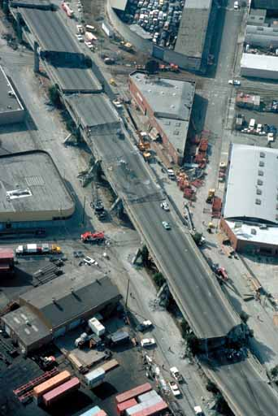
The San Francisco Earthquake, 1989
Case study
LO: to be able to explain the cause and effects of the earthquake (on the people, environment and economy)

Slide 14
Details….
17th October 1989, at 5.04 pm, an earthquake measuring 6.9 on the Richter scale, and lasting only 15 short, but devastating seconds, hit San Francisco

Slide 15
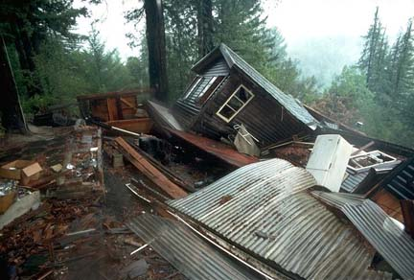
Watch the video
Make notes on the:
Cause
Effects
Response
Any facts, figures

Slide 16
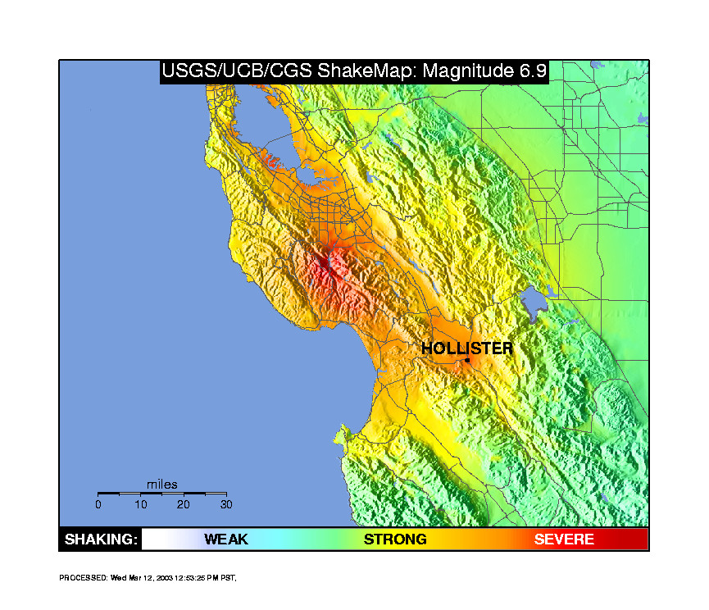

Slide 17
The effects of the 1989 earthquake included:
- 67 Deaths - 6,000 Homes damaged / destroyed - 2000 people made homeless - Upper deck of the Nemitz highway collapsing onto the lower deck crushing people in their cars - A section of the San Francisco-Oakland Bay Bridge collapsing - Fire resulting from gas explosions - Massive economic costs ($4.4 billion) - Damage to infrastructure - electricity / gas and water mains cut

Slide 18
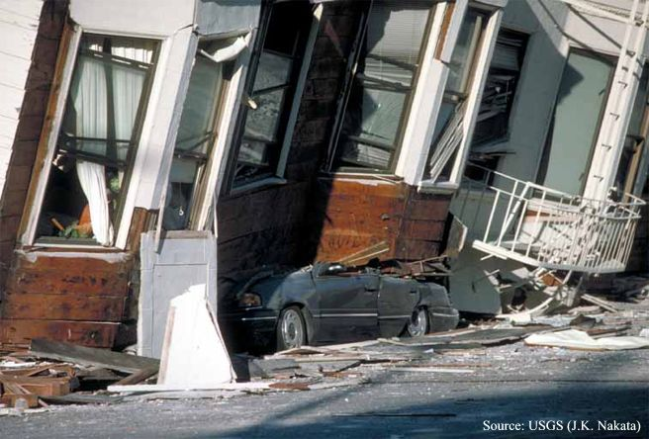
3 Areas in San Francisco were particularly badly affected:
1. The Marina / Bay District Here the buildings were wooden and not securely attached to their foundations. The area was also located on an old landfill site, which was created following the devastation caused by the 1906 earthquake. Liquefaction occured. This is where as the ground acted more like a liquid as water moved up through the sediments resulting in reduced strength and causing buildings to collapse due to lack of support.

Slide 19
Liquefaction
A condition where soil flows like a liquid. This caused extensive damage in the area including the collapsed overpasses and freeways.

Slide 21
2. Collapse of the Double-Decker Nimitz Highway and San Francisco-Oakland Bay Bridge
A number of roadways were damaged during the earthquake, including the collapse of the upper tier of the double-deck er Nimitz Highway (Interstate 80) onto the lower deck, killing and trapping motorists in their cars. The collapse was caused partly by soil faiture and also the unsuitable design of the supporting piers. A section of the Bay Bridge also collapsed killing motorists.

Slide 22
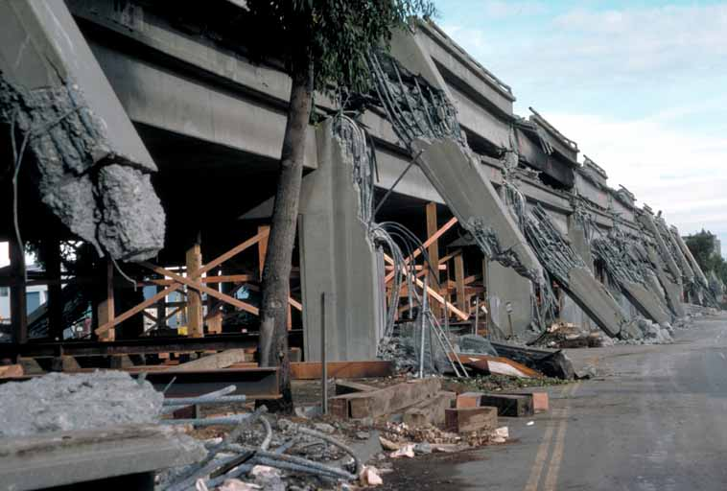

Slide 23
Older buildings
Many of the older (50-100 year old) buildings which were not designed to withstand earthquakes were most severely damaged. Low rise building were also worse affected than taller buildings which swayed with the quake / ground motions.

Slide 24
Task…..
Either create a 6-8 stage cartoon strip explaining the causes and effects of the 1989 San Francisco quake
Or
Write a newspaper report to explain the causes and effects of the1989 San Francisco quake
Success criteria for both tasks:
Explain the causes
Explain the effects- use specific case study detail
Explain which areas were worse hit and why
Use geographic terminology

Slide 25
Why does California need to prepare?

Slide 26
How can you prepare the population?

Slide 27
Building design
If people plan and prepare for earthquakes, then the risks can be reduced.
Advances in building design means that many new buildings are ‘earthquake proof’.
Older buildings can be retrofitted to strengthen them in order to reduce the effects of earthquake shaking.

Slide 28
Task 1: Key Terms
Retrofitting: the addition of new __________ to _________ buildings.
Epicentre: the point on the Earth’s surface
__________above the _______ of an earthquake.
3. Cross-bracing: two ___________ supports placed in a X shape manner.
diagonal focus directly
technology older

Slide 29
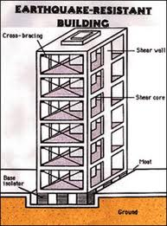
Computer controlled movable roof weights to counter the shock waves.
Cross – bracing to give added strength and prevent twisting.
Automatic window shutters to prevent falling glass.
Sheer core of reinforced concrete and tensioned cables around lift shaft.
Automatic sprinkler system and gas shut-off to prevent fires.
Strengthened steel and reinforced concrete road supports.
Foundations set deep into the ground.
Rubber shock absorbers.
Base isolator allows sideways motion.

Slide 30
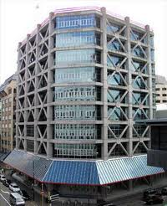
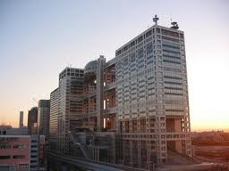
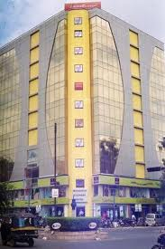
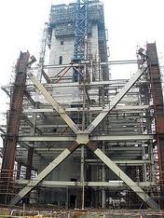
TOKYO, JAPAN
SAN FRANCISCOUSA

Slide 31
Task: Design an educational leaflet for the International school of San Francisco
A new school is opening in San Francisco. The school community are new to the area and need to know where would be safe to live andwhat to do if an earthquake hits….
Success criteria:
-Explain why they should be prepared
-where should they live?
-What features should they look for in their new homes?
If an earthquake hits what should they do?
What should they have in an emergency kit?

Slide 32
Task 3 – Design an earthquake proof building
In groups you need to design and make a building that can withstand an earthquake.

Slide 33
Design Criteria
 | CRITERIA | CHECKLIST
1 | The building must fit the base.
2 | The building must be at least 36 cm tall.
3 | The building must have 2 stories that are each at least 18 cm tall (approximately the height of 1 straw).
4 | Each story must support the weight of at least 1 sand bag (250 grams) without collapsing.
5 | A construction drawing with measurements and analysis must be submitted before earthquake testing.
6 | To survive an earthquake test, the building must not collapse for 10 seconds after the earthquake begins. The weights must stay on the building.

Slide 34
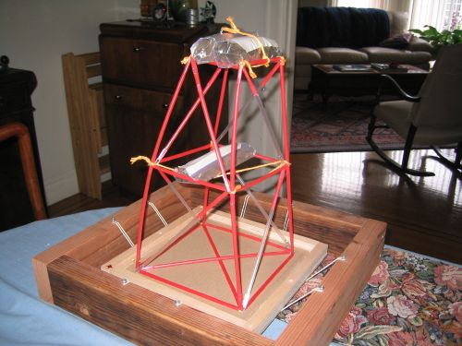

Slide 35
Peer Assessment – Moving through the grades
LEVEL | CRITERIA
1 | Construction Drawing only (L1)
2 | States 1 key features of building design (L1)
3 | 1 simple annotation which identifies a key feature of an earthquake proof building (L1)
4 | 2 annotations which describe the features of the of an earthquake proof building (L2)
5 | 3 annotations that describe the features of the of an earthquake proof building (L2)
6 | 3 annotations that explain how the features help to protect buildings against earthquakes (L3)
7 | Explains 3 features of an earthquake proof building in detail using a range of specialist terms (L3)

Slide 36
Exam Question – Describe 1 way in which buildings can be made to withstand an earthquake (3 marks)
P - One way in which a building can be made to withstand an earthquake is to have computer controlled movable roof weights.
E – This design feature has been used for building designs in San Francisco, California.
E - This is effective because they help to counter the shock waves that come from an earthquake.

Slide 37
Task 4 – Explain 3 ways in which buildings can be made to withstand an earthquake (9 marks)
Even Better – Can explain 3 key features in detail (L3)
13 min Quality Time
You may begin!

