Slide 1
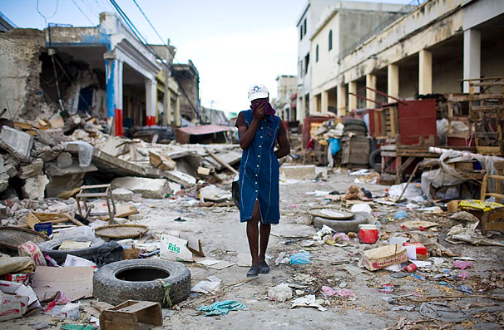
Starter:
What is your initial answer?
How could we investigate this?

Slide 2
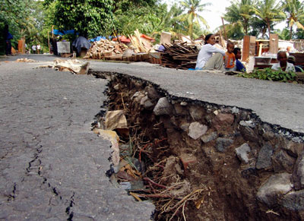
Earthquakes
What: What makes some earthquakes deadlier than others?
How: An investigation into the relationship between earthquake magnitude and death toll
Why: So that we can practice geographical skills e.g. data handling, drawing scatter graphs, data analysis

Slide 3
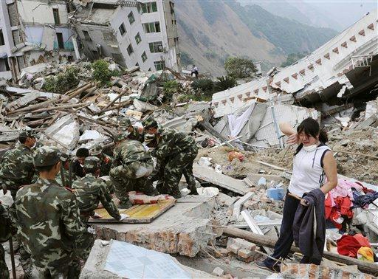
What is an earthquake?

Slide 4
Key terms:
Earthquake: Shaking and vibration of the ground caused by movements in the earth’s crust.
Magnitude???
Focus???
Epicentre???

Slide 5
Key terms:
Earthquake: Shaking and vibration of the ground caused by movements in the earths crust.
Magnitude: The strength of an earthquake
Focus: The point underground that shock waves travel out from
Epicentre: The point on the ground above the focus where the vibration is the greatest

Slide 6
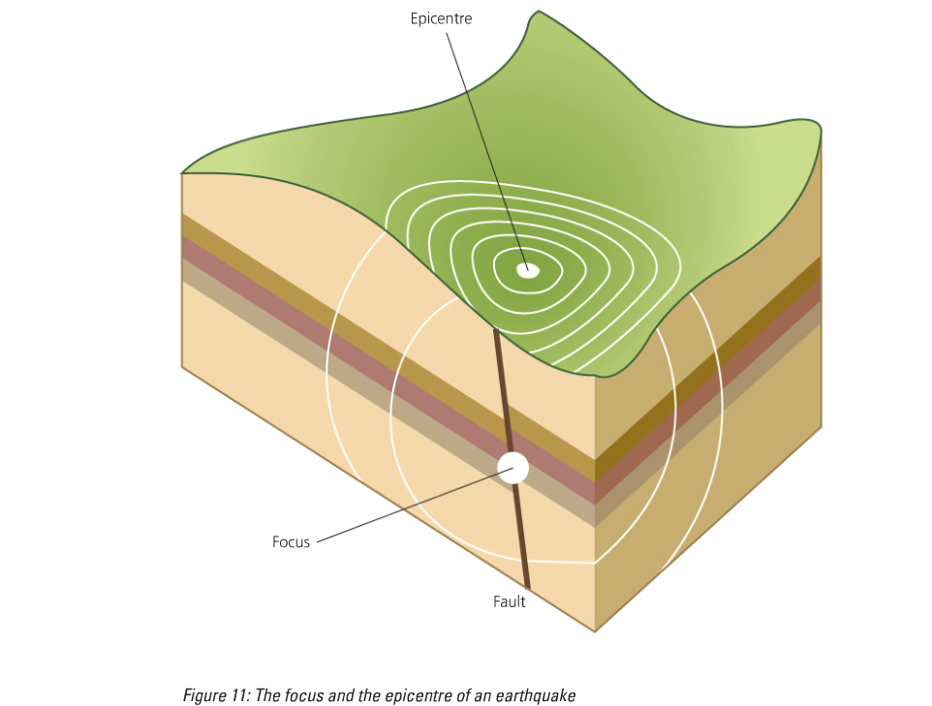
Explain the difference between the focus and epicenter

Slide 7
How are they measured? Richter scale
A logarithmic scale used to rate the strength or total energy of earthquakes.
The scale has no upper limit, but usually ranges from 1-9.
Because it is logarithmic, an earthquake of 5 is 10 x as powerful as one rated as 4.
An earthquake below 2.4 or less is usually not felt by people and is only detected by instruments.
An earthquake above 7.0 is considered a major earthquake.

Slide 8
What impacts the effects of an earthquake?

Slide 9
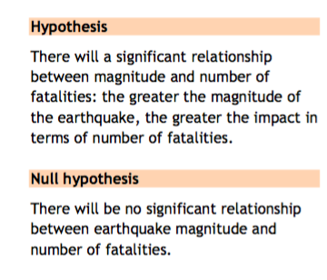
What is your prediction?

Slide 10
1.
2.
3.
4.
5.

Slide 11
What are variables?
In general, the independent variable (the variable that isn't influenced by anything) is on the x-axis, and the dependent variable (the one that is affected by the independent variable) is plotted on the y-axis.
Magnitude is the independent variable and death toll is the dependent variable (i.e. death toll depends on the magnitude).

Slide 12
Writing your analysis
Paragraph 1: What is the pattern shown in the graph?
Use names of countries and data
Say whether pattern shows a positive/negative or no correlation
Paragraph 2: Is this the pattern you would expect?
Paragraph 3: Explain this pattern? Why is it like it?
Paragraph 4: Are there any anomalies (things that don’t fit the pattern)?

Slide 15
Rural = countryside
Urban = town/city
MEDC= more economically developed country
LEDC = less economically developed country
Frequency = how often they occur
Population density = a measure of how crowded an area is
Focus = the place inside the earth’s crust where an earthquake starts
Epicentre = the place on top of the earth’s surface, directly above the focus
Magnitude = the strength of the earthquake (measured by the amount of energy released)

