Slide 1
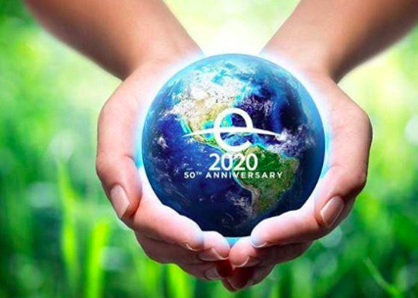
Earth Day's 50th Anniversary- 22nd April 2020

Slide 2
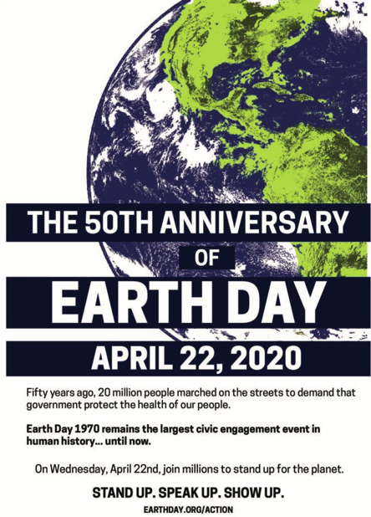
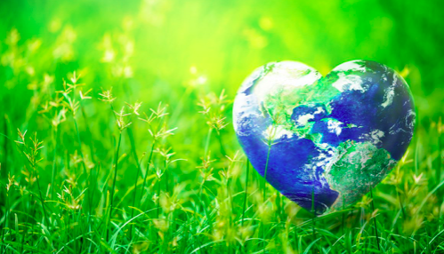
What: Earth Day's 50th Anniversary- 22nd April 2020 Why: To understand how we as individuals can take part in global actions How: To research Earth Day and take one step to make a difference

Slide 3
What conditions are needed to spark a mass movement for social change?

Slide 4
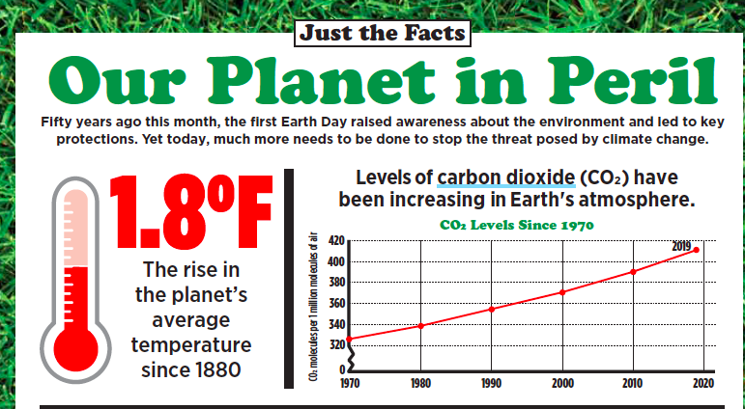

Slide 5
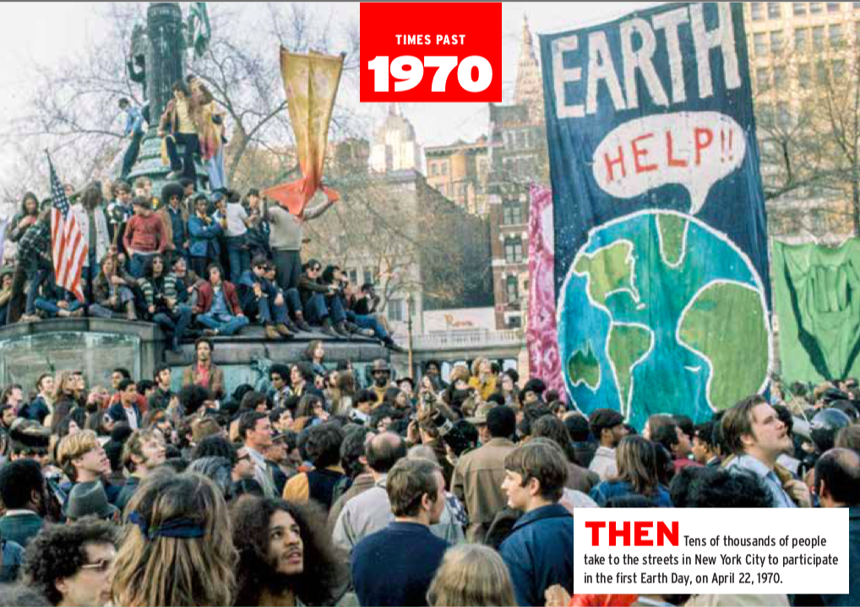
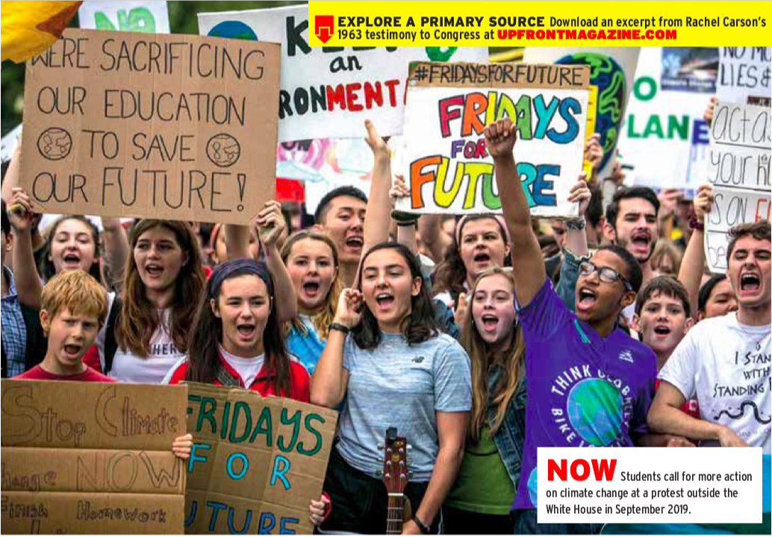
Task 1: Read the article- ‘Earth Day turns 50’
Answer these questions based on the article:
What major environmental events of the 1960s gave rise to the first Earth Day?
What happened as a result of the first Earth Day?
What are some similarities and differences between today’s environmental movement and that of the 1960s and ’70s?

Slide 6
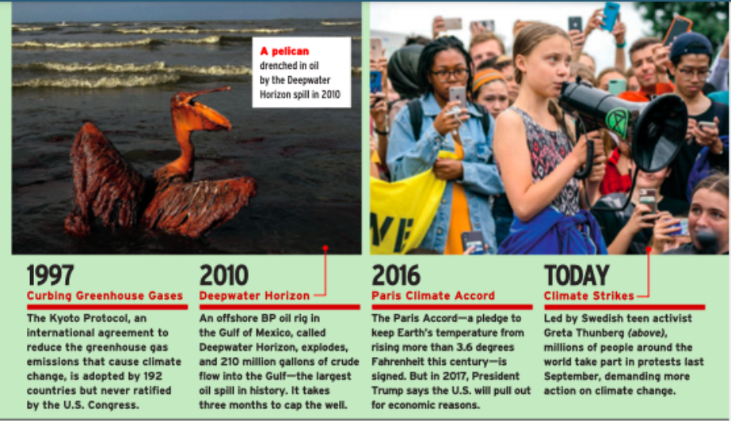

Slide 7
What can we do to make a difference?

Slide 8
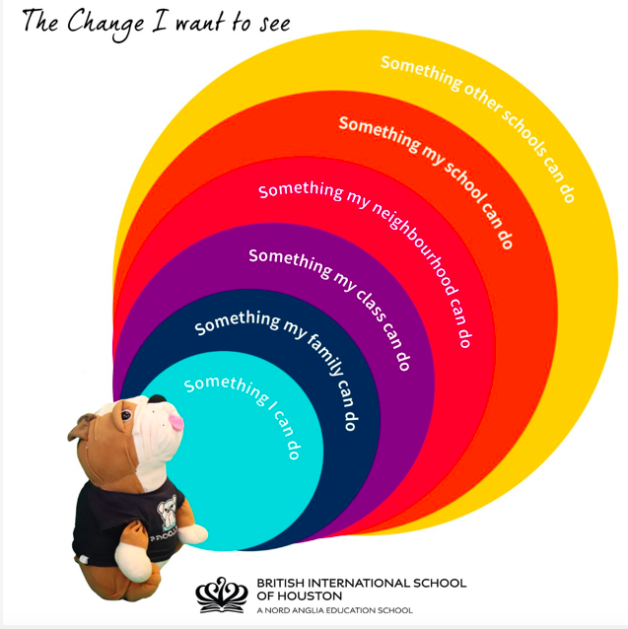
There are many small changes we can make that could have a positive impact on the environment. These could be done at different scales in your local community.
Task 2: Look at each of these 6 stages and explain a realistic change to reduce the environmental impact that could be made by each group

Slide 9
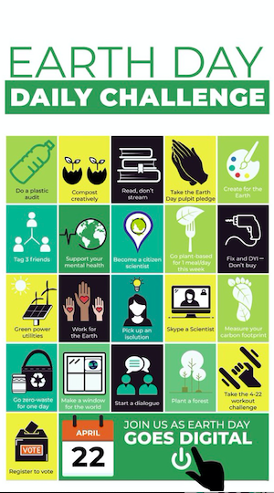
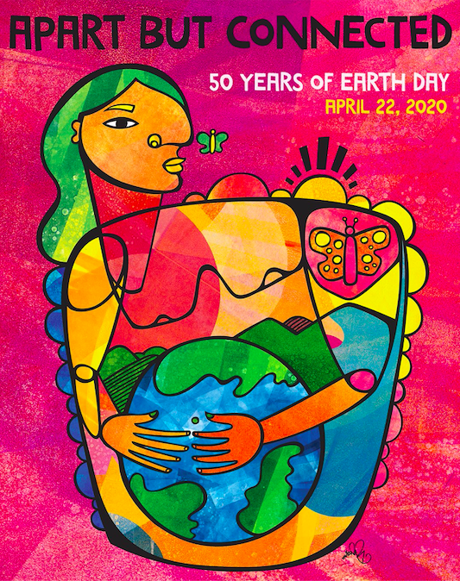
Earth Day activities you can get involved in from home
See more detail about the activities on the next 2 slides on the Weebly

Slide 10
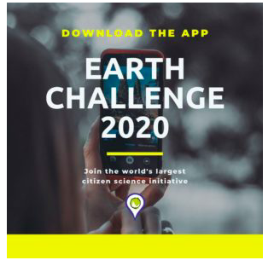
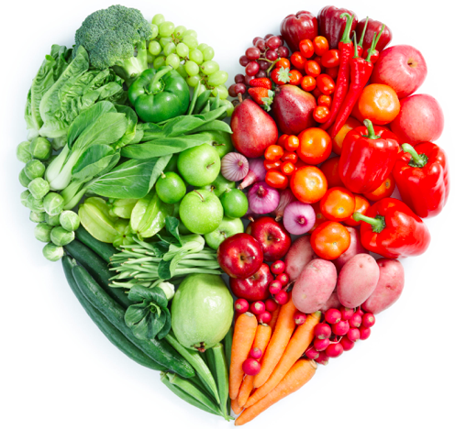
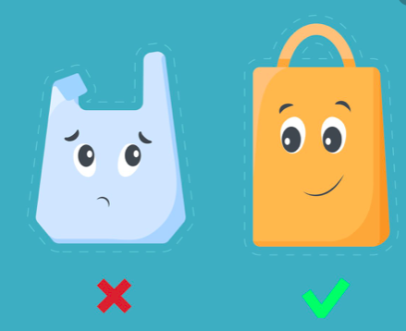
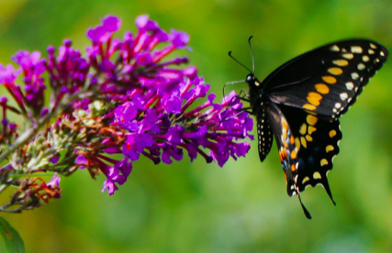
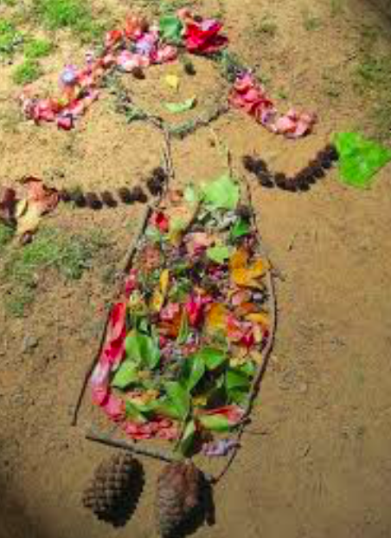
Download the Earth Challenge app- become a citizen scientist Gather air quality and pollution data in your community.
Learn new ways to protect our species
Create eco-art
Try some delicious plant-based cuisine
Make a plan to cut down on plastic pollution
Join EARTHRISE and make an Earth Day Poster

