Slide 1
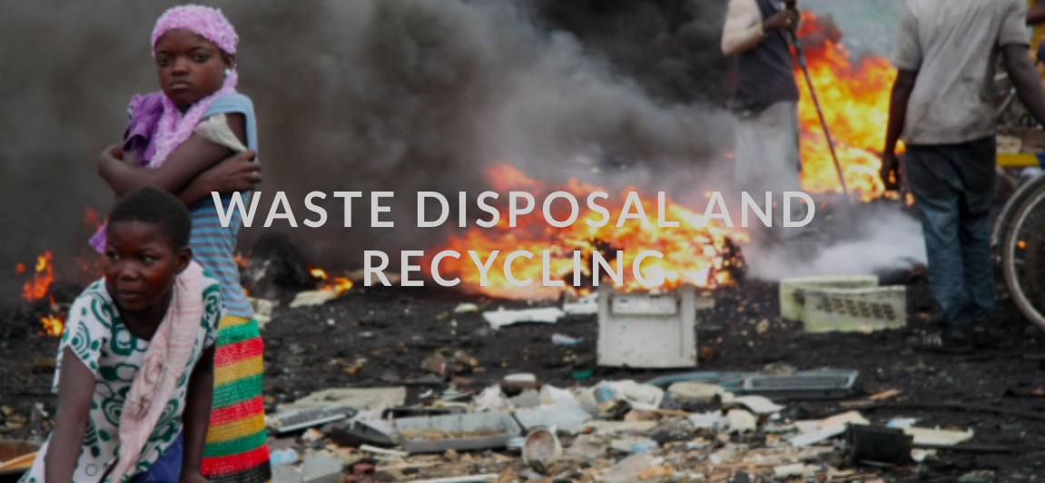
LO: The disposal and recycling of consumer items, including international flows of waste.

Slide 2
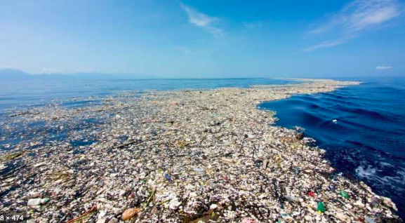
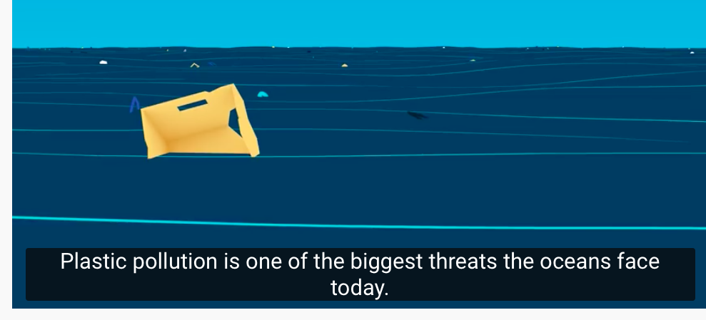
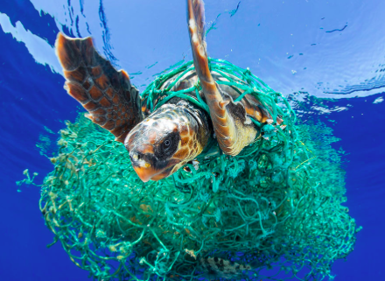

Slide 5
Objectives
What: The disposal and recycling of consumer items, including international flows of waste.
Why: The ecological footprint calculation takes account of the amount of land and resources required to dispose of our waste. As levels of consumption rise, then there is more waste to tackle. In emerging economies waste disposal has become a major problem.
How: Use the 4 Ps to investigate the consequences of different waste disposal strategies.

Slide 6
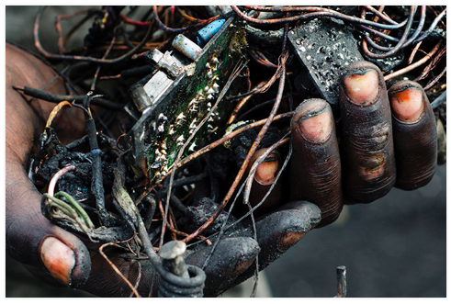
Waste disposal and recycling
What you you know about???
How waste is disposed of
How we can reduce our waste
Enquiry question
Who are winners and losers in consumer waste management?

Slide 7
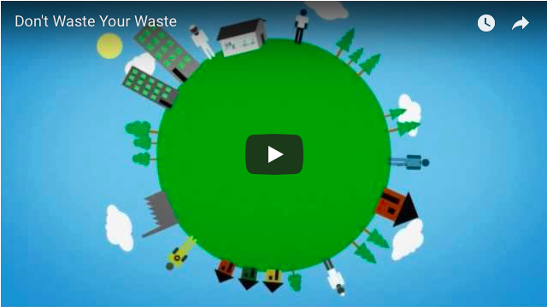
How waste is disposed of
https://www.youtube.com/watch?time_continue=165&v=Kr_DGf77OhM

Slide 8
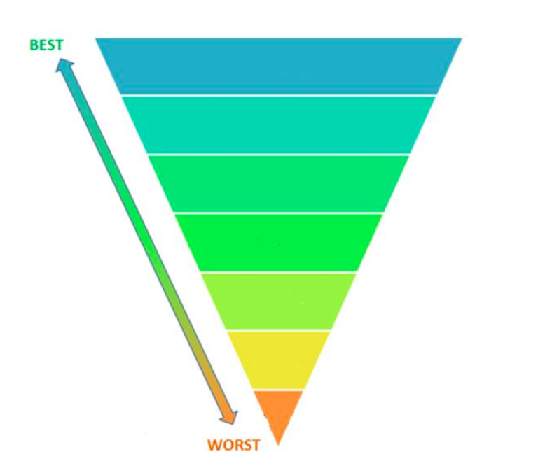
Study the list of strategies to manage waste and working with a partner (in pencil) rank the strategies from best to worst, placing the number in the correct level in the diagram.

Slide 9
Make notes from the main textbook p504- 509 and Kognity 3.2.12 on types of recycling

Slide 10
Trends
2. Suggest reasons for the trends shown
Comment on what factors you think would determine the three possible outlooks regarding projected global waste production

Slide 11
Patterns
Write a paragraph to explain the global pattern of waste production.

Slide 12
Landfill
Study the photograph of the a UK landfill site
Suggest the advantages and disadvantages of relying on landfill as a waste management strategy.

Slide 13
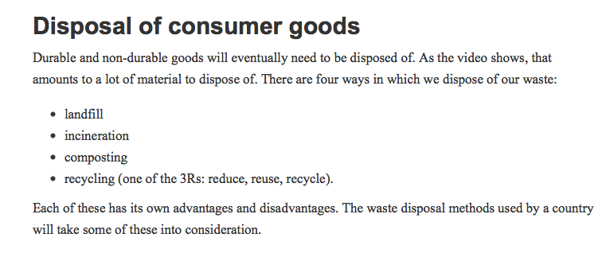
Take notes from Kognity 3.2.11 on the method, pros and cons of these methods of resource management

Slide 14
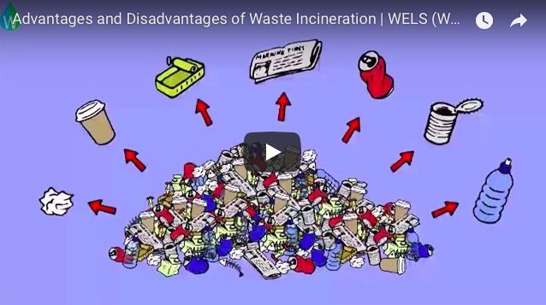
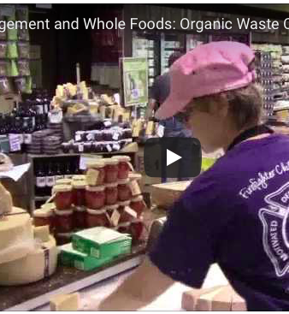
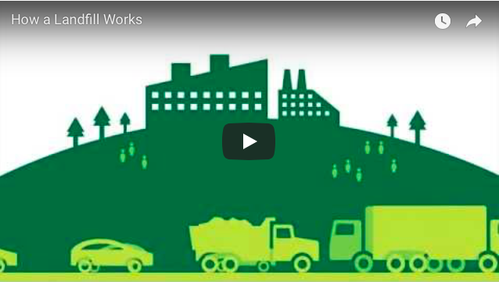

Slide 15
The 3 Rs

Slide 16
The 6 rs
Reduce the use amount of materials that are used to make and package the consumer products. Also, only buy what is needed. For example, refillable drinks bottles are much better than single-use ones.
Reuse an item multiple times, either for the original purpose or for some other purpose; for example, reusable shopping bags.
Repair broken items instead of throwing them away, such as repairing holes in clothes instead of throwing the item away.
Refurbish (may also be referred to as reconditioned or remanufactured): electronic products are returned to the manufacturer or certified companies and then repaired, tested and guaranteed. For instance, smartphones can be returned, all data cleared and restored to factory condition.
Recover materials from the products when they are no longer useful; for example, the rare metal in smartphones.
Recycle the material of the object by transforming it into the raw material for a new object. Old magazines can be used for artwork. Glass bottles can be re-smelted and made into new bottles.
Try for yourself!
The list of the 6Rs is in a specific order. Consider the relevance of this order in relation to waste management.

Slide 17
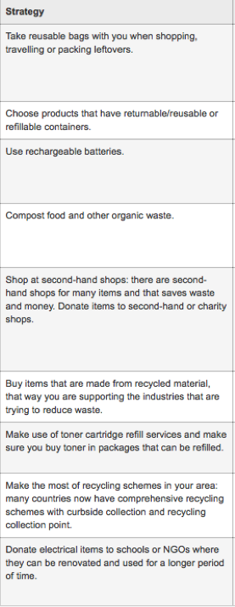
Can you evaluate the pros and cons of these waste management strategies?

Slide 18
Evaluating waste management strategies

Slide 19
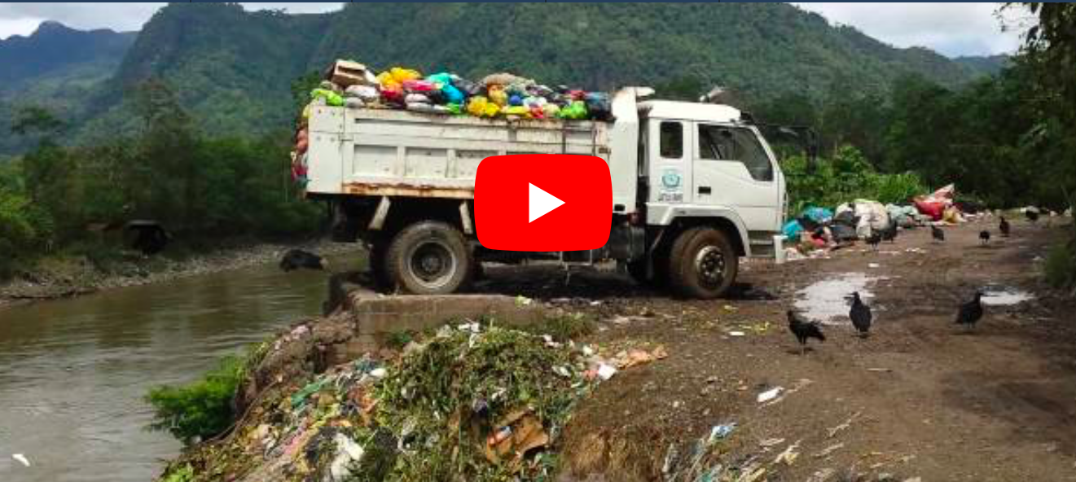
Places and Synthesis: Waste Disposal in LICs
Watch the following video filmed in Brazil and discuss the problems of waste management in LICs
Consider the following:
Population growth
Urbanisation
Mega cities
Governance

Slide 20
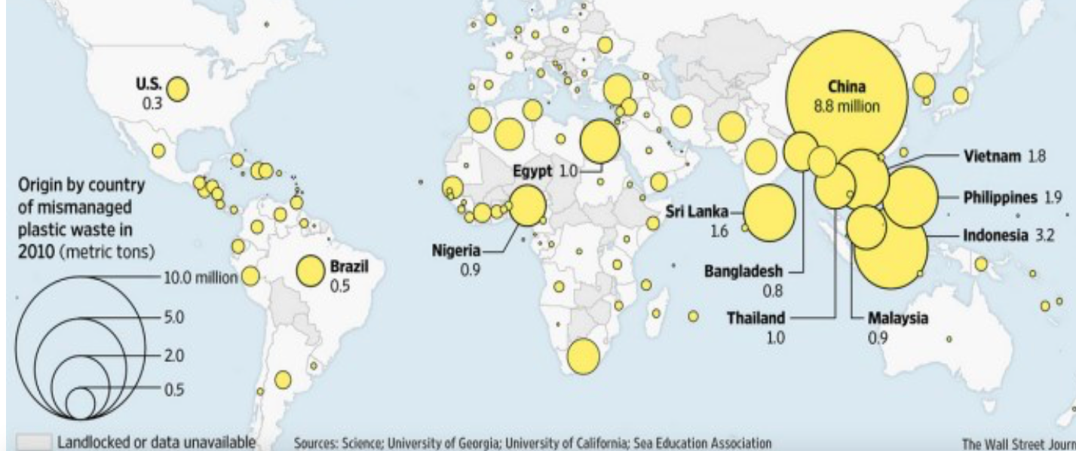
Study the following map and describe the pattern of plastic waste

Slide 22
International Waste Flows

Slide 23
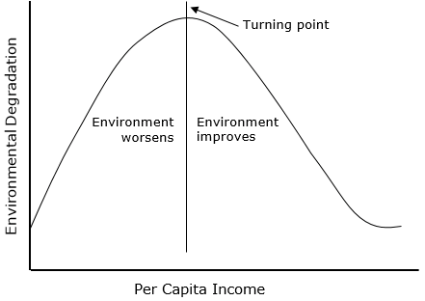
Kuznet curve

Slide 24
Study the cartoon below and discuss
1. The theme and message of the cartoon
2. The economic arguments which cause this
3. The arguments against this

Slide 25
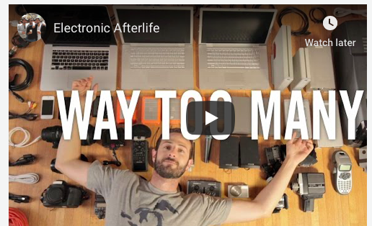

Slide 26
The facts:
Due to the rise of the global middle class, countries such as China produce more waste.
Due to globalisation factors many discarded and broken items are transported from HICs or LICs.
Since 1999 the EUs Landfill directive has reduced the proportion of waste that can be buried in landfills. In order to meet targets greater proportions of waste have been sent for recycling.
China leads the way importing 3 million tonnes of plastic and 15 million tonnes of paper.

Slide 30
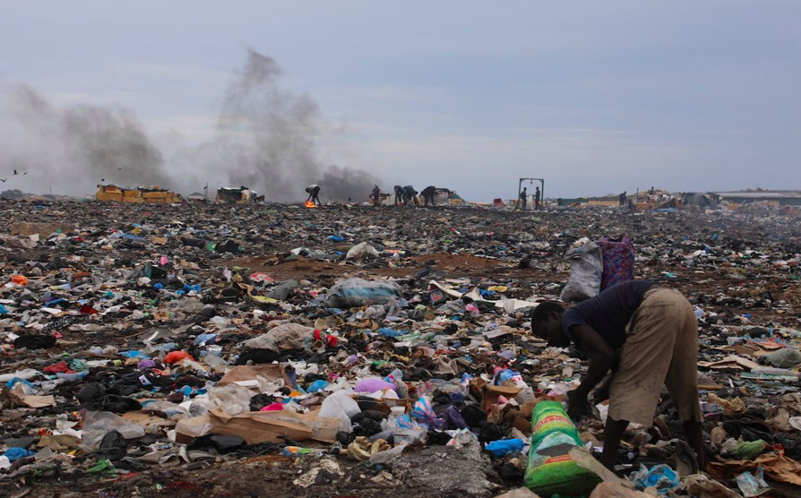
Agbogbloshie
ACCRA, GHANA

Slide 31
Case study: Agbogbloshie and e-waste
Choice 1: Research the impacts of e-waste on affected communities. You should complete your work as a 4 segment grid using the 4P's as your focus. Place, Process, Power, Possibility. Ensure that you use flow maps, charts as well as data that explains why this flow has grown (environmental legislation etc) as well as future trends. ​ Choice 2: You are going to use complete a short interactive study. Access the worksheet and website below .

Slide 32
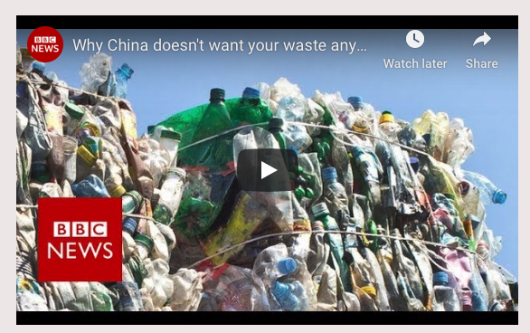
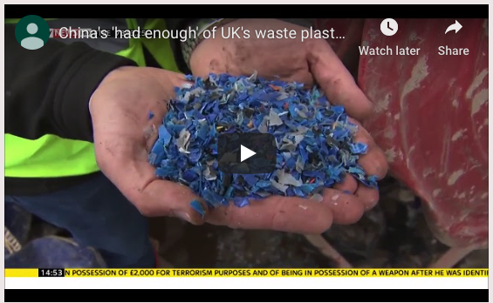
Case study: China bans import of plastic
What is the current crisis in many HICs caused by a banning of the importation of certain plastic waste products by the Chinese government. You should complete your work as a 4 segment grid using the 4P's as your focus. Place, Process, Power, Possibility. Ensure that you use flow maps, charts as well as data that explains why this flow has grown (environmental legislation etc) as well as future trends.

Slide 33
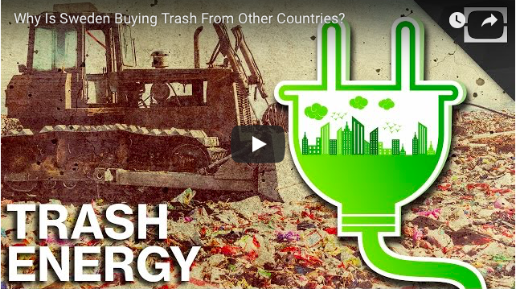
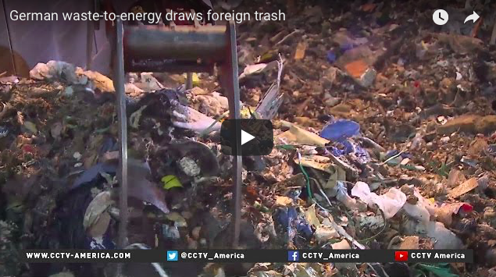
What are the benefits of international waste flows?
Take notes on these examples for Sweden/Germany

Slide 34
The issues of of international waste flows
You should work in pairs on this task. One student should focus on
the impacts of e-waste on affected communities and the other on the current crisis in many HICs caused by a banning of the importation of certain plastic waste products by the Chinese government. You should complete your work as a 4 segment grid using the 4P's as your focus. Place, Process, Power, Possibility. Ensure that you use flow maps, charts as well as data that explains why this flow has grown (environmental legislation etc) as well as future trends.
Use the case study template and resources on Weebly to help you. ​

Slide 35
Evaluation: The Kuznet curve
Where do the 3 waste disposal strategies (E-waste dumping, China banning imported waste and Sweden/ Germany turning waste to energy fit on the curve?

Slide 36
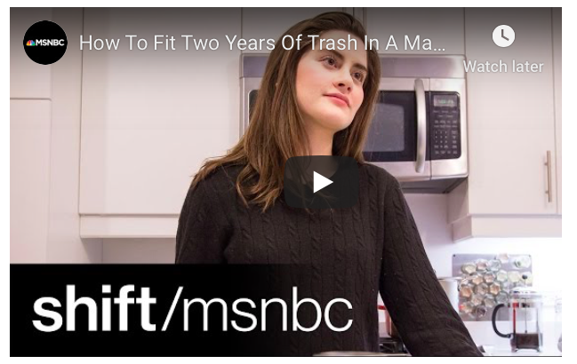
REFLECTION- COULD YOU LIVE A ZERO WASTE LIFESTYLE?

Slide 37
Essay question
Evaluate different waste disposal strategies (10)

Slide 38
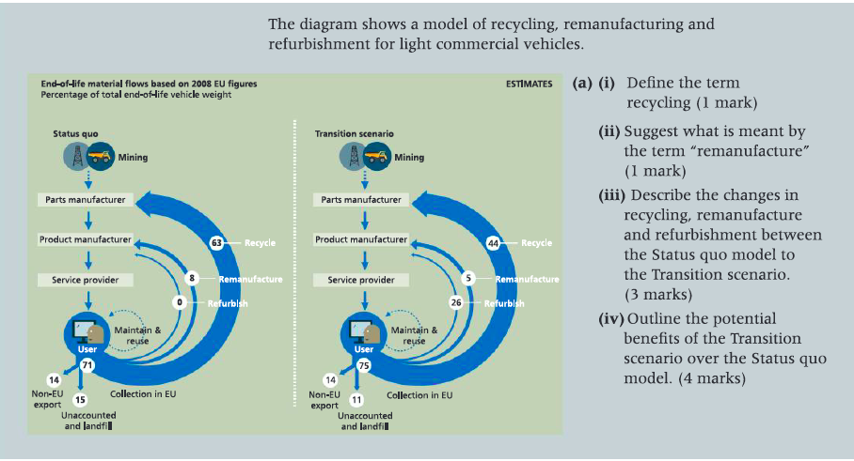
Assessment

