Slide 1
Resource stewardship

Slide 2
Divergent views
Enquiry question: What are the Possibilities for managing resources sustainably and power over the decision-making process?
Why: There are different perspectives on global resource use and the likely effectiveness of management actions at varying scales
How: Learning about the divergent thinking about population and resource consumption trends:
Pessimistic views, including neo-Malthusian views
Optimistic views, including Boserup
Balanced views, including resource stewardship
Linking these theories to those already studied in our paper 2 learning – synoptic learning

Slide 3
Synoptic links
The changing population is driving resource consumption ever higher and placing pressure on the entire global system. Certain resources are in extremely short supply and in many areas people live without reliable sources of water, food or clean, modern energy. Our resource consumption is testing the planet's ability to sustain the status quo and global climate change is adding to the problem.

Slide 4
Key term: Carrying capacity
When applied to humanity, looks at how many people planet Earth can sustainably support. Does the planet have enough of the necessities of life (food, space and water) to support the population indefinitely without causing environmental damage?

Slide 5
Discuss
Does planet Earth have a human carrying capacity?
https://www.youtube.com/watch?time_continue=43&v=WGcE3ZWBjfo

Slide 6
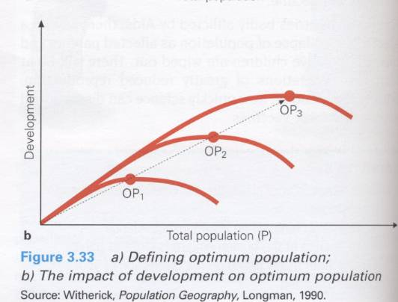
Carrying capacity
This is the maximum number of people that can be supported by a given area of land. It relates the size of population to the available resources in an area. There are three different views on the relationship between population and resources.
Constant carrying capacity – there is an upper limit of resources and output against which population presses
Falling carrying capacity - this implies that resource depletion and degradation will cause the population to decline
Rising carrying capacity – this implies that technical innovation and the discovery of new resources will match population growth

Slide 7
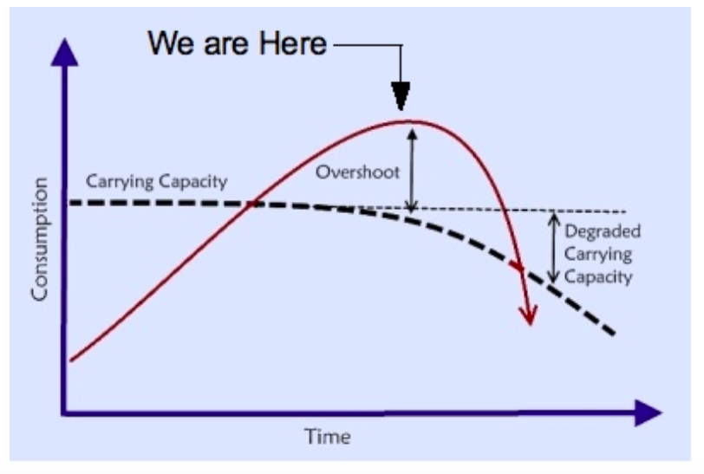

Slide 8
Ways in which humans can modify their carrying capacity
we produce non-biodegradable waste which can cause environmental degradation and reduce the ability of an area to provide certain resources, such as water
the resources we use are extremely varied: other animals just use the necessities but humans also use resources to provide luxuries; demand for both of these varies considerably between and within countries
human populations have the capacity to move goods around the world: we can import food from another region if there isn’t enough where we live
we employ technology to change the environment
humans have the ability to control fertility and mortality rates, which means that a given carrying capacity may become inaccurate fairly quickly.

Slide 9
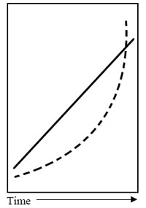
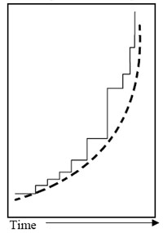
What is the difference between these 2 graphs?

Slide 10
The pessimists
One group of theorists about the relationship between population and resource consumption are the pessimists. As the name suggests, pessimistic theories are negative, proposing 'doom and gloom'.

Slide 11
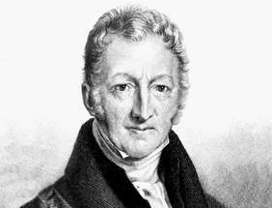
English scholar and cleric, Thomas Malthus (1798) wrote 'An Essay on the Principle of Population'. The essay was based on political and economic thinking and in it, he predicted the fate of humanity. He argued that population growth is exponential whereas the increase in food production is arithmetic at best

Slide 12
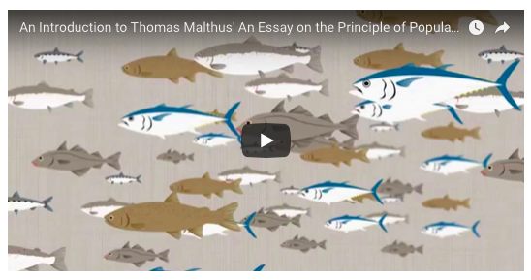
Watch the videos and make notes on…..
What did Malthus predict would happen to human population in the future?
Discuss: Was Malthus' prediction wrong? What do you think?

Slide 14
Checks on population: Malthusian perspective
At the point where the human population exceeds food supply (the carrying capacity) Malthus proposed two types of 'check':
Preventative or negative checks: these are within people's control and include sexual abstinence, delayed marriage, and reduced marriage among the poor because, Malthus believed, poverty is a defect in people that should prevent marriage!
Positive checks: these are occurrences outside of people's control such as disease, death, starvation and war.
These checks would return the population to a lower, more sustainable level. Although the model has not really been evident in HICs, many argue that it is evident in LICs.

Slide 15
Two possible outcomes. 1. Positive checks
Firstly, he said population could exceed food supply only to be positively "checked" (reduced) by famine, war, and disease.
* Population exceeds food supply and is kept in check by war, famine, or disease. It then drops below the food supply. As the population recovers, so the cycle continues.

Slide 16
2. Negative checks
Alternatively, the population could pre-empt the food shortages and so slow their population growth keeping it within the limits of the food supply. Malthus called these negative checks. These negative checks would include later marriages and abstinence from sex (Remember Malthus was writing before wide spread contraception!). People would make these decisions sub-consciously as food prices increased and standard of living fell.

Slide 17
He believes… There is no way food supply can keep up with population growth

Slide 18
Paul Ehrlich and the ''Club of Rome" both have Neo-Malthusiasn ideas.
Neo-Malthusians (modern supporters of Malthus’ views Some people believe that for some parts of the world his views are not wrong, just mis-timed. Sub-Saharan Africa has evidence of war, famine & disease. Population pressure leads to environmental degradation in this region, desertification results
Neo-Malthusian theories are still pessimistic but the emphasis is on promoting population control programmes to ensure sustainability with resources for present needs and the future. Neo-Malthusians support the use of contraception and are concerned with environmental degradation and widespread famine.

Slide 19
Paul Ehrlich
Paul Ehrlich is the author of The Population Bomb (1968). His theory predicted that:
overpopulation will cause disaster for humanity
the 1970s would see 10 million deaths per year from starvation
in the 1960s nothing could be done to stop this catastrophe
in 2001 2 million would die from famine-related causes
the USA can only support 150 million people.
He suggested that:
luxury taxes should be placed on all child-related items (nappies, toys, clothes, etc.)
'responsibility prizes' should be awarded for people who do not have children and for men who have vasectomies.

Slide 20
Club of Rome & its Limits to Growth Model
Developed by the Club of Rome it looked at population, natural resources, agricultural output, industrial production and pollution.
They predicted that the limits to growth would be reached in 2070.
The model basically suggests that ability of resources, food, the environment, etc. to meet human needs will be reached by 2070.
Beyond this point if population is not controlled naturally, it will start to decline because of increased death rates.
Explain three of the relationships shown using case study data from the IB Geography course so far.
What are the limitations of this model?

Slide 21
Malthus and the Club of Rome – are they right? What evidence is there to support their ideas?

Slide 22
Exam question
State and explain two characteristically neo-Malthusian views (1+2) + (1+2)

Slide 23
The optimists

Slide 24
Anti-Malthusian is simply the school of thought that disagrees with Malthus's pessimism and is more aligned to Boserup's optimism i.e. that humans will always find solutions to shortages.
Task:
Watch the three videos and outline their key message.
https://www.youtube.com/watch?v=vZVOU5bfHrM
https://www.youtube.com/watch?v=OXrN9HhnCcM

Slide 25
Positive views Boserup – Increasing the carrying capacity (1965)
People are our greatest resource
People can create new technology to solve problems in food production or resources

Slide 26
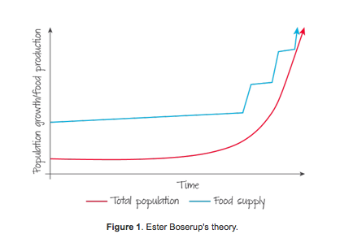
Boserup
Said that food supply would increase to accommodate population growth. As a population found that they were approaching food shortages they would identify ways of increasing supply whether through new technology, better seeds, new farming methods.

Slide 27
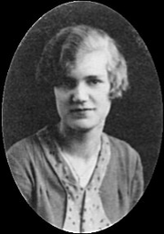
Esther Boserup 1965
Boserup believed that people have resources of knowledge and technology and that “necessity is the mother of invention”, thus as populations grow towards the carrying capacity they develop new ways to use resources (food) more productively.
Can you think of real life examples?

Slide 28
Was Boserup Right?
What about resource degradation and pollution? Can we continue to innovate to overcome these issues?
Key concept: Possibilities

Slide 29
Who is right?…….
Evidence for increasing
carrying capacity
Reclaiming land from the sea
Terracing on steep slopes
Better irrigation techniques
Artificial fertilizers and pesticides
New foods such as soy proteins
GM foods
Scuba rice! Which can withstand flooding for areas in Asia such as Bangladesh where there is increased flood risk due to global warming
Development of cleaner fuel technologies instead of oil such as ethanol in cars or electric cars

Slide 30
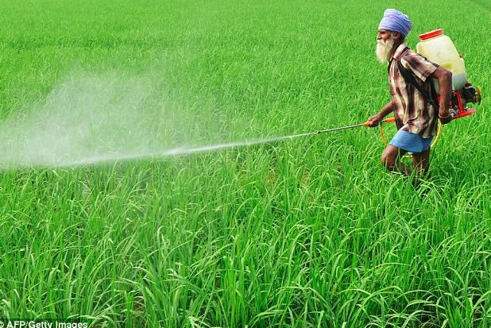
GREEN REVOLUTION
A complex of improvements which greatly increased agricultural production
Since 1950’s
Greatest effect felt in LDCs
Agricultural output outpaced population growth even without adding additional cropland
Adoption of new, improved varieties of grains
Application of better agricultural techniques
Irrigation
Mechanization
Use of fertilizer
Use of pesticides
http://www.youtube.com/watch?v=ECehO0iwr1o
Notes:
6

Slide 31
“Green Revolution” drawbacks
Favored farmers who could afford seeds,
inputs, machines, irrigation
Indebted farmers lost land, moved to cities
New “monocrops” lacked resistance to disease/pests
Environmental contamination, erosion
Oriented to export “cash crops,” not domestic food

Slide 32
In pairs…
One of you will find evidence for a neo-malthusian view and one will find one for anti-malthusian view
Summarise the ideas of the theory
Include a detailed case study with located specific detail (try and use one we have already studied in the IB course)
Link the points to the view you are supporting.
Share and explain case study with your partner
Target: Use the case studies already studied in the IB Geography course so far

Slide 33
Key Point
Demand for resources and the resulting waste and pollution depends on 3 factors.
Population - How many people are there?
Consumption – How much each person consumes?
Intensity – How efficiently we use resources?

Slide 34
Key Question
Neo- Malthusian?
Eco-centric Deep Ecologists (Doomsters) believe that rapid population growth and increased levels of development have led to a situation where there are insufficient resources and too much waste and pollution.
Anti-Malthusian?
Techno-centric Cornucopians (Boomsters) champion the ability of humans to innovate, develop and adapt, as the solution to the issues associated with population growth, resource consumption and waste.
Where do you stand on this continuum?

Slide 35
IB past paper practice questions
Explain the anti-Malthusian view of the relationship between population and resources. [5 marks] Explain the neo-Malthusian view of the relationship between population and resources [5 marks]
What may be the mark scheme (success criteria) for these questions?

Slide 36
Resource stewardship and sustainability
The pessimistic and optimistic views look at what has happened in the relationship between population and resource consumption with the aim of predicting what will happen if we keep on going in the same way. Another approach is to take these theories and make an alternative plan for the future. Humans need to take better care of the planet and use its resources more sustainably if we are to avoid the predictions of Malthus. To do this we will have to capitalise on the human ingenuity identified by Boserup.
IB learning objective: Resource stewardship strategies, including: the role of the UN Sustainable Development Goals and progress made toward meeting them

Slide 39
Resource stewardship
Resource stewardship is the responsible planning and management of resources

Slide 40
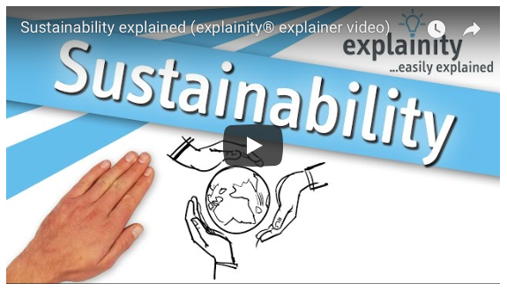

Slide 41
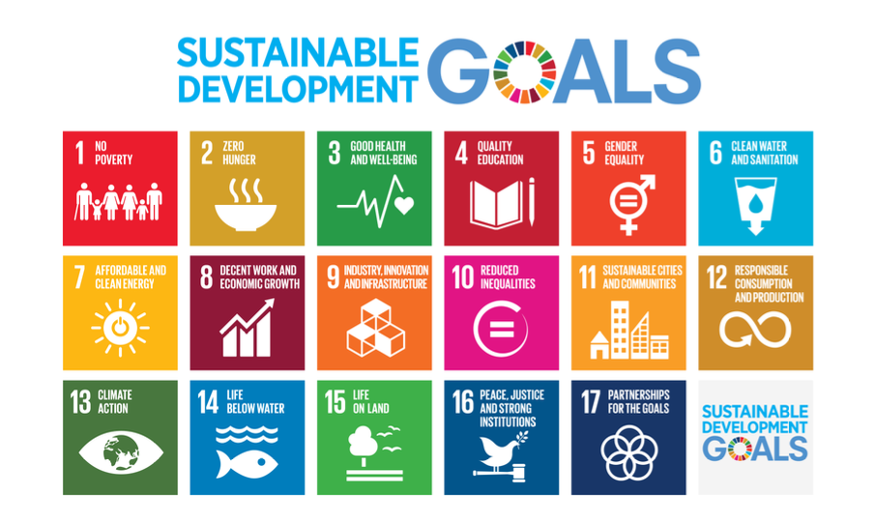
Why?

Slide 42
The aim of this task is: To be able to discuss the role of the UN Sustainable Development Goals as resource stewardship strategies and progress made toward meeting them You will focus on SDGs linked to food, energy and water.

Slide 43
How?
Use the embedded sheet on the Weebly to consider the role of the SDGs in helping achieve resource stewardship.
Use the resources on the weebly and kognity: 3.3.7 SDGs 6 and 7
SDGs 12 and 13

Slide 44
Exam practice
For a named Sustainable Development Goal explain how one of its targets can be viewed as a resource stewardship approach. (4)

