Slide 1
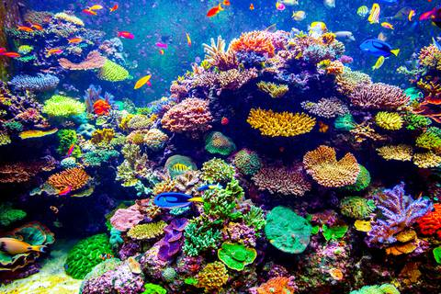
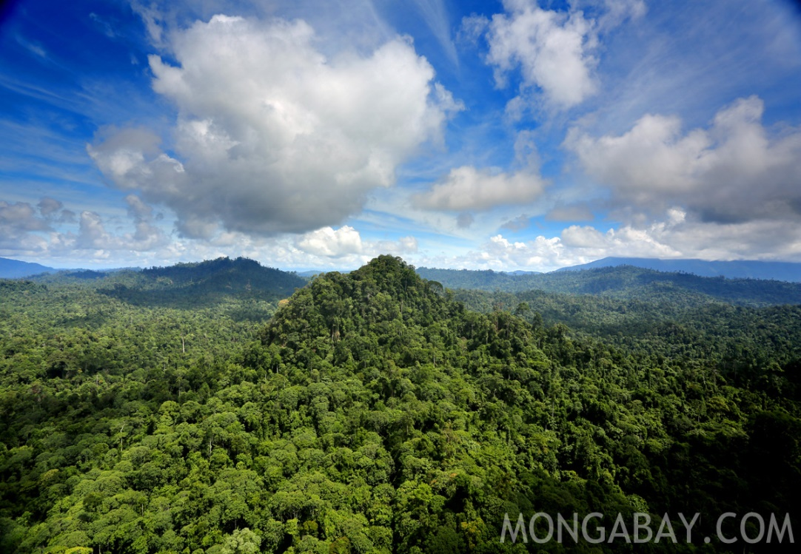
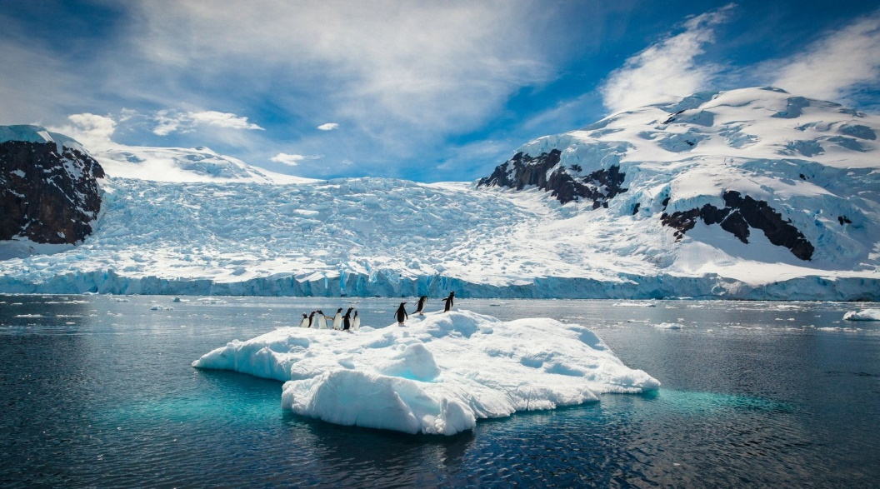
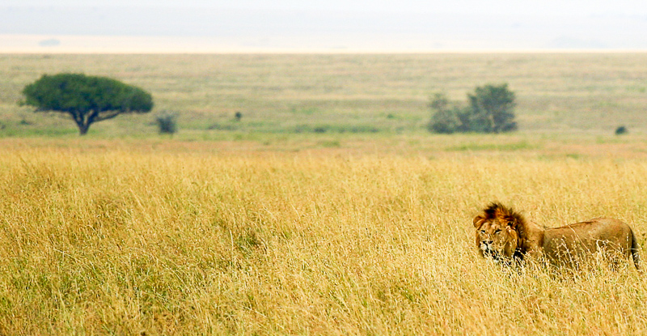
What do these four have in common?

Slide 2
Topic 3 – Fragile Environments
Title – Distribution of fragile environments
Outcomes:
All will be able to map the world’s most fragile environments
All will be able to describe the location of these environments
Some will be able to explain the location of these environments

Slide 3
Challenge 1:
Using the maps provided, complete a map showing the global distribution of the following threatened environments:
Rainforests
Coral Reefs
Grasslands at risk of desertification
Arctic region
Extra Challenge – Describe the distribution
Super Challenge – Explain the distribution

Slide 4
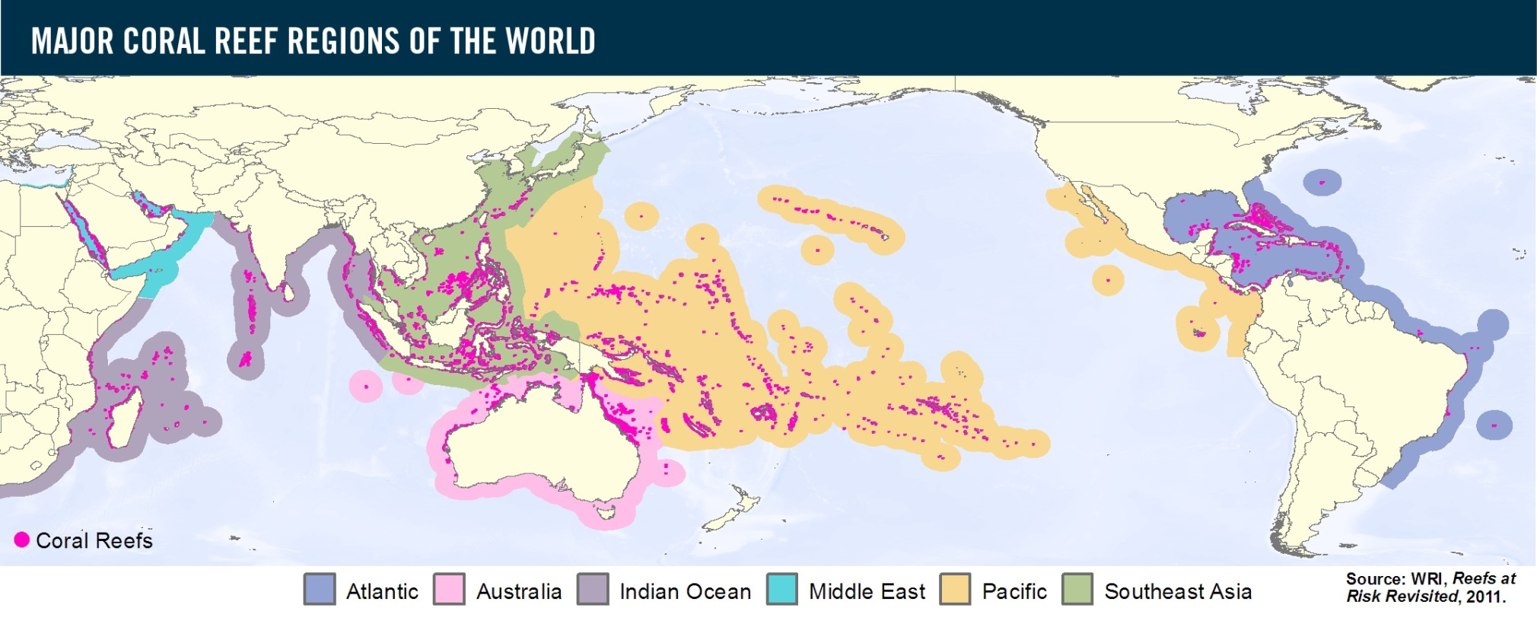

Slide 5
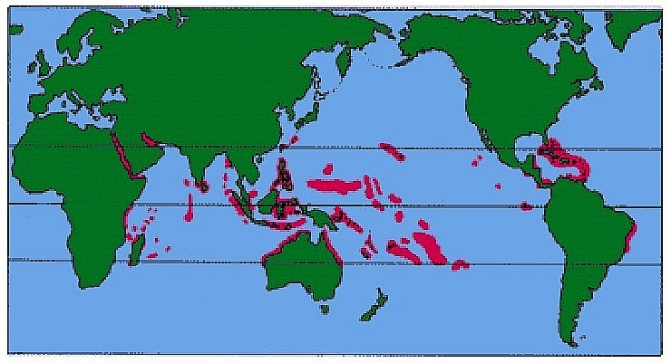

Slide 6
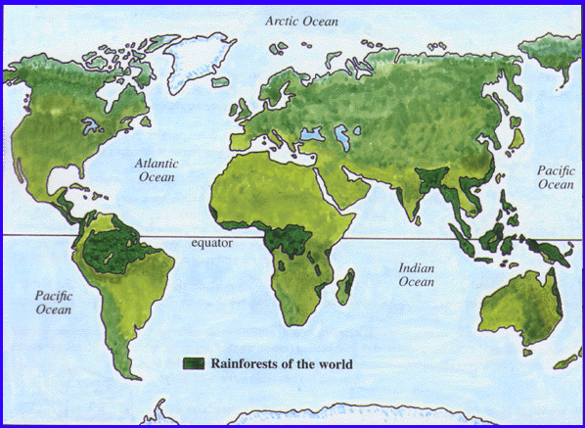

Slide 7
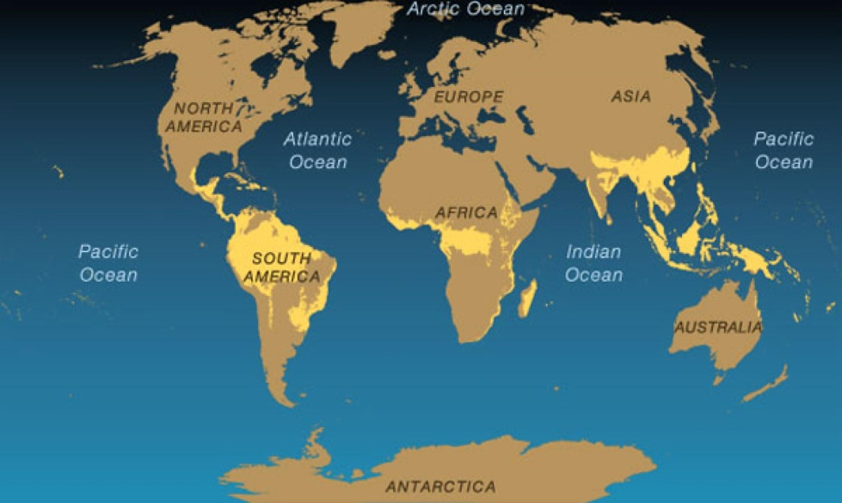

Slide 8
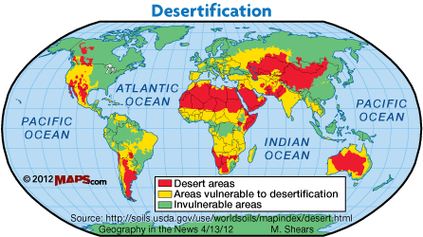

Slide 9
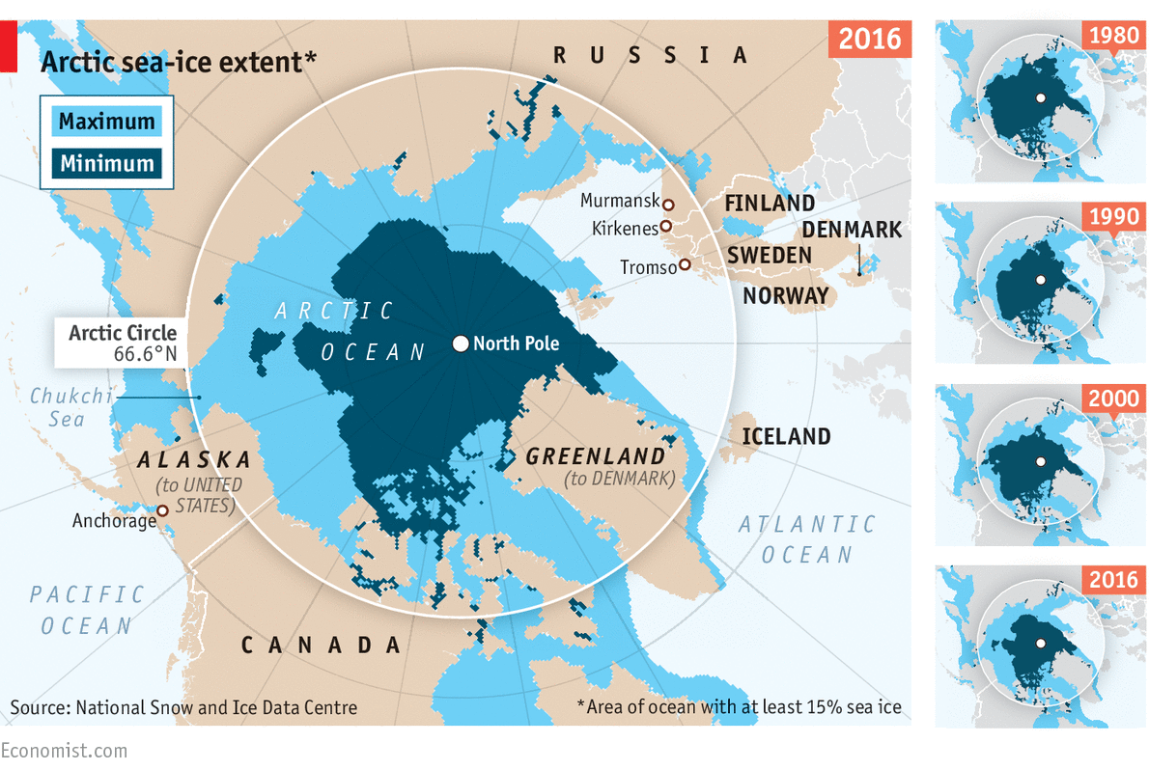

Slide 10
Challenge 2:
Follow the following QR codes to describe the characteristics of these threatened environments. You must include:
Temperature
Rainfall
Species diversity
https://earthobservatory.nasa.gov/experiments/biome/biodesert.php
https://earthobservatory.nasa.gov/Features/Desertification/desertification2.php
https://www.nationalgeographic.org/encyclopedia/desert/
https://sciencing.com/characteristics-rainforest-8514049.html
https://earthobservatory.nasa.gov/experiments/biome/biorainforest.php
https://www.nationalgeographic.org/encyclopedia/arctic/
https://www.britannica.com/place/Arctic#ref57850
https://oceanservice.noaa.gov/facts/coralwaters.html
https://www.eartheclipse.com/ecosystem/coral-reef-biome.html

Slide 11
Challenge 3:
Use the ecological footprint map to complete the following challenges:
Define ‘ecosystem’
List the ways in which humans threaten ecosystems
Define ‘ecological footprint’
Describe the distribution of unsustainable and sustainable ecological footprints.
Identify the 3 processes that most influence the distribution of fragile environments.
Describe the things that affect the size of your personal ecological footprint.

Slide 13
Desert Characteristics

Slide 14
Rainforest Characteristics

Slide 15
Coral Characteristics

Slide 16
Arctic Characteristics

Slide 17
Challenge 3:
Use the ecological footprint map to complete the following challenges:
Define ‘ecosystem’
List the ways in which humans threaten ecosystems
Define ‘ecological footprint’
Describe the distribution of unsustainable and sustainable ecological footprints.
Identify the 3 processes that most influence the distribution of fragile environments.
Describe the things that affect the size of your personal ecological footprint.
Challenge 3:
Use the ecological footprint map to complete the following challenges:
Define ‘ecosystem’
List the ways in which humans threaten ecosystems
Define ‘ecological footprint’
Describe the distribution of unsustainable and sustainable ecological footprints.
Identify the 3 processes that most influence the distribution of fragile environments.
Describe the things that affect the size of your personal ecological footprint.
Challenge 3:
Use the ecological footprint map to complete the following challenges:
Define ‘ecosystem’
List the ways in which humans threaten ecosystems
Define ‘ecological footprint’
Describe the distribution of unsustainable and sustainable ecological footprints.
Identify the 3 processes that most influence the distribution of fragile environments.
Describe the things that affect the size of your personal ecological footprint.
Challenge 3:
Use the ecological footprint map to complete the following challenges:
Define ‘ecosystem’
List the ways in which humans threaten ecosystems
Define ‘ecological footprint’
Describe the distribution of unsustainable and sustainable ecological footprints.
Identify the 3 processes that most influence the distribution of fragile environments.
Describe the things that affect the size of your personal ecological footprint.

Slide 18
