Slide 1
2010 eruptions of Eyjafjallajökull

Slide 2
2010 eruptions of Eyjafjallajökull
Social effects | 0 deaths
Economic effects | About 20 countries closed their airspace to commercial jet traffic and it affected approximately 10 million travellers. "Volcano tourism" quickly sprang up in the wake of the eruption, with local tour companies offering day trips to see the volcano.
Environmental effects | High-fluoride Hekla eruptions pose a threat to foraging livestock, especially sheep. Could produce temporary global cooling or reduction in global temperature.
Political effects | About 20 countries closed their airspace to commercial jet traffic and it affected approximately 10 million travellers.

Slide 3
Hurricane Harvey, 2017

Slide 4
Hurricane Harvey, 2017
Social effects | 103 people died in storm-related incidents The Floods inundated hundreds of thousands of homes which displaced more than 30,000 people and prompted more than 17,000 rescues. In the months after the hurricane struck, some hospitals in Texas saw a spike in birth rates, with a 17% increase in birth rates being reported at Corpus Christi Medical Cente
Economic effects | $125 billion in damage Energy production in the Gulf of Mexico declined in the wake of Harvey by approximately 21%
Environmental effects | The floodwaters contained a number of hazards to the environment and human health. Much wildlife in park and woodland areas was displaced
Political effects | Geo-political issues due to impacts on energy production

Slide 5
Haiti earthquake, 2010

Slide 6
Haiti earthquake, 2010
Social effects | Death toll 220,000 250,000 residences collapsed In 2017 there were still about 55,000 people in camps and makeshift structures
Economic effects | 30,000 commercial buildings collapsed- this caused mass unemployment which added to the high poverty levels in the country
Environmental effects | Most of the built environment was destroyed.
Political effects | The main political buildings such as the presidential palace and National assembly collapsed

Slide 7
Hurricane Katrina, 2005

Slide 8
Hurricane Katrina, 2005
Social effects | 1836 death toll Severe property damage occurred in numerous coastal areas 80% of New Orleans, became flooded, and the floodwaters lingered for weeks.[ Most of the transportation and communication networks servicing New Orleans were damaged or disabled by the flooding, and tens of thousands of people who had not evacuated the city prior to landfall became stranded with little access to food, shelter or basic necessities.
Economic effects | $125 billion (2005 USD) (Tied as costliest tropical cyclone on record⁾
Environmental effects | The storm surge caused substantial beach erosion, in some cases completely devastating coastal areas. The damage from Katrina forced the closure of 16 National Wildlife Refuges. Breton National Wildlife Refuge lost half its area in the storm. As a result, the hurricane affected the habitats of sea turtles, Mississippi sandhill cranes, Red-cockaded woodpeckers and Alabama Beach mice. Katrina also produced massive tree loss along the Gulf Coast
Political effects | Impact oil production in the Gulf of Mexico- geo-political issue Much criticism of the government response to the disaster

Slide 9
2013 Moore tornado

Slide 10
2013 Moore tornado
Social effects | 24 fatalities (+2 indirect), 212 injuries 1,150 homes were destroyed
Economic effects | $2 billion
Environmental effects | Much of the built environment was destroyed
Political effects

Slide 11
2003 European Heatwave

Slide 12
2003 European Heatwave
Social effects | At least 70,000 deaths (more than 14,000 in France alone).
Economic effects | The total economic losses in Europe are estimated to exceed 13 billion Euros (i.e. due to reduction in agricultural productivity)
Environmental effects | Alpine glaciers shrank by 10 percent over the summer, and thawing in the mountains reached greater depths and occurred at higher altitudes than on average, contributing to rock slides. Forest fires raged across western Europe as weakened trees and dry underbrush fed the flames. The heat affected harvests as well: fodder and grain production declined, elevating costs for livestock farmers. In addition, high water temperatures and low water levels shut down French nuclear power facilities just when demand for electricity peaked.
Political effects | Governments blamed for not responding The heat wave raised concerns over global warming and, in particular, Europe’s readiness for climate change.

Slide 13
1883 eruption of Krakatoa

Slide 14
1883 eruption of Krakatoa
Social effects | 36,417 deaths
Economic effects | Crops failed worldwide
Environmental effects | 20 million tons of sulfur released into the atmosphere; produced a volcanic winter (reducing worldwide temperatures by an average of 1.2 °C (2.2 °F) for five years) Some land in Banten, approximately 90 km south, was never repopulated; it reverted to jungle and is now the Ujung Kulon National Park.
Political effects

Slide 15
Great Chinese Famine 1959–1961

Slide 16
Great Chinese Famine 1959–1961
Social effects | At least 45 million deaths
Economic effects | Loss of agricultural productivity
Environmental effects | Loss of agriculturally productive land
Political effects | Poor government management to blame due to of the Chinese ‘Great leap forward’

Slide 17
September 11 attacks, 2001

Slide 18
September 11 attacks, 2001
Social effects | The attacks caused the deaths of 2,996 people and the injuries of more than 6,000 others. Hundreds of thousands of tons of toxic debris containing more than 2,500 contaminants, including known carcinogens, were spread across Lower Manhattan due to the collapse of the Twin Towers. ] Exposure to the toxins in the debris is alleged to have contributed to fatal or debilitating illnesses among people who were at Ground Zero.
Economic effects | The attacks had a significant economic impact on United States and world markets. The stock exchanges did not open on September 11 and remained closed until September 17. In New York City, about 430,000 job-months and $2.8 billion dollars in wages were lost in the first three months after the attacks. he city's GDP was estimated to have declined by $27.3 billion for the last three months of 2001 and all of 2002.
Environmental effects | Loss of significant parts of the built environment
Political effects | Start of the ‘War on terror’ As a result of the attacks, many governments across the world passed legislation to combat terrorism.

Slide 19
Genoa bridge collapse, 2018

Slide 20
Genoa bridge collapse, 2018
Social effects | 43 deaths
Economic effects | Shares in Italian company Atlantia, which runs much of Italy's motorway network including the collapsed stretch of the A10, plunged on the Milan stock exchange after the news.
Environmental effects
Political effects | Poor government management to blame

Slide 21
The black death 1347 to 1351

Slide 22
The black death 1347 to 1351
Social effects | 75 to 200 million people in Eurasia Estimated to have killed 30–60% of Europe's total population. In total, the plague may have reduced the world population from an estimated 450 million down to 350–375 million in the 14th century. It took 200 years for the world population to recover to its previous level.
Economic effects | The decrease in population caused by the plague increased the wages of peasants. As a result, peasants began to enjoy a higher standard of living and greater freedom.
Environmental effects | The air was lead-free for the first and only time over the last two millennia. As it turns out, with so many people dying so quickly, mining for lead became a far less important priority than just basic survival.
Political effects | The the plague caused a political uprising.

Slide 23
Hurricane Maria, 2017

Slide 24
Hurricane Maria, 2017
Social effects | 5,000 death toll Puerto Rico without electricity for months
Economic effects | $91.61 billion (2017 USD) (Third-costliest tropical cyclone on record; costliest in Puerto Rican history) Infrastructure devestation impacted sectors of the economy such as tourism
Environmental effects | Water pollution and toxic waste deposited
Political effects

Slide 25
Indian Ocean Tsunami, 2004

Slide 26
Indian Ocean Tsunami, 2004
Social effects | 227,898 dead and missing
Economic effects | $19.9 billion The two main occupations affected by the tsunami were fishing and tourism.
Environmental effects | 2004 Indian Ocean earthquake is the third-largest earthquake ever recorded on a seismograph and had the longest duration of faulting ever observed, between 8.3 and 10 minutes. It caused the entire planet to vibrate as much as 1 centimetre (0.4 inches), and it triggered other earthquakes as far away as Alaska. Severe damage has been inflicted on ecosystems such as mangroves, coral reefs, forests, coastal wetlands, vegetation, sand dunes and rock formations, animal and plant biodiversity and groundwater. In addition, the spread of solid and liquid waste and industrial chemicals, water pollution and the destruction of sewage collectors and treatment plants threaten the environment even further
Political effects | The widespread devastation caused by the tsunami led the main rebel group GAM to declare a cease-fire on 28 December 2004 which resulted in a peace agreement signed 15 August 2005. The agreement explicitly cites the tsunami as a justification.

Slide 27
2011 Tōhoku earthquake and tsunami

Slide 28
2011 Tōhoku earthquake and tsunami
Social effects | 15,896 deaths 6,157 injured 2,537 people missing
Economic effects | $360 billion USD It destroyed 138,000 buildings and cost $360 billion in economic damage. Second, it crippled Japan's nuclear industry. Eleven of Japan's 50 nuclear reactors were immediately closed after the disaster This disrupted the global supply chain of semiconductor equipment and materials. Japan manufactures 20 percent of the world's semiconductor products. That includes the NAND flash, an indispensable electronic part of Apple's iPad. Japan also supplies the wings, landing gears and other major parts of Boeing's 787 Dreamliner. Toyota, Nissan, Honda, Mitsubishi and Suzuki temporarily suspended production. Nissan considered moving a production line to the United States. A total of 22 plants in the area, including Sony, were shut
Environmental effects | The waves damaged the Fukushima nuclear power plant, creating radioactive leaks. At first, engineers couldn't stop the leakage. Even after they did, it took months to completely halt emissions. Radiation showed up in local milk and vegetables. It also briefly appeared in Tokyo's drinking water. Radioactive materials continued to leak into the Pacific Ocean, raising levels to 4,000 times the legal limit.
Political effects | Japan had to import oil to replace generation capacity. This caused record trade deficits.

Slide 29
Hawaii's Kilauea Volcano Eruption, 2018

Slide 30
Hawaii's Kilauea Volcano Eruption, 2018
Social effects | One man was seriously injured when a molten rock projectile shattered his leg while he was standing on a balcony. Thousands of people have been forced to flee their homes after molten hot lava, ash and gasses first spewed into the air
Economic effects | Lodging and tour bookings are down 50% for May to July in 2018. Cruise ships skipping the Island- loss of approx. $5 million revenue $1,240,434 loss from the 10 million tons of sugar wiped out when numerous lava flows covered 3,900 acres of Hawaii’s Big Island.
Environmental effects | Lava flows, pyroclastic flows, and Kilauea’s release of toxic sulfur dioxide can contribute to the famine and eventual loss of livestock and other animals. olcanic eruption’s long-term effects on climate change. Kilauea’s eruption is already spewing hydrogen chloride, sulfur dioxide, ash, and other materials high into the stratosphere. Not only can the carbon dioxide that Kilauea is releasing augment the effects of climate change, but the eruption may also cause chemical reactions that produce chlorine monoxide, a substance that destroys the Earth’s ozone layer.
Political effects

Slide 31
Fuego eruption, Guatemala, 2018

Slide 32
Fuego eruption, Guatemala, 2018
Social effects | 69 deaths More than 3,200 people have been evacuated and 1.7million people affected by the Fuego eruption.
Economic effects | Loss of farmland and ability to produce economic output
Environmental effects | Flows of mud and ash have covered roads and crops and destroyed bridges.
Political effects | Residents criticized local authorities, asking why there was no advance warning and why officials waited so long to tell them to leave

Slide 33
East Africa Drought, 2011

Slide 34
East Africa Drought, 2011
Social effects | Up to 10,000 per day . Total deaths - 260,000 Caused a refugee crisis
Economic effects | Loss of farmland and ability to produce economic output- mortality of livestock in drought-affected areas.
Environmental effects | Semi arid areas turn to desert. Environmental damage due to the construction of refugee camps
Political effects | Political tensions due to pressure for land in already marginal and vulnerable areas. Tensions over the need to develop refugee camps.

Slide 35
1931 China floods

Slide 36
1931 China floods
Social effects | 4,000,000 deaths 25 million people had been affected The flood destroyed huge amounts of housing and farmland. With no food people were reduced to eating tree bark, weeds and earth. Some sold their children to survive, while others resorted to cannibalism
Economic effects | 15% of the wheat and rice crops was destroyed The disaster also caused an economic shock with the price of vital commodities rising rapidly.
Environmental effects | Large areas of land wiped out
Political effects | Investment into schemes such as the Three Gorges Dam to try an prevent future disasters

Slide 37
South Asia floods, 2017

Slide 38
South Asia floods, 2017
Social effects | Killed 1,200 and 1.8 million children out of school 40 million affected by the devastation
Economic effects | Low-lying Bangladesh is at the frontline of at-risk countries from climate change and could suffer annual losses of up to 9.4 percent of its economy by the end of this century.
Environmental effects | Loss of farm land and residential areas washed away by flood waters. In the long tern the silts deposited by the floods will increase the agricultural productivity of the area.
Political effects | Geo-political tensions between countries affected

Slide 39
Gulf oil spill, 2010

Slide 40
Gulf oil spill, 2010
Social effects | 11 were killed by the blast.
Economic effects | BP fined $18 billion under the Clean Water Act. The Gulf fishing and tourism industries produce $3.5 billion to $4.5 billion a year and these were severely affected by the spill.
Environmental effects | Oil leakage in the Gulf of Mexico created the biggest oil disaster in the United States. Scientists estimated 184 million gallons were spilled. Impacted coastal ecosystems.
Political effects | Pressure on President Obama to stop offshore oil drilling.

Slide 41
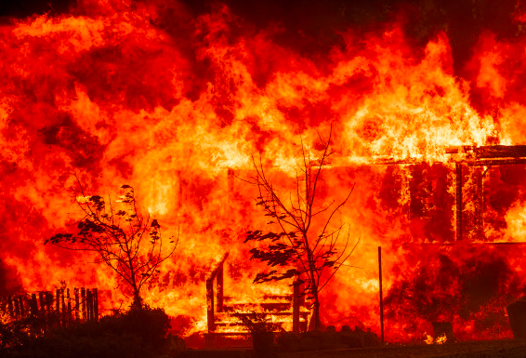
Californian wildfires, Nov 2018

Slide 42
The Camp fire, Northern California, 2018
Social effects | Wiped out the town of Paradise (with a former population of 26,682 people). It killed 85 people, making it the deadliest in California history.
Economic effects | It was the world's costliest natural disaster in 2018 causing $16.5 billion in damage.
Environmental effects | It burned 153,336 acres. Trees do not quickly grow back and cannot even grow because of soil destruction and erosion caused by fire. Wildlife of most every kind, including wolfs, mountain lions, rodents, rabbits, small birds and other indigenous animals that rely on California’s native vegetation may have trouble finding enough food to live.
Political effects | Blames for mis-management of forest areas and climate change

Slide 43
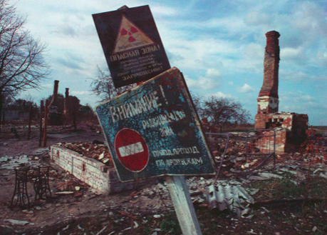
Chernobyl, 1986

Slide 44
Chernobyl, 1986
Social effects | Roughly 4,000 deaths from thyroid cancer have been attributed to nuclear explosion. Tens of thousands of deaths from cancer around the world have been attributed to the radiation distributed by winds around the world.
Economic effects | Many cities in this region went into economic decline following the radiation sicknesses that arrived with poisoned clouds.
Environmental effects | The Chernobyl fallout had a major impact on both agricultural and natural ecosystems in Belarus, Russia and Ukraine. Radioactive particles were subsequently found in milk, meat, forest food products, freshwater fish and wood. Forests and fresh water bodies have been among the most affected ecosystems.
Political effects | The accident prompted nuclear energy policy to arise as a significant public issue. It also led to a distrust and unease between Soviet citizens, specifically those in the evacuated and nearby areas, and President Gorbachov's regime.

Slide 45
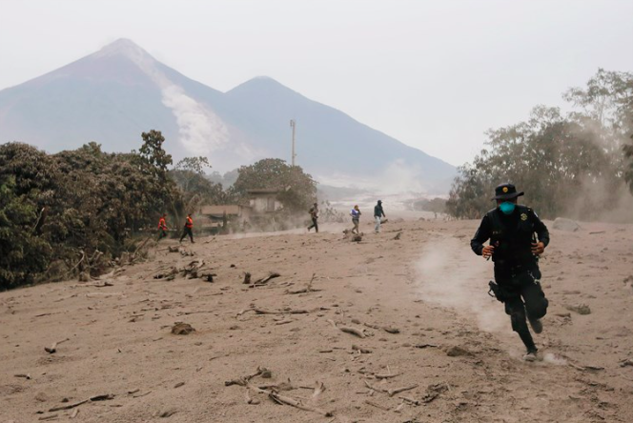
Fuego Volcanic Eruption, Guatemala

Slide 46
Fuego Volcanic Eruption, Guatemala
Social effects | 425 deaths
Economic effects | Much farmland devastated. The eruption had devastating effects to any farmers in the area, since this is the time of year when seeds are germinating.
Environmental effects | Volcanic ash has spread over a 12-mile radius. Surrounding areas were soon engulfed in a deadly pyroclastic flow, a mixture of hot gas and volcanic rock that can move at speeds up to 90 miles per hour.
Political effects

Slide 47
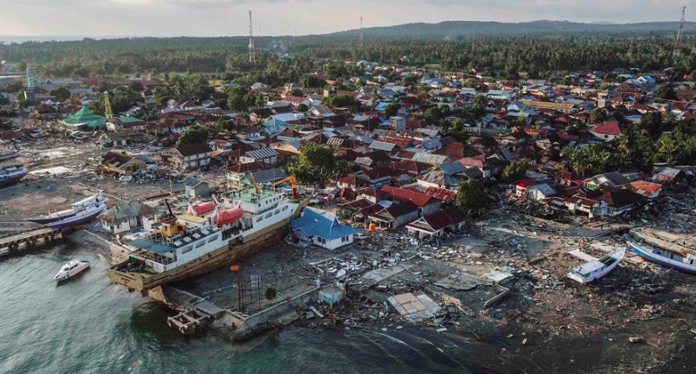
Sulawesi Earthquake and Tsunami (Indonesia), 2018

Slide 48
Sulawesi Earthquake and Tsunami (Indonesia), 2018
Social effects | 4340 deaths, levelled entire cities and rendered more than 330,000 people homeless
Economic effects | Infrastructure such as hospitals, the airport and shopping centres were destroyed. The devastation has heavily damaged roads, which makes any attempt to continue farming as normal impossible. The roads are broken so the farmers can’t deliver the beans for processing.
Environmental effects | Liquefaction occurred (where the ground turns to jelly). This leads to Contamination of soil and water. Loss of Natural Ecosystems: Coral reefs, mangroves, coastal areas, wetlands, agricultural fields and forests, and aquaculture areas
Political effects

Slide 49
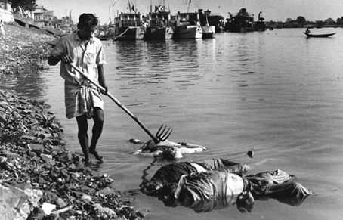
Bhola Cyclone (Bangladesh 1970)

Slide 50
Bhola Cyclone (Bangladesh 1970)
Social effects | At least 500,000 people lost their lives in the storm. The storm surge wiped out villages with the most severely affected area, Tazumuddin, losing over 45% of its population (167,000 people) in the district of Thana alone
Economic effects | Over $490 million (USD 2009) of damage occurred. Approximately 85% of homes in the area were destroyed or severely damaged, with the greatest destruction along the coast. early 46,000 of the estimated 77,000 fishermen of the region perished in the cyclone, and those that survived were severly injured. Approximately 65% of the coastal region’s fishing industry was destroyed, in a region where about 80% of the protein consumed comes from fisheries.
Environmental effects | Land lost. Crops damaged
Political effects

Slide 51
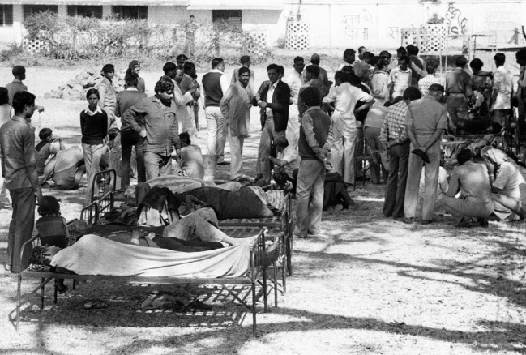
The Bhopal disaster, India 1984

Slide 52
The Bhopal disaster, India 1984
Social effects | Over 500,000 people were exposed to methyl isocyanate gas. The highly toxic substance made its way into and around the small towns located near the plant. 8,000 died within two weeks, and another 8,000 or more have since died from gas-related diseases. The leak caused 558,125 injuries, including 38,478 temporary partial injuries and approximately 3,900 severely and permanently disabling injuries. Children are being born with illnesses as their parents were poisoned by the gas.
Economic effects | 50,000 people lost their jobs and were indirectly forced into poverty
Environmental effects | Water supplies were still contaminated 20 years on
Political effects | People are still protesting for fair compensation The people don’t trust the local government anymore- they blame them for poor management of the pesticide plant

Slide 53
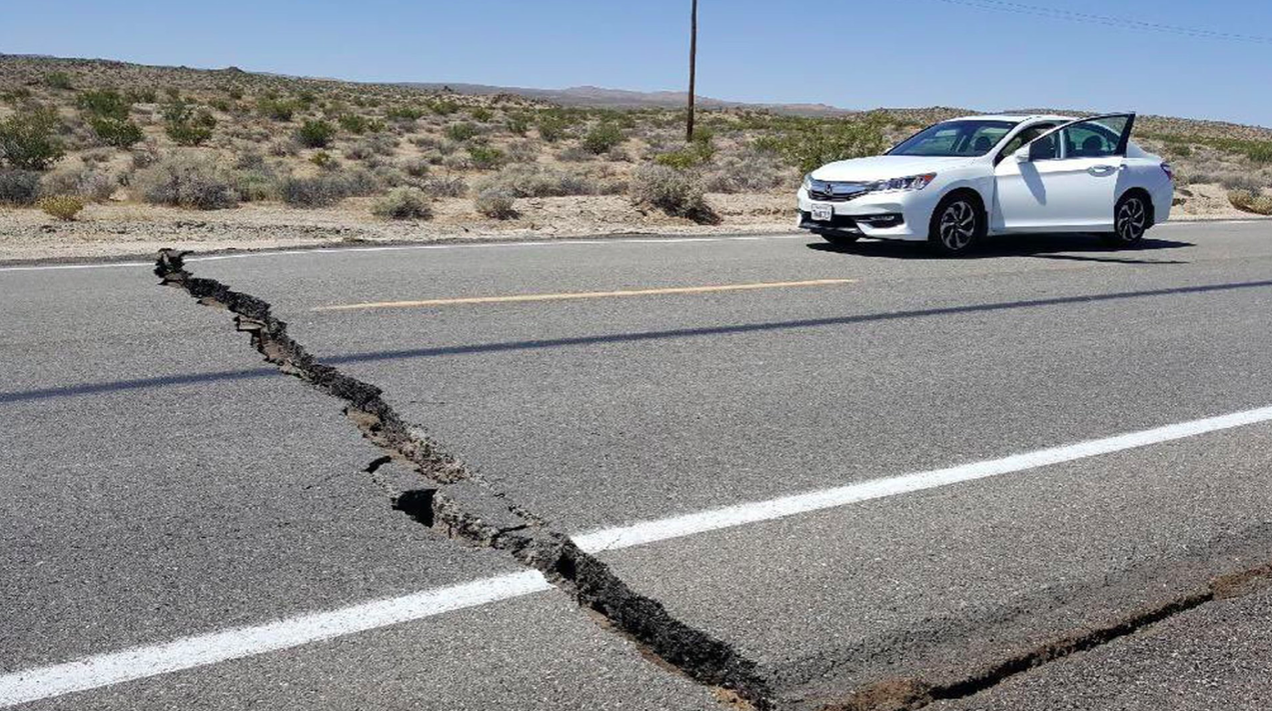
July 4^{th 2019} 6.4 magnitude quake in California

Slide 54
July 4^{th 2019} 6.4 magnitude quake in California
Social effects | Structural damage to homes. Some communities without running water or electricity.
Economic effects | Damage to infrastructure such as roads which will need to be repaired.
Environmental effects
Political effects

Slide 55
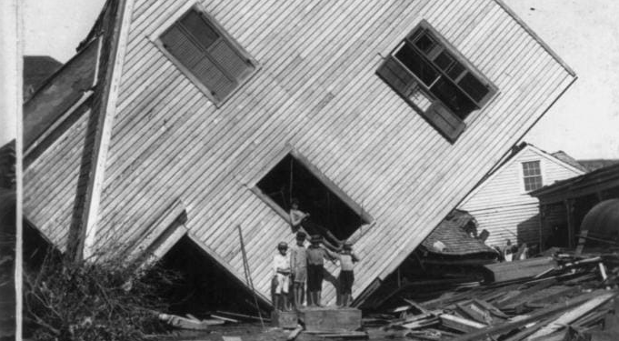
The Great Galveston Storm of 1900

Slide 56
The Great Galveston Storm of 1900
Social effects | An estimated 6,000 to 8,000 people perished in the storm, the single deadliest in U.S. history. The storm destroyed about 7,000 buildings of all uses in Galveston, which included 3,636 destroyed homes; every dwelling in the city suffered some degree of damage. The hurricane left approximately 10,000 people in the city homeless, out of a total population of nearly 38,000.
Economic effects | The disaster ended the Golden Era of Galveston, as the hurricane alarmed potential investors, who turned to Houston instead. Rebuilding infrastructure cost $516 million
Environmental effects | 15-foot storm surge flooded the city, which was then situated at less than 9 feet above sea level
Political effects | Texas legislation agreed on a new Tax to pay for the raising of the city

Slide 57
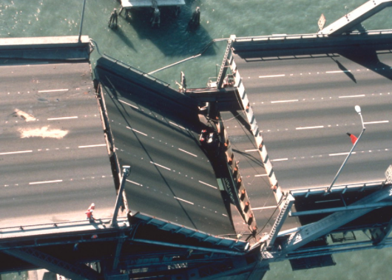
San Francisco Earthquake, 1989

Slide 58
The San Francisco Earthquake, 1989
Social effects | Killed 67 people. 3,000 others were injured.
Economic effects | $5 billion in damages
Environmental effects | San Francisco’s Marina district suffered extensive damage. Built on an area where there was no underlying bedrock, the liquefaction of the ground resulted in the collapse of a number of structures. Additionally, gas mains and pipes burst, sparking fires.
Political effects | In the quake’s aftermath, San Francisco and other communities enacted strict regulations requiring unreinforced masonry buildings to be retrofitted.

Slide 59
Mt. St. Helens Volcanic eruption, 1980

Slide 60
Mt. St. Helens Volcanic eruption, 1980
Social effects | .57 people died
Economic effects | Floodwaters washed away several roads and railway bridges. Falling ash hindered the smooth running of car engines in three states. Electricity supplies were interrupted and telephone wires cut.
Environmental effects | The sudden lateral blast—heard hundreds of miles away—removed 1,300 feet off the top of the volcano, sending shockwaves and pyroclastic flows across the surrounding landscape, flattening forests, melting snow and ice, and generating massive mudflows. sh fell into rivers and lakes raising temperatures, while sediment and mud choked channels. This combined effect resulted in the death of all fish, including those in a hatchery and the loss of 250km of top-class salmon and trout rivers. Spirit Lake was filled in.
Political effects

