Slide 1
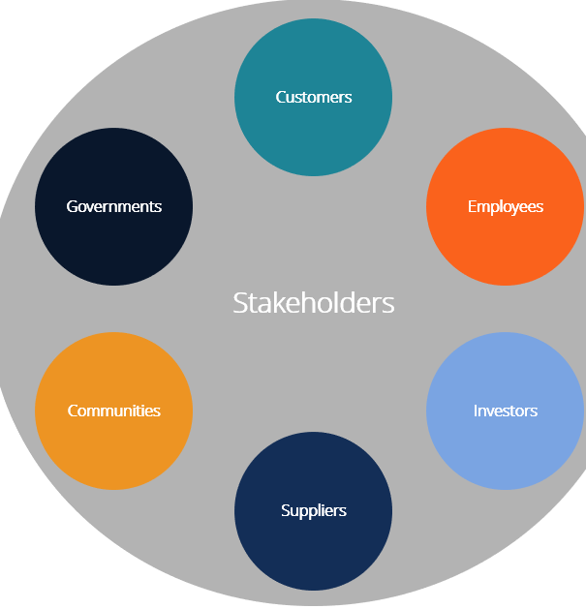
What might all of these groups have an interest in?

Slide 2
Role of different groups in managing the social, economic and environmental challenges of cities around the world
Lesson Outcomes
All will be able to define ‘Stakeholder’
All will be able to identify the different stakeholders involved in decision making
All will be able to appreciate the role of all stakeholders in decision making

Slide 3
Challenge 1 – Stakeholder definition
A stakeholder is a person or __________ that has an interest in a particular thing and can either _____________ or be affected by that thing. For example, the ____________stakeholders in a typical business are its investors, ______________, customers and suppliers.
Missing words:
affect group employees primary
Extra challenge – Write down all of the stakeholders in BISH

Slide 4
Challenge 2 - Stakeholders in an LIC
We are looking at slum management and who the stakeholders would be in this situation.
For all of the stakeholders on your list, identify whether they are a local, national or international stakeholder. Make sure to include a key!
Extra Challenge – Which of these stakeholders would be present for urban development in a HIC?
Slum Residents | Government | City Council
Planners | Residents living nearby | National Charities
Intergovernmental Organisations (IGOs) | International Charities | Utility suppliers
Landowners and property developers | City Council Representative | Employers

Slide 5
Slum Residents | Government | City Council
Planners | Residents living nearby | National Charities
Intergovernmental Organisations (IGOs) | International Charities | Utility suppliers
Landowners and property developers | City Council Representative | Employers
Slum Residents | Government | City Council
Planners | Residents living nearby | National Charities
Intergovernmental Organisations (IGOs) | International Charities | Utility suppliers
Landowners and property developers | City Council Representative | Employers
Slum Residents | Government | City Council
Planners | Residents living nearby | National Charities
Intergovernmental Organisations (IGOs) | International Charities | Utility suppliers
Landowners and property developers | City Council Representative | Employers
Slum Residents | Government | City Council
Planners | Residents living nearby | National Charities
Intergovernmental Organisations (IGOs) | International Charities | Utility suppliers
Landowners and property developers | City Council Representative | Employers
Slum Residents | Government | City Council
Planners | Residents living nearby | National Charities
Intergovernmental Organisations (IGOs) | International Charities | Utility suppliers
Landowners and property developers | City Council Representative | Employers
Slum Residents | Government | City Council
Planners | Residents living nearby | National Charities
Intergovernmental Organisations (IGOs) | International Charities | Utility suppliers
Landowners and property developers | City Council Representative | Employers

Slide 6
Challenge 3 – Which of the options would you support?
Below are 5 different slum management options used around the world. For the designated stakeholder that you have been given, argue which of the options would be best for you!
Bulldoze and clear away
Clear away but relocate
Redevelop
Improve by self-help schemes
Ignore
Sentence Starters
The best option for us would be…
This is because...
However, the option to ________________ would also be good as...
The worst option for us would be...
This is because...

Slide 7
To finish – Who do you think is the most important stakeholder?

