Slide 1
What: TRANSPORT DEVELOPMENTS
Why: to explain How political, technological and physical processes influence global interactions by explain how a reduction in the friction of distance results in time–space convergence.
Success criteria
Give a developed and well-substantiated explanation of how transport development has helped form global interactions.
Analyse the effects this has had on the world.

Slide 2
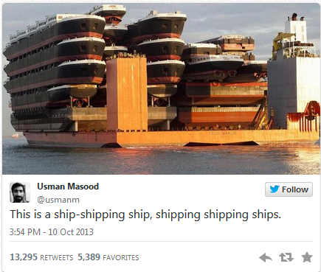

Slide 3
Communications contribution to Economic Opportunities
Industrial Revolution
Mass Production
Globalization
Telecommunications
Roads
Air
Economic Opportunities
Railways
Canal shipping
Maritime shipping
Horses
1750
1775
1800
1825
1850
1875
1900
1925
1950
1975
2000
2025
2050
Time
Notes:
Source: adapted from HOP Associates. http://www.flexibility.co.uk/issues/transport/time-mobility.htm

Slide 5
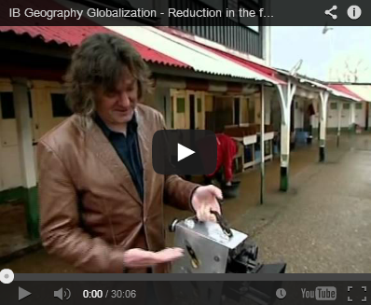
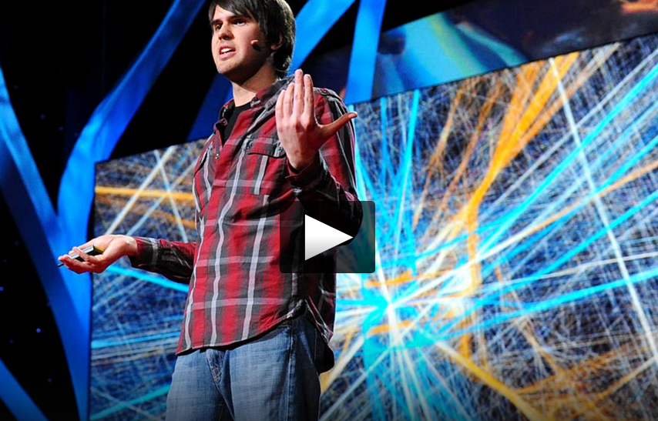
Group Task
Demo: Watch the video (IB Geography Globalization) to the right. Make notes on each of the factors that James May claims to have "made the world a smaller place".
Demo: Watch the 18 minute TED Talk video below and take notes on the issues discussed by Aaron Koblin in the lecture.
Notes:
https://www.youtube.com/watch?v=mLqmjJTbigU

Slide 6
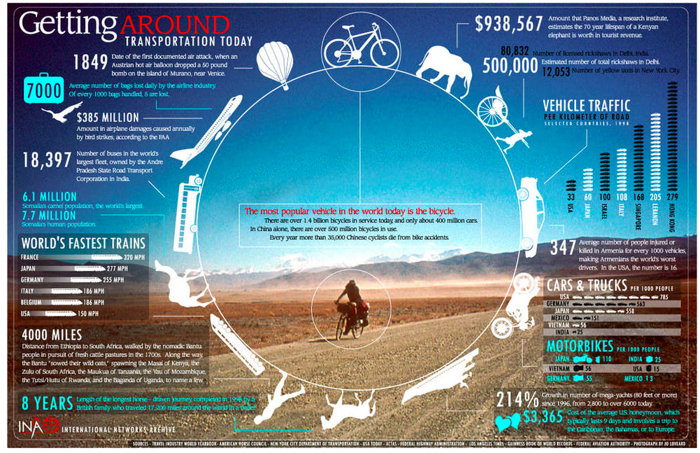

Slide 7
Task
Investigate the relative changes (history and development) of your allocated transport method:
AIR
OCEAN
Include
A timeline of developments in technology and availability
What are the future possibilities?
Examples of geographical locations
Geographical advantages and barriers.
Explain how their development links to the space-time convergence and reduced friction of distance.

Slide 9
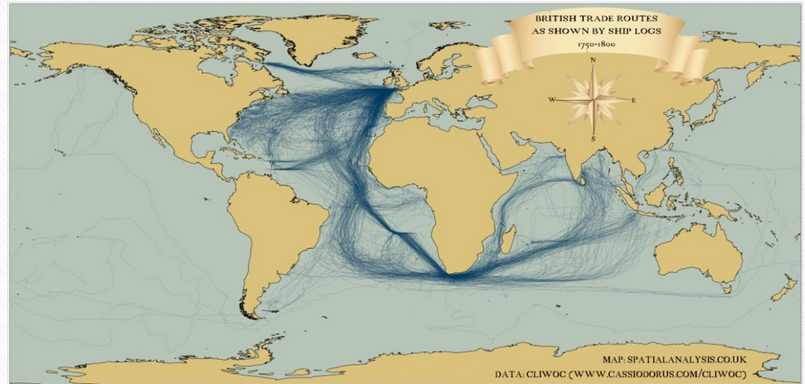
Shipping routes 1750 - 1800

Slide 10
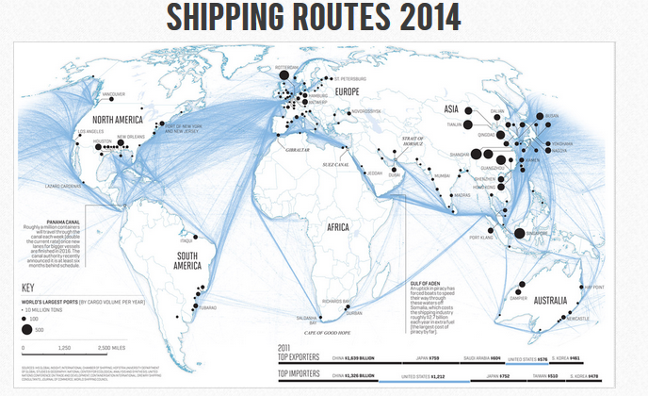

Slide 11
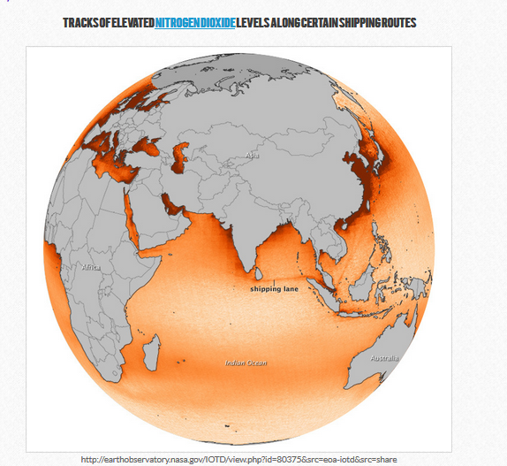
Link to environmental aspects of globalization

Slide 12
Exam style question (from May 2014):
Using examples, explain how transport developments over time have lead to a shrinking world. [12]

