Slide 1
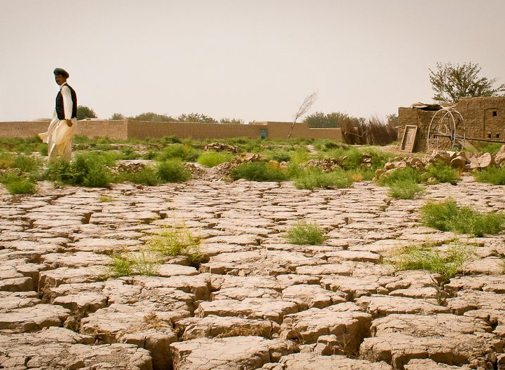
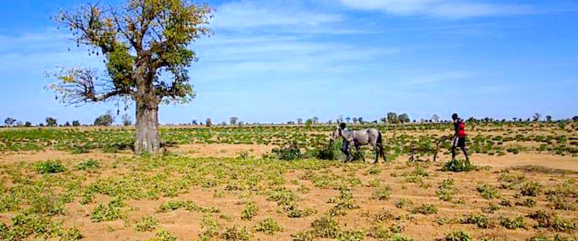
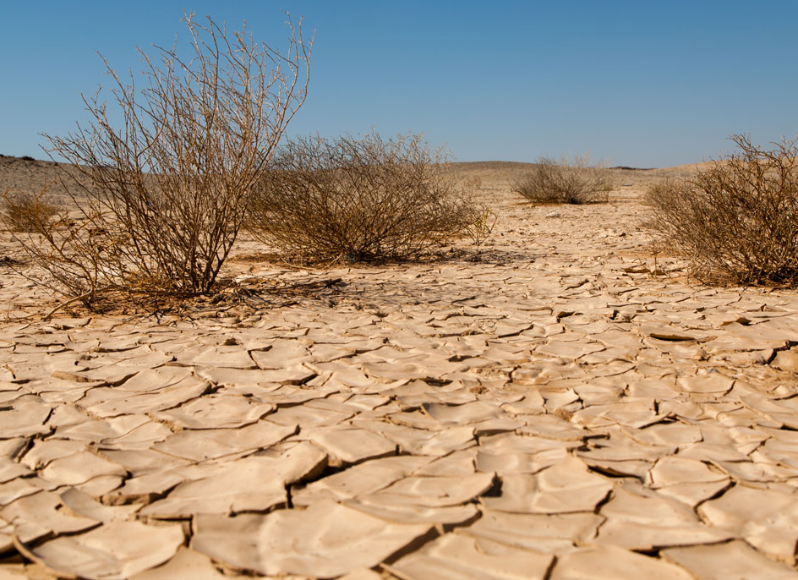
What process might these images be linked to?

Slide 2
Causes of desertification
Outcomes
All will be able to define desertification
All will be able to describe the causes of desertification
Most will be able to explain the causes of desertification

Slide 3
Challenge 1 – Desertification Definition
Watch the video – can you think of an appropriate desertification definition?
Choose one of the following definitions and write it in your book, filling the blanks in as you go.
Desertification is the __________ of land turning into __________ as the quality of the soil declines over time.
Desertification is land _____________ in arid, semi-arid, and dry sub-humid areas resulting from various __________, including climatic variations and ___________ activities
Missing words
desert degradation process factors human
https://www.youtube.com/watch?v=LbFefdUM55Q

Slide 4
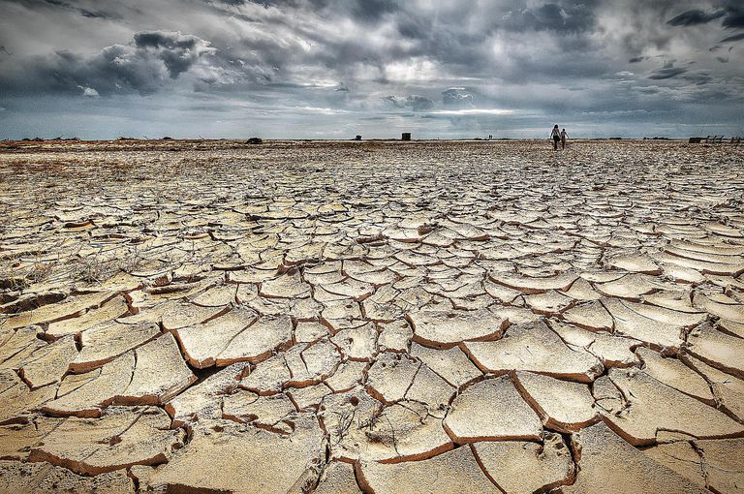
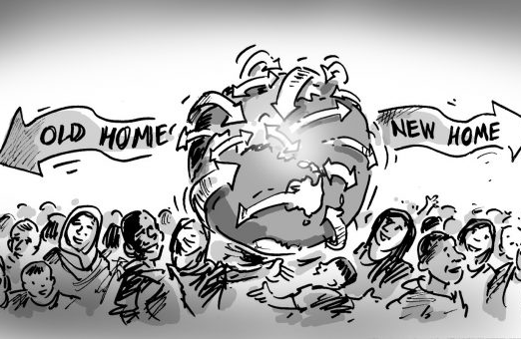
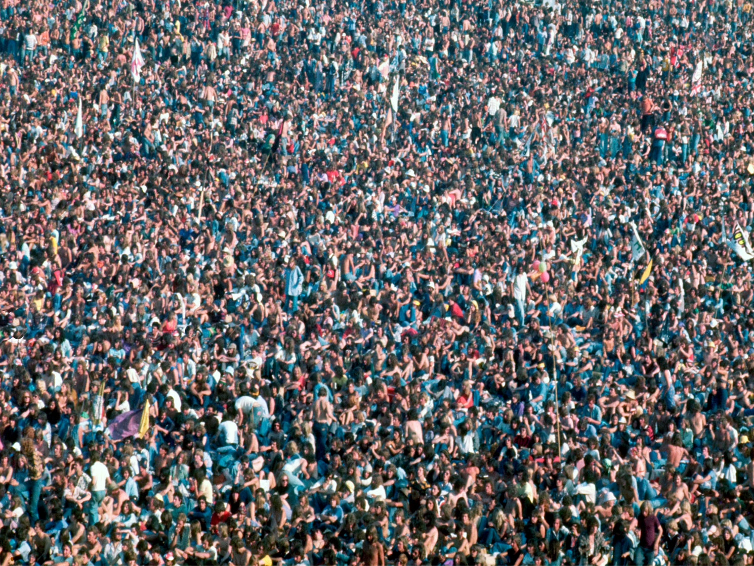
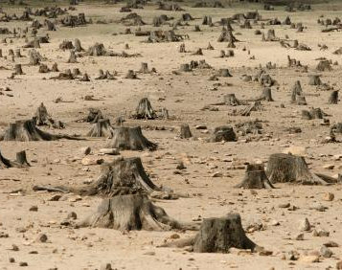
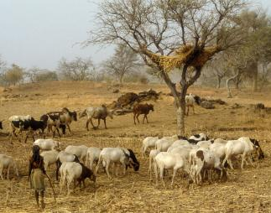

Slide 5
Challenge 2 – Describe the causes of desertification.
Either label the 5 images, or copy and match them to each of the following causes:
Population pressure
Migration
Drought
Deforestation
Overgrazing
Challenge – Define what each of the causes actually means i.e. migration is the movement of people from one place to another with the intention of settling
Extra challenge – Try to name places in the world that are experiencing at least one of these causes

Slide 6
Challenge 3 – Explain the causes of desertification.
After watching the desertification video, use it and page 188 to explain the causes of desertification.
All must explain at least 2.
Most will explain all five
Some will colour code them to identify whether they are human or physical causes.
https://www.youtube.com/watch?v=w9RxnuBiFbg

Slide 7
To finish – Answer the following questions from the 2017 IGCSE

