Slide 1
Population as a resource
The demographic dividend
What: The demographic dividend and the ways in which population could be considered a resource when contemplating possible futures.

Slide 2
Demographic Dividend
The accelerated economic growth that may result from a decline in a country's mortality and fertility and the subsequent change in the age structure of the population.
Source

Slide 3
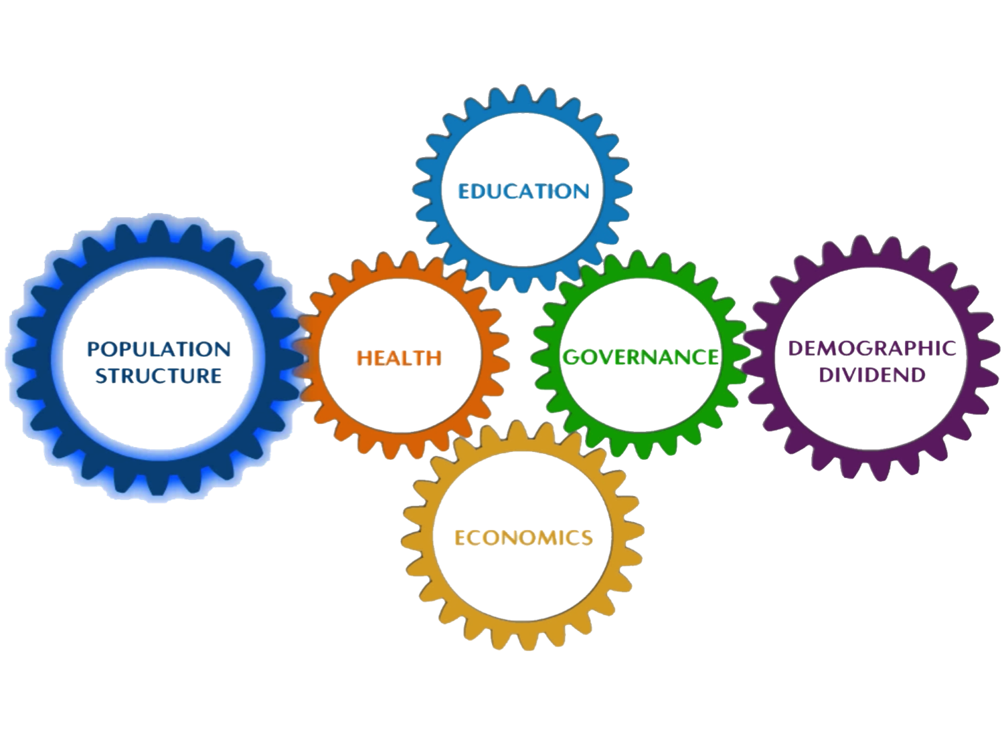

Slide 4
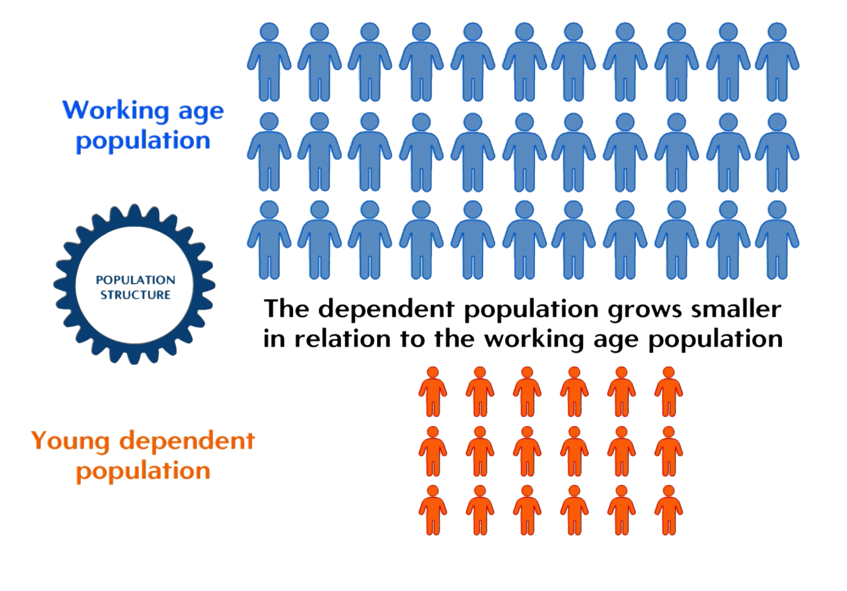

Slide 6
What is the Demographic Dividend?
Use the resources on the weebly to create your own definition of "The Population Dividend". What is the difference between what the IMF refer to as the first and second population dividends?

Slide 7
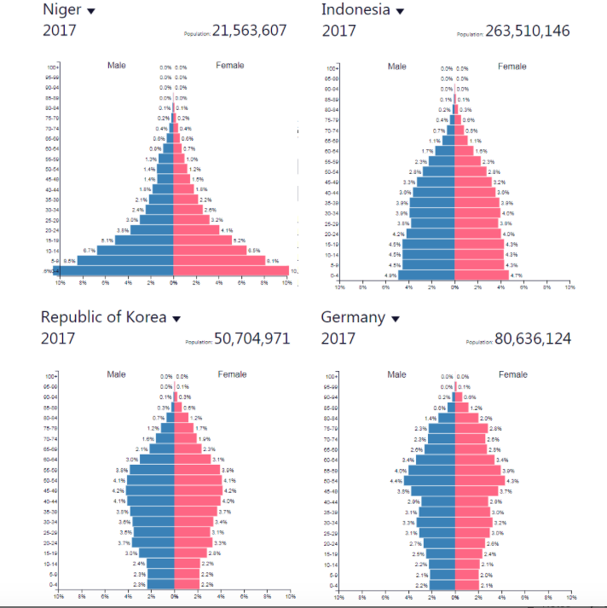
Identifying countries who might experience a demographic dividend
Study the population pyramids to the right.
Which country would you judge to be most likely to benefit from what the IMF describes as the first demographic dividend. Justify your answer.
Which country would be most likely to benefit from the second population dividend? Why?

Slide 8
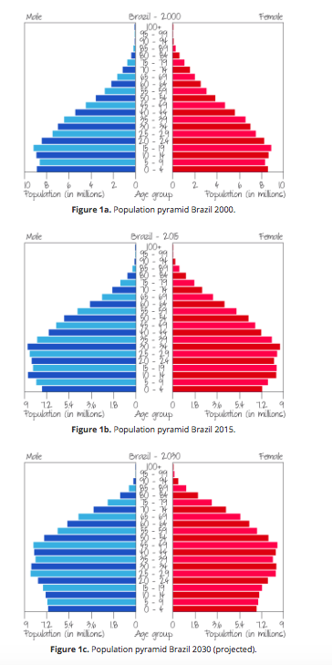
Figures 1a–1d shows what the demographic dividend is: a bulge in particular age groups that passes up through the population pyramid.

Slide 9
Task: using populationpyramid.net sketch the changing population pyramids for South Korea, Ethiopia, India or Thailand to show their demographic dividend

Slide 10
Demographic Dividend
View: Demographic dividend explained, read p. 418-420 in your text or the file embedded on the weebly or kognity- make notes on the demographic dividend and answer the following:
What type of government policies are needed for a country to achieve a demographic dividend?

Slide 11
Demographic Dividend
Read:
Attaining the Demographic Dividend
The challenge of attaining the demographic dividend

Slide 12
Case study:
Create an infographic (like the one on p. 424) for one case study (Ethiopia, South Korea, India or Thailand) that highlights the population structure, what investments the country is making and what challenges it faces.
Select from one of the following to explore making a digital infographic:
Piktochart
Infogram
Venngage
Case Studies:
of Ethiopia / South Korea p. 421-422 in text.
India embedded on weebly
Thailand on kognity

Slide 13
10 mark essay example

