Slide 1
What are the causes and consequences of deforestation?

Slide 2
Objectives
What: The causes and consequences of deforestation
Why: So that we can consider whether the benefits of deforestation outweigh the costs
How: Debate: Deforestation is not always a bad thing Discuss.
Websites for a starting place for research:
Live Science: Deforestation
Green Garage Blog – pros and cons of deforestation
Conserve-future-energy.com – deforestation facts

Slide 3
Watch the video and take notes on the causes/consequences deforestation can bring…
https://www.youtube.com/watch?v=RawJ875KCco
(start at 19 mins)

Slide 4
Debate: Deforestation is not always a bad thing Discuss.
Structure of the debate:
For the proposition: Opening statement
Against the proposition: Opening statement
For argument #1 + rebuttals from opposing team
Against Argument #1 + rebuttals from opposing team
For argument #2 + rebuttals from opposing team
Against Argument #2 + rebuttals from opposing team
And so on…..
For the proposition: Closing statement
Against the proposition: Closing statement

Slide 5
Resources
https://www.livescience.com/27692-deforestation.html
https://greengarageblog.org/17-important-pros-and-cons-of-deforestation
https://www.conserve-energy-future.com/various-deforestation-facts.php
http://msue.anr.msu.edu/news/tree_cutting_can_have_positive_environmental_consequences

Slide 6
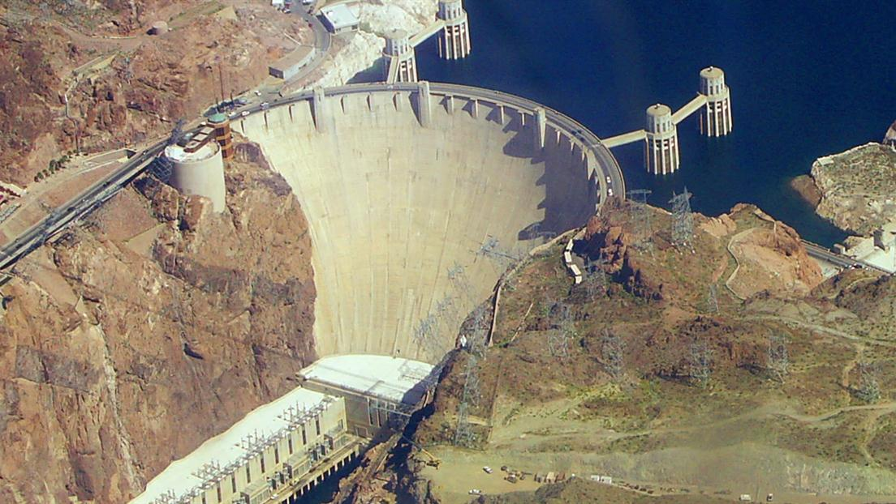
IDEAL analysis
I
Identify what can you see?
D
Describe why is this required in a desert?
E
Explain- what are the advantages and disadvantages?
Complete the IDEAL analysis on your sheet.
A
Apply- how did this create economic opportunities for the USA?
Literacy
Challenge
Can you use these key terms:
Sandbanks
Irrigation
Tourism
Agriculture
Water transfer
Meltwater
Hydroelectric power
Flow rate
Can you now answer the following question using the IDEAL analysis to help you:
To what extent was the Colorado dam successful in brining about economic opportunities in the Western Desert?
L
Link- how is this development affecting the water crisis in the Western Desert?

Slide 8
Identify
__________________________________________________________________________________________
Describe
__________________________________________________________________________________________
Explain
_______________________________________________________________________________________________________________________________________
Apply
_______________________________________________________________________________________________________________________________________
Link
_______________________________________________________________________________________________________________________________________

