Slide 1
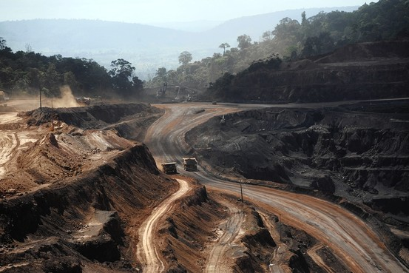
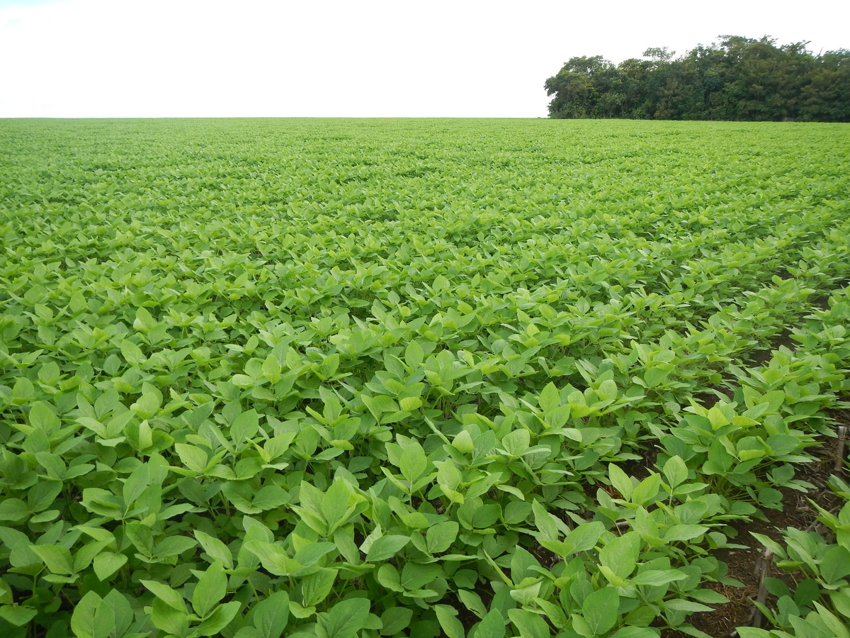
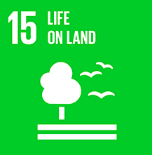
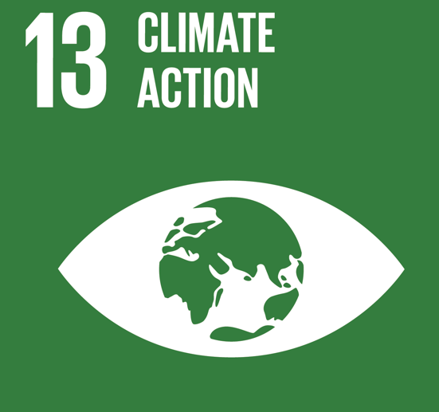
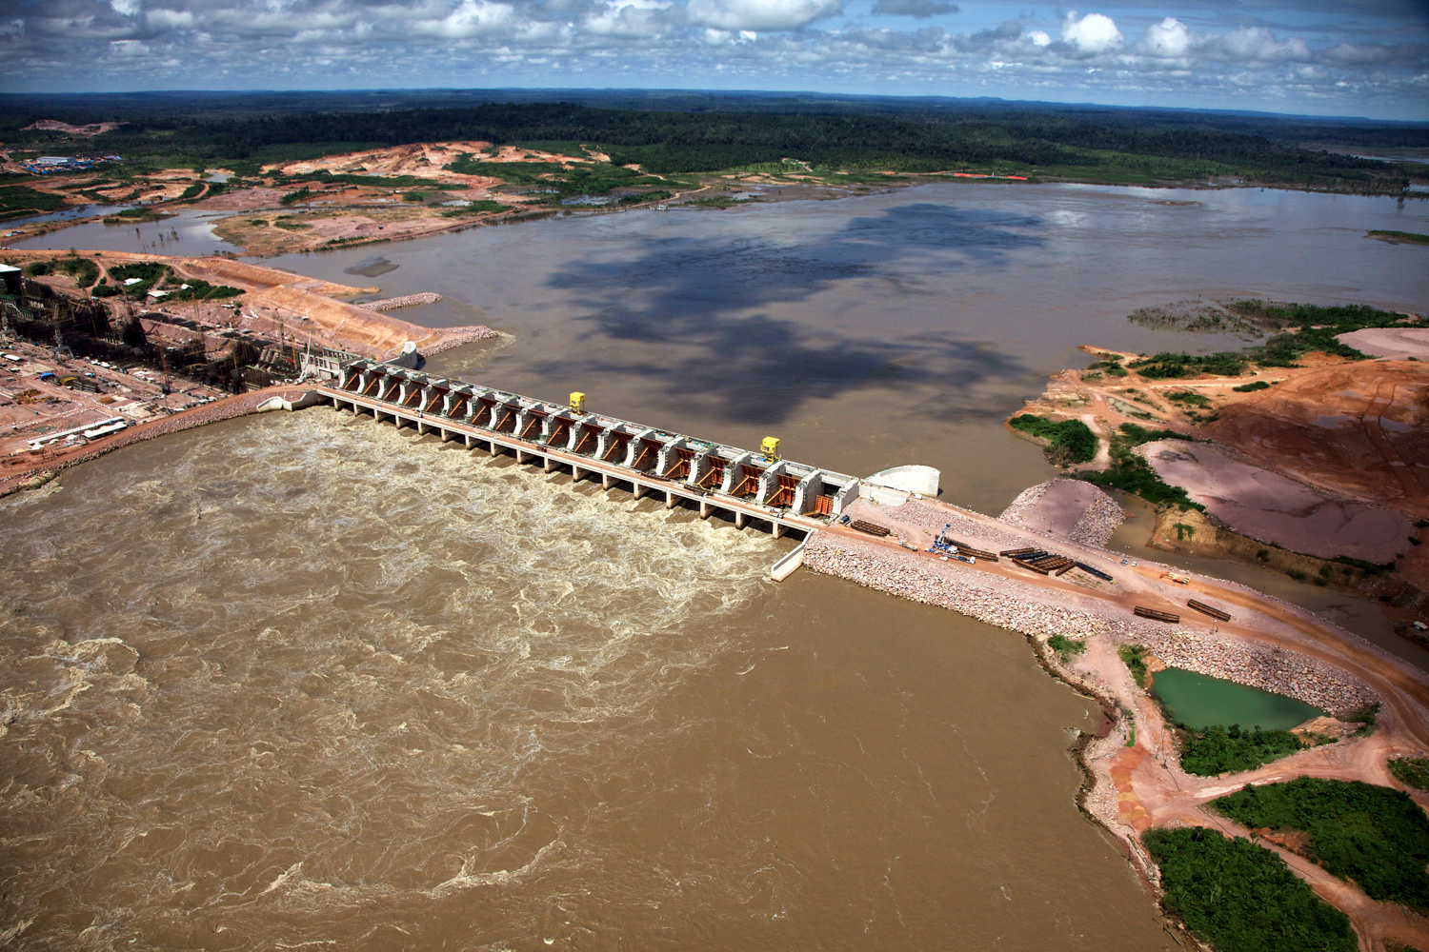
What are the causes of deforestation in Brazil?
Lesson objectives- What:
To develop a greater understanding of the scale of deforestation in the Amazon rainforest.
To develop a greater knowledge of the causes of deforestation in the Amazon rainforest.
Why: To understand that for most geographical issues there are a range of complex reasons

Slide 2
Starter
Decide where you stand on the decision line in relation to the statement. Be prepared to justify!
Yes
Maybe
“All development in the Rainforest should be stopped”
No
Yes!
Maybe?
No!
Why is it the best way?
What are the most influential reasons?
What should we worry most about?
What is making you unsure?
What would it take for you to make a decision?
What are both sides of the argument?
Why not?
What is a better way?
Which negatives particularly outweigh the positives?
What are the advantages of development in the tropical rainforest?
What are the disadvantages of development in the tropical rainforest?
What are the conditions like in the tropical rainforest?
What examples can you use to illustrate the advantages and disadvantages?
How can you decide?

Slide 3
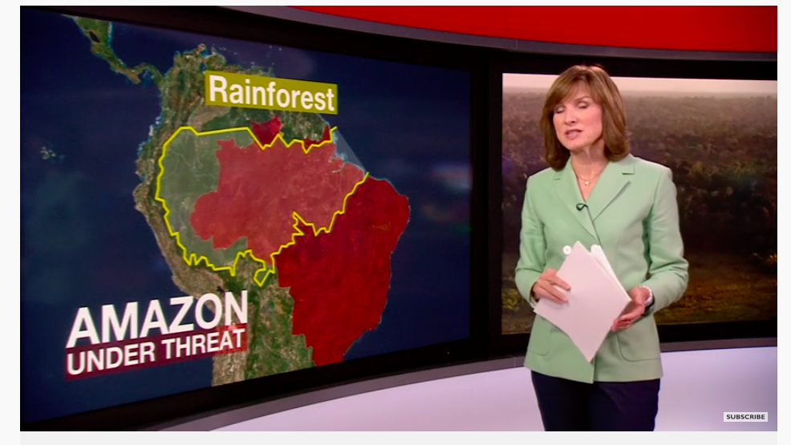

Slide 4
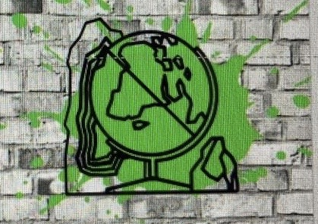
Amazon Deforestation Soars as Pandemic Hobbles Enforcement
A rise in illegal deforestation heightens the risk of fires in the Brazilian rainforest even more destructive than those that drew global outrage last year.
06/06/20
1
Who is the president of Brazil?
Since coming to office, President Jair Bolsonaro of Brazil has enabled increased razing of the Amazon rainforest.
Now, the coronavirus has accelerated that destruction.
Illegal loggers, miners and land grabbers have cleared vast areas of the Amazon with impunity in recent months as law enforcement efforts were hobbled by the pandemic.
Those recently cleared areas will almost certainly make way for a rash of fires even more widespread and devastating than the ones that drew global outrage last year. The newly cleared patches are typically set ablaze during the drier months of August to October to prepare the land for cattle grazing, often spiraling out of control into wildfires.
“The trend line is shooting upward compared to a year that was already historic in terms of a rise in deforestation,” said Ana Carolina Haliuc Bragança, a federal prosecutor who leads a task force that investigates environmental crimes in the Amazon. “If state entities don’t adopt very decisive measures, we’re looking at a likely tragedy.”
The fallout from the pandemic has exacerbated the ecological degradation set in motion by government policies under Mr. Bolsonaro, who favours expanding commercial development in the Amazon and views environmental regulations as a hindrance to economic growth. But some career civil servants are still working to enforce environmental protections.
An estimated 464 square miles of Amazon tree cover was slashed from January to April, a 55 percent increase from the same period last year and an area roughly 20 times the size of Manhattan, according to Brazil’s National Institute for Space Research, a government agency that tracks deforestation with satellite images
Already last year, deforestation in the Amazon had reached levels not seen since 2008.
At the same time, the coronavirus has killed more than 34,000 people in Brazil, which now is recording the highest daily number of deaths in the world. It has also fueled political polarization and dominated headlines and policy debates in recent months, eclipsing the increased damage to the rainforest.
Environment Minister Ricardo Salles, who supports Mr. Bolsonaro’s loosening of environmental regulation, said in late April that he saw the pandemic as an opportunity to reduce restrictions while attention was focused elsewhere.
“We need to make an effort here during this period of calm in terms of press coverage because people are only talking about Covid,” he said during an April 22 cabinet meeting.
The association that represents government environmental workers issued a statement calling Mr. Salles a “criminal” who has been “hollowing out” his own ministry.
Enforcement actions by the country’s main environmental protection agency, the Brazilian Environmental and Renewable Natural Resources Institute, or Ibama, fell sharply during 2019, Mr. Bolsonaro’s first year in office.
In 2019, Ibama reported 128 instances of environmental crimes, a 55 percent decrease from the year before. The amount of illegally logged timber seized by the agency fell by nearly 64 percent from 2018 to 2019, according to the document.
Roughly 50 percent of the tree cover lost during the first four months of this year was on public land, according to Ipam Amazônia, an environmental research organization.
Fearing a new wave of international condemnation, the Bolsonaro administration in May dispatched a few thousand troops to the Amazon and tasked them with preventing environmental crimes for 30 days.
“We don’t want Brazil to be portrayed in front of the rest of the world as an environmental villain,” Vice President Hamilton Mourão said as the initiative was launched.
In an emailed statement, the Defense Ministry said it had devoted 3,800 service members, 11 aircraft, 11 boats and 180 vehicles to support the mission. The operation, it said, “clearly demonstrates Brazil’s firm determination to preserve and defend the Amazon.”
Environmental activists say they welcome any increase in enforcement, but most see the military operation as a public relations ploy that will not change the trajectory of deforestation or lead to punishment for the key people driving the destruction.
Brazil’s record on environmental matters during the Bolsonaro era has set off calls for boycotts of Brazilian exports and threatens the implementation of a trade agreement between the European Union and four South American nations.
Adriano Karipuna, an Indigenous leader in Rondônia state where illegal deforestation has increased, said his community feels increasingly vulnerable.
“They launch a big operation but it’s just to put it on the news,” he said. “They never actually arrest anyone.”
Mr. Karipuna said the ease with which illegal loggers and miners are destroying the forest is putting remote Indigenous communities — including uncontacted tribes — in grave danger.
“The dynamic can set in motion a genocide by spreading the coronavirus,” he said. “The Brazilian government will be responsible.”
7
What was Minister Ricardo Salles opinion?
2
What has happened to the Amazon in recent months?
8
What is Ibama and how has their work changed in recent months?
3
Why has there been a change in deforestation in recent months?
9
What has the Defense Ministry done?
4
Why is cleared land set on fire?
10
What was the Indigenous leaders opinion?
5
Why isn’t the president stopping the deforestation?
11
Summarise this article.
6
How has the tree cover changed from January to April?

Slide 5
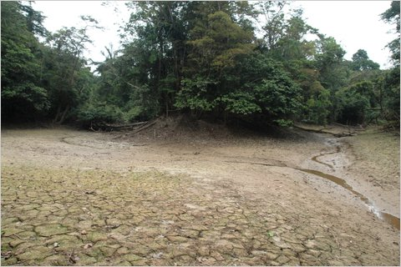
Task
Figure 1- Impact of deforestation in the Amazon
Easy Describe the impact(s) of deforestation shown in figure 1.
Medium Explain a global impact of deforestation shown in figure 1.
Hard Explain a local impact of deforestation that can lead to global consequences.

Slide 7
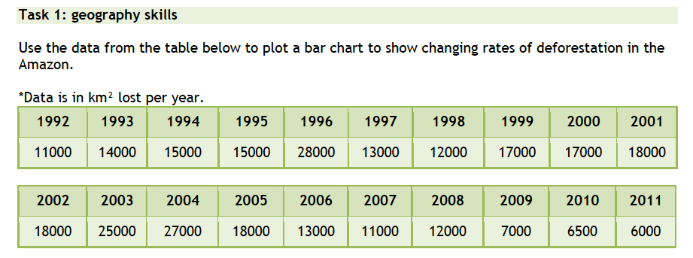
Global rates of deforestation
Target: Ensure you include a descriptive title and label your axis

Slide 8
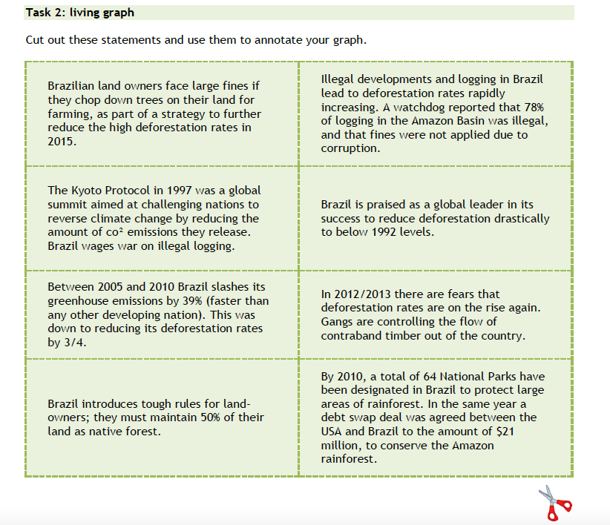

Slide 9
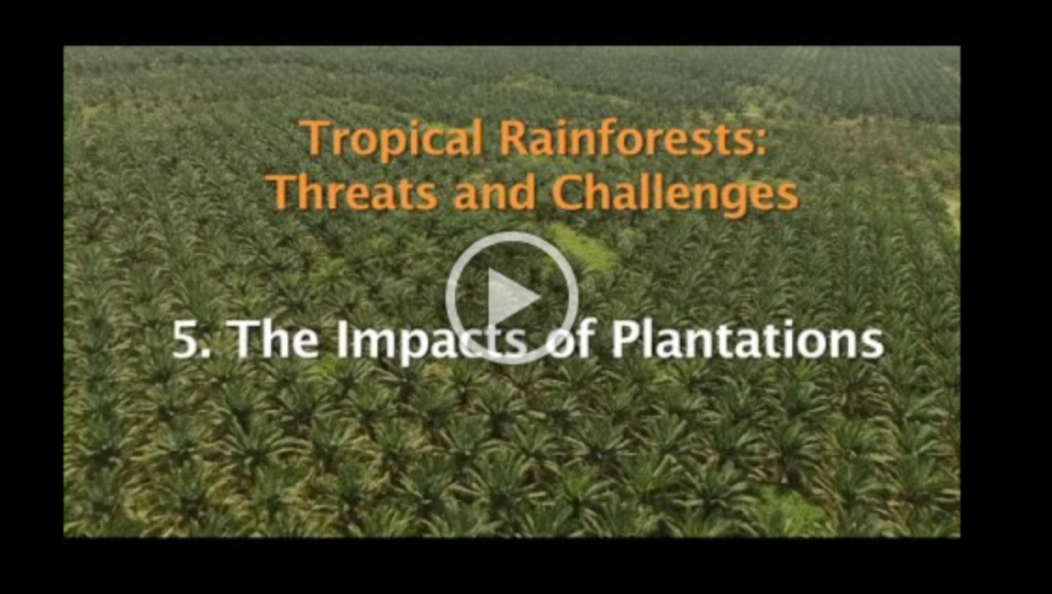
Watch the video…make notes under the following headings…..
1 The Value of the Rainforest
2 Threats to the Amazon – Oil and mineral extraction?
3 Threats to the Amazon –building roads?
4 Threats to the Amazon – plantations
5 Threats to the Amazon – Benefits and Impacts

Slide 10
What is the greatest threat to the Amazon?
Several threats to the Amazon are shown in this programme.
Work in groups of 2-3 to rank these nine threats in a ‘diamond ranking’.
Present your findings to the class and compare rankings overall.
Write a summary of 500 words using the title above to explain your ranking.
Nine threats to the Amazon
Population increase
Traditional economic activities e.g. farming using ‘slash and burn’
Commercial logging
Oil exploration
Deforestation for cattle ranching
Road building
Giving land for farming to poor landless labourers
Oil palm plantations
Mining or quarrying for minerals

Slide 11
Geographic skill: annotating photos
Success criteria:
Give image a title and figure number
Give detailed explanations to explain the geography that is being shown on the image (linked to the question)

Slide 12
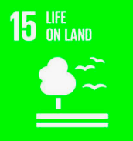
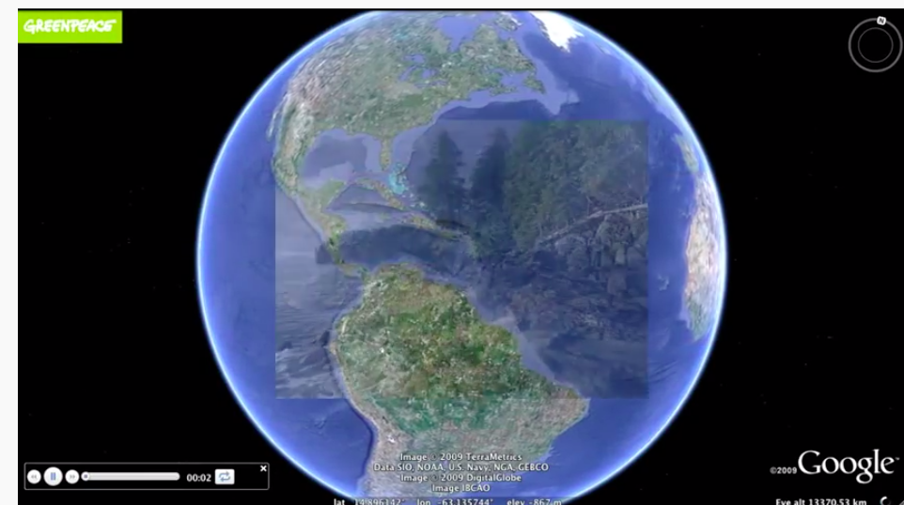
What can we do about this?

Slide 13
Recap
Decide where you stand on the decision line in relation to the statement. Be prepared to justify!
Yes
Maybe
“All development in the Rainforest should be stopped”
No
Yes!
Maybe?
No!
Why is it the best way?
What are the most influential reasons?
What should we worry most about?
What is making you unsure?
What would it take for you to make a decision?
What are both sides of the argument?
Why not?
What is a better way?
Which negatives particularly outweigh the positives?
What are the advantages of development in the tropical rainforest?
What are the disadvantages of development in the tropical rainforest?
What are the conditions like in the tropical rainforest?
What examples can you use to illustrate the advantages and disadvantages?
How can you decide?

