Slide 1
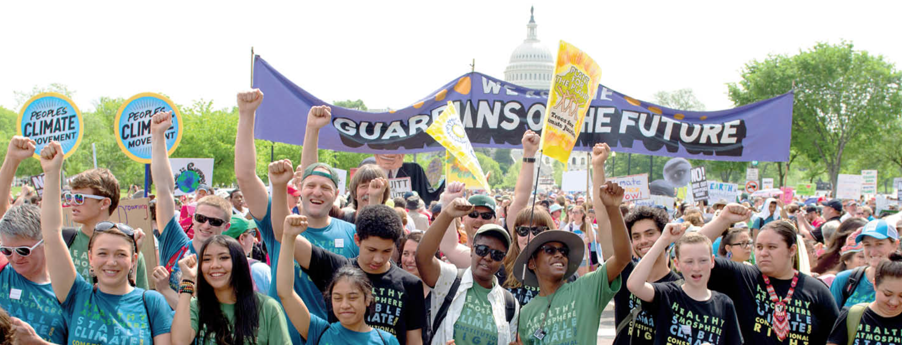
What are the ways of dealing with climate change?

Slide 3
Government strategies for climate change
There are 3 broad ways in which governments can respond to the threat of climate change:
Do nothing
Act to reduce the severity or intensity of climate change by reducing the output of greenhouse gases and/or decreasing greenhouse stores. Mitigation.
3. Adjust to changes in the environment, for example by building coastal defences, rather than trying to stop climate change from happening. Adaption

Slide 5
Organise the following into ‘adaption’ and ‘mitigation’
Water and energy conservation
Insulate buildings
Health Programmes
Sustainable transportation, improved fuel efficiency
Renewable energy
Upgrades of buildings and infrastructure
Capture and use of landfill and digester gas
Carbon sinks and storage
Fish and shellfish
Training programmes and education
Change in land use, relocation
Energy conservation and efficiency
Green Infrastructure
Business community planning

Slide 7
https://ig.ft.com/climate-game/?fbclid=IwAR2AskX5F3tLqerLkFnK092MK94S35-2_m5O9--vHMxFs9_vCpq-5ef9YOA

Slide 8
Task: The climate change treaties
Geopolitics: politics, especially international relations, as influenced by geographical factors.

Slide 11
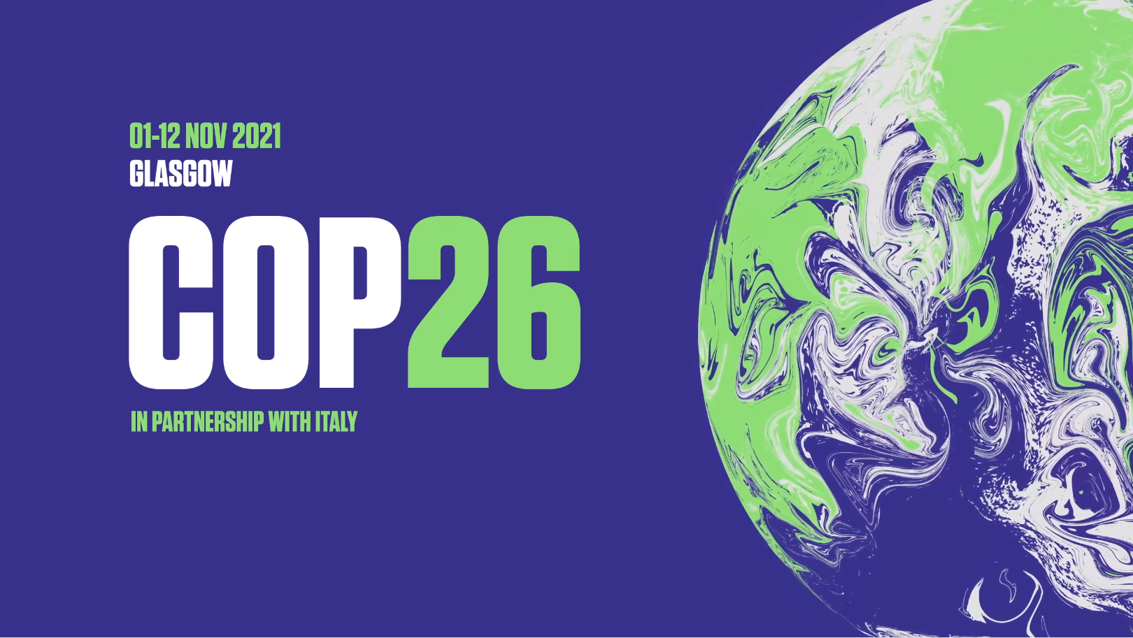
GLASGOW, SCOTLAND
First things first – what does ‘COP26’ even mean?! Well, ‘COP’ stands for ‘conference of parties’ – a meeting that involves lots of different people working towards the same goal. In this case Climate Change or ‘The Climate Emergency’
Notes:
What is COP26 promo video:
https://www.youtube.com/watch?v=hNzr75MbzZs

Slide 12
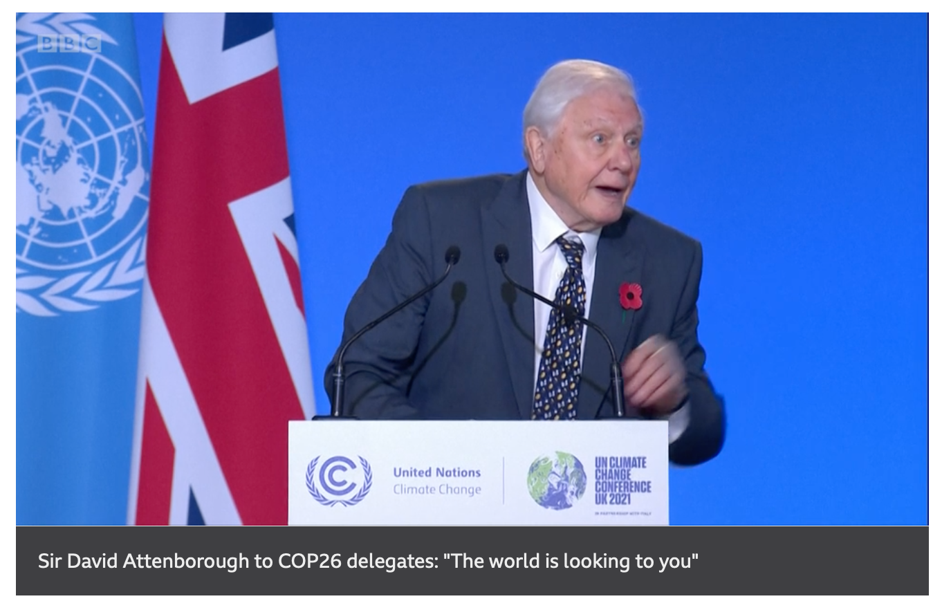
World leaders meeting
https://www.bbc.com/news/world-59125138

Slide 13
COP26
What happened at COP26?
Leaders from 200 countries will review progress made since COP21 in Paris (2015)
They will then make new decisions on how to cut carbon dioxide emissions.
The rich countries will review their pledge to provide financial assistance to poorer countries ($100 bn)
Many people believe that COP26 is our last chance to stop a climate catastrophe

Slide 14
'We are sinking': Tuvalu minister gives Cop26 speech standing in water to highlight sea level rise
https://www.youtube.com/watch?v=jBBsv0QyscE

Slide 15
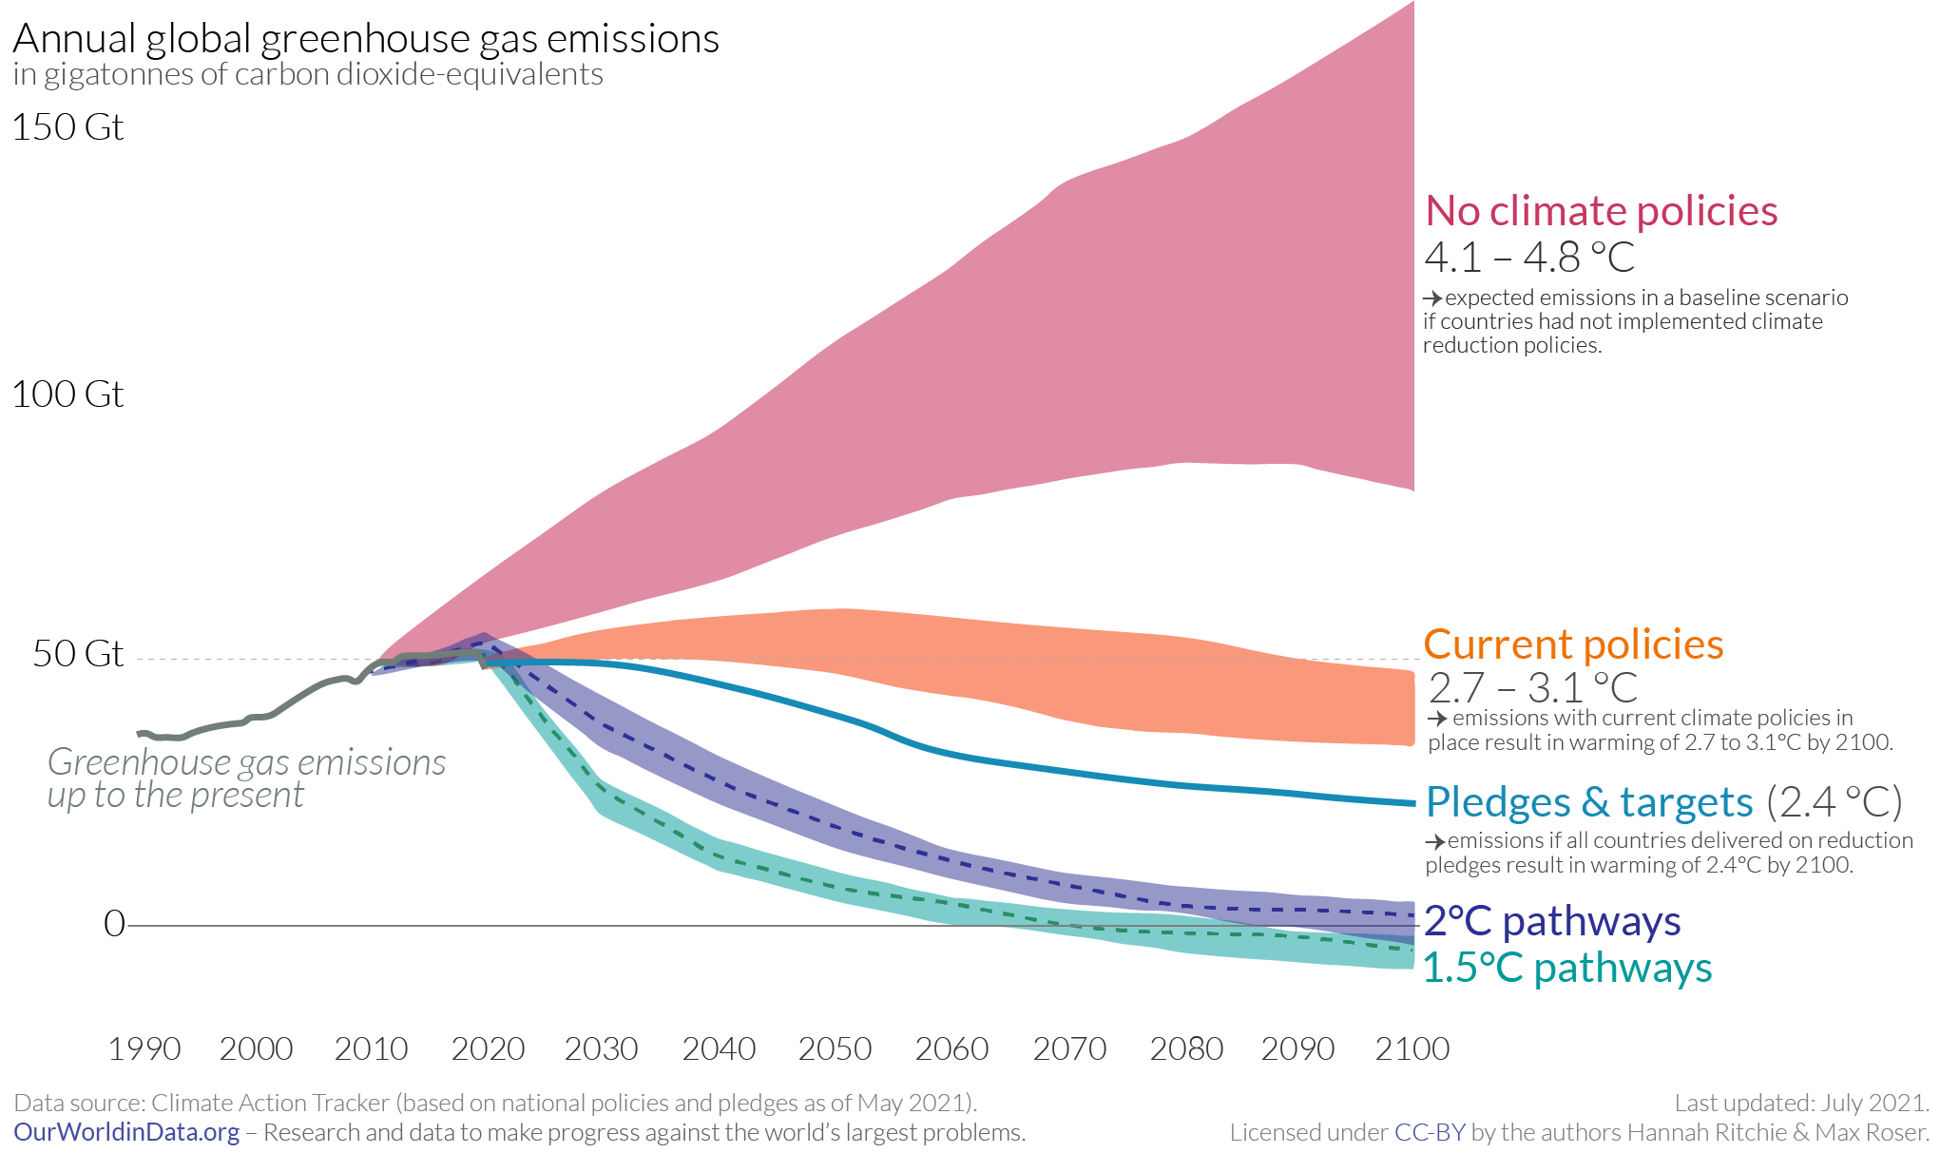
COP26
Target: What we say we will do
Policy: What are are actually doing
So, how are we doing?
Remember the Paris Agreement was to keep Global Warming below 2C by the year 2100.
Current policies means warming will be 2.7-3.1°C
Current targets means warming will be at least 2.4°C
We are NOT on track to meet the Paris Agreement of 2°C

Slide 16
Task: The climate change treaties
Person 1 - The Kyoto Protocol 1997 Person 2 - The Paris Agreement 2015
Person 3- Cop 26 Glasgow Use the website below and your textbook to create revision resource which includes all of the following: 1 - Publicity photo from the event with leaders involved 2 - Objectives 3 - Who signed up? Who didn't? 4 - Successes & Failures

Slide 17
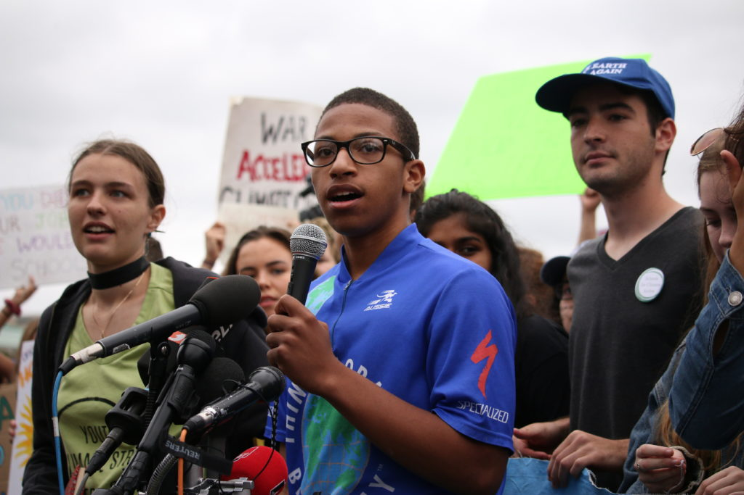
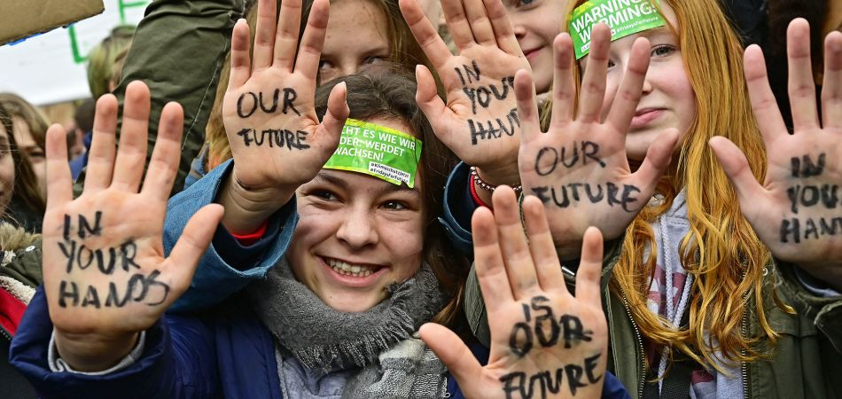
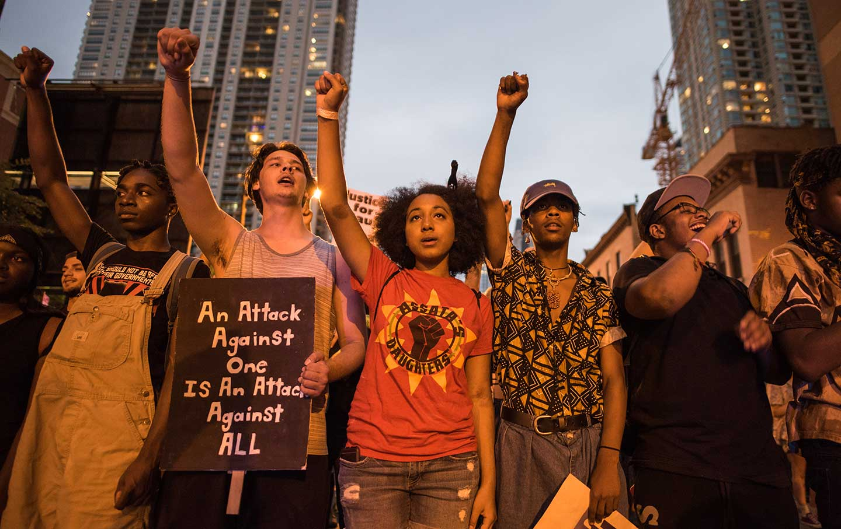
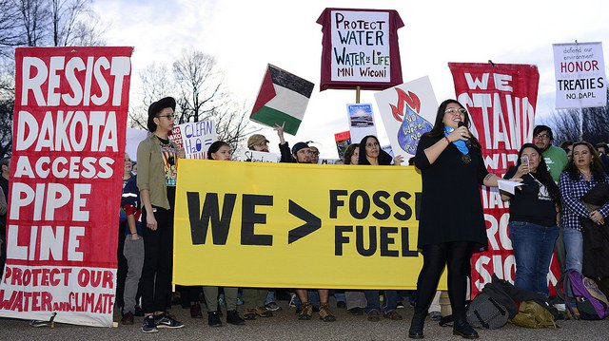
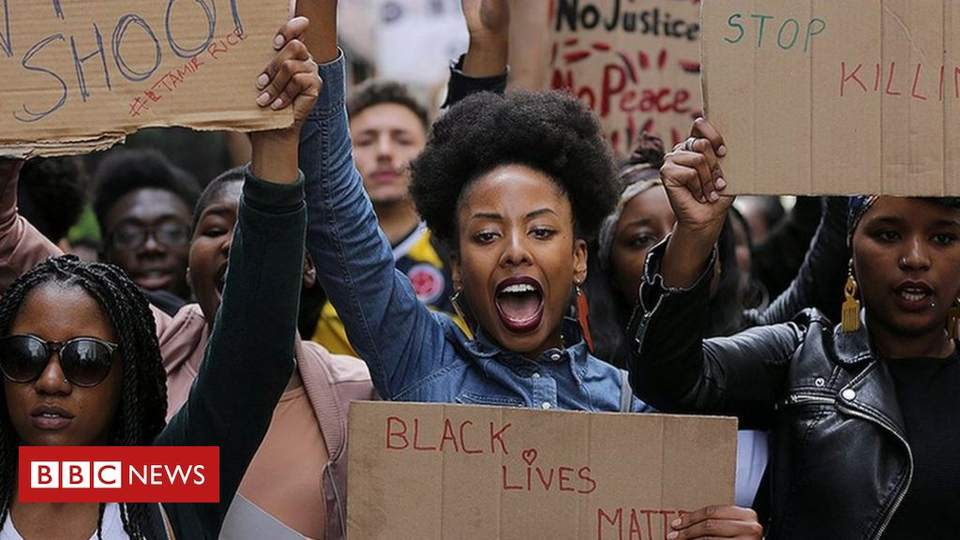
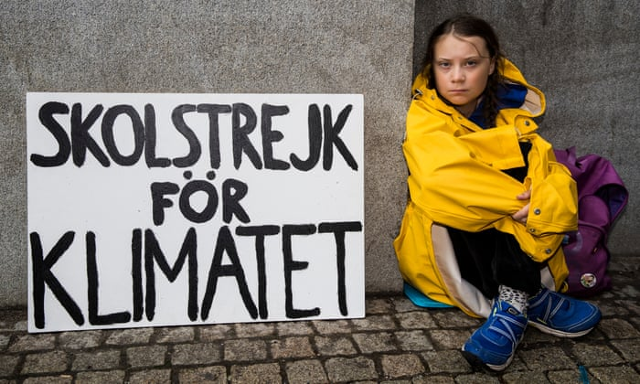
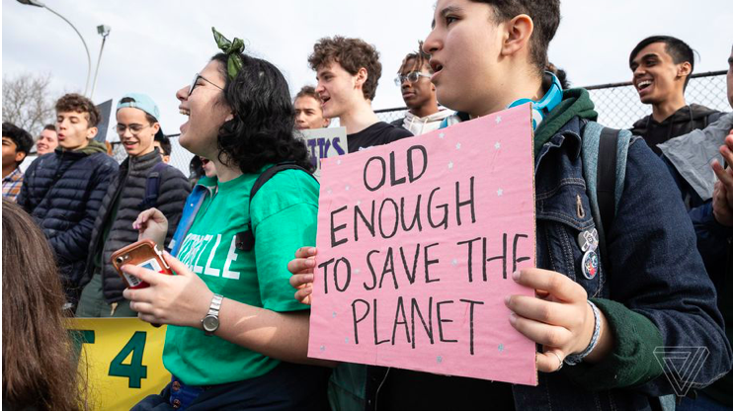
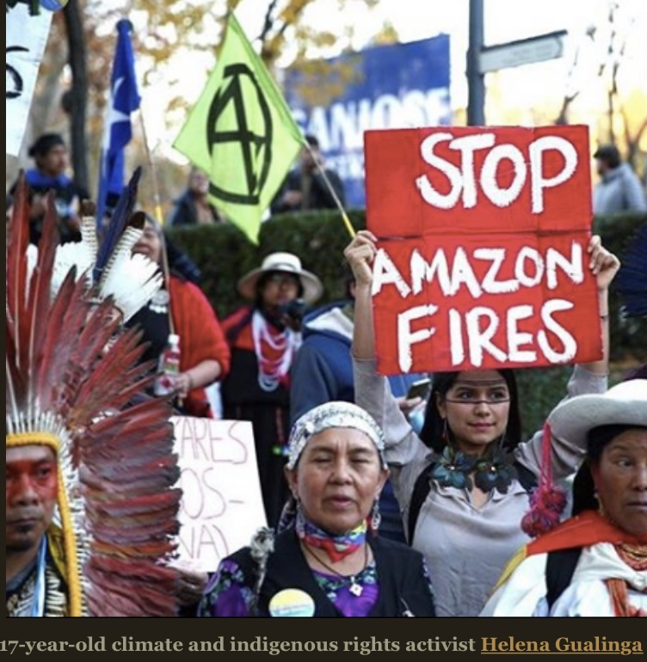
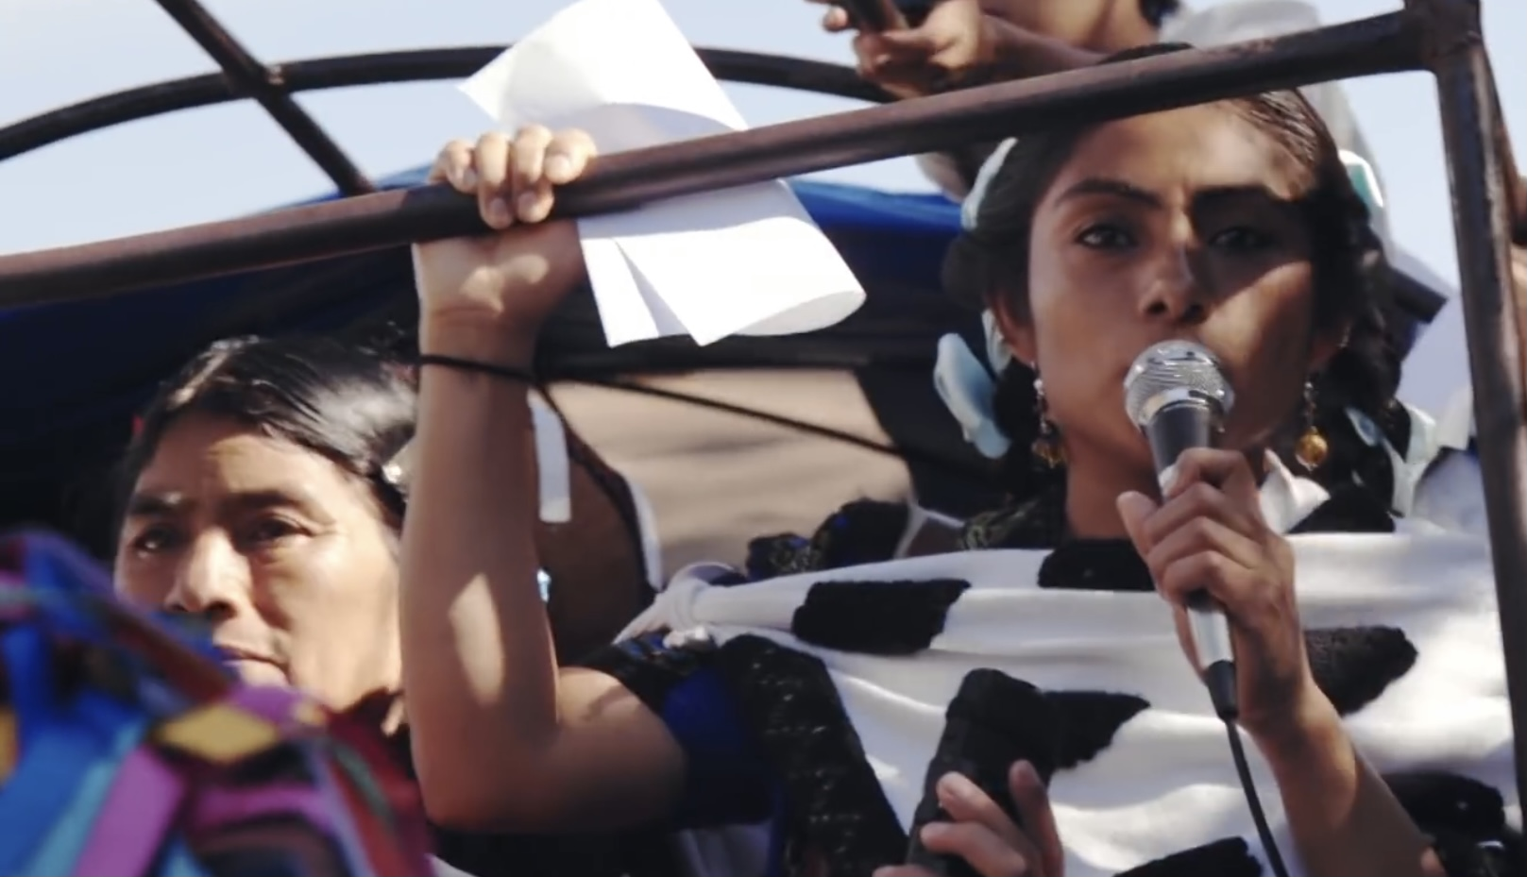
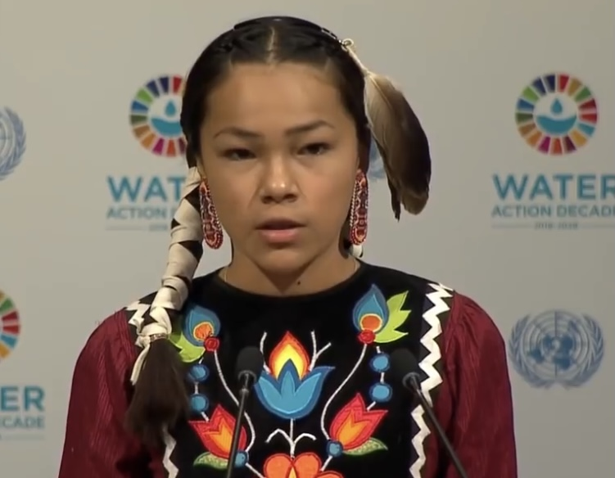
Are protest movements an effective way to change the world?

Slide 18
Are protest movements effective?
Before you look at any further information, where would you place yourself on this continuum?

Slide 19
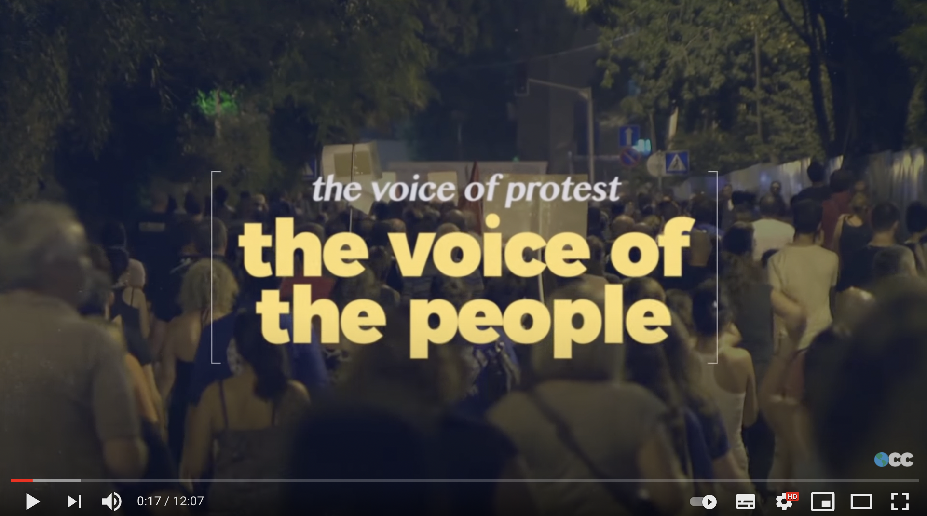
Watch 1: Youth protest
How are these young people protesting?
What do they hope to achieve?
What successes have they had?
What are criticisms of their methods?
https://www.youtube.com/watch?v=sP9TGpBGy08&feature=emb_logo

Slide 20
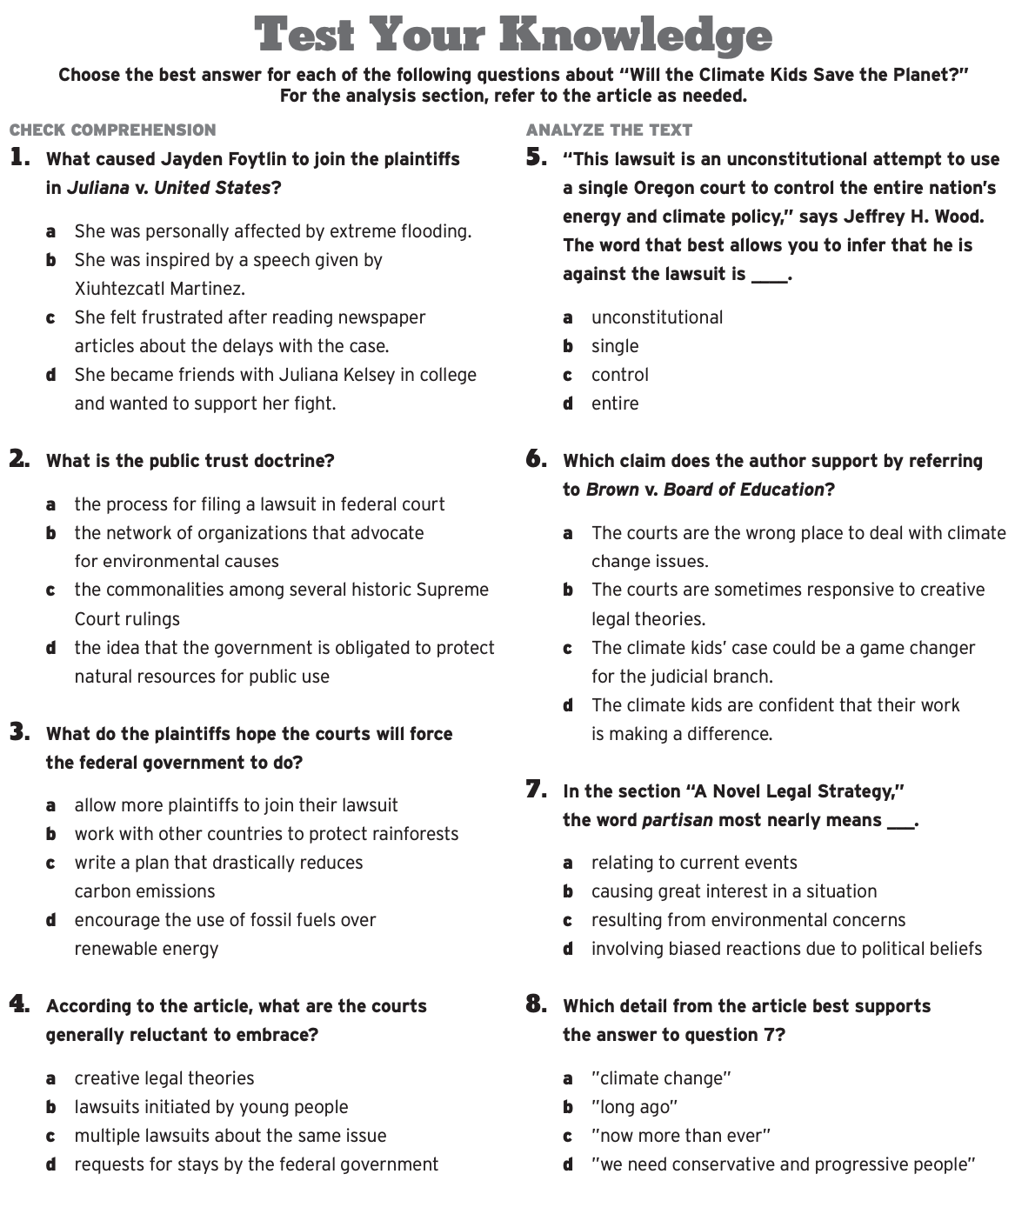
Will climate kids save the planet?

Slide 21
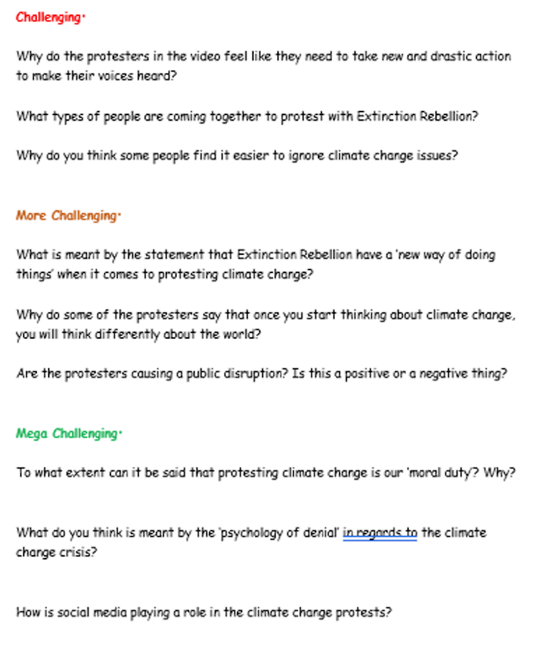
Extinction rebellion
https://www.youtube.com/watch?v=7FitSDGF6o0

Slide 22
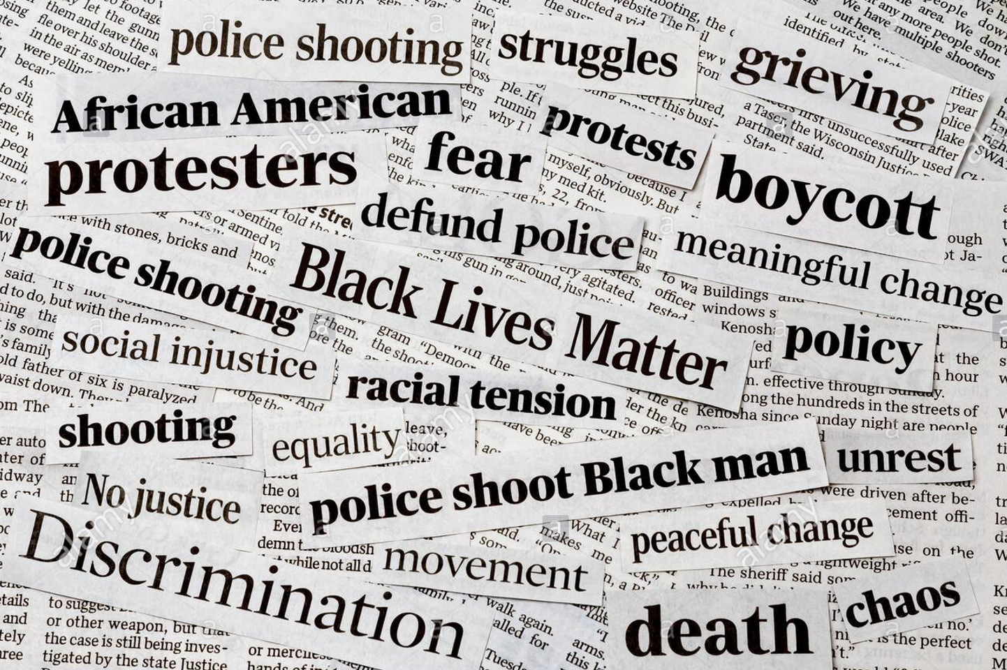
Of Course There Are Protests. The State Is Failing Black People. The collapse of politics and governance leaves no other option
Protest movements can change the world (a selection of linked articles)
Think we should be at school? Today’s climate strike is the biggest lesson of all
From Birmingham to Bristol, how the Black Lives Matter protests started a movement for change
Greenpeace. Protesting peacefully to change the world
“Never doubt that a small group of thoughtful, committed citizens can change the world; indeed, it is the only thing that ever has.”
From Parkland students to the Arab Spring, teenagers and young adults have a history of pushing social change forward.
'People thought I was too young to protest': the rise of student activism
Greta Thunberg’s enemies are right to be scared. Her new political allies should be too
What have Black Lives Matter Protests achieved?
To enact change in the world, we must protest

Slide 23
Priti Patel hits out at 'dreadful' Black Lives Matter protests
Protest movements are problematic/ineffective (a selection of linked articles)
The Extinction Rebels have got their tactics badly wrong. Here’s why
Will Protests Set Off a Second Viral Wave?
Demonstrations make for selfies and virtue-signalling, not political change
Why Street Protests Don't Work
Greta Thunberg says school strikes have achieved nothing
Public statues of controversial historical figures should be "retained and explained" instead of being taken down, the government has said.
In chaotic scenes protesters stormed their way into the heart of American democracy

Slide 24
How Protests Become Successful Social Movements
Other articles
Myanmar coup: Police clamp down as protesters ignore ban on gatherings
Scientists say they’ve pinpointed the reasons why people protest
Semi-naked climate protesters disrupt Brexit debate

Slide 25
Some questions to consider:
What protest movements are you aware of?
Have you ever been involved in a protest movement/do you know anyone who has? Can you imagine yourself protesting in the future?
Who is involved in protest movements?
What methods are used by protesters to achieve their aims?
What are the positives of protest movements?
In what ways are protest movements problematic or ineffective?
Can you give examples of where protest movements have been more successful and/or less successful?
Why are some protest movements more successful than others?
Youth activism has been a key feature of recent protest movements; what responsibility do young people have in bringing about change in the world?
Who has the power to bring about change in society?
Can violent protest ever be justified?
Why are there different perspectives on these issues?
How can we know that protest movements are making a difference?
What other strategies are needed to address global problems?
Overall, to what extent do you think protest movements are an effective strategy in addressing global problems?
You may consider these questions based on your own knowledge and the video resource on the previous slide. You may also like to consider some of the evidence linked on the next two slides (optional)

Slide 26
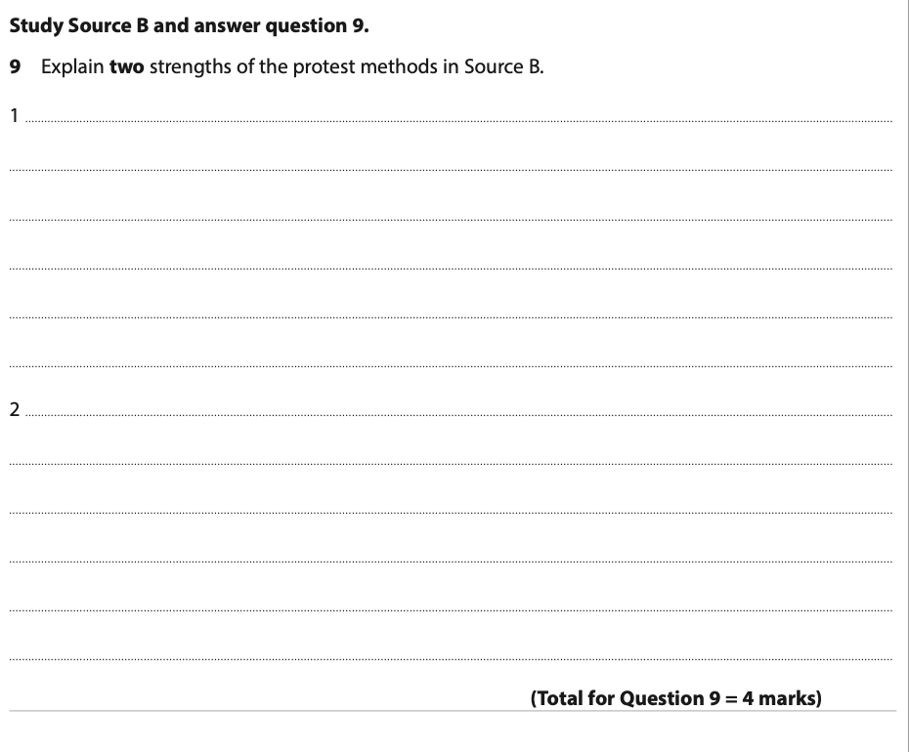
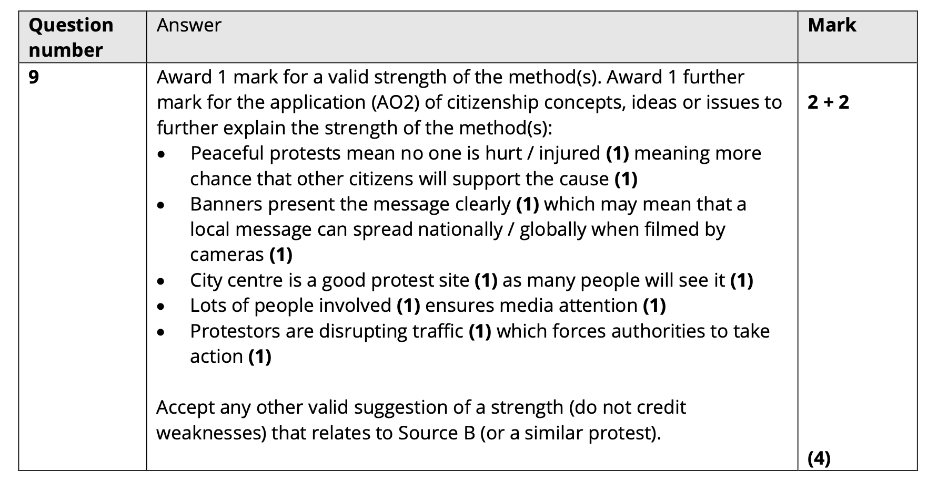
Exam practice

Slide 27
