Slide 1
Controlled assessment data presentation
LO: To learn a variety of ways in which data could be presented

Slide 2
Mark scheme
What this means….Success criteria
Logically ordered data presentation
Aesthetically pleasing data presentation
Uses a range of appropriate techniques
The methods used are linked to the aims
of the study

Slide 3
What to include….
Try and use a variety of graphical techniques e.g. pie, line, scatter and bar. Wherever possible combine data with maps to show how the data varies spatially
Use annotated photos
Use a mapping technique – you must create at least one of your own maps
Summary tables are often a good way to show results
Make sure all graphs, tables and maps are properly labeled (title, labeled axis, correct units)
Make sure all graphs are relevant to either proving or disproving your hypotheses. They must also be referred to in the data analysis section or they become irrelevant.
Remember a lot of raw data can go in the appendix. The examiner will not want to read pages and pages of information. He wants to see clearly presented and summarized results.
Also include secondary data – this should be annotated land use maps and possibly things such as walk scores

Slide 4
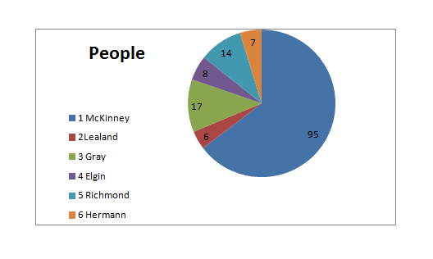
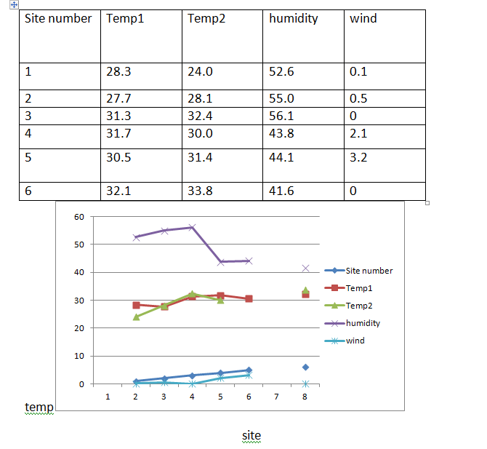
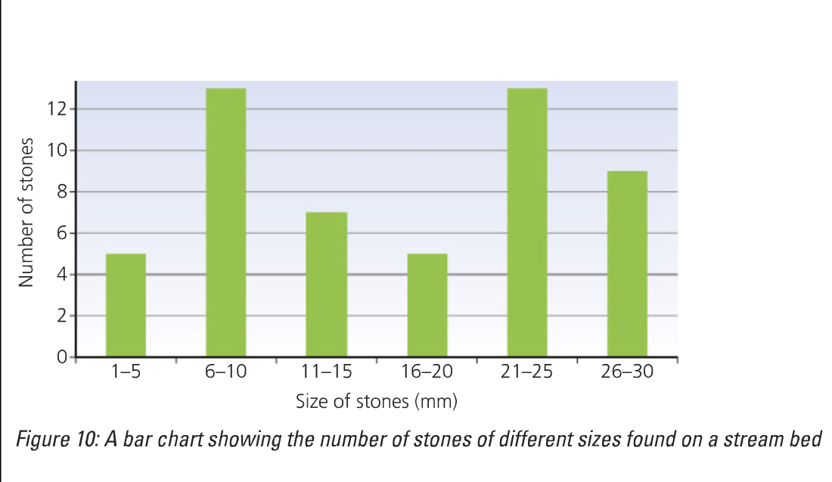
Level 1

Slide 5
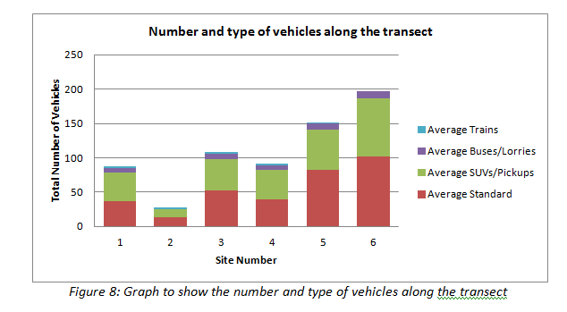
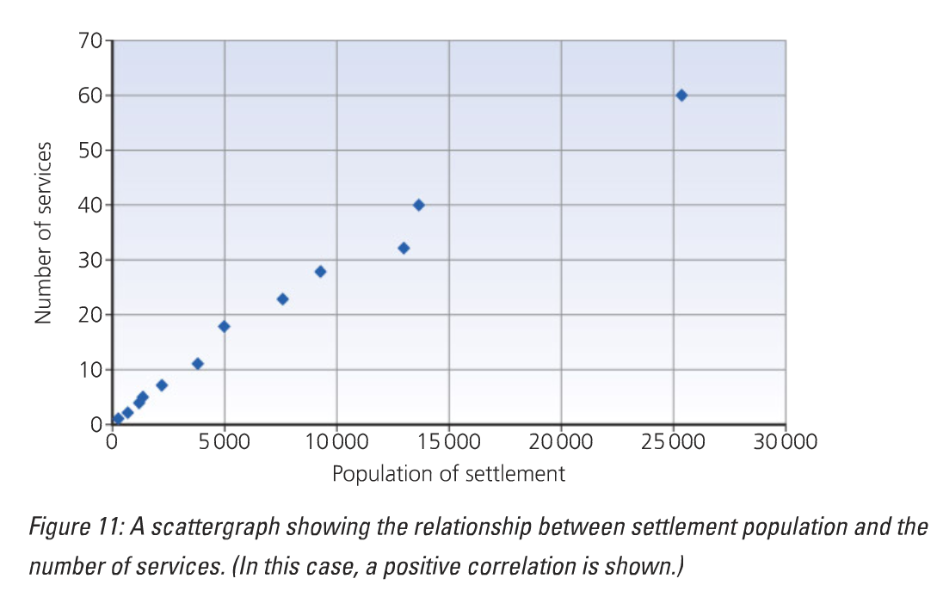
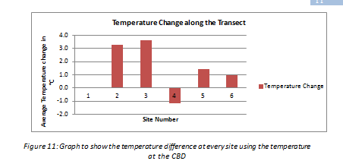
Level 2

Slide 6
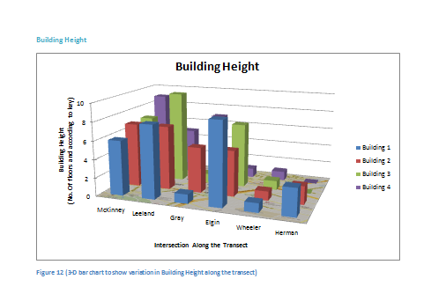

Slide 8
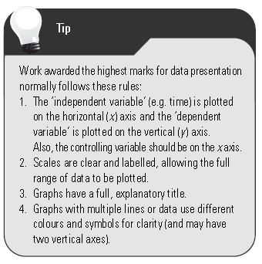

Slide 9
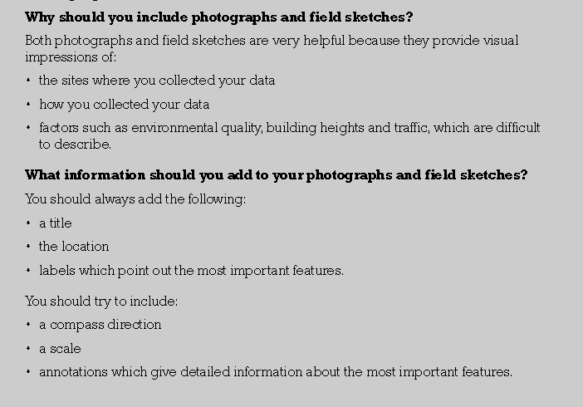

Slide 10
Task: Peer evaluate presentation from past students

Slide 11
Annotated photos Fig 3.8 Annotated photo to show leisure and environmental quality in site 7, West Gray shopping centre
Palm trees and landscaping planted to try and improve environmental quality
Range of leisure facilities such as shops, restaurants and cinema
High order, exclusive shops for wealth residential population
Large amounts of free parking in front of shops for convenience
Bike rack to improve accessibility

Slide 13
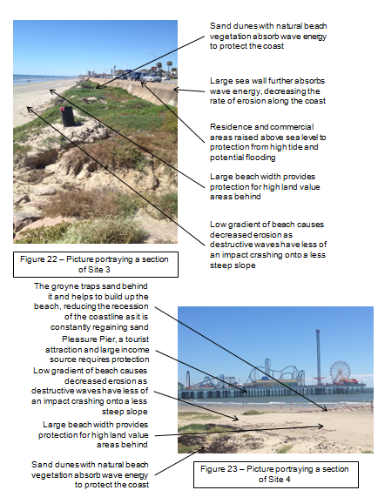

Slide 14
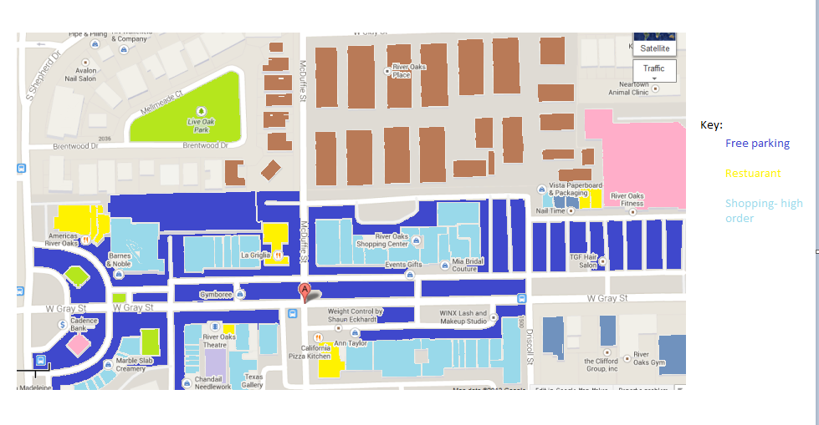
Land use mapping
Use a key:
The key could be split into different types of land-use e.g.
residential
commercial
parkland
parking
derelict land
sea defence (hard)
sea defence (soft)
beach
promenade

Slide 17
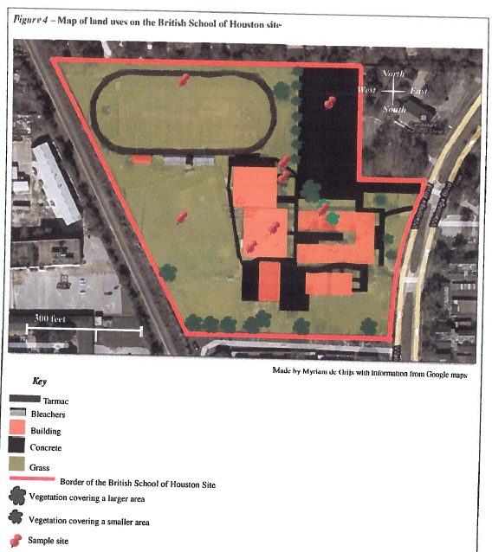

Slide 19
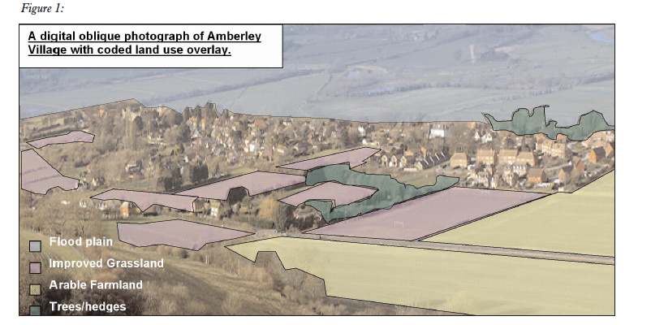

Slide 20
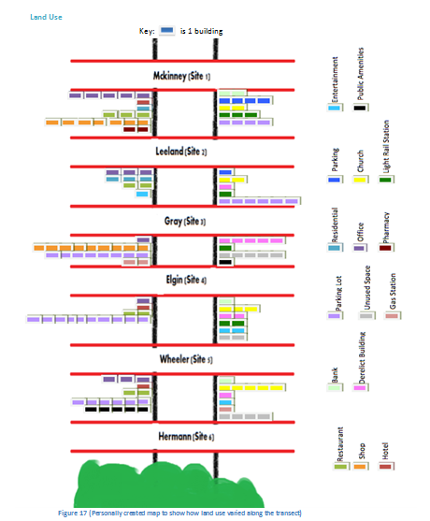

Slide 21
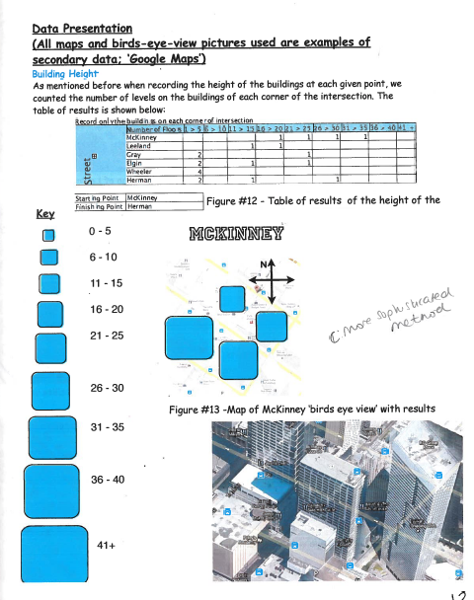
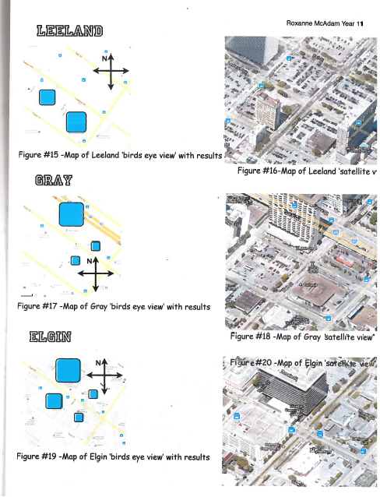

Slide 27
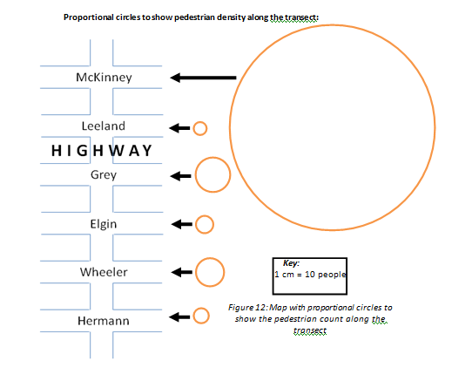

Slide 28
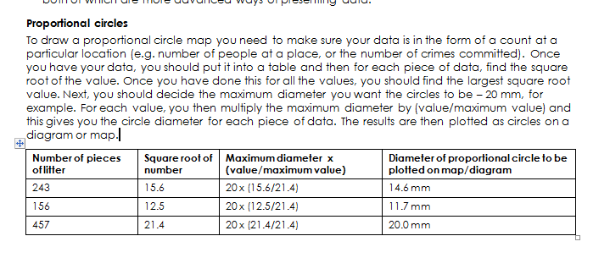

Slide 29
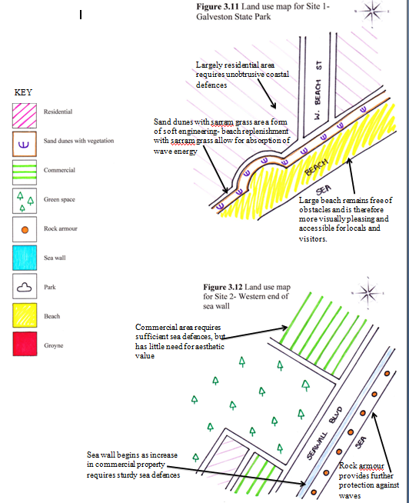

Slide 30
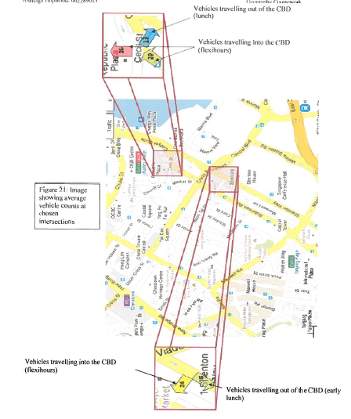

Slide 31
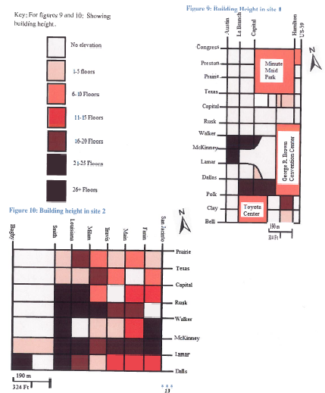

Slide 32
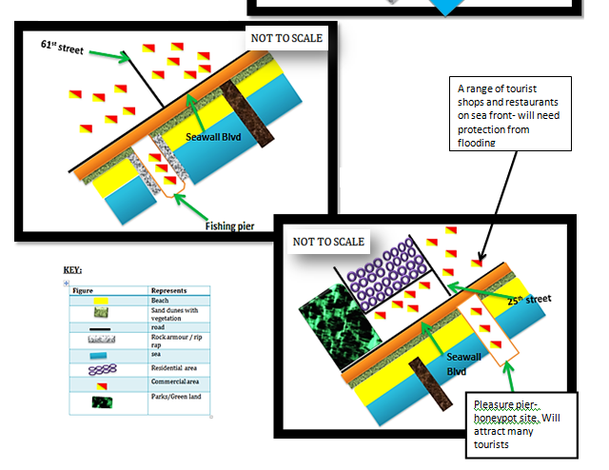

Slide 33
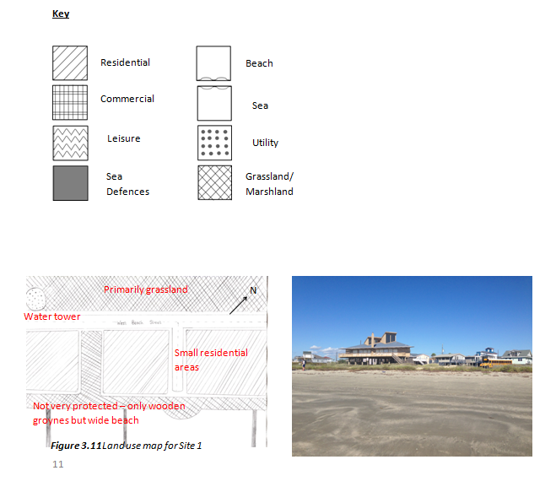

Slide 34
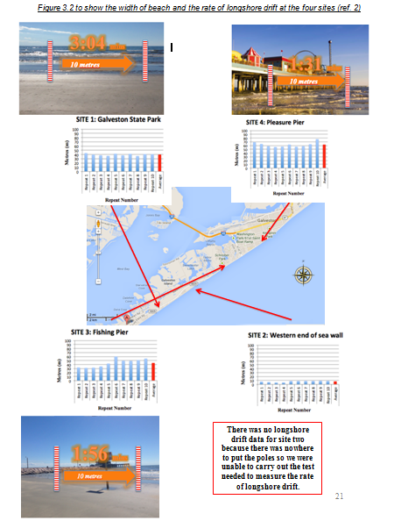

Slide 35
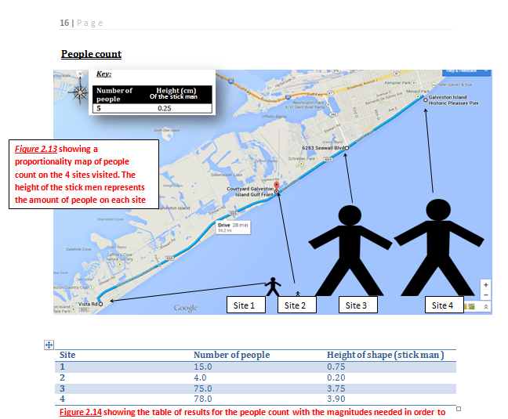

Slide 36
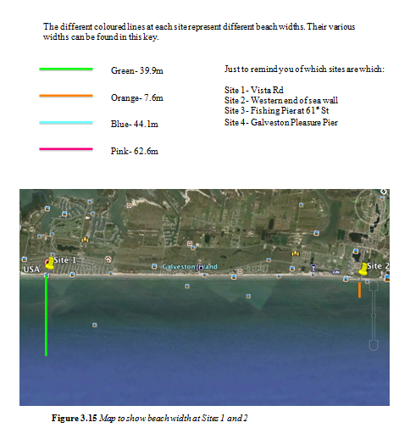
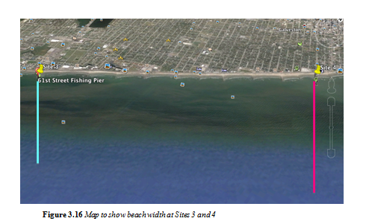

Slide 37
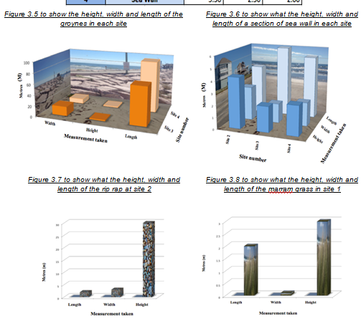

Slide 38
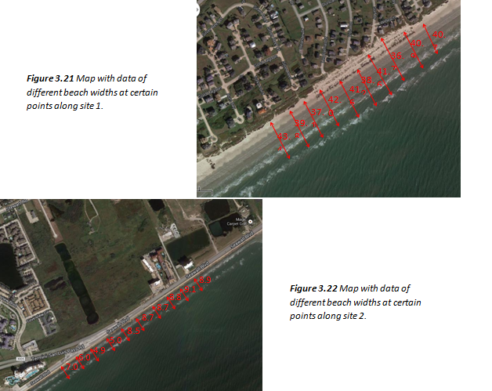

Slide 40
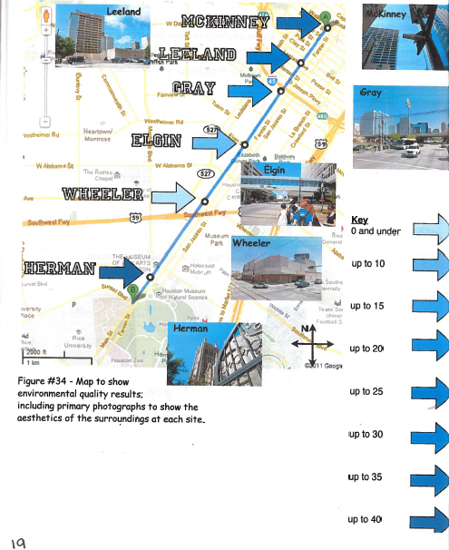

Slide 41
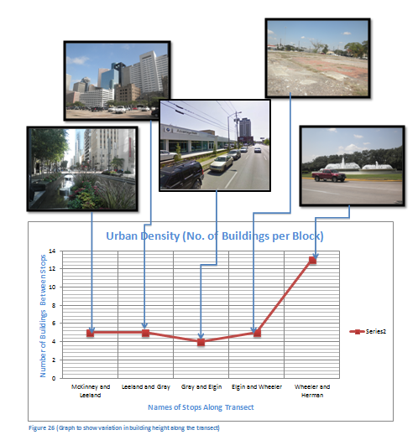

Slide 42
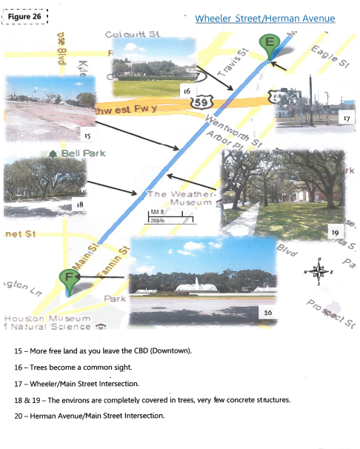

Slide 43
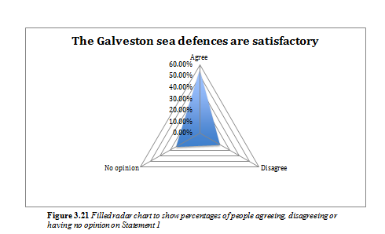

Slide 44
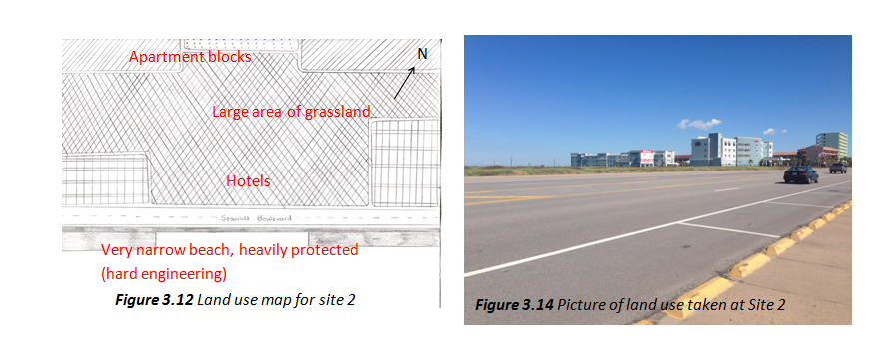

Slide 48
Sphere of influence

Slide 49
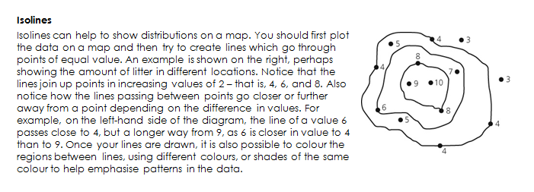

Slide 50
Things you need to include…..
Always give a clear title and figure number
Use a range of data presentation methods and make sure they are appropriate and clear for the data you are presenting.
Only use one method per set of data (i.e. not 3 different ways of presenting the people count).

