Slide 1

Data presentation

Slide 3
Criterion C: data presentation (worth 5 marks)
You have included a range of data presentation techniques: annotated photographs sketch maps graphs diagrams maps
I have tried to be inventive with my data presentation techniques
I have shown how the data varies spatially- i.e. combined the data with maps
I have done appropriate statistical test on some of my data
I have used tests of significance on the statistical analysis
The techniques used are suitable for the question and data
The techniques used allow for detailed analysis
Ensure all data presentation techniques are clearly labeled (axis, title, fig no, key etc…)

Slide 4
What to include….
Try and use a variety of graphical techniques e.g. pie, line, scatter and bar
Use a mapping technique – you must create at least one of your own maps
Statistical analysis with confidence levels
Summary tables are often a good way to show results
Make sure all graphs, tables and maps are properly labeled (title, labeled axis, correct units)
Make sure all graphs are relevant to either proving or disproving your hypotheses. They must also be referred to in the data analysis section or they become irrelevant.
Remember a lot of raw data can go in the appendix. The examiner will not want to read pages and pages of information. He wants to see clearly presented and summarized results.

Slide 5

IB ADVICE:
It is strongly recommended that maps are student generated, either by being hand drawn or computer‑derived, and they must be made relevant to the study.
Maps that are downloaded or photocopied should be adapted to the student’s own information and this may be achieved effectively by overlays. Normal map conventions must be followed.

Slide 6
ARCgis softward
login: BISHhumanities
Password: humanities1
https://bishouston.maps.arcgis.com/home/organization.html

Slide 7
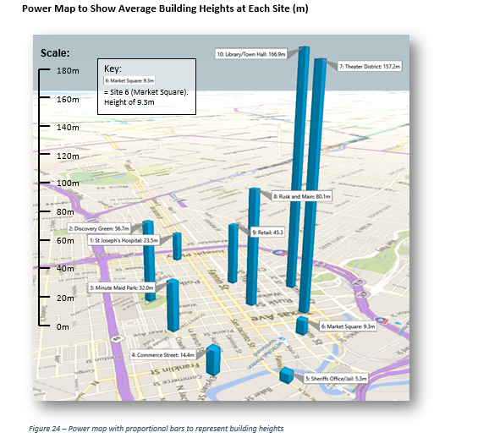
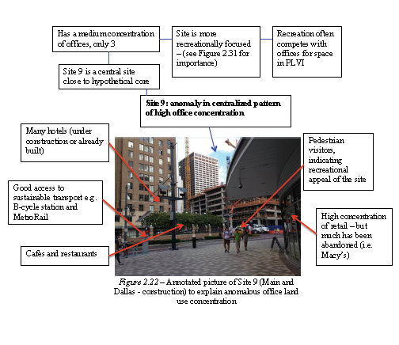
Data presentation examples

Slide 8
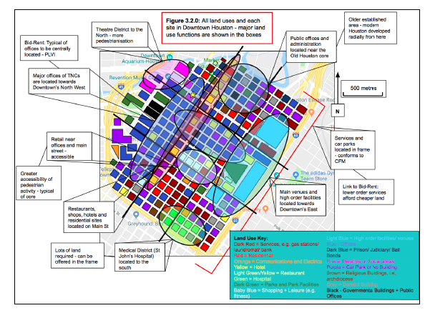

Slide 9
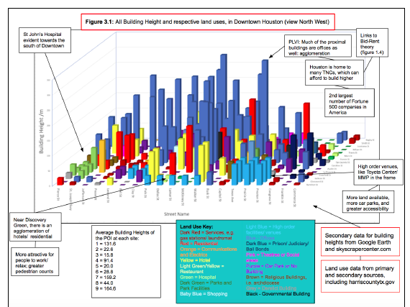

Slide 10
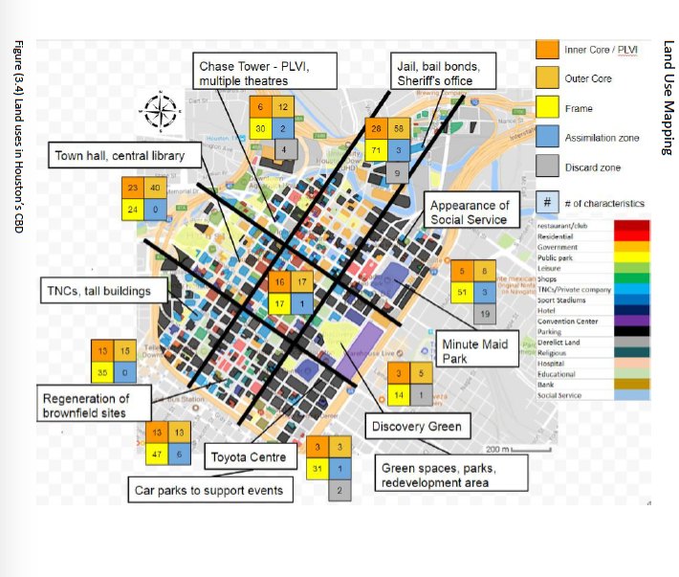

Slide 11
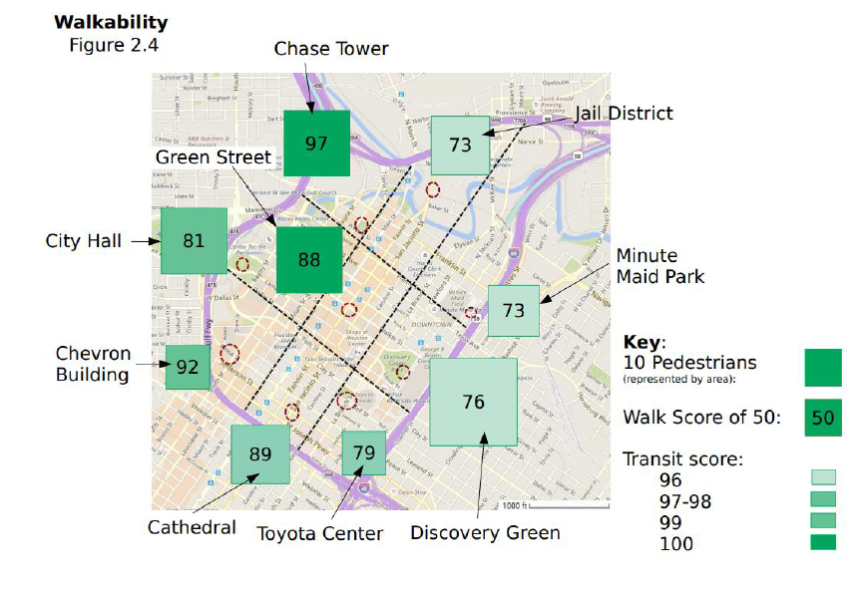

Slide 12
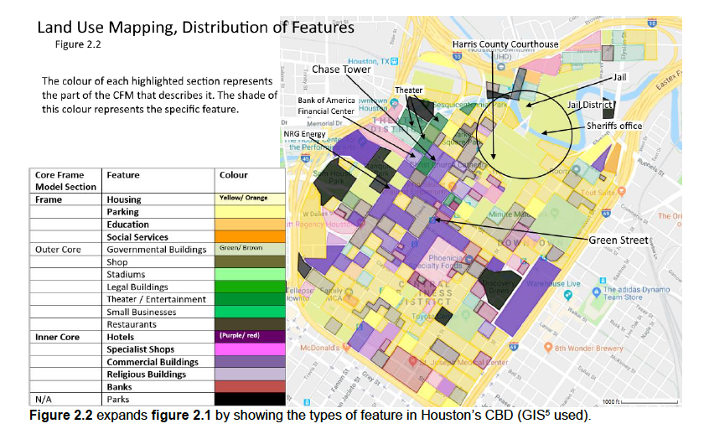

Slide 13
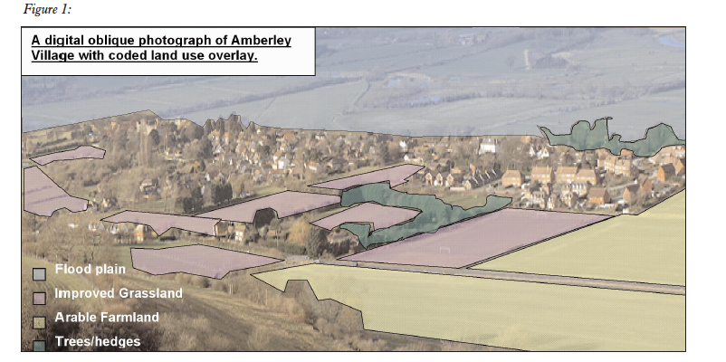
Examples of data presentation techniques

Slide 14
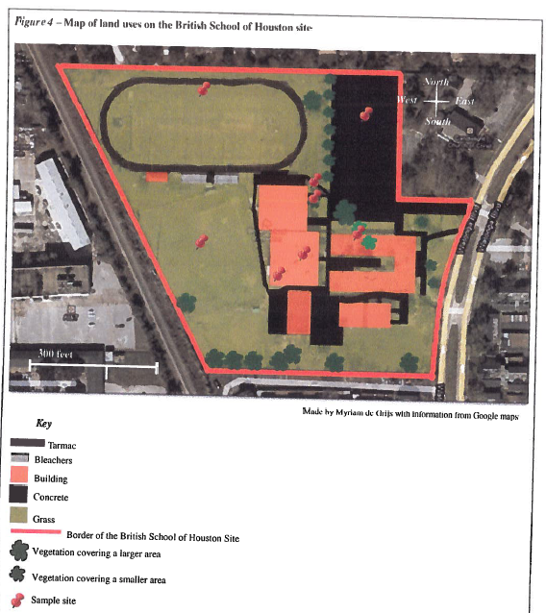

Slide 15
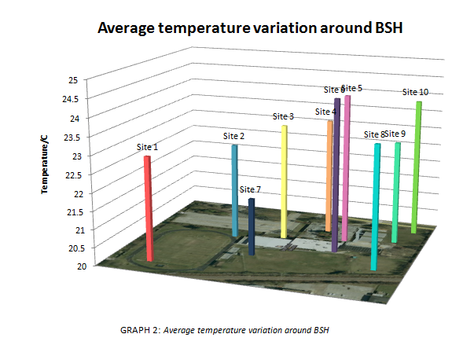

Slide 16
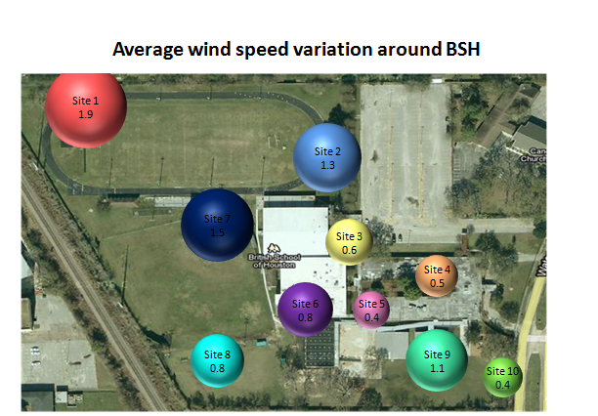

Slide 17
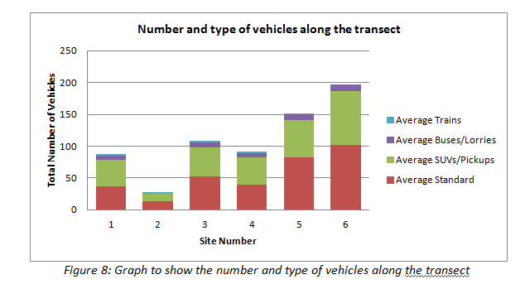

Slide 18
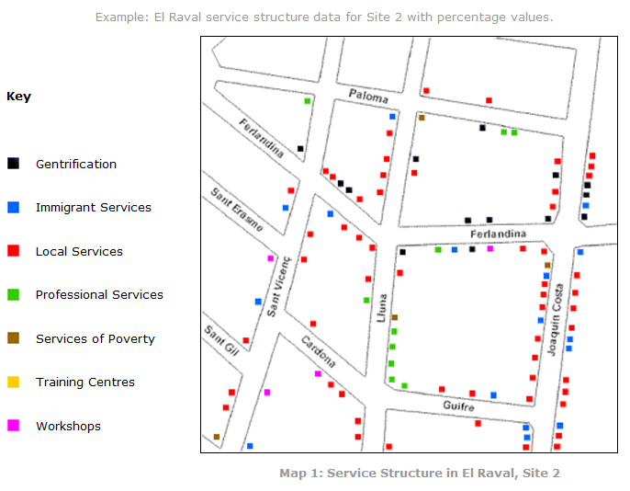
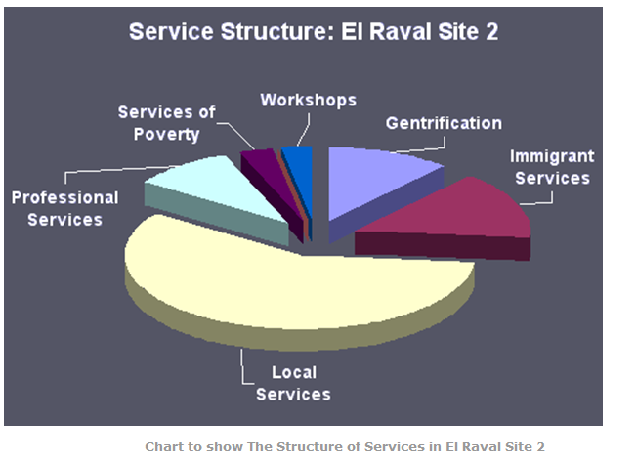

Slide 19
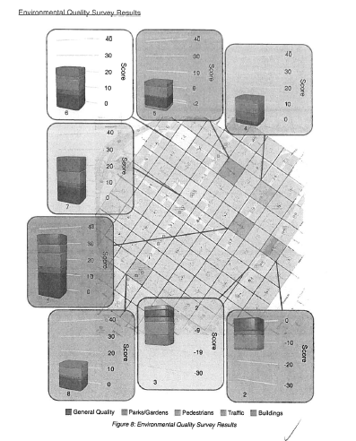

Slide 21
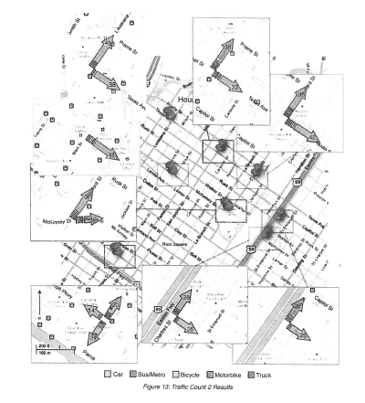

Slide 22
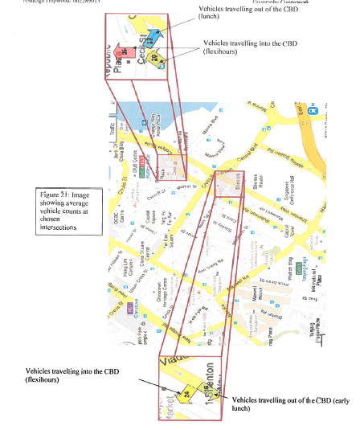

Slide 23
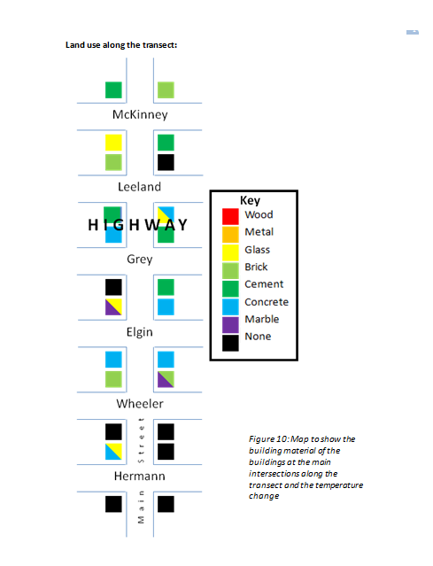

Slide 24
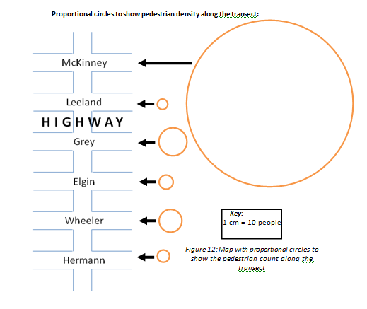

Slide 25
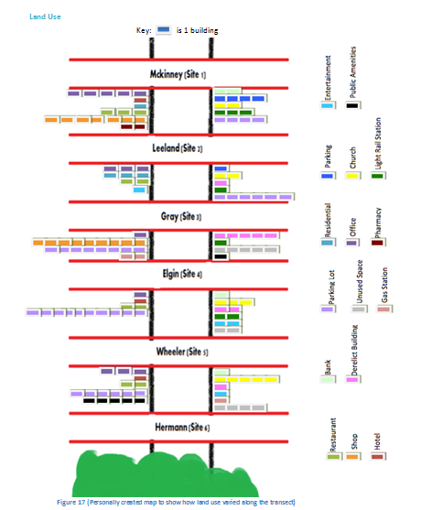

Slide 26
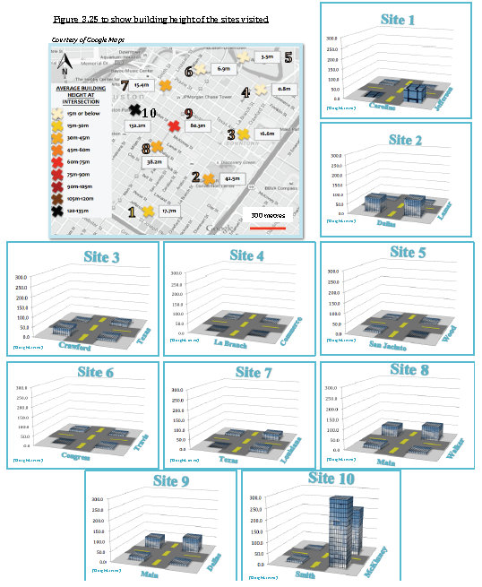

Slide 28
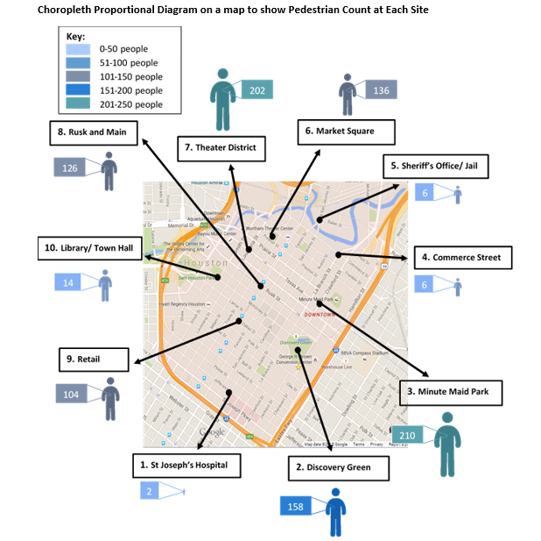

Slide 29
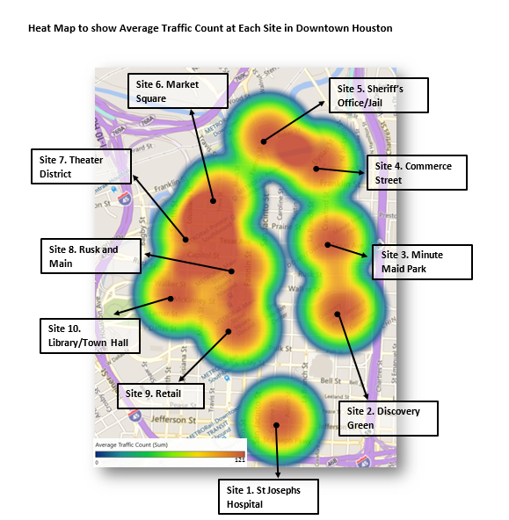

Slide 30
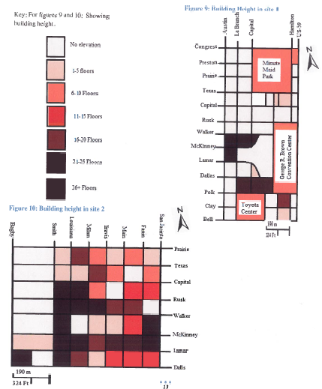

Slide 31
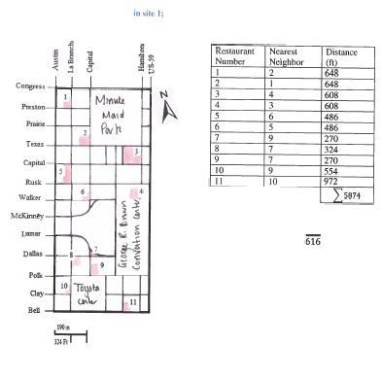

Slide 32
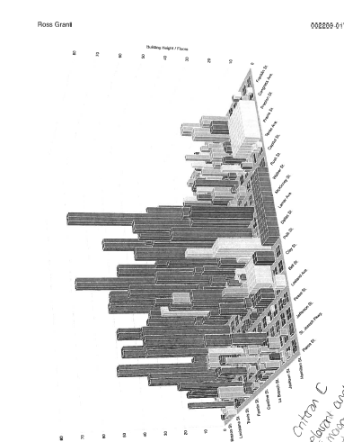

Slide 33
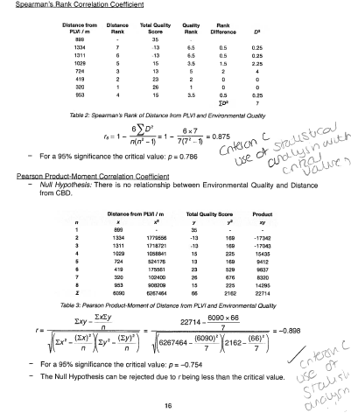

Slide 34
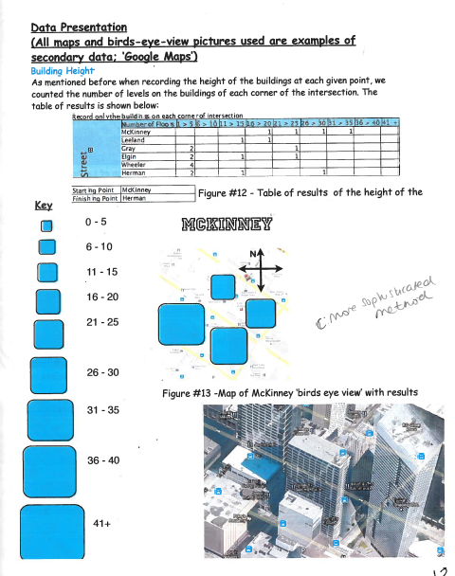
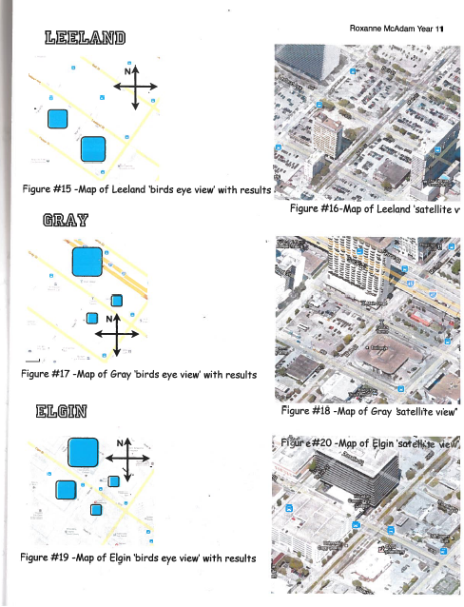

Slide 35
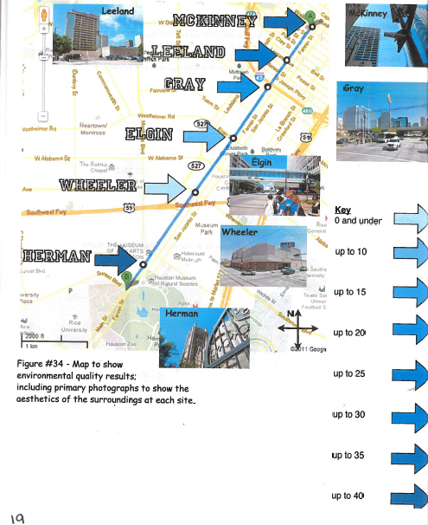

Slide 36
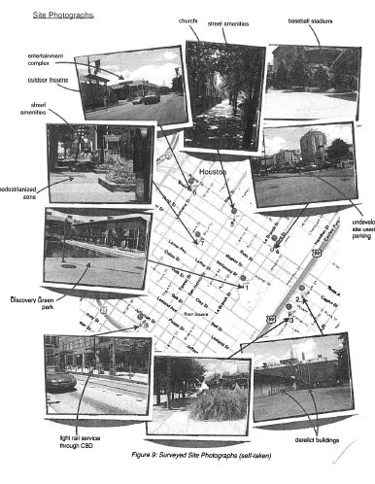

Slide 37
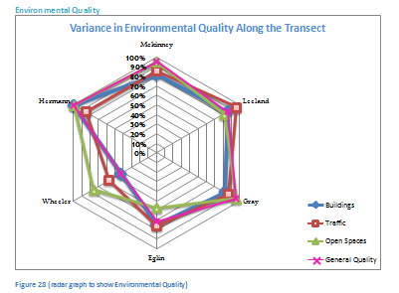

Slide 38
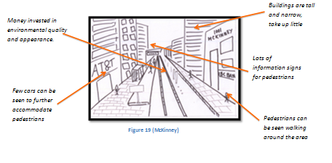
Using images

Slide 39
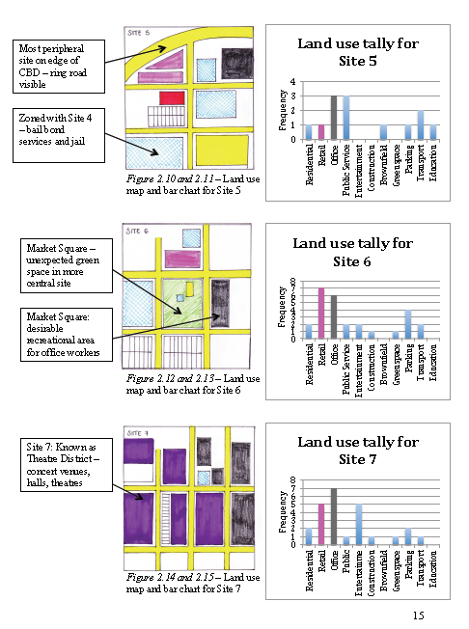

Slide 41
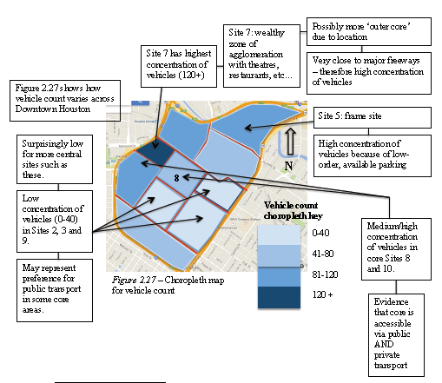

Slide 42
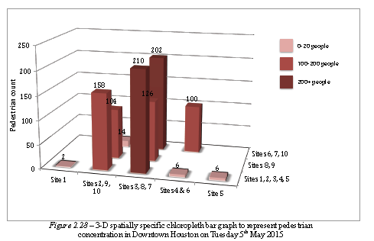

Slide 43
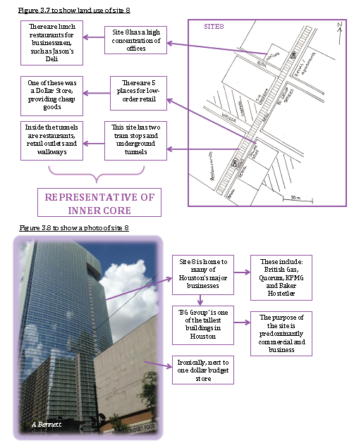

Slide 44
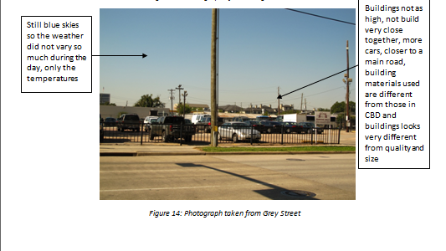

Slide 45
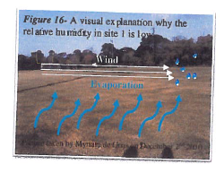

Slide 46
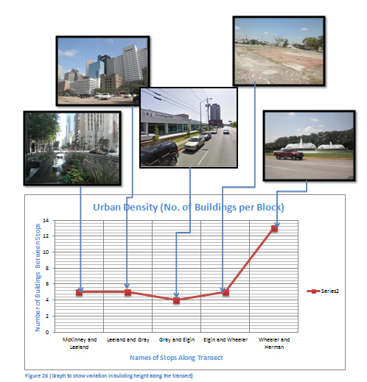

Slide 47
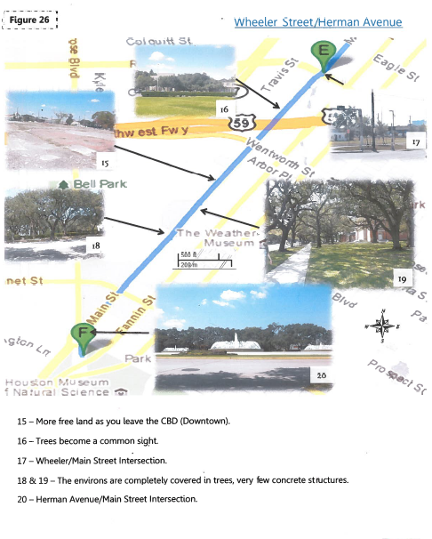

Slide 48
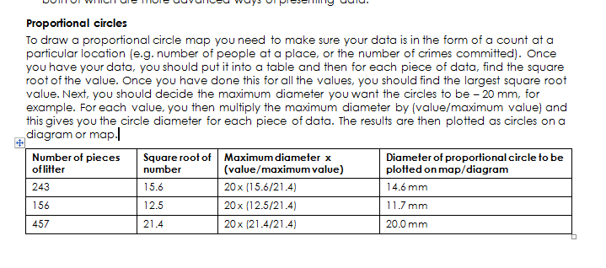

Slide 49
Statistical tests for geography
CORRELATION: to test for association/correlation/independence between 2 sets of data, formulate the Null Hypothesis and then:
  If the data is at the ordinal or interval level AND BOTH SETS are normally distributed: use the Pearson Product-Moment Correlation Coefficient AND use a Linear Regression analysis IF you wish to predict values by constructing a line of best fit
  If the data is at the ordinal or interval level and you're not sure if both sets of data are normally distributed: use the Spearman's Rank Correlation Coefficient
https://sites.google.com/site/geographyfais/fieldwork/6-data-analysis/statistical-tools

Slide 50
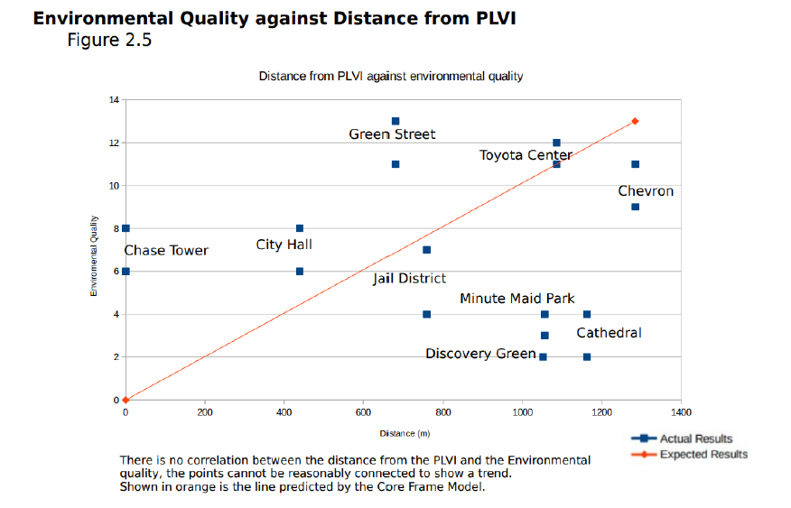

Slide 51
