Slide 2
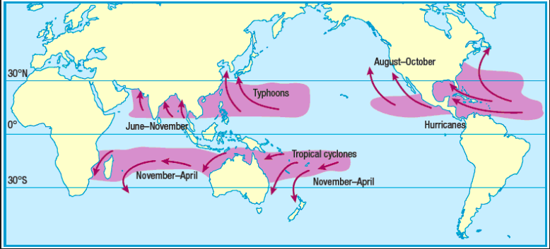
Task: Describe the global distribution of tropical storms (4)
Extension: Why do you think these happen in this location?

Slide 3
The cause of tropical storms
https://www.youtube.com/watch?v=SSx_gisp24w
Watch the video and then write an explanation of how hurricanes are formed

Slide 4
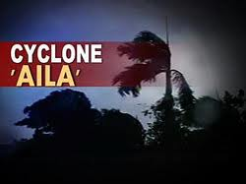

Slide 5
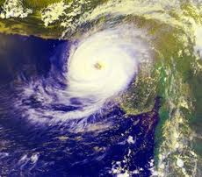
Cyclone “Aila”

Slide 6
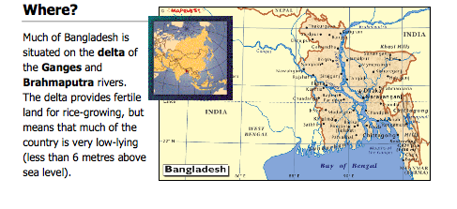

Slide 8
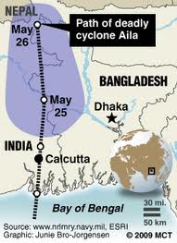

Slide 9
Case study notes CYCLONE AILA :

Slide 11
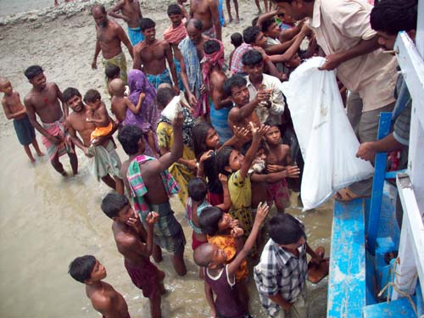
The cyclone named Aila destroyed a large part of West Bengal. The sufferers after this cyclone Aila waiting for the relief materials which was not sufficient for the villagers http://photos.merinews.com/newPhotoLanding.jsp?imageID=16472&offset=4

Slide 12
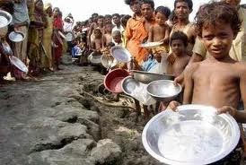
Cyclone Aila victims in Bangladesh
In the aftermath of Cyclone Aila, thousands of villagers in Bagerhat, Satkhira, Khulna, Bhola and Noakhali now cry for food and drinking water for survival, as relief operations are insufficient to deal with the enormity of the situation
http://www.etcspot.com/?s=bangladesh+aila

Slide 13
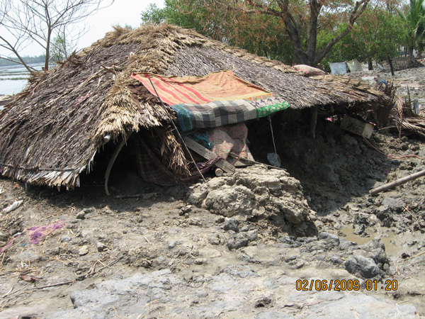
Cyclone Aila, crossed through the coastal belt on 25th May, 2009, causing devastating damage to homes, crops and livestock in the far south of Bangladesh. http://ujjibitopran.org/?p=1

Slide 14
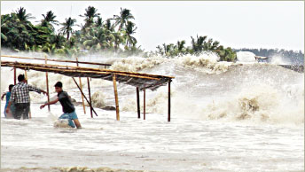
The tidal surge made the situation worse. The water was 10 – 12 feet higher than normal. Many roads and dams have been destroyed, tresses uprooted, houses blown down, and cattle and crops washed away.
http://www.ncm.org/news/press/cyclone_aila_hits_bangladesh/

Slide 15
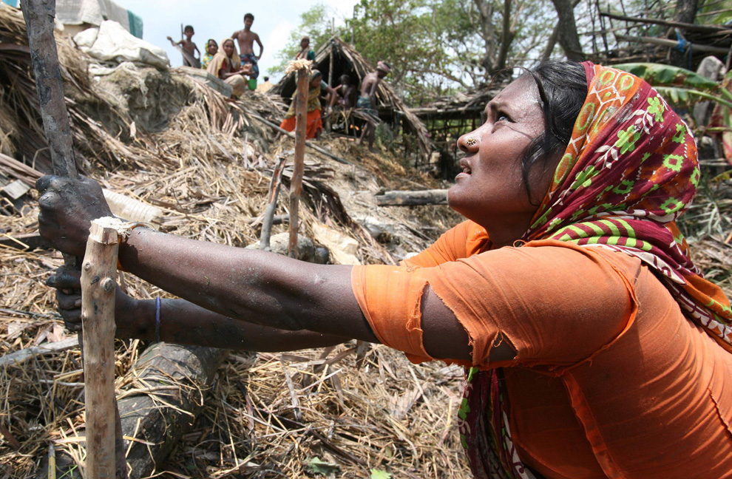
Villagers rebuild houses at a cyclone affected village in Shatkhira, Bangladesh, Friday, May 29, 2009. (AP Photo/Pavel Rahman)
http://www.boston.com/bigpicture/2009/06/cyclone_aila.html (Good website for more pictures – some in India)

Slide 16
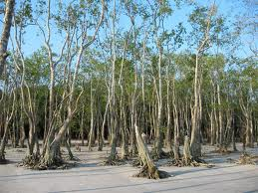
Sundarban is the biggest mangrove forest in the world.
Sundarban is in South West part of Bangladesh, in the district of greater Khulna. India shares a bit of the forest with Bangladesh. http://www.sundarban.org/support_comm.php

Slide 17
Example exam question:
Describe the impacts of a natural hazard on a named coastal area which you have studied. (7)
Explain the benefits and hazards of living on a named coastline (7)

