Slide 1
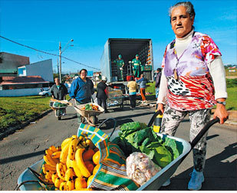
To start:
Discuss what you think is happening here.
Extra Challenge – How might it link to urban sustainability?

Slide 2
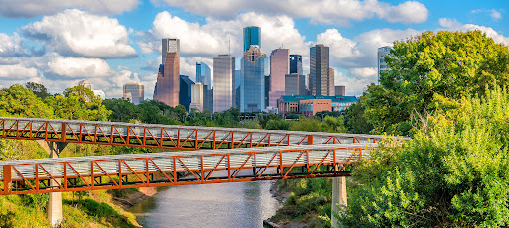
Sustainable Cities, Curitiba
What – Understand the possible strategies available to low income countries or newly emerging economies that can make urban living more sustainable.
Why – So that we can appreciate the varying options available to countries at lower levels of development.
How – By exploring a variety of sources based on the Brazilian city of Curitiba, an example of a city that has successfully implemented several sustainable initiatives.

Slide 3
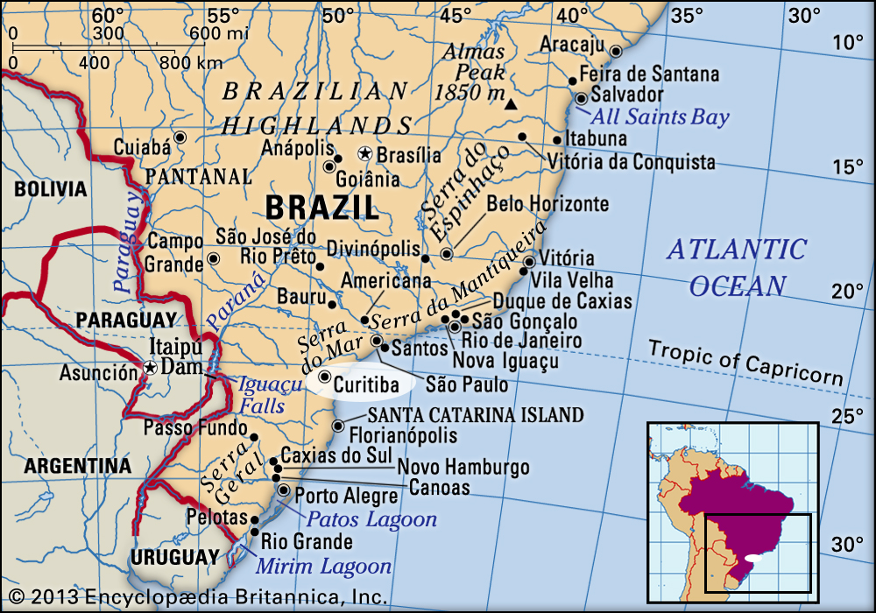
Challenge 1 – Curitiba’s Location
In your OneNote, describe the location of Curitiba. You can use Google Earth to help with this as well as the map below.
Make sure to include:
Global Location i.e. continent
National Location i.e. within Brazil
Compass directions
Location relative to other major cities in Brazil
Extra challenge:
Use the measuring tool on Google Earth to add the distance of Brazil from other major Brazilian cities, and then from us here in Katy.

Slide 4
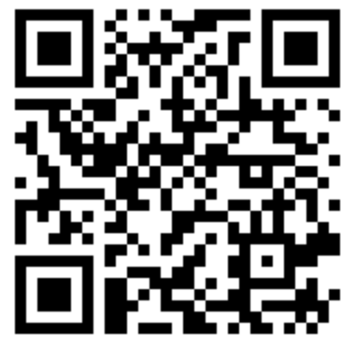
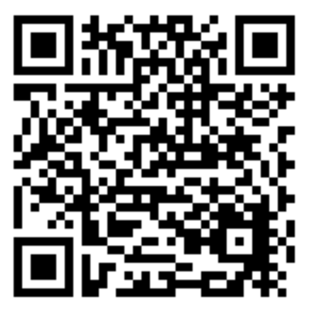
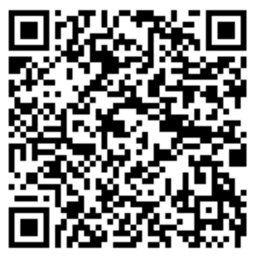
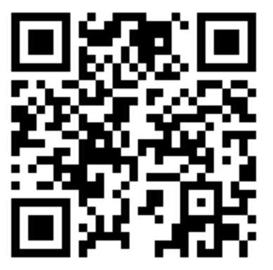
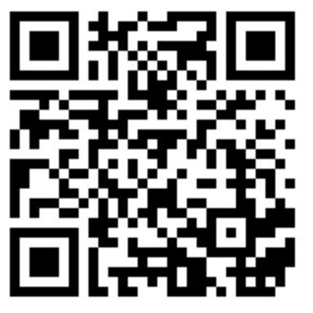
Challenge 2 – Curitiba’s Sustainability
Using the sources provided, create a piece of work that highlights Curitiba’s sustainable initiatives. The work should describe things that improve:
Waste disposal
Transport
Education
Health
Employment
housing
This could be a made as a table (see example on slide 6), a spider diagram, a bullet point list. It is up to you.
Those of you that want to read (coloured according to level of challenge. Green least, red most):
Those of you that want to watch (watch both):
Notes:
https://www.theguardian.com/cities/2016/may/06/story-of-cities-37-mayor-jaime-lerner-curitiba-brazil-green-capital-global-icon
https://www.ted.com/talks/jaime_lerner_a_song_of_the_city?language=en
https://www.youtube.com/watch?v=r4sumpEqnlY

Slide 5
Sustainable Solutions in Curitiba | Sustainable Solutions in Curitiba
Solution linked to… | Waste Disposal | Transport | Education | Health | Employment | Housing
Description

Slide 6
Challenge 3
Create a piece of work that creatively sums up the sustainable solutions implemented in Curitiba. This could be:
A poem (acrostic etc.)
A diary entry of a person that has just moved to Curitiba from a less sustainable city in Brazil
A song
A poster
A news report
Any other means that you feel is appropriate and have checked with your teacher.
Optional Extension Challenge – Create a Kahoot / Blooket based on what you have discovered about Curitiba.

Slide 7
Challenge 4
Add your work to your Google Earth case study project.

Slide 8
To Finish:
Of the 3 places we’ve looked at recently, where would you rather live and why?
Lagos – Go to the front of the room
Hong Kong – Go to the middle of the room
Curitiba – Go to the back of the room
Be prepared to share your reasons why, using what you have learned over the last few lessons! You can say the negatives of the places you’ve not chosen to help with this. This will help with your justification!

