Slide 1
History presentation
Culture and Art policy

Slide 2
Introduction
All authoritarian leaders, having taken power, seek to use government structures to enact their policies on society. All leaders hope to shape and recast society according to their political ideologies. All authoritarian states have ideas about the nature, form and direction that society should take. Whether traditional or progressive, all authoritarian states engage in extensive social engineering to produce citizens whose values mirror those of the state. This requires state control over communications, the media, education, culture and the arts in order to ‘condition’ citizens. In this presentation will be analyising Castro’s Cultural policies and his support towards more progressive and social ideas promoting his revolution through art and using education as a mean to control the society giving a high value to culture manipulating the idea of liberty of expression in order to achieve indoctrination.

Slide 3
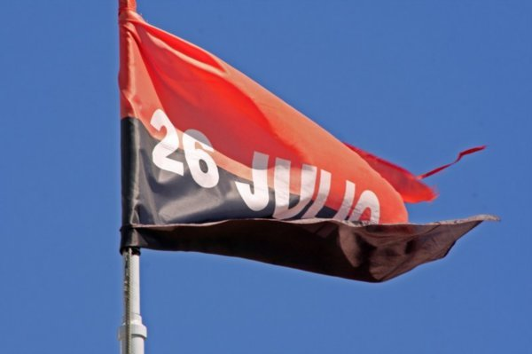
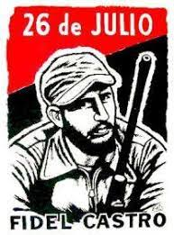
Relation with the movement
Fidel Castro outlined a political programme which became something of a manifesto for the nascent 26 July Movement.
By the time of the first formal manifesto issued by the 26 July Movement in 1955, while Fidel was in exile in Mexico, education had become inextricably bound up with culture, in advocating the ‘Extension of culture, preceded by reform of all methods of teaching.

Slide 4
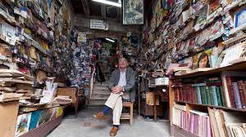
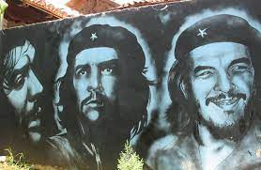
Determination of cultural policy
The basis of the revolutionary approach is that culture:
Belongs to everyone (as both spectators and creators) rather than being limited to an elite minority. Is a form of social production (with humanity’s happiness as its end product)
Stimulates not only social but also economic development (by increasing the cultural levels of the population in a country emerging from underdevelopment)

Slide 5
Promotes revolutionary (and hence critical) thinking
Haydée Santamaría Cuadrado – was charged with creating a pan-American cultural house, which became known as Casa de las Américas.
Key moment: the First National Congress of Writers and Artists in August 1961, they implicated their work in social justice towards the Revolution.
The relationship between culture and revolution was crucial and gave the ruling government a lot of strength.

Slide 6
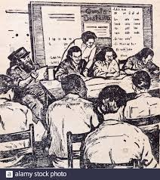
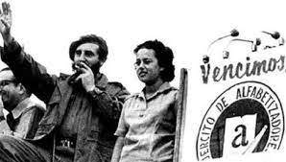
How high a value was placed on culture?
The drive to eliminate illiteracy began in 1961 desiganted the year of education, the revolutionary government took over all private and Church schools and after some difficulties it achieved virtual universal attendance at primary schools.

Slide 7
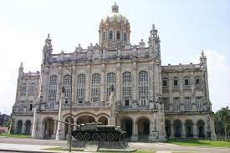
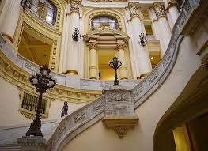
Revolution Museum
There was a very high value placed on culture and the Revolution relied on this in order to spread ideology.
The initial action of the Revolutionary Government in this regard was to redesign the premises and to improve the service in the National Museum, to restore and re-equip the museums.

Slide 8
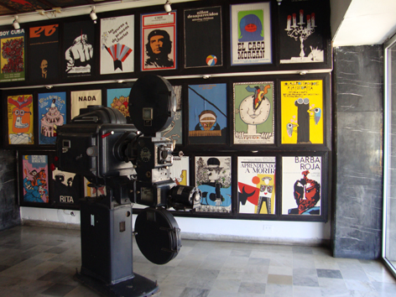
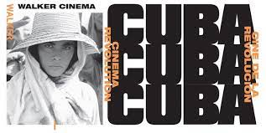
Were some aspects of culture and the media considered more important than others?
Film was understood as an art form in its own right, partly as the result of a close connection between the revolutionary leadership and an influential group of filmmakers.
It was on of the cultural aspects that had more importance than others, explaining land and housing reforms.
Alfredo Guevara Valdés director of ICAIC which was set up not only to commission films but also to disseminate them, via 616 cinemas.

Slide 9
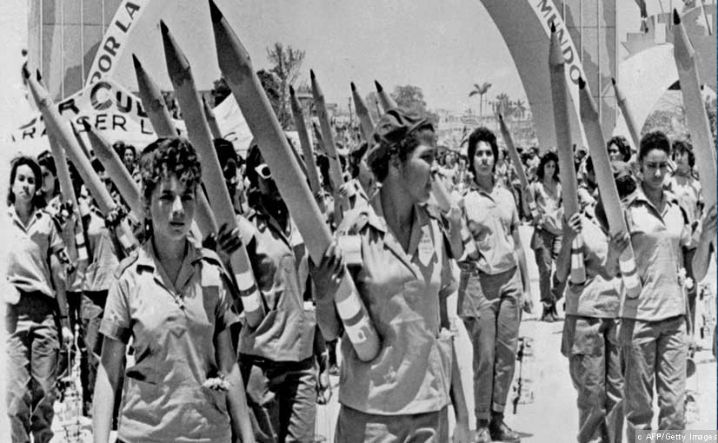
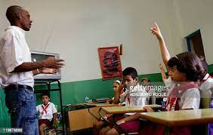
More than 3,000 schools were built in the first year and over 300,000 children attended school for the first time.
Cuba’s development of a greatly improved educational system which was free, this caused that the literacy campaign and school reforms continued through adult educational system.

Slide 10
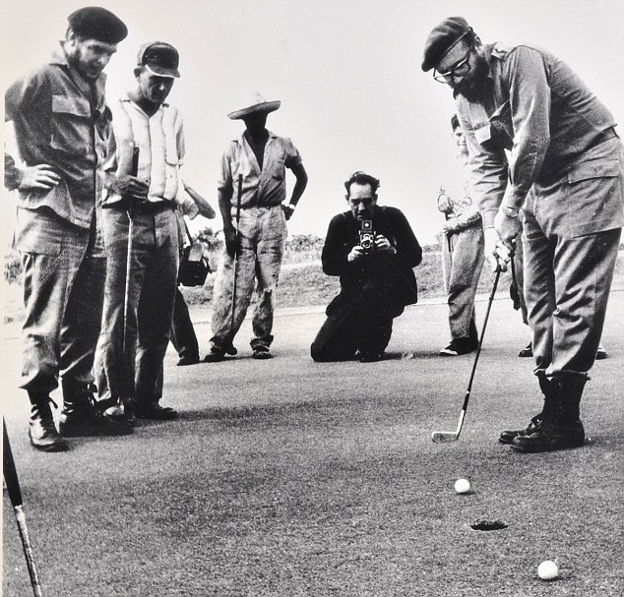
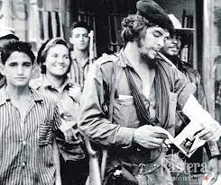
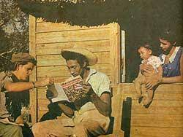
Use of literacy campaings in order to keep promises
Literacy campaign was launched which saw quarter of a million mainly young people going into the countryside to teach the peasant population to read and write.
they used the culture and the literacy campaign to keep up the Revolution promises in a sense

Slide 11
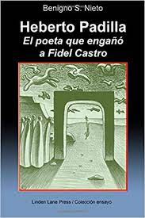
How, to what extent, and with what results, were (a) the media and (b) culture controlled by the state?
The establishment of the key cultural institutions was crucial for the cultural policy
the institutions where lead by established ideas.
Fidel Castro government arrested Cuban poet called Heberto Padilla.
The government castigated the small minority and called them intellectual traitors who had criticized the Revolution
The poet that played Fidel Castro

Slide 12
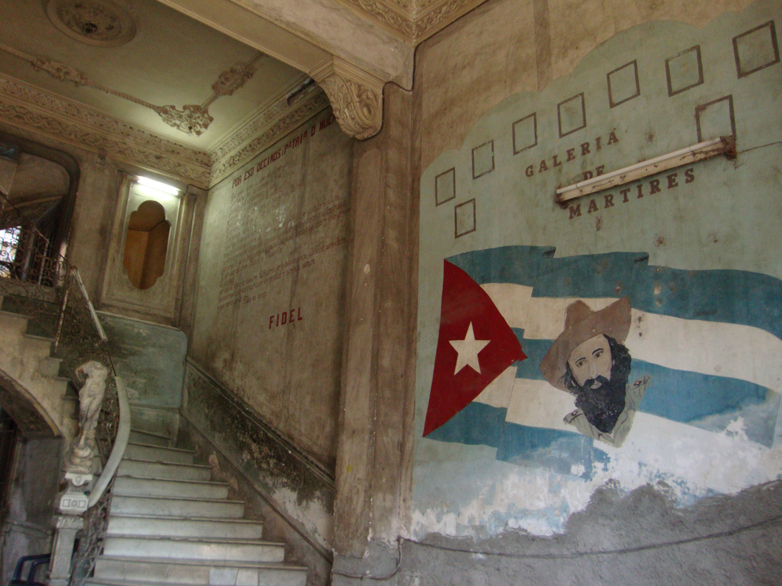
The PSP development of ideas in 1950s, with the leading artists, musicians and filmmakers of the day,
Culture was placed in hands of the PSP in January 1961, their members were charged with running a new National Council of Culture (CNC).
Consternation in the cultural field and rise to some very public disputes members of the PSP against artists form another cultural perspectives defended an brooder perspective.

Slide 13
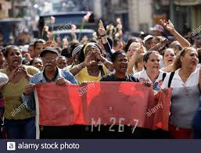
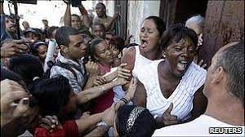
2003 crackdown on 75 human rights defenders, journalists, trade unionists, and other critics of the government. Accused of being “mercenaries” of the United States government.
The 1968 congress provided a forum for defining the role of artists and writers in revolutionary situations.
April 1971: the grey period, during this time, intellectuals that didn’t agreed with the Revolution were persecuted and deprived of money and status.

Slide 14
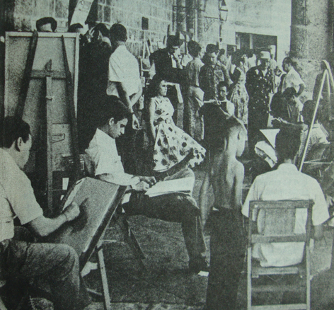
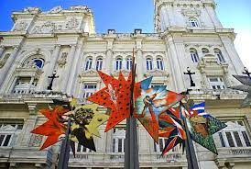
What was the impact on the quality and variety of culture?
Opening and organization of museums and galleries exposing the artworks that had previously been reserved for an elite audience to the people of Cuba following the ideology that art belong to everyone.

Slide 15
Expression despite the oppression
In some ways, a culture of hardship can spawn artists that find creative methods of expressing themselves despite a culture of oppression. That’s what Coco Fusco, a Cuban-American artist and curator, argued last year in her book Dangerous Moves: Performance and Politics in Cuba. Fusco highlights the manner in which the state censors dissent and controls artistic expression, thereby driving artists to find oblique, indirect, metaphorical methods of providing social commentary

Slide 16
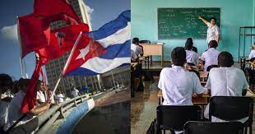
Quality in education therefore creating a country with culture
Jennis Ramone argues that Castro cited the lack of rural education and access to adequate schools as a primary impulse for seeking social change in 1953.
By 1961, Castro’s literacy campaign had almost entirely eradicated illiteracy by sending thousands of young teachers into rural areas to teach farmers and their families to read and write.

Slide 17
What balance was struck between indoctrination and entertainment?
The creation of The Union of Cuban Writers and Artists was created to defining the characteristics of Cuban nationhood, bringing a critical eye to bear on our cultural heritage.
1960 all the media came under government control, the only avenue of criticism was via the letters and they couldn’t criticize a policy directly.
Limited freedom of expression in the publication in the arts and the academic worlds for those who supported the revolution and who wrote on topics other than contemporary politics.
In 1961 Castro said about culture: Within the revolution, everything; against the revolution, nothing. Material opposed by the revolution or written by opponents was not published.

Slide 18
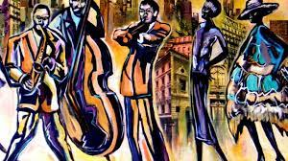
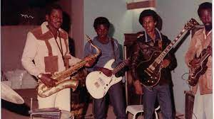
Humanist cultural policy and the indoctrination
Artists and writers were – and are – valued: ”they are state employees”.
December 1975:the first congress of the governing party, formalized the basis for the Marxist-humanist cultural policy that thrives to this day.
The congress sought to establish the most conducive atmosphere for the progress of art and literature. Giving a special recognition to culture in Cuba

Slide 19
To what extent was culture the product of collective endeavour?
Over 100,000 volunteer student, teachers, recruited into brigades, over one million children to learned read and write.
Importance to it: More than 3,000 schools were built in the first year and over 300,000 children attended school for the first time.
Cuba development in the greatly improved educational system and school reforms.

Slide 20
Benefits of the policy
Castro’s revolution replaced a military dictatorship built on organized crime and racist discrimination with equality of opportunity to, education, culture and the arts.
Cuba made important advances under Castro in the progressive realization, social, and cultural rights such as education For example, UNESCO has concluded that there is near-universal literacy on the island despite there were codified in law and enforced by security forces, groups of civilian sympathizers tied to the state, and a judiciary that lacked independence.

Slide 21
References
https://shiftyparadigms.wordpress.com/policy/a-brief-history-of-cultural-policy-in-cuba/
https://www.fraserinstitute.org/blogs/cuba-castro-the-arts-and-freedom
https://theconversation.com/education-and-art-for-all-castros-cultural-legacy-69513
https://postcolonialstudiescentre.wordpress.com/2016/11/30/fidel-castros-legacy-education-culture-and-the-arts/
https://www.hrw.org/news/2016/11/26/cuba-fidel-castros-record-repression

Slide 22
Questions

