Slide 1
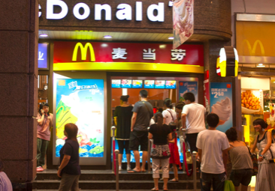
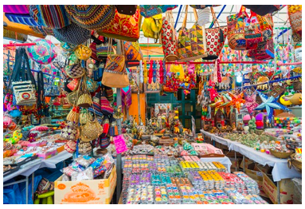
CHANGING CULTURES AND IDENTITIES
Syllabus Link: How global interactions bring cultural influences and changes to places

Slide 2
Key question:
To what extent is there a global culture?

Slide 3
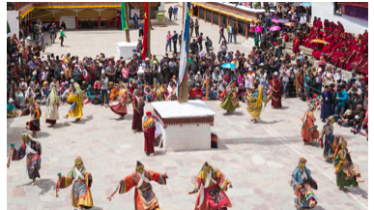
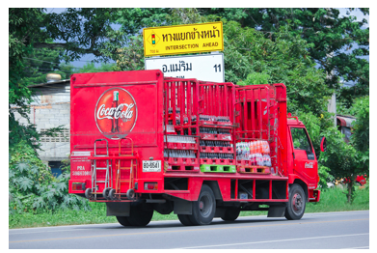
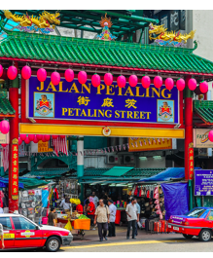
Global spectrum of cultural traits

Slide 5
Culture describes the characteristics of a group of people; it gives people a sense of identity. Cultural traits are the different aspects of culture. They include inherited ideas, beliefs, values, language, religion, social habits, images, clothing, cuisine, music and knowledge. They can be passed on from one generation to the next and they can be learned and adapted. Cultural traits change over time and also unite people.

Slide 6
What is culture?

Slide 7
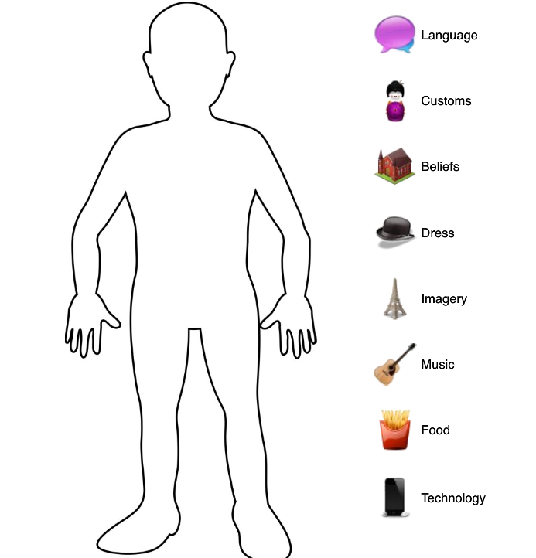
Draw a cultural stereotype ... consider the language(s) they speak, the customs the follow, the beliefs they hold, how they dress, the music they listen to, the food they like to eat and the technology they use.

Slide 8
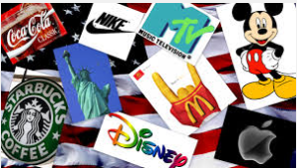
Important to note that cultures are not static. Cultures and cultural traits constantly changing and evolving.
Think of examples of changes in the culture and the cultural traits of a country you are familiar with.

Slide 11
What could be seen as the cultural objects of 2020?
Think gadgets, TV and film, music, dress, books, games and hobbies
Would these be the same globally ?

Slide 12
Global culture
A shared sense of belonging at the planetary scale that is demonstrated through common ways of communicating, consuming media and food, dressing or behaving (including shared social norms such as a commitment to upholding human rights).

Slide 13
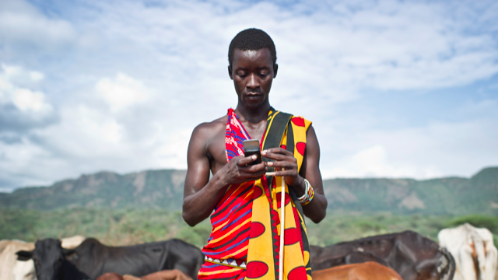
A global culture
The world is changing fast
New technologies mean the world is becoming more interconnected
Proponents of the idea of a ‘global culture’ suggest that different places around the world are converging and becoming more similar

Slide 14
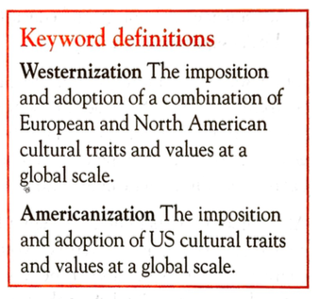
A Global culture is the product of….
The export of supposedly ‘superior’ cultural traits and products from advanced countries, and their worldwide adaption (Westernization, Americanization) Cultural imperialism
The mixing and hybridization of cultures through greater interconnections and time space compression.

Slide 15
Cultural traits

Slide 17
584-585 in textbook/ kognity and the news articles
Also use the information on the following slides using the notes and news articles…..

Slide 18
Diffusion of cultural traits news articles
The Eight Case Studies 1. Language - Twitter & the French language - or this
https://www.theguardian.com/world/2018/feb/26/icelandic-language-battles-threat-of-digital-extinction 2. Customs - Case study - St Patrick's Day or this case study of British style weddings in France. 3. Beliefs - Islam in France 4. Dress - Case studies from around the world. 5. Music - English Music in France 6. Food - Global spread of McDonalds 7. Technology - Internet and China. 8. Images - Western style advertising in Middle East & Images - Western Women in advertising.

Slide 19
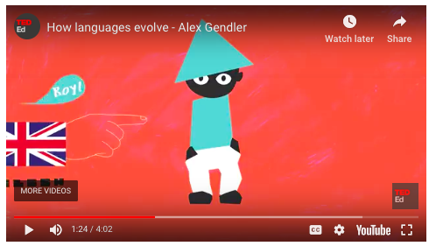
Language
Language is one of the most important aspects of national identity. Globally there are over 7000 different languages. Language evolves over time as words are adapted or integrated from other languages. 45% of all words in the English language are of French origin. Country borders do not restrict languages and in some countries more than one language is spoken. For example, Canada has two official languages: English and French.
English is considered a world language and is learned as a second language by many to access employment, information and markets. It is expected that in time some languages may disappear completely. For example, Cornish, a Celtic language spoken in Cornwall, UK, is considered to be critically endangered by UNESCO.
Read these relevant news articles:
Language - Twitter & the French language - or this
Icelandic language battles digital extinction

Slide 20
The spread of language

Slide 21
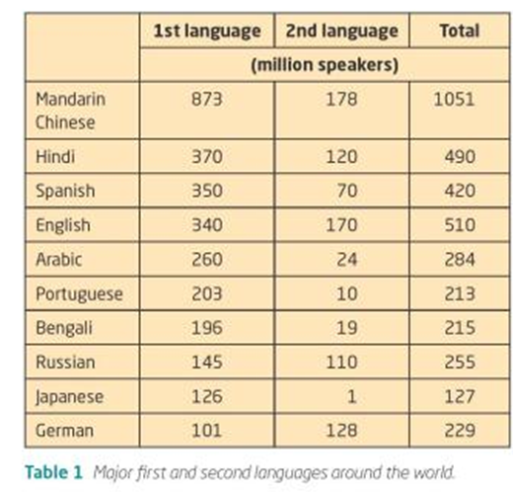

Slide 22
Food
Watch: Whopper Virgins
Many countries have distinctive foods and national dishes. Some foods form part of religious beliefs. For example, the Jewish faith requires food to be kosher and in the Islamic faith food is prepared so that it is halal. Globalisation has resulted in the spread of food around the world. For example, Indian, Chinese and Mexican restaurants are now common in many global cities. However, sometimes food is adapted to meet local tastes; an example is the chicken balti in the UK. Unlike in Pakistan, the chicken is served off the bone which is preferred by the British population. The chicken balti is the result of cultural hybridity. In the UK specialty food stores have sprung up to meet the growing demands of immigrant populations and changing tastes of local people.

Slide 23
The spread of McDonalds across the globe

Slide 24
Customs:
These are common patterns of behaviour found with particular countries or regions that are then passed down through generations. Examples may include bowing to elders, not tipping, taking of shoes inside houses and celebrating certain days e.g. St. Patrick's Day. Some of these customs may get diluted as young people see different behaviour in the media, while others may grow.
10 Surprising Ways To Offend People In Other Countries

Slide 25
Technology:
The development of technology can certainly change culture. The development of agricultural equipment e.g. tractors and combine harvesters has meant that the number of agricultural societies around the world has decreased. The development of contraception and the medical procedure of abortion has brought about debate in the Catholic church. Also the development of computers and phones has possibly reduced face-to-face contact both in social and business settings.

Slide 26
Beliefs:
There are five major religions in the World i.e. Islam, Christianity, Buddhism, Hinduism, Judaism and Taoism. Out of these probably only Islam and Christianity can be regarded as truly global. However, even these world religions have many different sects e.g. Islam has Sunni, Shia, Wahhabi, etc., while Christianity has Roman Catholic, Baptist, Church of England, etc. However, despite the growth of some religions e.g. Islam, many are seeing a reduction in the number practicing. Secularism is also on the rise in many countries like France and the UK.

Slide 27
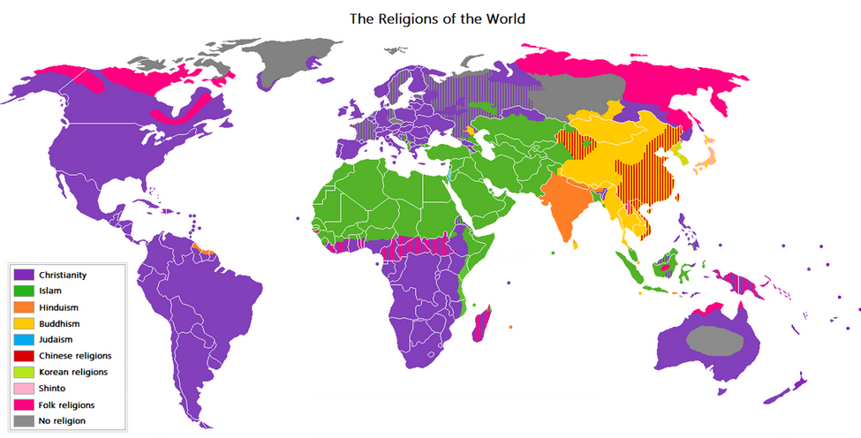

Slide 28
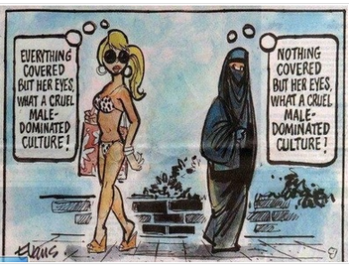
Dress:
Most countries have traditional dress e.g. the ao dai in Vietnam and the sari in India. However, globalisation has meant that in many countries traditional dress is worn less as global fashions take over e.g. jeans. Some cultures though do follow strict dress codes either by choice or by law in Saudi Arabia women have to wear an abaya and head scarf, in Afghanistan women also had to wear a full burka (although these restrictions have now been slightly relaxed). At the other end of the extreme the French government has decided that the burkha is a sign of repression and banned its wearing in public.

Slide 30
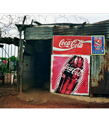
Images:
Images can now be spread around the world via the internet. These images can be from the past or the present. Images can help break or reinforce stereotypes. Traditional stereotypes of the English may be suited people with bowler hats and brief cases, but more images show that it is much more diverse. The internet can be used for positive purposes e.g. to spread images of environmental damage or political repression or more negative purposes e.g. promoting racism. Therefore images may not necessarily change our culture, but it may change our understanding and opinions of others.

Slide 31
Music
Globalised as it is a form of popular culture that does not dependent on the spoken/ written word.
The global music market is dominated by TNCs and most popular music comes from the USA and UK.
‘World music’ has now become a marketing strategy.
Migrations of people have led to a spread of music and hybridized forms of music.

Slide 32
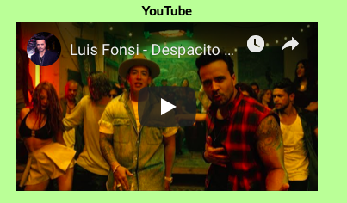
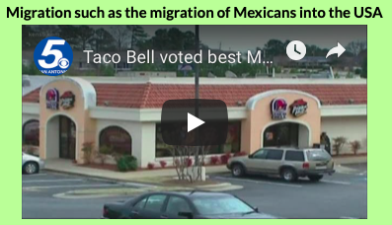
Influence over the spread of culture
Which of the above has had the greatest influence over the spread of ‘Western Culture’?

Slide 33
Homework: Cultural diffusion
Read: Kognity 5.2.1 Culture and the diffusion of cultural traits
Make notes on the different factors that will spread (diffuse) cultural traits

Slide 34
Example of an exam question
Examine the international diffusion of three cultural traits. [12 marks]
How could we approach this question
What examples could be used?
How can interrelationships be shown? Link to global interactions

Slide 35
Part B question

Slide 36
Part B question
To what extent do digital technologies influence the diffusion of cultural traits. [16]

Slide 37
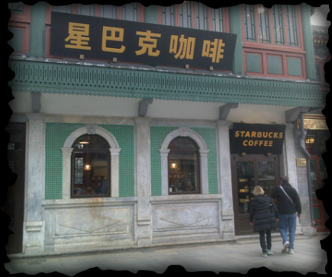
Cultural Imperialism
LO:
To be able to define and exemplify the concept of cultural imperialism

Slide 40
Define…..
IB Geography definition of Cultural Imperialism
The practice of promoting the culture/language of one nation in another. It is usually the case that the former is a large, economically or militarily powerful nation and the latter is a smaller, less affluent one.

Slide 41
Cultural dilution: Local cultures becoming less pronounced as they are influenced by outside (foreign) cultures.

Slide 42
Explanation…
Cultural imperialism can take the form of an active formal policy or a general attitude.
First started back in the times of the Roman Empire.
More recently seen in the ‘scramble for Africa’- in this colonial period Western culture was diffused around the world. The widespread independence of colonies saw the first stage of cultural imperialism finish, one of direct political domination.

Slide 43
Explanation cont…
After independence most colonial powers still exerted their power over their former colonies. The influence was now largely economic, but also cultural and indirectly political.
An example could be providing aid (which makes the former colony dependant) also locating TNCs to take locational advantages.
Some see world institutions as the IMF and WTO as facilitating this process.
Read p60-61 from’ Changing cultures and identities’ and
586-587 changing cultures and identities

Slide 44
Power of the USA linked to cultural imperialism
The U.S currently has the World's largest economy and has been able to export its control and influence through the commodities of its TNCs e.g. Google, Ford, McDonald's, Walmart. America's cultural imperialism has sometimes be described as Westernization and/or Americanization. Cultural imperialism may also take place via global institutions like the IMF, WTO and World Bank (many of which are heavily influenced by the US and Western Europe).

Slide 45
Five common areas that are often studied to look at the impacts of cultural imperialism are:
i. Language: There are currently over 6,000 languages spoken around the World, but half my disappear by 2100. Although Mandarin is spoken by the most people, English is becoming the dominant international language. ii. Tourism: Tourism is one of the World's largest industries and at the moment it is mainly citizens from developed countries (US, UK, Germany, Japan) that can afford to travel internationally and spread their culture (although they also experience new foreign cultures). iii. Global Brands: Apple, Google, Coca-Cola, McDonald's are all brands recognised and used around the World. iv. The Media: Disney, Time Warner, HBO, BBC , CNN, etc. all have enormous influence in terms of the television programmes made and aired as well as the music played and the news reported. v. Democracy: The US as well as organisations like the World Bank and the UN have often promoted Democratic Capitalist systems instead of systems like Communism.

Slide 46
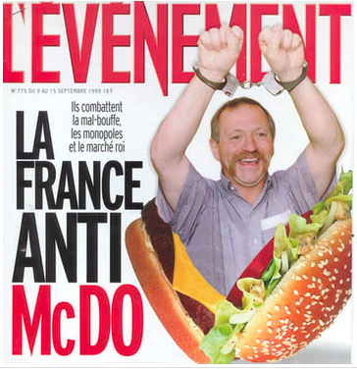
ADVANTAGES OF CULTURAL IMPERIALISM
There may be a greater variety of commodities available
It may mean new technologies are introduced
Language skills may increase
Economic development may take place as trade increases between two locations
DISADVANTAGES OF CULTURAL IMPERIALISM
Places around the World become increasingly homogenized (the same)
Local cultures are lost or diluted (language, dress, food, music, etc.)
Local businesses maybe forced out of business they can't compete with large international TNCs
Economic and political exploitation e.g. resources may be stripped, taxes not paid.

Slide 47
Current example of cultural imperialism
”Doing this to establish the kingdom of Jesus on the island … Do not blame the natives if I am killed"
https://www.news.com.au/world/asia/traumatic-history-of-isolated-tribe-who-killed-american-missionary/news-story/75120b92130bcea44642156bffd60059
https://www.bbc.com/news/world-asia-india-46337353
https://www.survivalinternational.org/tribes/sentinelese

Slide 48
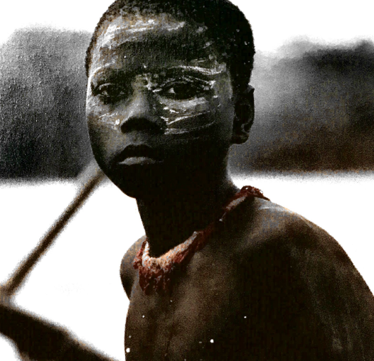
Textbook reading on the Sentinelese
Read the Textbook case study ‘ Cultural change in the Andaman Islands’
What global interactions are impacting the Indigenous populations of the Andaman islands?- links to tourism unit
How can these issues link to cultural imperialism/ cultural dilution ?
What impact will this have on the tribes cultural traits?

Slide 49
Watch the survival International video
Synoptic links
What links can be made between the ideas in this video and..
Our concept of development?
Sustainable development?
Cultural imperialism?
Civil society group

Slide 50
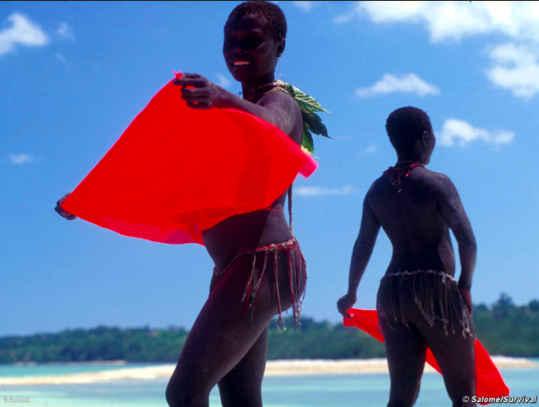
Impact of cultural diffusion on an indigenous population
The Jarawa
SYLLABUS LINK
Examine the impact of cultural diffusion on one indigenous and remote society through the influence of international interactions.

Slide 53
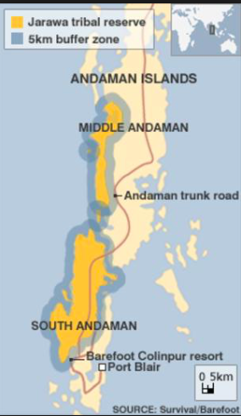
The road that cuts through their territory brings thousands of outsiders, including tourists, into their land. The tourists treat the Jarawa like animas in a safari park.

Slide 54
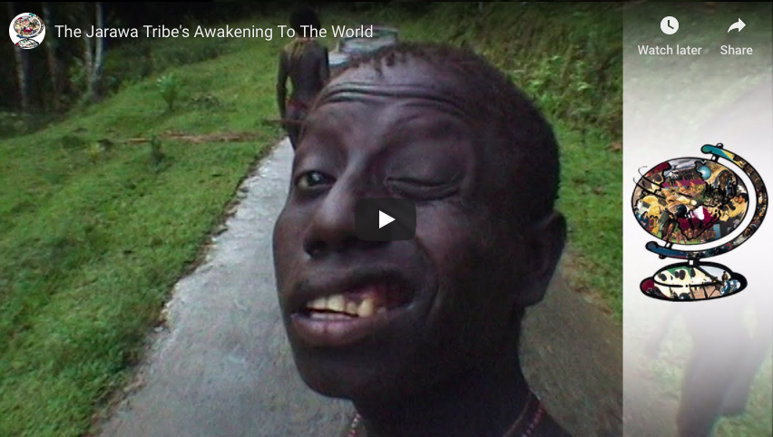
Watch…
What are the cultural traits of the Jarawa?
How are these being impacted? – what are the global influences that are impacting this group?
Read: Cultural traits of the Jarawa

Slide 56
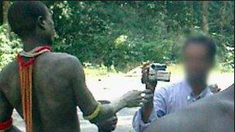
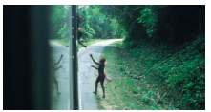
Human Safari
Reading: A Human Zoo on the World's Most Dangerous Island? The Shocking Future of North Sentinel

Slide 57
Dilution of gene pool due to contact with outside world
Should the Jarawan people be outside the law?
https://www.telegraph.co.uk/news/worldnews/asia/india/12194701/Death-of-fair-skinned-child-among-Jarawa-tribe-leaves-Indian-police-puzzled.html

Slide 58
Synoptic links to other sections of the course
Paper 3: Impacts of and global interactions
Paper 3: Environmental impacts of global interactions
Paper 3: Impact of civil society- what can organisations such as survival international do to reduce the impacts?
SDGs- reducing inequalities
Paper 1: Impact of tourism- is this an example of ‘zooifcation of culture’/ Human safaris

Slide 59
Survival International: Civil Society
https://www.survivalinternational.org/tribes/jarawa
Why is it important for Survival international to protect the cultural traits of a tribe such as the Jarawa?
How can the work of Survival international be seen as civil society action?
How can the work of survival international be seen as an anti- globalisation movement?

Slide 61
