Slide 1
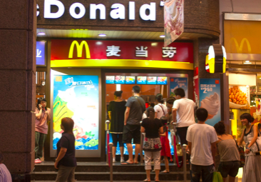
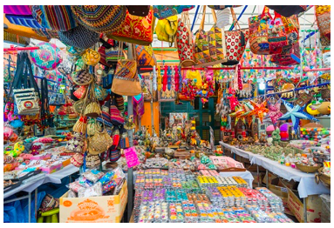
CHANGING CULTURES AND IDENTITIES
Syllabus Link: How global interactions bring cultural influences and changes to places

Slide 2
Key question:
To what extent is there a global culture?

Slide 3
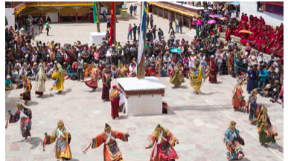
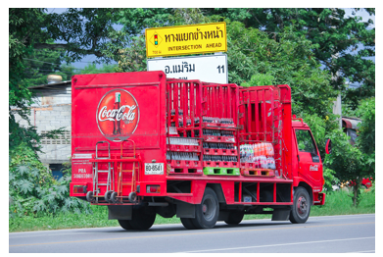
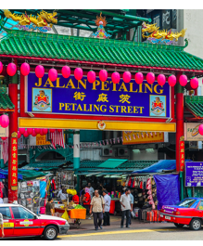
Global spectrum of cultural traits

Slide 4
Globalisation, in its broad sense, refers to the diffusion (spread) of; manufacturing, services, markets, culture, lifestyle, capital, technology and ideas across national boundaries and around the world. Also the integration of these geographically dispersed economic and social activities.

Slide 6
Culture describes the characteristics of a group of people; it gives people a sense of identity. Cultural traits are the different aspects of culture. They include inherited ideas, beliefs, values, language, religion, social habits, images, clothing, cuisine, music and knowledge. They can be passed on from one generation to the next and they can be learned and adapted. Cultural traits change over time and also unite people.

Slide 7
What is culture?

Slide 8
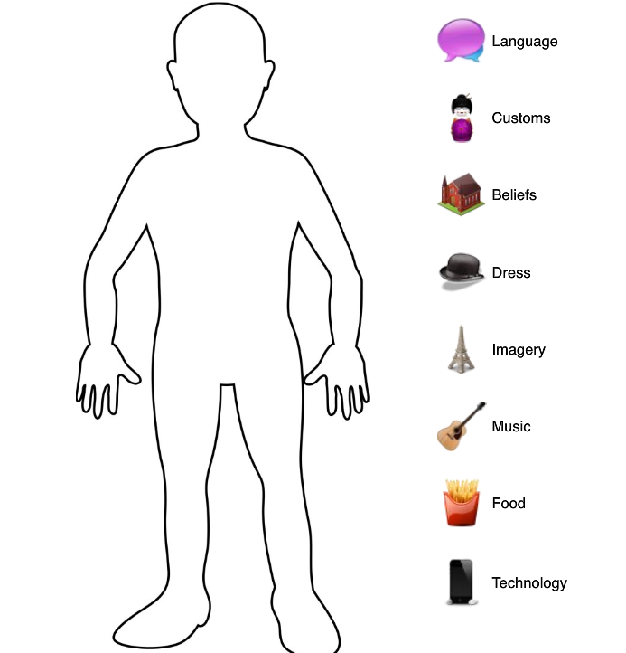
Draw a cultural stereotype ... consider the language(s) they speak, the customs the follow, the beliefs they hold, how they dress, the music they listen to, the food they like to eat and the technology they use.

Slide 9
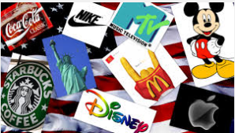
Important to note that cultures are not static. Cultures and cultural traits constantly changing and evolving.
Think of examples of changes in the culture and the cultural traits of a country you are familiar with.

Slide 12
What could be seen as the cultural objects of 2018?
Think gadgets, TV and film, music, dress, books, games and hobbies
Would these be the same globally ?

Slide 13
Global culture
A shared sense of belonging at the planetary scale that is demonstrated through common ways of communicating, consuming media and food, dressing or behaving (including shared social norms such as a commitment to upholding human rights).

Slide 14
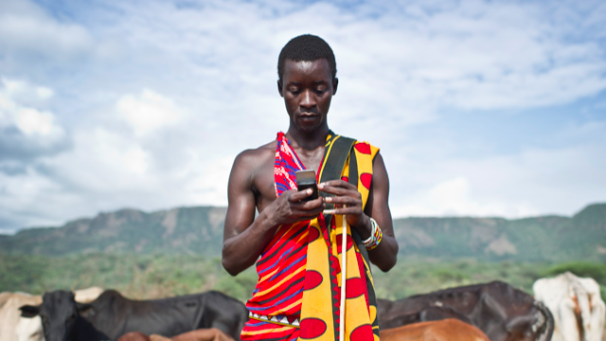
A global culture
The world is changing fast
New technologies mean the world is becoming more interconnected
Proponents of the idea of a ‘global culture’ suggest that different places around the world are converging and becoming more similar

Slide 15
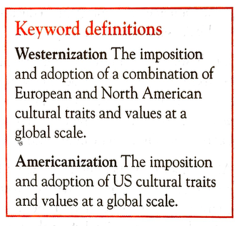
A Global culture is the product of….
The export of supposedly ‘superior’ cultural traits and products from advanced countries, and their worldwide adaption (Westernization, Americanization) Cultural imperialism
The mixing and hybridization of cultures through greater interconnections and time space compression.

Slide 16
Cultural traits

Slide 18
584-585 in textbook/ kognity and the news articles
Also use the information on the following slides using the notes and news articles…..

Slide 19
Diffusion of cultural traits news articles
The Eight Case Studies 1. Language - Twitter & the French language - or this
https://www.theguardian.com/world/2018/feb/26/icelandic-language-battles-threat-of-digital-extinction 2. Customs - Case study - St Patrick's Day or this case study of British style weddings in France. 3. Beliefs - Islam in France 4. Dress - Case studies from around the world. 5. Music - English Music in France 6. Food - Global spread of McDonalds 7. Technology - Internet and China. 8. Images - Western style advertising in Middle East & Images - Western Women in advertising.

Slide 20
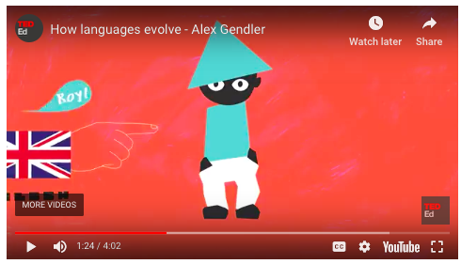
Language
Language is one of the most important aspects of national identity. Globally there are over 7000 different languages. Language evolves over time as words are adapted or integrated from other languages. 45% of all words in the English language are of French origin. Country borders do not restrict languages and in some countries more than one language is spoken. For example, Canada has two official languages: English and French.
English is considered a world language and is learned as a second language by many to access employment, information and markets. It is expected that in time some languages may disappear completely. For example, Cornish, a Celtic language spoken in Cornwall, UK, is considered to be critically endangered by UNESCO.
Read these relevant news articles:
Language - Twitter & the French language - or this
Icelandic language battles digital extinction

Slide 21
The spread of language

Slide 22
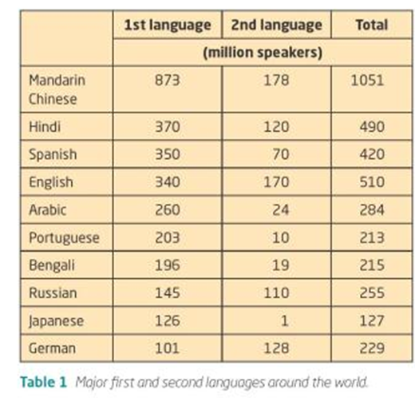

Slide 23
Food
Watch: Whopper Virgins
Many countries have distinctive foods and national dishes. Some foods form part of religious beliefs. For example, the Jewish faith requires food to be kosher and in the Islamic faith food is prepared so that it is halal. Globalisation has resulted in the spread of food around the world. For example, Indian, Chinese and Mexican restaurants are now common in many global cities. However, sometimes food is adapted to meet local tastes; an example is the chicken balti in the UK. Unlike in Pakistan, the chicken is served off the bone which is preferred by the British population. The chicken balti is the result of cultural hybridity. In the UK specialty food stores have sprung up to meet the growing demands of immigrant populations and changing tastes of local people.

Slide 24
The spread of McDonalds across the globe

Slide 25
Customs:
These are common patterns of behaviour found with particular countries or regions that are then passed down through generations. Examples may include bowing to elders, not tipping, taking of shoes inside houses and celebrating certain days e.g. St. Patrick's Day. Some of these customs may get diluted as young people see different behaviour in the media, while others may grow.
10 Surprising Ways To Offend People In Other Countries

Slide 26
Technology:
The development of technology can certainly change culture. The development of agricultural equipment e.g. tractors and combine harvesters has meant that the number of agricultural societies around the world has decreased. The development of contraception and the medical procedure of abortion has brought about debate in the Catholic church. Also the development of computers and phones has possibly reduced face-to-face contact both in social and business settings.

Slide 27
Beliefs:
There are five major religions in the World i.e. Islam, Christianity, Buddhism, Hinduism, Judaism and Taoism. Out of these probably only Islam and Christianity can be regarded as truly global. However, even these world religions have many different sects e.g. Islam has Sunni, Shia, Wahhabi, etc., while Christianity has Roman Catholic, Baptist, Church of England, etc. However, despite the growth of some religions e.g. Islam, many are seeing a reduction in the number practicing. Secularism is also on the rise in many countries like France and the UK.

Slide 28
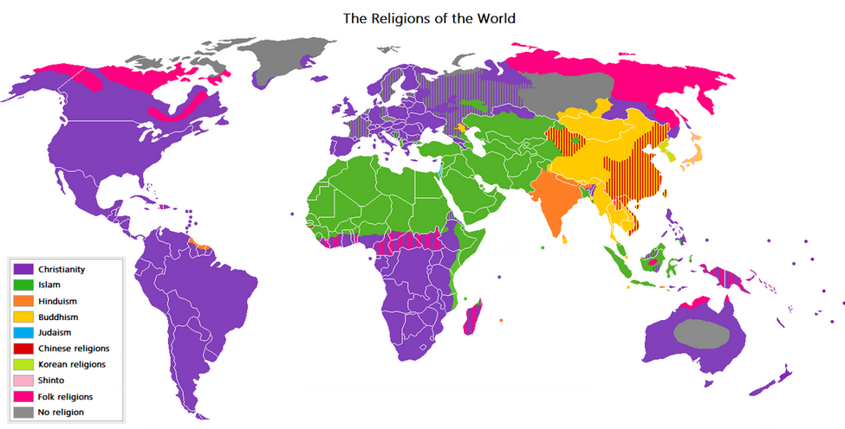

Slide 29
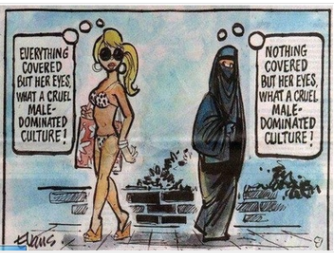
Dress:
Most countries have traditional dress e.g. the ao dai in Vietnam and the sari in India. However, globalisation has meant that in many countries traditional dress is worn less as global fashions take over e.g. jeans. Some cultures though do follow strict dress codes either by choice or by law in Saudi Arabia women have to wear an abaya and head scarf, in Afghanistan women also had to wear a full burka (although these restrictions have now been slightly relaxed). At the other end of the extreme the French government has decided that the burkha is a sign of repression and banned its wearing in public.

Slide 31
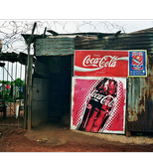
Images:
Images can now be spread around the world via the internet. These images can be from the past or the present. Images can help break or reinforce stereotypes. Traditional stereotypes of the English may be suited people with bowler hats and brief cases, but more images show that it is much more diverse. The internet can be used for positive purposes e.g. to spread images of environmental damage or political repression or more negative purposes e.g. promoting racism. Therefore images may not necessarily change our culture, but it may change our understanding and opinions of others.

Slide 32
Music
Globalised as it is a form of popular culture that does not dependent on the spoken/ written word.
The global music market is dominated by TNCs and most popular music comes from the USA and UK.
‘World music’ has now become a marketing strategy.
Migrations of people have led to a spread of music and hybridized forms of music.

Slide 33
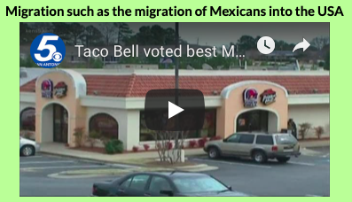
Influence over the spread of culture
Which of the above has had the greatest influence over the spread of ‘Western Culture’?

Slide 34
Homework: Cultural diffusion
Read: Kognity 5.2.1 Culture and the diffusion of cultural traits
Make notes on the different factors that will spread (diffuse) cultural traits

Slide 35
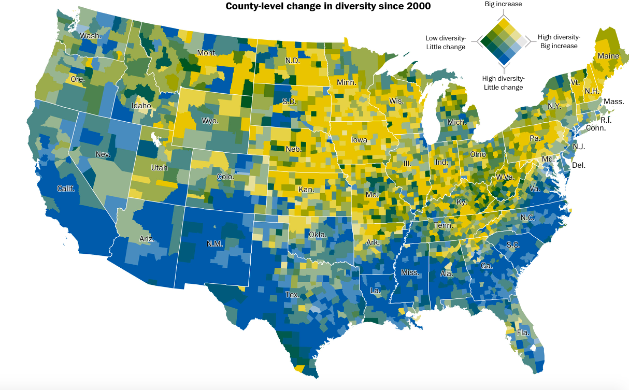
Extra Reading
Washington post: The increasingly diverse United States of America

Slide 36
Example of an exam question
Examine the international diffusion of three cultural traits. [12 marks]
How could we approach this question
What examples could be used?
How can interrelationships be shown? Link to global interactions

Slide 37
Part B question

Slide 38
Part B question
To what extent do digital technologies influence the diffusion of cultural traits. [16]

