Slide 1
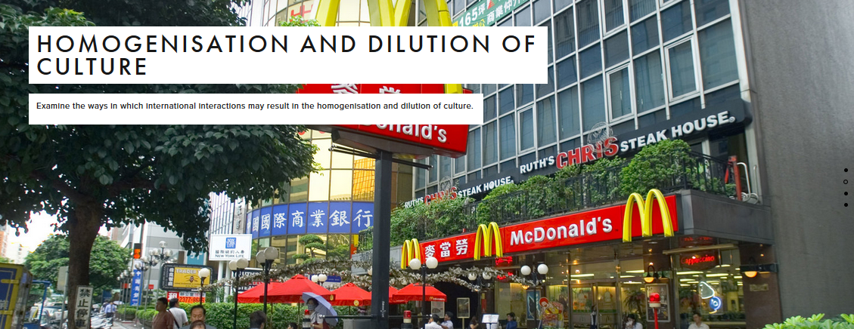

Slide 2
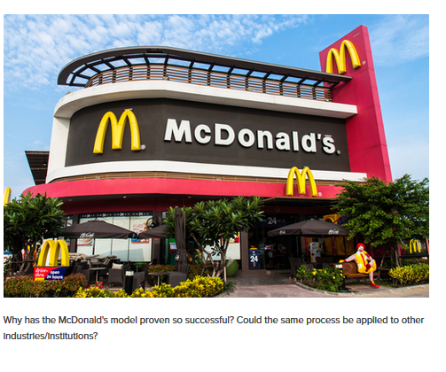

Slide 4
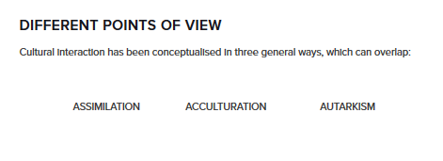
What do these words mean?

Slide 5
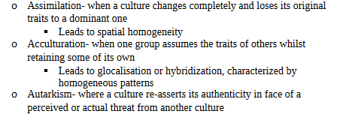
Key word definitions

Slide 6
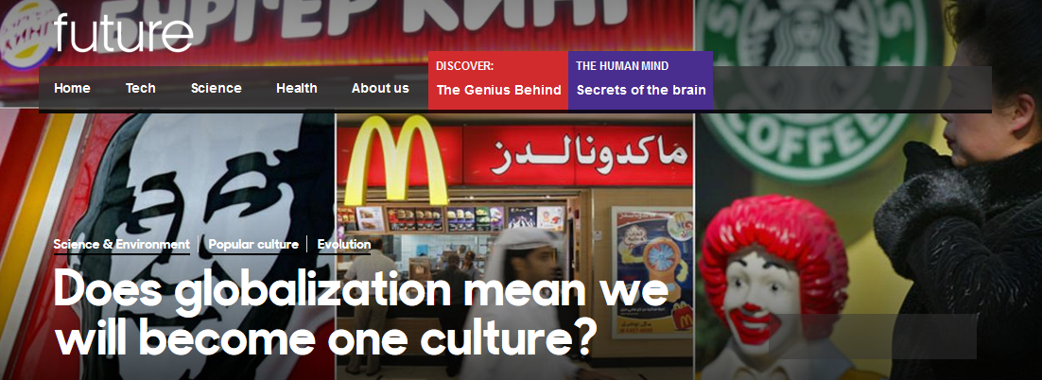
Good extra reading
What views are being shown here?
http://www.bbc.com/future/story/20120522-one-world-order

Slide 7
Example essay question
"International interactions always result in the homogenisation of culture." Discuss this statement. (15 marks)
In pairs:
Identify the key words in this question.
What strategies should you use to approach a discuss exam question?

Slide 8
Collaborative writing
Work in pairs to write an essay response to the following exam question. Elaborate each topic sentence into a paragraph using the resources provided.
Use resource as a shared google doc to write a paired.

Slide 9
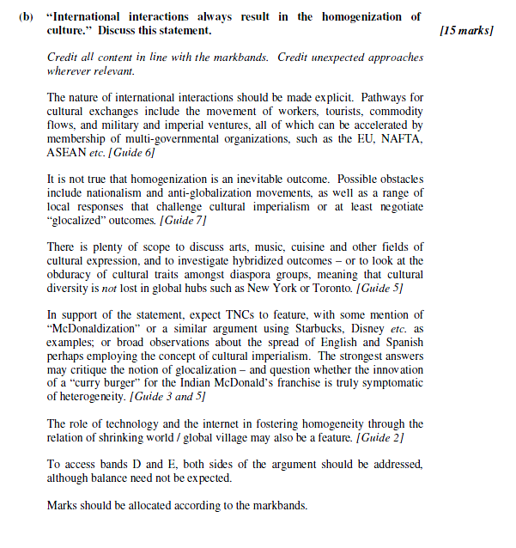
Mark scheme

Slide 10
Plenary
What is your position on this exam question? Which camp do you agree with? Justify your views.
"International interactions always result in the homogenisation of culture." Discuss this statement. (15 marks)
HYPERGLOBALISTS (ASSIMILATION)
TRANSFORMATIONALISTS (ACCULTURATION)
AUTARKISTS

