Slide 1
Cuba Under Castro
Charyse Goodlow Nazmeen Muhammed
Jacqueline Booker Leyna Nguyen

Slide 2
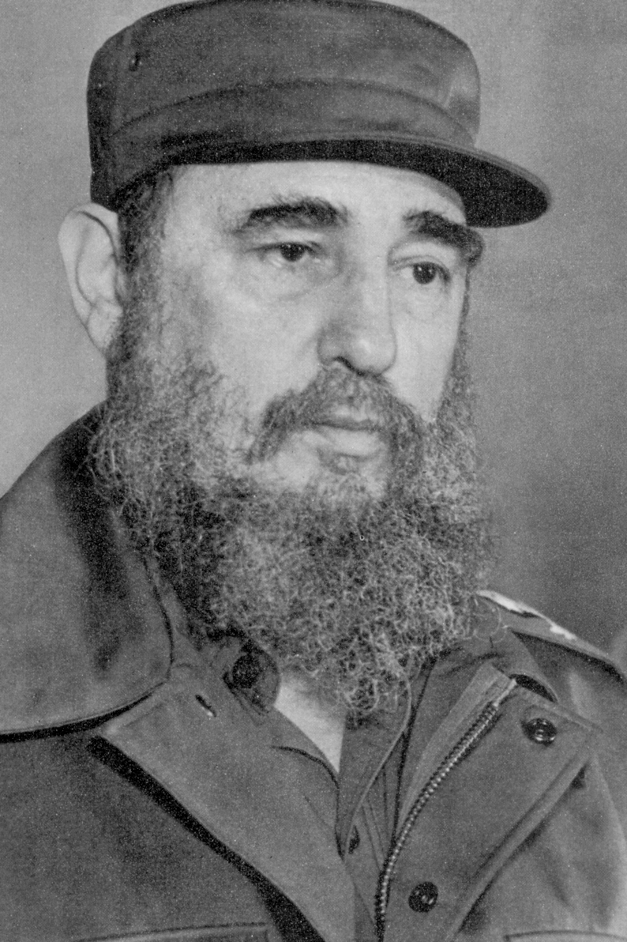
Background Information
Fidel Castro - Born August 13, 1926
Son of a wealthy Spanish sugar cane farmer and a domestic servant
He attended the University of Havana to study law and started a law office after graduation.
Castro was a supporter of the democratic system in Cuba (he wanted to run for parliament)

Slide 3
Background CONT.
1952- Batista stages a coup and ruins elections
Batista then overtook country’s economics and resources
Castro leads the first opposition to Batista on July 26, 1953. He fails and goes to jail
Castro is released 3 years later in 1955. He travels to Mexico to plan an attack against Batista and meets Che Guevara of Argentina
1956 - Castro leads a guerilla campaign VS Batista and wins consecutive battles
Batista flees to the Dominican Republic and Castro takes power in 1959
Castro’s charisma and popular support helped help consolidate power.

Slide 4
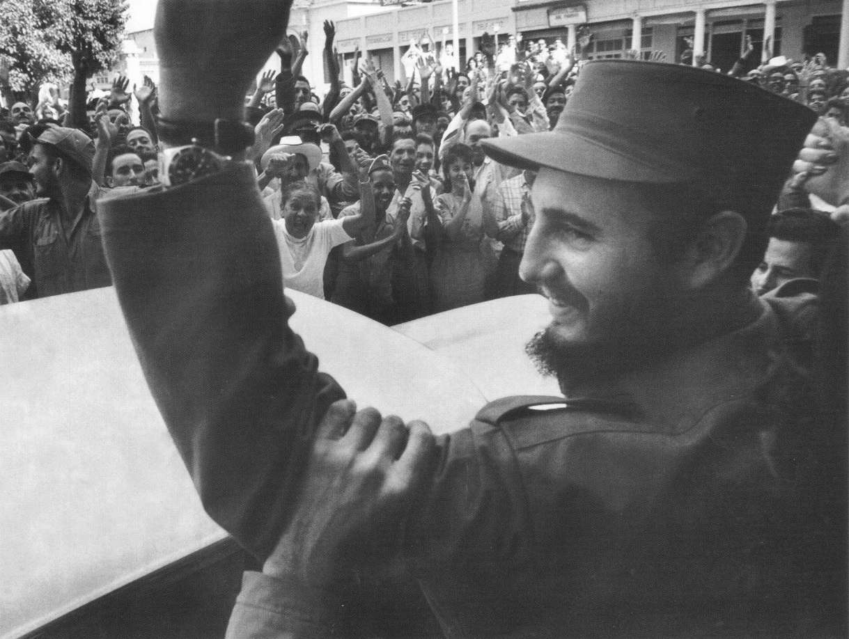
Castro being welcomed after removing Batista

Slide 5
Politics under Castro
Revolutionary groups controlled Cuba
  Batista supporters were removed from office, put on trial and executed, and had their property confiscated.
  The congress was dissolved, and Castro became prime minister.
  Feb 7, 1959 – The Fundamental Law of the republic gave all political power to the cabinet.
  Castro’s main goals were to become independent of U.S influence and lessen the economic gap between classes.

Slide 6
Reforms
During the first five months, Castro issued land reforms.
May 17, 1959 – The First Agrarian Reform Law created the National Institute for Agrarian Reform (INRA), which placed a 1000-acre limit on land holdings
  Cattle ranches and sugar and rice plantations could have over 3000 acres.
  Any excess land was turned into cooperatives that were run by the INRA.
Tariffs were increased to protect domestic businesses.
Smaller sugar mills and rice growers were encouraged to export more.
The desire to do away with the corruption of the Batista era resulted in making it a capital crime to steal from the government. Prostitution and gambling were outlawed.

Slide 7
Opposition to Reforms
U.S-owned businesses lost land and money due to land reforms and the nationalization of industries.
The upper class (large plantation and ranch owners and industrialists) opposed the reforms.
  Workers were given higher wages, and peasants were given land.
The more moderate and non-communist members of the central government left as the government became more radical.
  The loss of many skilled advisors helped lead to Cuba’s turn to the USSR for assistance.

Slide 8
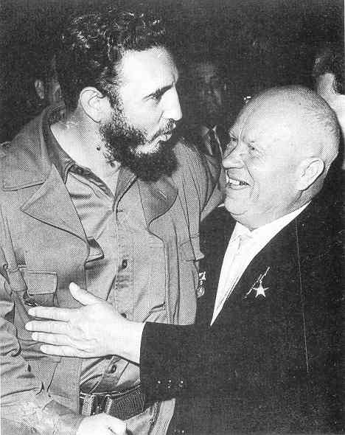
An agreement between Soviet deputy premier Anastas Mikoyan and Castro was reached – The Soviet Union would purchase 425,000 tons of sugar from Cuba in 1960 and 1,000,000 tons in 1961.

Slide 9
Economic Policies
Unemployment was virtually eliminated, and wages rose by as much as 40%.
The cost of rent dropped, and other services became free.
Issue – more Cubans had too much extra income and there were not enough consumer goods and food to buy because Cuba had ceased importing them.
  The government had to begin rationing food (like cattle) by March 1962.
The new government wanted to diversify agriculture and become less dependent on imports.
  Sugar fields and empty fields were used to produce cotton, vegetable oils, rice, soybeans, and peanuts.

Slide 10
Cont.
The government also tried to manage privately-owned farms through the National Association of Small Farmers (ANAP).
Result – the government couldn’t efficiently organize and manage agriculture, and Castro often ignored the advice of JUCEPLAN (a central planning agency)
Cuba attempted to industrialize between 1959 and 1961
The government began with taking over the U.S-owned telephone company. U.S-owned refineries and factories, banks, and Cuban-owned businesses were nationalized.

Slide 11
Any further industrial development proved to be too difficult for the government to carry out.
1963-1970 – The government turned to emphasizing sugar production again, and faced a series of bad harvests.

Slide 12
Cuba during the 1970s and 1980s.
Cuban Internationalism: Castro sent military and financial aid to help leftist movements in Latin America and Africa.
Thousands of Cuban doctors, teachers, and other specialists were sent to help developing countries, boosting Cuba’s global image.
The economy dropped and rose with world sugar prices, but was ultimately damaged by the collapse of the Soviet Union.
Corruption increased – Goods meant for the state were sold on the black market.
Several Cubans left the country to escape economic hardship.

Slide 13
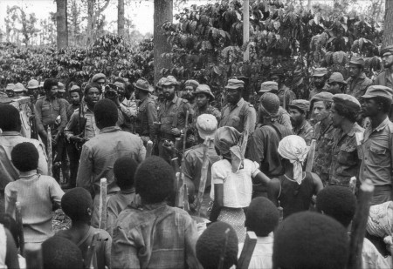
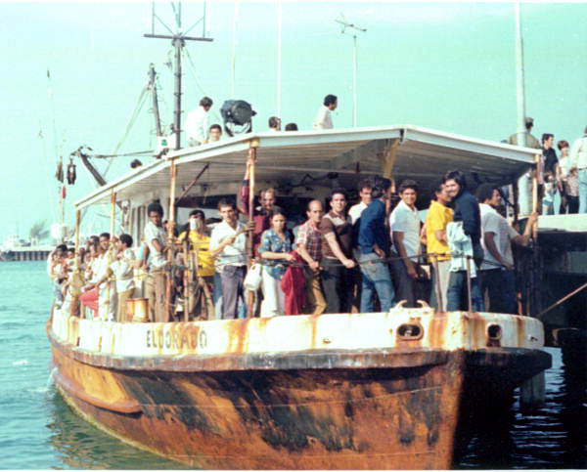
Cuban forces in Angola
Cuban refugees to Florida
State Archives of Florida, Florida Memory, http://floridamemory.com/items/show/98693

Slide 14
The “Special Period”
Refers to Cuba after the end of the Soviet Union.
Cuba had been financially dependent on the USSR, so Castro had to allow major policy changes to keep the country going.
The use of the U.S dollar was allowed in 1993.
Private restaurants and self-employment were allowed.
1995 – Partial and complete ownership of businesses by foreigners was allowed.

Slide 15
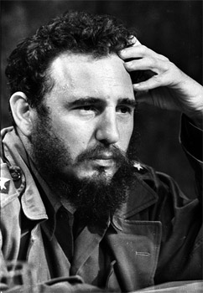

Castro’s Treatment of minorities and cultural policies

Slide 16
The Arts
After the Cuban revolution of 1959 Cuban artists became more isolated from the artistic movements of the United States and Europe
Though artists continued to produce work in Cuba, many pursued their careers in exile
Theaters, cinemas, concerts, art exhibitions, etc. were all censored

Slide 17
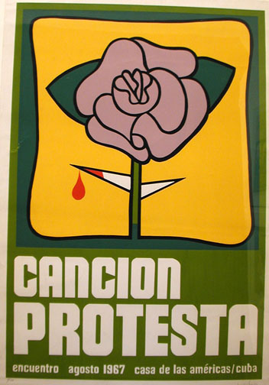
Song of protest
Consisted of young people who believed in social justice from the revolution but opposed the hierarchical nature state of decision making.
Protest songs contributed to development of Cuban music and culture
  Combination of traditional cuban country music with lyrics that sang the raises of the revolution and its heroes.

Slide 18
CONt.
The great failure of the 1970 sugar harvest changed the way of thinking towards revolutionary policies
Castro took blame for failure and led to greater political openness and popular participation.
Cuban government then supported the new music (nueva trova) or new ballad

Slide 19
Cont.
Government encouraged young musicians to represent Cuba at international music festivals organized in Latin Amerca, Spain, and Eastern Europe
Also created the National Movement of the Ballad (MNT)
  Its purpose was to encourage musical careers and fund the creative arts

Slide 20
Cont.
MNT refused to support particular songs because lyrics were antisocial, but it greatly expanded the resources available to young musicians
  New electronic technology- synthesizer
  More studio time
  Help them distribute recordings

Slide 21
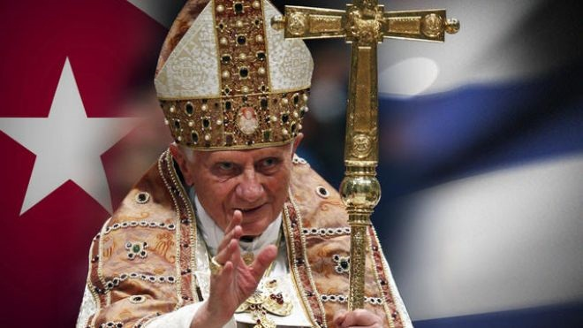
Religious Groups
Cuba was declared to be atheist
No religions were allowed to proselytize
Cuban agents from the Ministry of the Interior watched and spied on those who have worshiped in churches and in their homes

Slide 22
Cont.
1992- Castro loosens the restrictions placed on religion
Cuban then described as “secular” instead of “atheist”
Pope John Paul II visited Cuba in 1998, the first visit by a reigning pontiff to the island.
Castro and the Pope appeared side by side in public on several occasions during the visit.
Castro treated the Pope with reverence and respect

Slide 23
Cont.
The government still restricts religion by:
  Blocking construction of new churches
  Limits the arrival of foreign religious leaders
  Import of religious articles is controlled and monitored
  Many private churches and other houses of worship, including meetings in private places have been disbanded, boarded up and shut down
  So called "unregistered religious groups" (not state recognized) experience regular harassment, and repression
  Religious material is confiscated

Slide 24
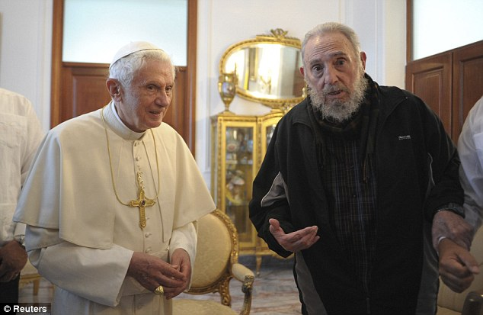
Cont.
There are still many Cuban religious leaders in prison for their religious beliefs
The Ministry of the Interior still engages in controlling and monitoring religious activities and uses surveillance, infiltration, and harassment against any religious people

Slide 25
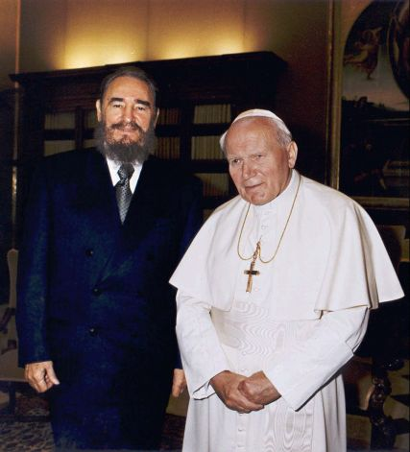
Fidel castro and john paul II

Slide 26
Role of Women
One of the most significant changes brought about by the Cuban Revolution has been to the lives and status of women
Before 1959, the role of most Cuban women resembled that of other women in most countries
Women had few rights and were expected to sacrifice their interests for the well-being of the family

Slide 27
Role of Women
The Labor Code ensures equal rights and opportunities for women in all fields of work as well as an equal salary
Social security applies to men and women equally
Women have the right to an abortion
Equality of access is ensured in both education and health

Slide 28


Role of women- FMC
3 months after revolution, the Cuban Women’s Federation (FMC) was created
  Its main goal was to gather women to support the revolution through work, participation in the literacy campaign, and in neighborhood projects

Slide 29
Cont.
The Federation’s activities cover a wide number of areas:
  Works collaboratively with the government, trade unions, mass media, international organizations, etc.
  Mounts grass-roots level campaigns
  Runs women’s training centers for awareness of their rights
  Develop non-sexist attitudes among students in schools
  Carry out research where there are still problems

Slide 30
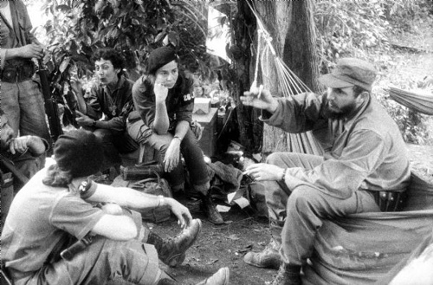
Role of Women cont.
Much of the success in realizing the legislation relating to the rights of women has been achieved thanks to the work of the FMC
Over 85% of Cuban women are members and it now has 73,710 branches throughout the country

Slide 31
Women and children
Children under age 7 and pregnant women received daily distribution of milk and benefitted from provided health care
1975- the Family Code recognized the equal rights of both spouses to education and career, required both to share household duties and child care, and legalized divorce

Slide 32
End to racial discrimination
Castro supported the end of Cuban racism against Afro-Cubans an white republican elites
Benefitted from revolution and are able to hold high-status positions in Cuban Society
Improvement in literacy (FMC), and employment

Slide 33
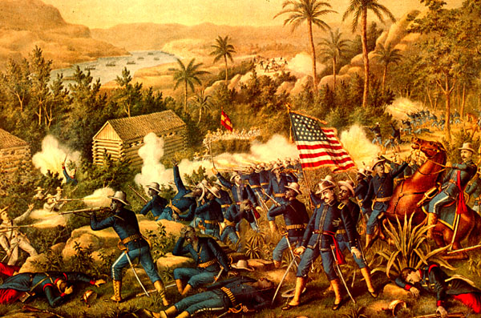
U.S. Intervention

Slide 34
Economic Interests
In 1895, US-Cuban trade was about $100 million a year.
US investment in Cuba was about $50 million, mostly in sugar and iron but some in mining and tobacco.
US investment in Cuba greatly expanded in the last quarter of the 19th Century.
US ownership of Cuban sugar mills placed the most valuable assets on the island in foreign hands.

Slide 35
Rising of Conflicts: Oil refineries
The Cuban government requested that petroleum refineries that were owned by Texaco, Standard Oil, and Royal Dutch Shell, process Soviet crude oil.
  Cubans received the Soviet crude oil at a lower price than the three companies charged.
  The U.S State Department urged the companies not to refine Soviet oil.
    The oil companies refused to refine the oil
  Cuba was forced to expropriate the refineries.
  This led the United States to retaliate by abolishing the Cuban sugar quota
  However, Cuba reacted and in turn expropriated numerous U.S. owned properties.

Slide 36
Bay of Pigs
Conflicts continued between the two. Meanwhile, the Central Intelligence Agency (CIA) distributed money to various exile groups for arms and to set up a training camp in Guatemala to prepare an invasion force.
On January 3, 1961, the Eisenhower administration severed diplomatic relations with Cuba.
April 15, President John F. Kennedy authorized the exile invasion at the Bay of Pigs.
The invasion was weak and not planned out very well which led to its failure.
The failure of Bay of Pigs increased Castro’s prestige and brought new ideas for radical reconstruction of the Cuban economy and society.

Slide 37
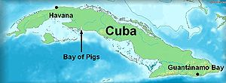
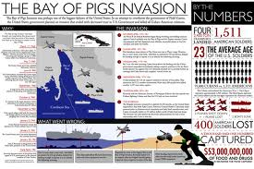
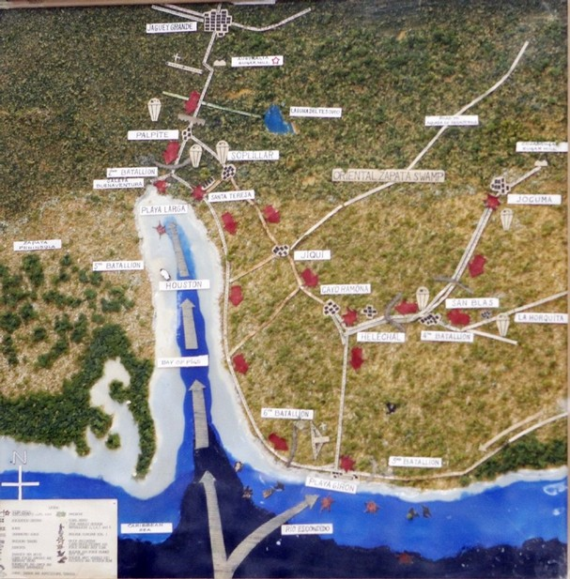

Slide 38
Cuban Missile Crisis
After the Bay of Pigs invasion the Soviet Union sided with the Cuba pledging to defend them against another U.S attack.
In order to defend and protect Cuba, missiles and aircrafts delivering atomic weapons were used.
The United States took these weapons as offensive and ordered a naval quarantine of Cuba and demanded the dismantling of the missile sites.
The world had came close to a nuclear war, however, the two superpowers: US & Soviet came to a compromise.
The Soviet Union agreed to remove the missiles from Cuba as long as the United States also agreed to remove their missiles in Turkey and pledge not to invade Cuba.

Slide 39
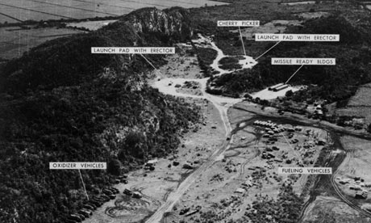
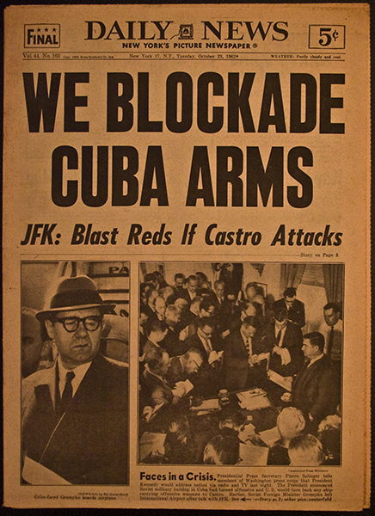
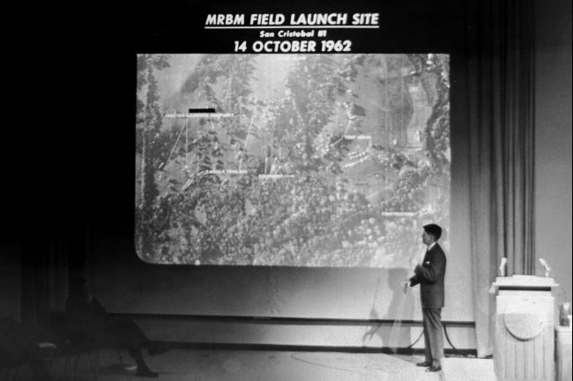

Slide 40
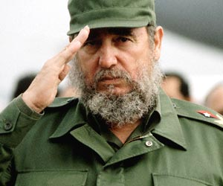
Achievements and Failures of Castro

Slide 41
Achievements
Castro was able to concentrate legislative power towards the executive.
Castro held the positions of prime minister and first secretary of the Communist Party, which meant that he held strong positions in the government and the ruling party of Cuba.
Cuba had well-developed communications and transportation systems, including an extensive railroad network and excellent primary roads.
There was a considerable amount of unused land and industrial capacity, which could be quickly employed to raise living standards and increase productivity.

Slide 42
Cont.
Wages were raised by 40% and overall purchasing power was raised by 20%.
Workers were paid better wages and offered improved working conditions.
Castro reorganized the government to be more efficient. He established clear boundaries between institutions of the government like the armed forces, the bureaucracy, and the Communist Party.
Castro tried to get workers involved with the policies of the government and industry.

Slide 43
Cont.
Cuba’s leadership vastly improved the revolution’s policy of economic development. They introduced sophisticated computerized planning techniques and inaugurated a system of material incentives for workers and managers.
A work quota system was implemented and brought out a 20% increase in productivity in just one year.
People were paid according to the productivity and complexity of their job.
Between 1971 and 1975, the gross national product grew at an annual rate of more than 10%.

Slide 44
Cont.
Cuba’s economic growth between 1960 and 1985 was the second highest in Latin America.
Cuba had the lowest rate of unemployment in Latin America.
Inequalities of the living standard were greatly reduced.
80% of Cubans owned their own homes.
Agricultural workers on state farms and cooperatives had houses with T.V.s and community recreational centers.

Slide 45
Cont.
Cuba’s city streets had very little beggars and sidewalk vendors.
Education and health care were free and equally accessible to all. Cuba had transformed itself in to a world class health care provider.
Children and pregnant women were special to the government and were given daily distributions of milk and the best medical care.

Slide 46
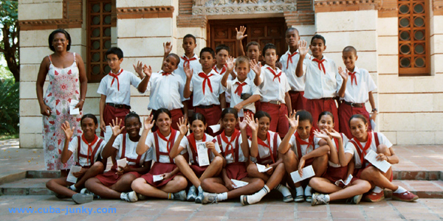
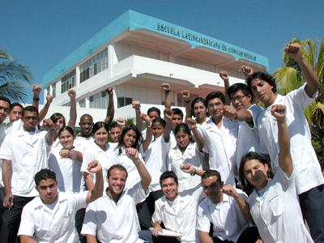
Health care and education
School in Havana

Slide 47
Cont.
Illiteracy was starting to disappear and women were becoming better educated.
Social justice throughout Cuba was obtained as Castro called upon the Cubans to fight against racism in their country.

Slide 48
Failures
Castro’s revolutionary regime suppressed the right of free press and the centuries-old autonomy of the University of Havana.
The socialist reorientation of the economy caused disruptions.
Many of Cuba’s best technicians fled to the U.S. with the first wave of refugees.

Slide 49
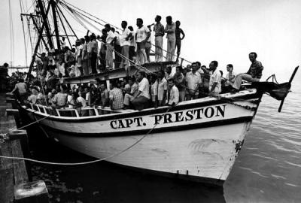
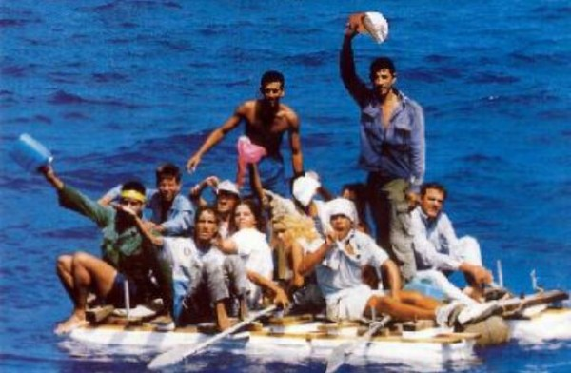
refugees

Slide 50
Cont.
The consumption of food, mainly meat, rose 100%. The rising demand led to the overkill of cattle, which severely hurt the government’s ability to supply meat.
Shortages occurred in Cuba as the country could no longer import consumer goods and food stuff.
The government increased disposable income more as they lowered rent and utility rates and supplied many free services.

Slide 51
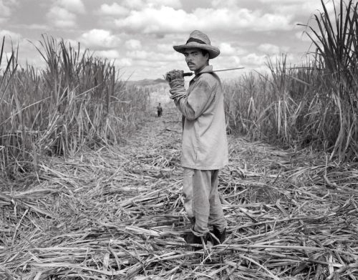
Cont.
Revolutionaries poured a large amount of money into rural housing, roads, and other improvements but poor planning wasted their scarce resources.
Increased agricultural production damaged their agriculture, mainly their sugar industry.

Slide 52
Cont.
Government neglected the private agricultural sector as more than half the farmlands were in private ownership.
The revolutionary’s inability to organize, plan, and administer the economy was causing them serious problems.
The Ten-Million-Ton sugar harvest of 1970 was doomed to fail as the agricultural infrastructure was severely damaged and underdeveloped.

Slide 53
Cont.
The regime’s disastrous economic policies and centralized authoritarian state was separating the revolutionary leadership from its base of support.
Persistent economic problems and political disaffection led to a huge emigration of Cubans, primarily to the U.S. from April to September 1980.

