Slide 1
Creating a permanent settlement at base camp

Slide 2
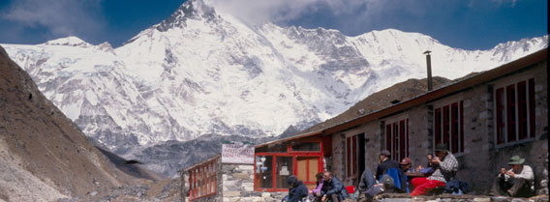
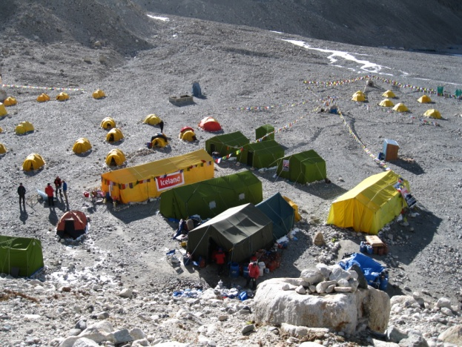
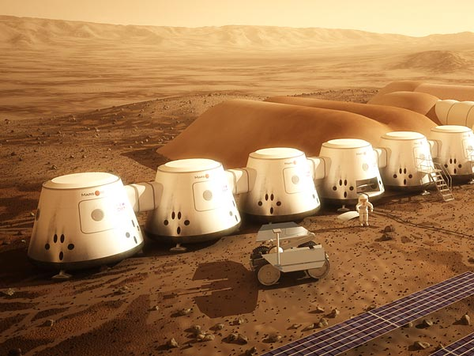
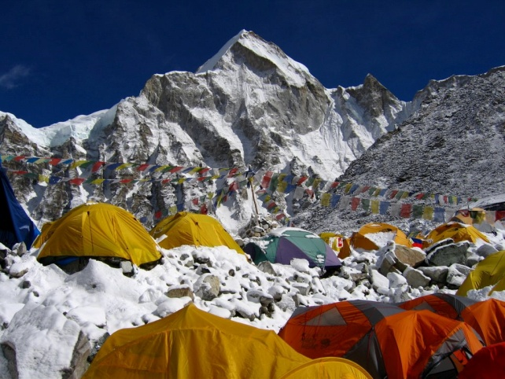
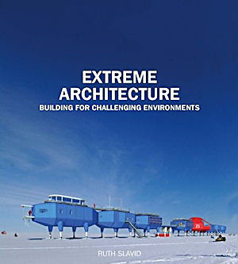
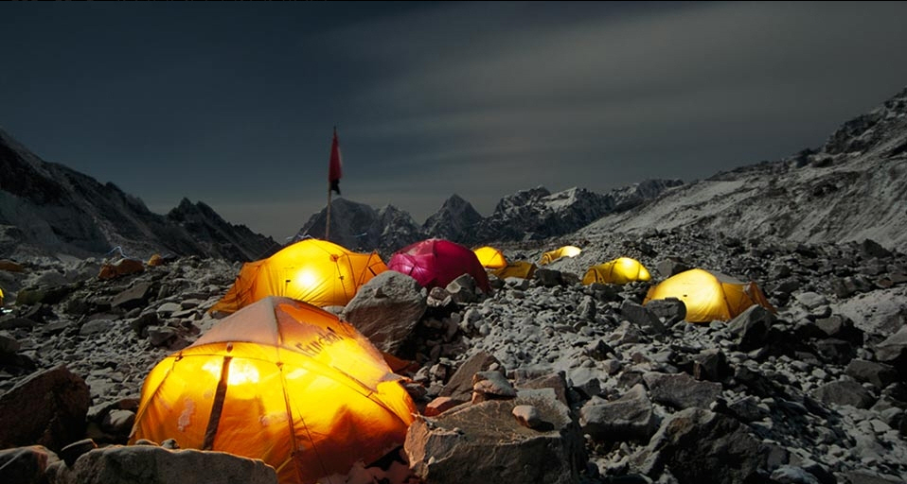
To this?
From this

Slide 3
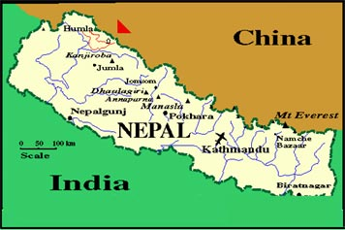
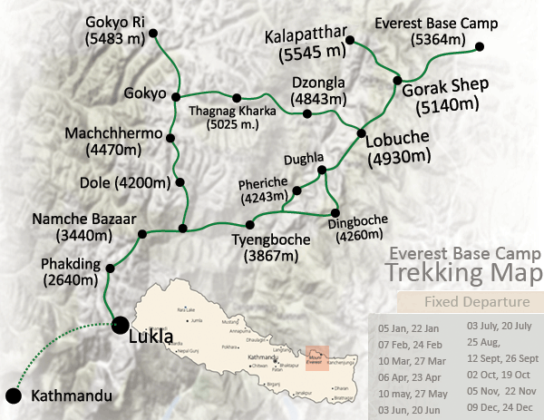
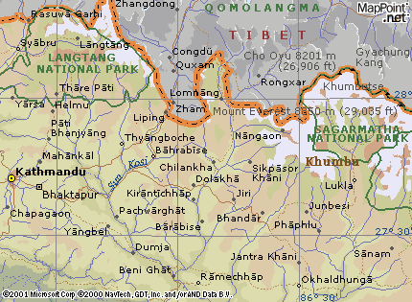
Location of base camp
Mount Everest Base Camp is located in the Khumbu region of Nepal close to the border with Tibet. It is 5364 m above sea level. It is north-east of Lukla airport and the only way to access it is by trekking .

Slide 4
Building in extreme environments

Slide 5
The planet Mars!
Building a permanent settlement on Mars?
Non-profit Mars One aims to do so by 2023
The project states the aim is the permanent emigration of human astronauts -"Mars becomes their new home, where they will live and work for what will likely be the remainder of their lives.“
Despite the one-way ticket, more than a thousand people volunteered when the project was announced last year.

Slide 6
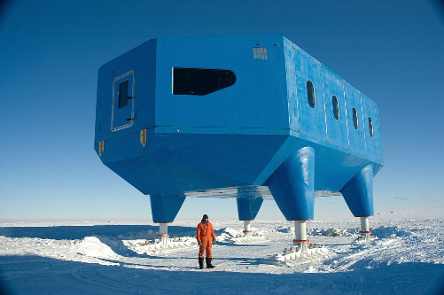
Antarctica
Buildings are buildings are buildings … except when they’re in Antarctica, where the extreme environment make them look like futuristic spaceships that have landed on a desolate, frozen landscape.

Slide 7
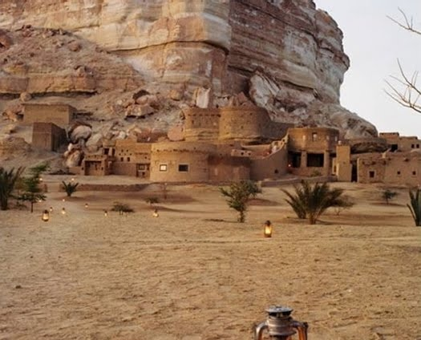
Hot deserts
In the deserts surrounding Cairo, Egypt, you find the eco-lodge, Adrère Amellal. The handcrafted buildings of stone and clay blend into the natural landscape surrounding them, as if they could disappear at any moment.
The #1 reason to stay at Adrère Amellal: with no electricity, the rooms are softly lit with a dozen beeswax candles and the starry desert sky.

Slide 8
Weblink for building in extreme environments
http://www.coolhunting.com/design/extreme-archite.php#

Slide 9
Sustainable design

Slide 10
What is sustainable design?
Sustainable architecture seeks to minimize the negative environmental impact of buildings by enhancing efficiency and limiting the amount of materials, energy, and development space. The idea of sustainability, or ecological design, is to ensure that our actions and decisions today do not inhibit the opportunities of future generations.

Slide 11
Sustainable design ideas
What materials will you use? Think about recyclable materials, materials that are available locally and materials that will be appropriate to the environmental extremes
What is your source of power and why might it be better to use renewable energy?
How will you dispose of waste/sewage?

Slide 12
Ideas for sustainable building design here
http://en.wikipedia.org/wiki/Sustainable_architecture

Slide 13
Meeting the needs of the people

Slide 14
What is sustainability?
Sustainability means meeting the needs of the present without jeopardising the ability of future generations to meet their own needs.
Sustainability can be divided into three areas: economic, social and environmental.
Economic sustainability means that people will have jobs and a decent source of income both now and in the future
Social sustainability means that people’s everyday needs are being met adequately
Environmental sustainability means that the environment is being conserved for current and future generations to use and enjoy

Slide 15
How will your settlement meet the needs of the people both now and in the future?
Think about the different groups of people who use base camp e.g. mountaineers, sherpas, porters, trekkers, ecologists, glaciologists, mountain doctors etc.
How will the facilities you have planned meet the economic, social and environmental needs of the people using base camp, both now and in the future? Think about:
e.g. economic – employment and money
social – quality of life/cultural and religious issues/enjoyment etc
environmental – preservation/conservation/environmental monitoring

Slide 16
Task
Create a plan for a settlement at Everest’s base camp.
Think about:
What it will look like and why
The materials you will use
How you will supply power/water/dispose of waste in a sustainable way
How your settlement will meet the needs of the people using base camp

