Slide 1
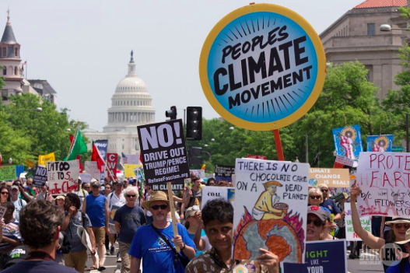
​CIVIL SOCIETY AND CORPORATE STRATEGIES TO ADDRESS CLIMATE CHANGE

Slide 2
Subject Guide
Civil society and corporate strategies to address global climate change
​Case study of the response to climate change in one country focusing on the actions of non-governmental stakeholders

Slide 3
Key terms
​Civil Society: Society considered as a community of citizens linked by common interests and collective activity.
Civil society is the “third sector” of society, along with government and business. It comprises civil society organizations and non-governmental organizations. (United Nations)
Non-governmental organisations (NGOs):A non-profit organization that operates independently of any government, typically one whose purpose is to address a social or political issue. A non-governmental organization (NGO) is any non-profit, voluntary citizens' group which is organized on a local, national or international level.
A non-profit organization that operates independently of any government, typically one whose purpose is to address a social or political issue.
Corporate: Relating to a large company or group.

Slide 4
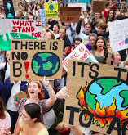
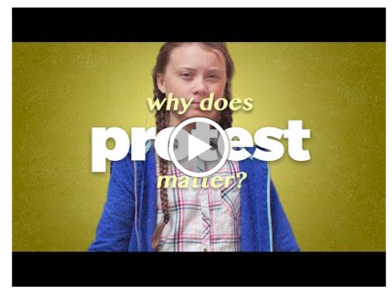
Examples of civil society response related to climate change- Students around the world go on climate strike

Slide 5
Adults have failed. Failed to slash emissions and failed to curb global warming -- that is the view of hundreds of thousands of students who will protest climate inaction this Friday, by taking part in the Global Climate Strike.
Inspired by 16-year-old Swedish activist Greta Thunberg's weekly protests, the global youth climate movement has swept the globe, with students organizing strikes on every continent.

Slide 6
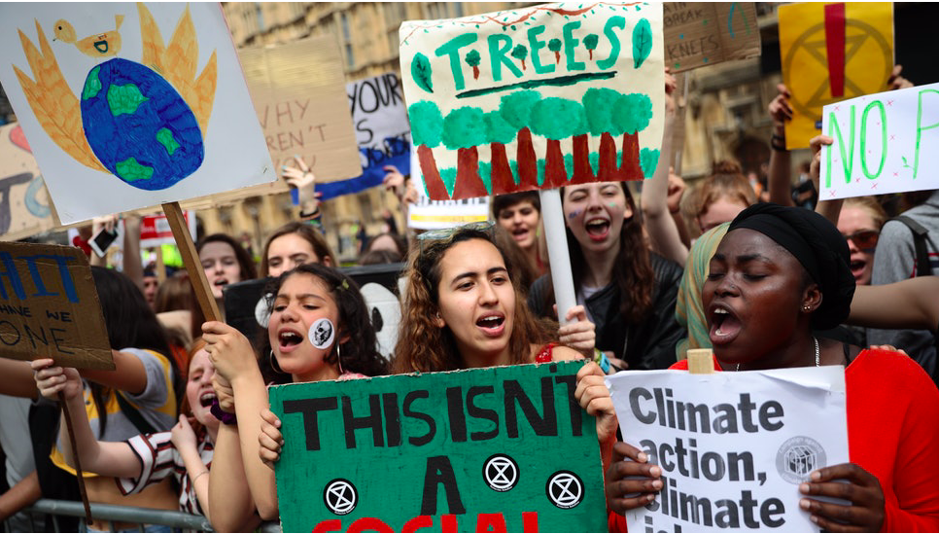
Conduct some research into the climate strikes
Who: is protesting? Who initiated this?
Where: are the protests happening?
Why: are they protesting?
What: Do they hope the outcomes will be?
How: is this an example of civil society action?
https://www.cnn.com/2019/03/14/world/global-climate-strike-teenagers-school-walkout-greta-thunberg-intl/index.html

Slide 7
Civil society action example 2: Semi-naked climate protesters disrupt Brexit debate: https://www.theguardian.com/world/2019/apr/01/semi-naked-climate-protesters-disrupt-brexit-debate?CMP=Share_AndroidApp_Outlook

Slide 8
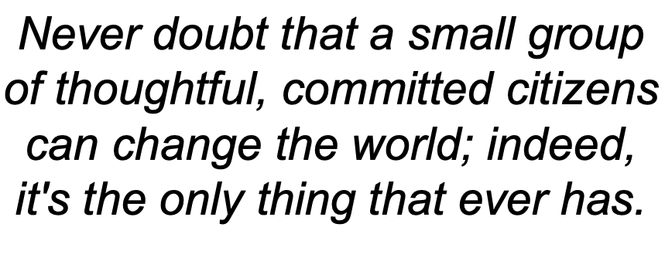
Is non violent direct action effective?

Slide 9
Power and Possibilities_Civil Society Advocacy
Read one or two of the cut out cards, each documenting one example of civil society advocacy on climate change.
Report back to your partner or group on the:
Place
Role of the civil society group
Scale at which the advocacy was operating
Discuss the wider role of civil society groups.

Slide 10
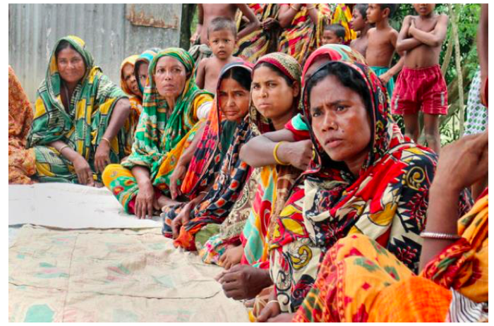
Civil society response in Bangladesh-
Place, Power and Possibilities_Building Resilience in Bangladeshi Women
Read the case study adapted from UN Women and the questions on how they are working on increasing women's resilience in Bangladesh.
How did the project work?
Why is it focused on women?
What makes women in particular more vulnerable to climate change?

Slide 12
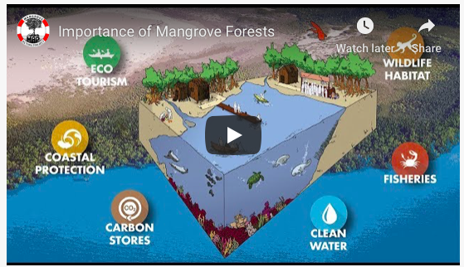
Place and Possibilities - Evaluating the Work of the Mangroves Action Project in Bangladesh
Use the worksheet, to evaluate the success of the NGO Mangroves Action Project in Bangladesh. Use the following site to research the NGO's role.

Slide 13
Civil society response in USA- extra reading
1. Read the text book overview on the Weebly
2. Study the links and videos on the Weebly. For each organisation identify:
Place - where do they operate? Where did they begin?
Process - how do they operate? Direct action? Campaigning/advocacy? Explain the ways in which they respond to climate change
Power - who are the people who run the organisation? What motivates them? Who makes the decisions? To what extent do they challenge government, business or NGOs?
Possibility - what are they aiming to achieve? What are the possible outcomes?

Slide 14
Why do companies care about climate change?
Watch the following video and make notes on:
1. Why corporations are taking climate change seriously
2. The role of corporations in regard to policy making

Slide 15
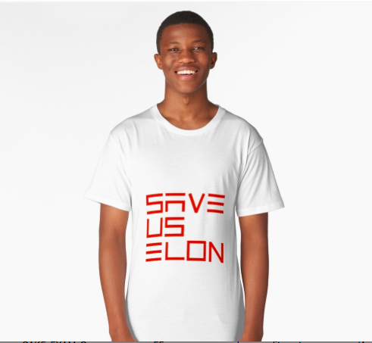
Corporate response
​Read page 465-466 in the textbook
1. Explain three reasons that some people, businesses and governments do not see climate change as a priority. 2. Describe four areas of risk that climate change could bring to companies (p227 Codrington) 3. Now describe four responses that some companies are making to the risks of climate change (p227 Codrington)
Read the Guardian article and respond to the questions on the weebly.

Slide 16
A case for optimism?

Slide 17
A case for optimism? Focus questions
What % of our energy still depends on carbon based fuels? How much extra heat energy is being trapped each day?
Describe what has happened to the “normal distribution” of temperatures using data from the clip.
What is happening to ocean temperatures and what impact has this had?
What has happened to global levels of humidity and why? What effect does this have?
How have predictions on the development of wind power been wrong?
What progress has been made in use of energy storage?
How were predictions on use of solar wrong?
How have investments in renewable/clean energies from business (corporate) sources grown?
How does this compare to previous projections (eg cell phones)? What were the reasons for this? What was the role of LICs? How might this be applicable to energy?
What evidence is there of individual nations taking action?
Why do the actions of individuals have importance?
What is the relevance of the story about Kennedy’s challenge to the US to go to the moon and the average age of the team who worked on this?
Why is this regarded as a moral challenge?

