Slide 1
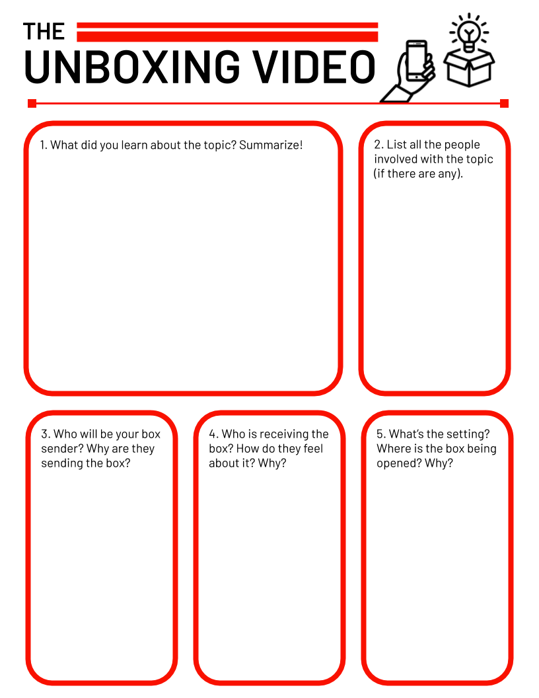
Having a hard time reading something? Remember, you can zoom in on any part of this planning guide. Just use the zoom button. The little dropdown arrow next to it has an option called “zoom in”.
Type your answer here ...
Type your answer here ...
Or you can click the zoom button and then click and drag the area you want to zoom in. That way, it’s zoomed to exactly the part you need! (You can always zoom out by choosing “fit” in the zoom dropdown menu.)
Type your answer here ...
Type your answer here ...
Type your answer here ...

Slide 2
Having a hard time reading something? Remember, you can zoom in on any part of this planning guide. Just use the zoom button. The little dropdown arrow next to it has an option called “zoom in”.
Type your answer here ...
Type your answer here ...
Or you can click the zoom button and then click and drag the area you want to zoom in. That way, it’s zoomed to exactly the part you need! (You can always zoom out by choosing “fit” in the zoom dropdown menu.)
Type your answer here ...

Slide 3
Having a hard time reading something? Remember, you can zoom in on any part of this planning guide. Just use the zoom button. The little dropdown arrow next to it has an option called “zoom in”.
Type your answer here ...
Or you can click the zoom button and then click and drag the area you want to zoom in. That way, it’s zoomed to exactly the part you need! (You can always zoom out by choosing “fit” in the zoom dropdown menu.)

