Slide 1
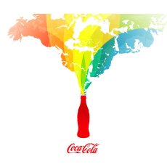
Consumer culture

Slide 2
Consumerism
Consumerism is the opposite and enemy of culture. Whereas culture is embedded in history, tradition and continuity, goods are manufactured for the profit they make.
“Every time you spend money, you're casting a vote for the kind of world you want’.
Anna Lappe, O Magazine, June 2003

Slide 4
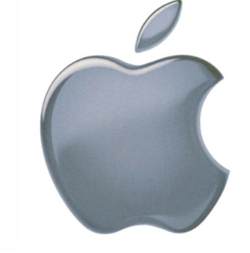
Global Brands: How many can you identify and which country are they from?

Slide 5
Interbrand: the top 100 global brands 2017?
Predict- what will be in the top 10?
(based on income)

Slide 6
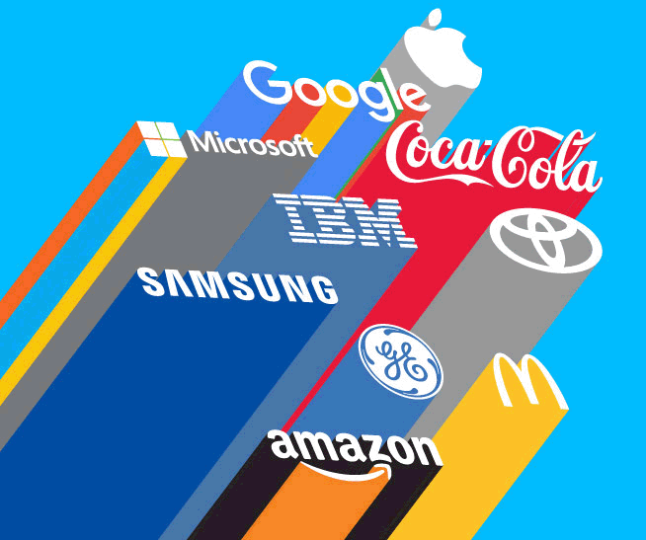
http://interbrand.com/best-brands/best-global-brands/2017/
Make notes on the brand value of coco cola and MacDonalds and explain why they are successful globally.

Slide 7
Discuss….
What role do these brands have in spreading a global culture?

Slide 9
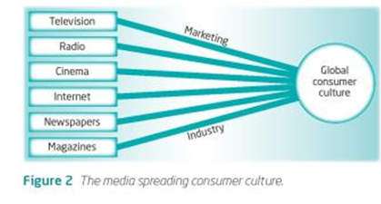

Slide 10
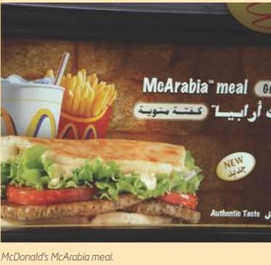
Branded commodities
You are expected to show how a branded commodity adopted globally in terms of time and space.
When and where did this product enter into different global markets? Which countries did not adopt this commodity?

Slide 12
EXAM QUESTION
Analyse the spatial and temporal pattern of adoption of one or more branded commodities. [10 marks]

Slide 15
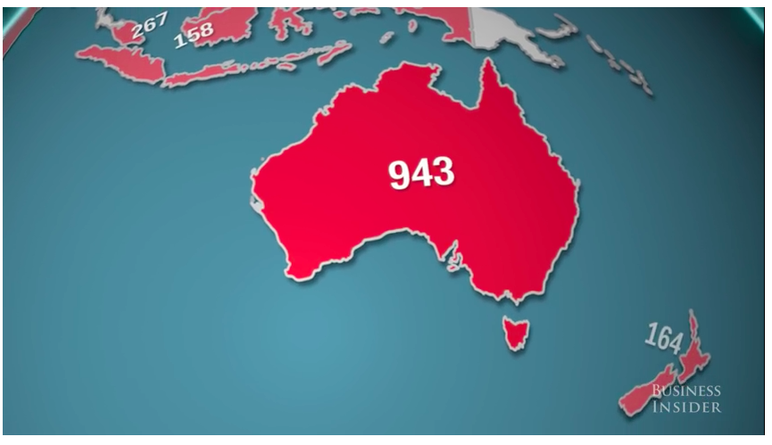
Where are the McDonalds?
Which countries have a lot?
Which have none?
WHY?

Slide 16
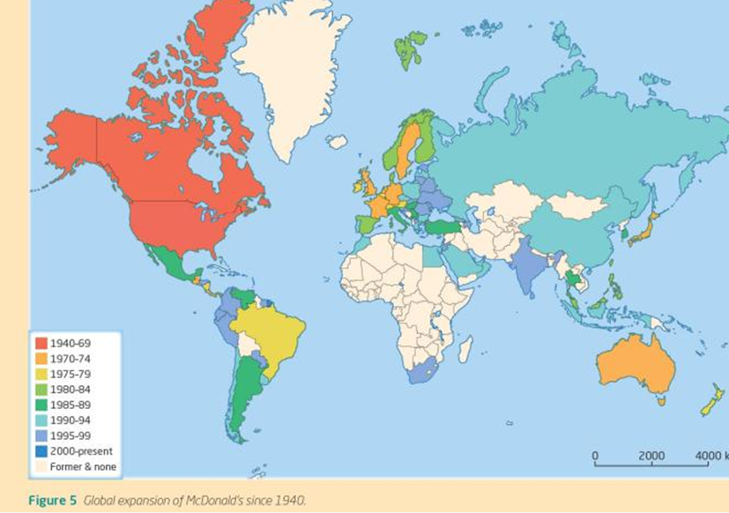
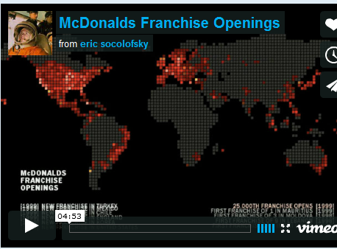

Slide 17
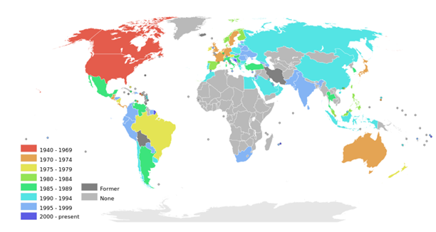
The global spread of McDonalds

Slide 18
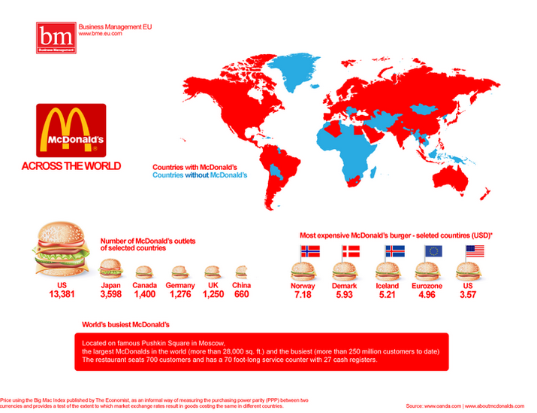
What may be barriers to globalization?
List at least 3 with your partner

Slide 19
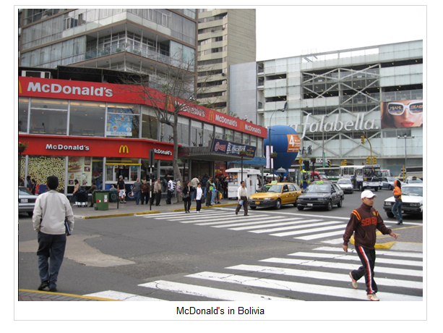
McDonald’s close all their stores in Bolivia, making Bolivia the only Latin- American free McDonald’s.

Slide 20
McDonald’s close all their stores in Bolivia, making Bolivia the only Latin- American free McDonald’s.
After 14 years in the nation and despite many campaigns and promos McDonald’s was forced to close its 8 Bolivian restaurants in the major cities of La Paz, Cochabamba and Santa Cruz de la Sierra.
McDonalds announced a global restructuring plan in which it would close its doors in seven countries with poor profit margins.
With over 33 000 stores worldwide one could suppose that 8 less would hardly make a difference to the world’s largest food vendor’s bottom line but could inspire a revolt amongst other nations who equate the chain as low brow fast food that leads to health problems or worse American imperialism- something that has never gone down too well with the locals.
The failure of McDonald’s in Bolivia had such a deep impact in the company’s Creative and Marketing staff, that they produced a documentary titled “Why did McDonald’s Bolivia go Bankrupt,” trying to explain why did Bolivians never crossed-over from empanadas to Big Macs.

Slide 21
iv. Read the article to the right hand side and this BBC article then explain why McDonald's a Coca Cola have consistently maintained their brand value and loyalty. What has been the key to their success? Are there any areas that have been hard to reach?

Slide 22
Extra information:
BBC Documentary 2013 Inside The McDonalds Empire National Geographic Documentary : here

Slide 23
McDonalds facts

Slide 24
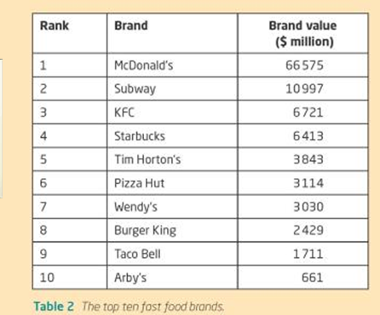

Slide 25
McDonalds global expansion
On average 30 million customers are served in one of the 31,000 McDonalds restaurants in one of more than 100 countries.
First located in USA and Canada, then spread to Europe, Australia and Japan in 1970s.
1980s spread to Mexico, S America and SE Asia
1990s the restaurant spread to China, Russia and the Arab World

Slide 26
Why did McDonalds go global?
The company initially had rapid growth (between 1961 and 1991 it was 24 % annually)
Growth based on innovative marketing and high standards of quality and marketing
BUT competition grew stiffer in USA so they had to expand
In 1991 was the first time McDonalds had more outlets overseas than in the USA
In 1996 the peak year of expansion McDonalds opened 200 restaurants globally

Slide 29
Global McDonalds
The company probably expanded too quickly in countries that cannot afford the $1 burger.
About 14000 restaurants are in the USA-43.5% of global trade
Growth rate has been high in China where there were 136 new restaurants in 2008.
Low representation in African nations.

Slide 30
Global McDonalds
McDonalds are famed for their uniformity (small variations e.g. Mc Spaghetti in Philippines) and the same style service
But McDonalds may not be the force of Cultural homogenization that it suggests- McDonalds has been localized, indigenized and incorporated into local cultural forms and practices.

Slide 31
It was an experience, eating out at McDonalds, one in which parents were willing to spend about 1/6 of their monthly income on in order to treat the family to a meal. McDonald’s was considered quintessentially American, and thus, mothers and fathers were enthusiastic about providing their children an opportunity to observe this. Unlike local restaurants, McDonald’s expected the customer to seat themselves and to clear their trash after eating. Resident had learned these behaviors by observing foreigners’ behaviors.

Slide 32
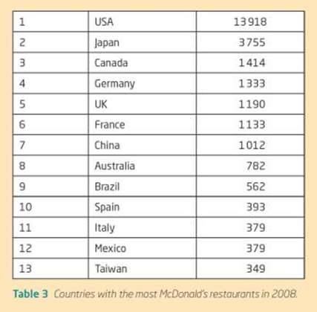

Slide 33
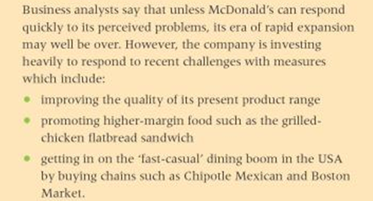

Slide 35
Some questions about McDonalds…

Slide 37
Read….
P590-593 of changing identities and cultures 2

Slide 38
Glocalisation
Spot the difference between the two images. Why is this an example of glocalization?

Slide 39
Aims of this lesson:
To be able to distinguish between the terms globalization and glocalization.
To examine the extent to which commercial activities at a local scale have become globalized.
To examine the reasons why the level and rate of adoption varies from place to place.

Slide 40
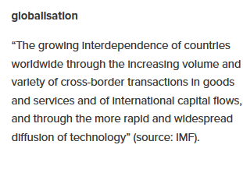
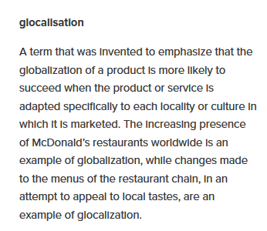

Slide 41
What is Glocalisation?

Slide 42
Glocalisation: The adaptation of a global product for a local market place. The word comes from an amalgamation of the words globalisation and localisation. Globalisation: The spread of economic, cultural and social ideas across the world. Localisation: The act of operating locally in terms of employees, product, supply of raw materials, etc.

Slide 43
Why did glocalisation devlop?
From the local sourcing of parts by TNCs when establishing branches overseas.
It involves using components from local suppliers to assemble global products.
Glocalisation helps a firm gain acceptance in the local economy while customizing the product to local tastes.

Slide 44
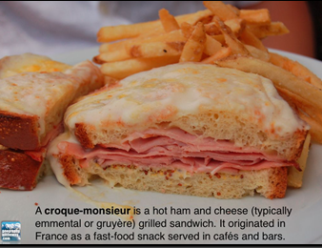
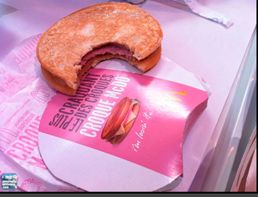
Glocalisation and MacDonalds

Slide 45
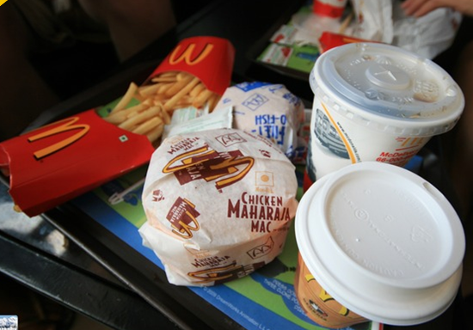
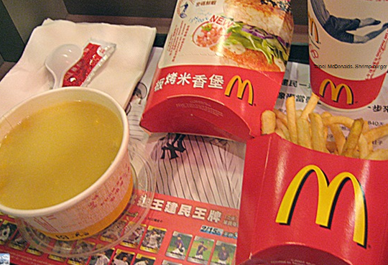
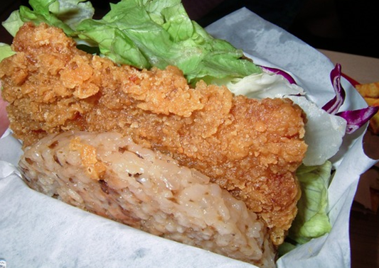
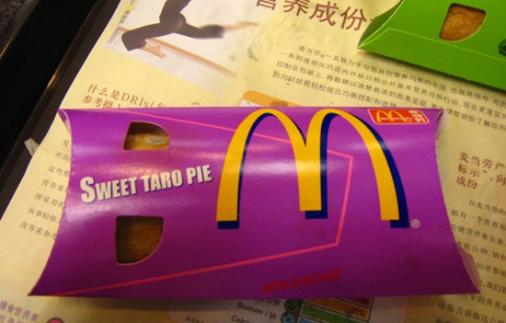
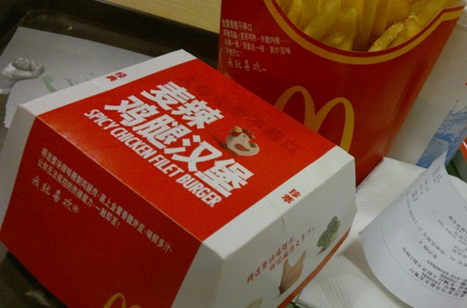

Slide 46
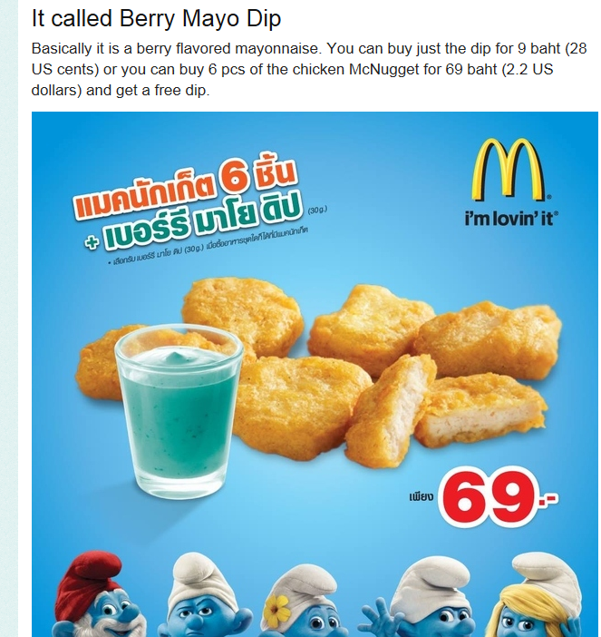

Slide 47
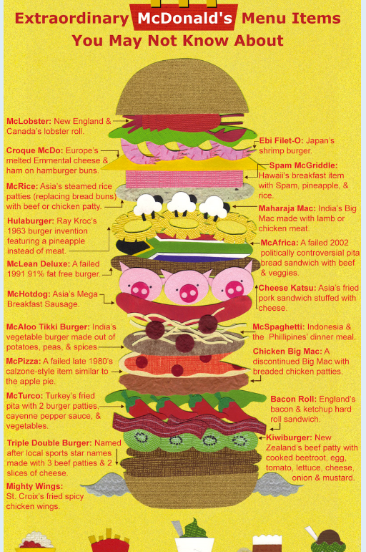

Slide 48
McDonalds and Glocalisation
Some researchers believe that the extremes of globalisation could be modified or adapted to fit local conditions.
In the USA McDonalds is a fast food restaurant, but in Seoul, Taipei and Beijing it is a place to go for a leisurely meal.

Slide 49
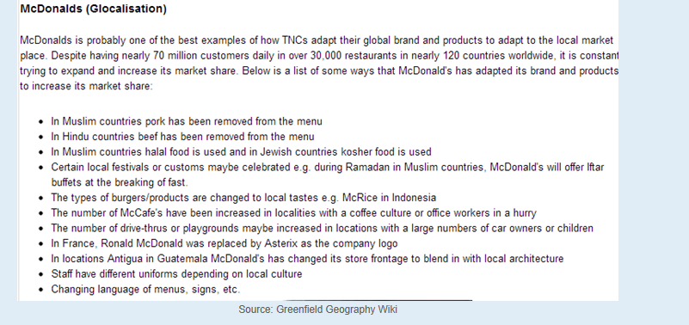

Slide 50
McDonalds and globalisation
A number of questions could be asked of McDonalds:
Does the spread of fast food undermine local producers
Does the spread of fast food undermine local dietary patterns?
Does the spread of fast food create environmental problems such as water shortages?
Does the spread of fast food cause socio-cultural problems such as conflict between different generations.

Slide 51
How fast food restaurants may vary globally….
In China and Vietnam, locals have to dress up and make reservations to dine at Pizza Hut. "When I'm out on a date and want to impress a girl“
In Hong Kong, upscale McDonald's recently started offering wedding packages.
In Japan, Denny's serves dishes with foie gras and truffles.
Also in Japan, Subway, which surpassed McDonald's last month as the world's largest fast food chain, does not just serve fresh ingredients, it grows them in its backyard.
The McDonald's in China is a prestigious place to work. The corporation recently opened a Hamburger University in Shanghai. With an acceptance rate less than 1%, the management training program is harder to get into than Harvard.
In India, Taco Bell and McDonald's are Hindu-friendly, substituting beef for chicken, lamb, potatoes or paneer (Indian cheese). In Muslim countries, Subway, Taco Bell, KFC and McDonald's serve only halal meat.

Slide 52
Read the articles:
McDonald's 'Italianised' menu: the future of fast food?
http://www.theguardian.com/lifeandstyle/wordofmouth/2013/may/27/mcdonalds-italianised-menu-future-fast-food
http://newsfeed.time.com/2012/09/04/mcdonalds-goes-vegetarian-in-india/
Make notes on how McDonalds are adapting their menu items to suit local tastes

Slide 53
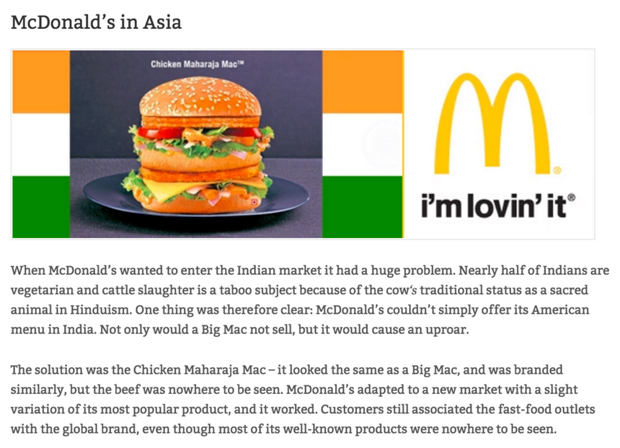

Slide 54
Anti McDonalds sentiments in India
McDonalds has opened restaurants in New Deli and Mumbai.
Environmentalists believe that the fast food industry is destroying not only the Indian environment but also the traditional way of life.
Encourages a diet of meat that the country cannot afford
The animals that give the meal, milk and eggs are fed on the same amount of grain that would feed 5x more people if they ate it themselves.

Slide 55
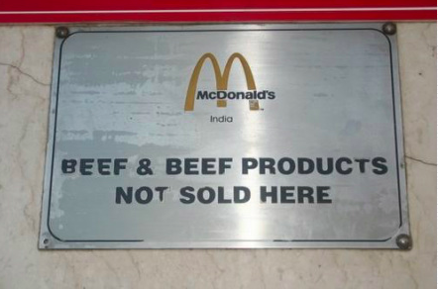
How have McDonalds conquered the Indian Market?
Check out this October 2014 BBC news article about how McDonalds has "conquered" India. How did McDonalds glocalize their product to fit the Indian food market?
Complete the worksheet
You will need to access the global McDonalds site: http://corporate.mcdonalds.com/corpmcd/about-us/around-the-world.html

Slide 56
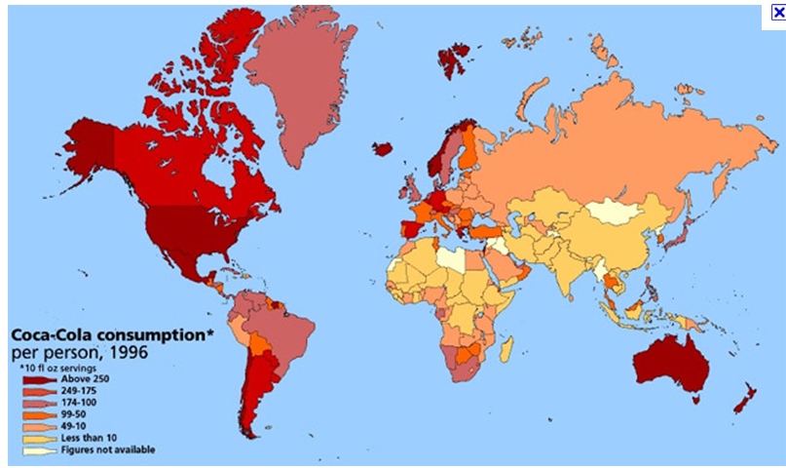
Global coca-cola

Slide 57
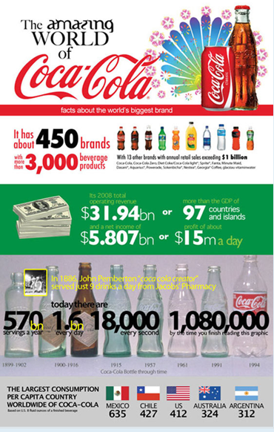

Slide 59
Extra information:
Coca Cola The Real Story Behind the Real Thing : here

Slide 60
Coca cola
Started in Atlanta, USA (this is where its headquarters are still located) in 1896 by John Pemberton .
Around the world, people enjoy Coca-Cola beverages 1.5 billion times a day, and its 450 brands and more than 2,800 products are distributed in 200-plus countries.

Slide 61
Coca cola
The biggest selling drink in history.
Arrived in the UK in 1900 through soda fountain outlets in locations such as Selfridges.
Now the word ‘coca cola’ is thought to be the second most recognized world in the world after “OK”!

Slide 62
Production of coca-cola
Coca cola brands in the UK
Its drinks are produced by local people with local resources. Coca cola produces brands that embrace distinct tastes and preferences.

Slide 63
Coca cola in China
Worlds biggest market
Coco cola has adapted its product range to gain a larger market share e.g. 355ml bottles (half the size of the normal bottle)- makes it cheaper and so more accessible to a larger market.

Slide 64
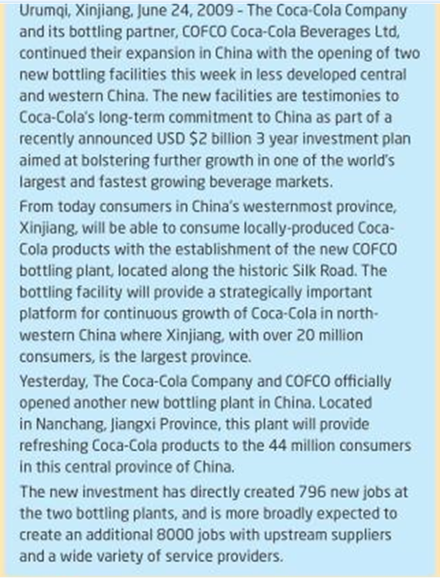

Slide 65
Coca cola in China
In 2008 Coca colas market share accounted for 52.5% of the carbonated drinks market. The biggest selling product was not actually lemon-lime sprite which is a coco cola brand.
Has used marketing extensively to gain market share- particularly through sports.

Slide 66
Investment in China
Has invested $1.6 billion in China since 1979 and plans to invest another $2 billion between 2010 and 2013.
Its sees increased urbanization in China an important way in which it can increase its market share.
The company were disappointed when the government recently blocked its merger with Chinese drink manufacturer Huiyuan. The government were concerned it would give coca- cola too bigger market share.

Slide 67
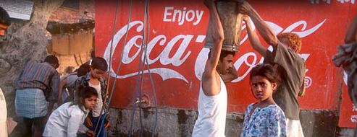
Link back to Coca Cola and water issues in India
Coca-Cola established a bottling plant in the village of Kaladera in Rajasthan at the end of 1999. Rajasthan is well known as a desert state, and Kaladera is a small, impoverished village characterised by semi-arid conditions. Farmers rely on access to groundwater for the cultivation of their crops. but since Coca-Cola's arrival, they have been confronted with a serious decline in water levels. Locals are increasingly unable to irrigate their lands and sustain their crops, putting whole families at risk of losing their livelihoods.
http://www.waronwant.org/media/coca-cola-drinking-world-dryhttps://bassaleggeography.wordpress.com/2012/01/18/coca-cola-causes-water-shortages/

Slide 68
Less Consumer Culture?
http://www.businessweek.com/innovate/content/jun2007/id20070618_505580.htm: Sao Paulo- The city that said no to advertising

Slide 69
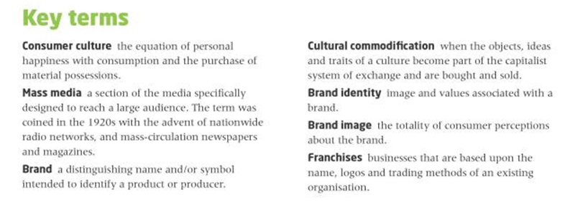

Slide 70
Exam question
'Wealth is drained out of local economies into the hands of a very few, very rich elite.’ Discuss this statement in terms of TNCs and consumer culture. (15)

