Slide 1
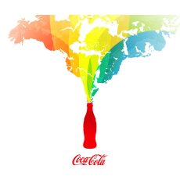
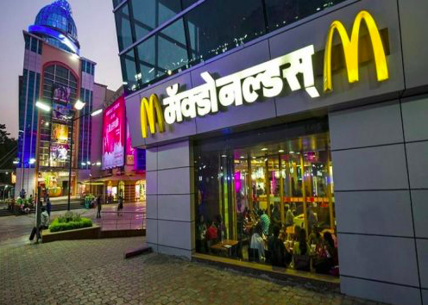
Consumer culture
IB LO:
The effects of global interactions on cultural diversity in different places:
Glocalization of branded commodities, and cultural hybridity
WHY: To understand how global interactions bring cultural influences and changes to places

Slide 3
Consumerism
Consumerism is the opposite and enemy of culture. Whereas culture is embedded in history, tradition and continuity, goods are manufactured for the profit they make.
“Every time you spend money, you're casting a vote for the kind of world you want’.
Anna Lappe, O Magazine, June 2003

Slide 4
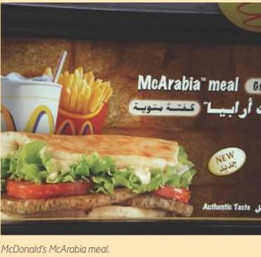
What is Glocalisation?
TNCs must glocalise for numerous reasons, including:
to meet local tastes and customs
to meet the health, safety or electrical requirements of the country
to meet the economic needs of the market.

Slide 6
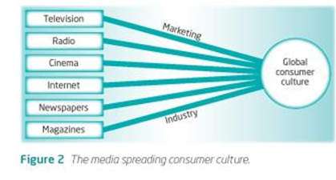

Slide 7
Branded commodities
You are expected to show how a branded commodity adopted globally in terms of time and space.
When and where did this product enter into different global markets? Which countries did not adopt this commodity?

Slide 9
EXAMPLE EXAM QUESTION
Analyse the spatial and temporal pattern of adoption of one or more branded commodities. [12 marks]

Slide 12
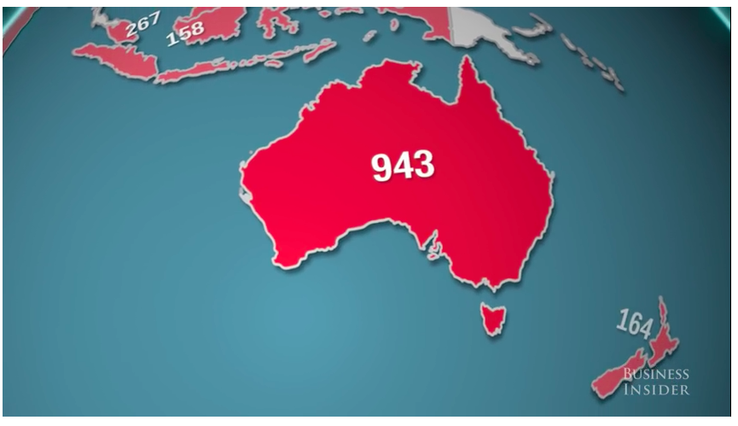
Where are the McDonalds?
Which countries have a lot?
Which have none?
WHY?

Slide 13
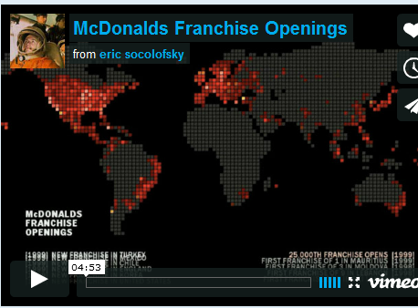
McDonalds timeline

Slide 14
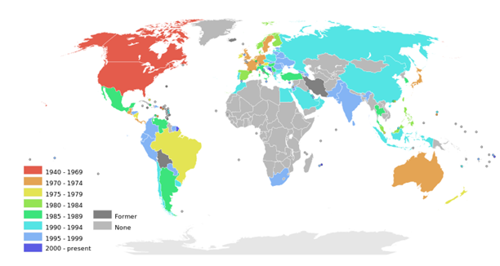
The global spread of McDonalds

Slide 16
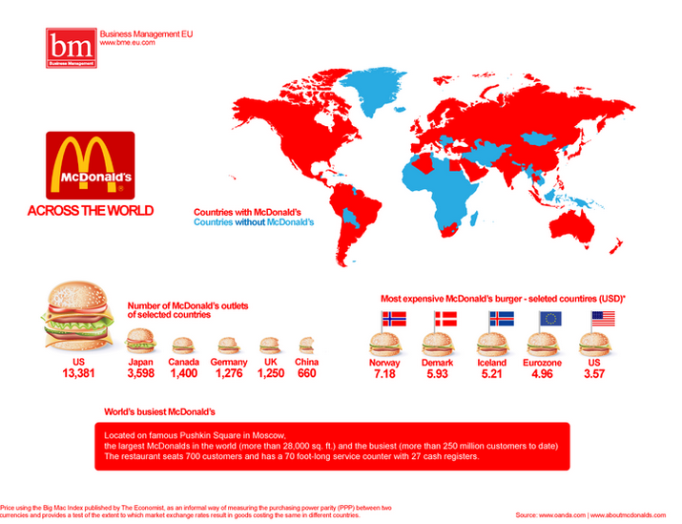
What may be barriers to globalization?
Which countries in the world don’t have a McDonalds?
List at least 3 with your partner

Slide 17
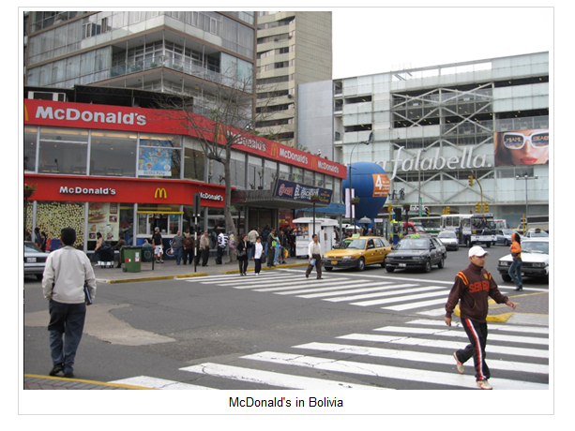
McDonald’s close all their stores in Bolivia, making Bolivia the only Latin- American free McDonald’s.

Slide 18
McDonald’s close all their stores in Bolivia, making Bolivia the only Latin- American free McDonald’s.
After 14 years in the nation and despite many campaigns and promos McDonald’s was forced to close its 8 Bolivian restaurants in the major cities of La Paz, Cochabamba and Santa Cruz de la Sierra.
McDonalds announced a global restructuring plan in which it would close its doors in seven countries with poor profit margins.
With over 33 000 stores worldwide one could suppose that 8 less would hardly make a difference to the world’s largest food vendor’s bottom line but could inspire a revolt amongst other nations who equate the chain as low brow fast food that leads to health problems or worse American imperialism- something that has never gone down too well with the locals.
The failure of McDonald’s in Bolivia had such a deep impact in the company’s Creative and Marketing staff, that they produced a documentary titled “Why did McDonald’s Bolivia go Bankrupt,” trying to explain why did Bolivians never crossed-over from empanadas to Big Macs.

Slide 19
iv. Read the article to the right hand side and this BBC article then explain why McDonald's a Coca Cola have consistently maintained their brand value and loyalty. What has been the key to their success? Are there any areas that have been hard to reach?

Slide 20
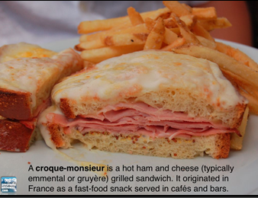
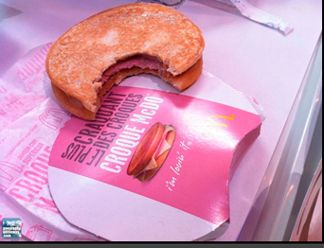
Glocalisation and MacDonalds

Slide 21
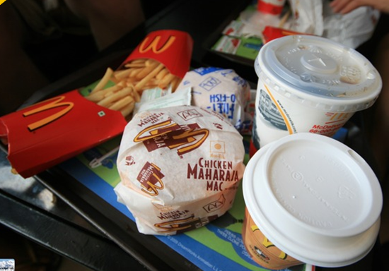
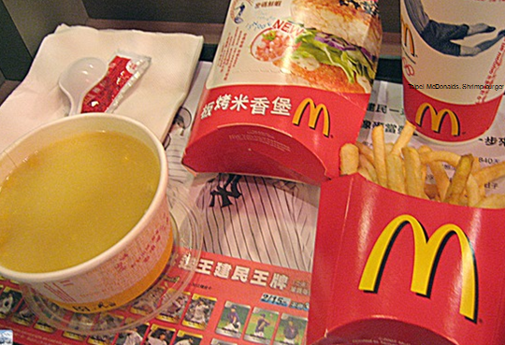
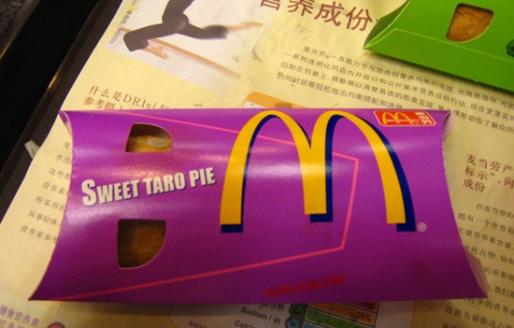
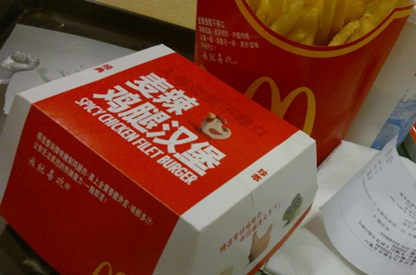

Slide 22
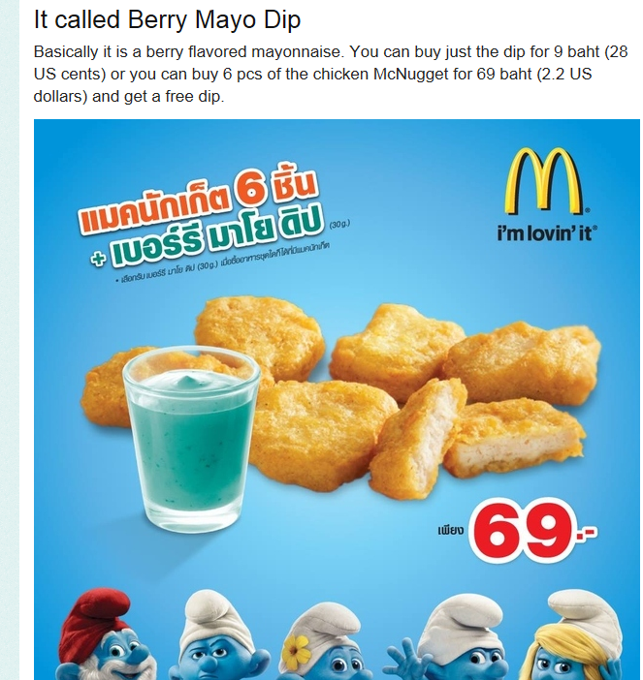

Slide 23
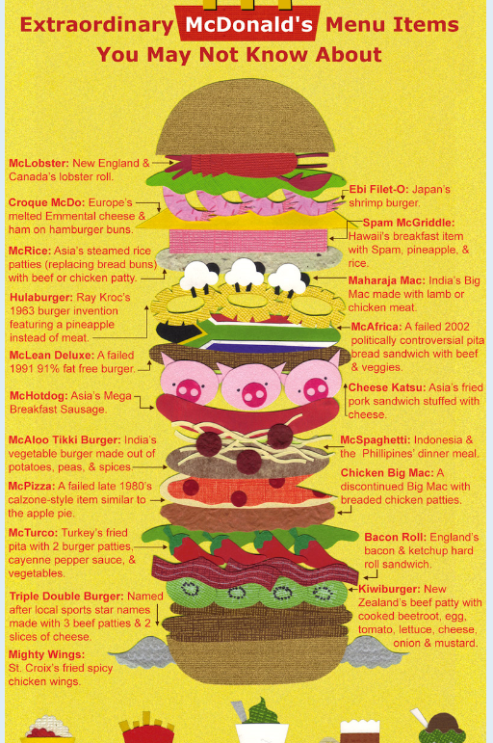

Slide 24
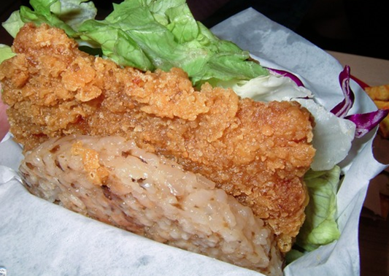
McDonalds and Glocalisation
Some researchers believe that the extremes of globalisation could be modified or adapted to fit local conditions.
In the USA McDonalds is a fast food restaurant, but in Seoul, Taipei and Beijing it is a place to go for a leisurely meal.

Slide 25
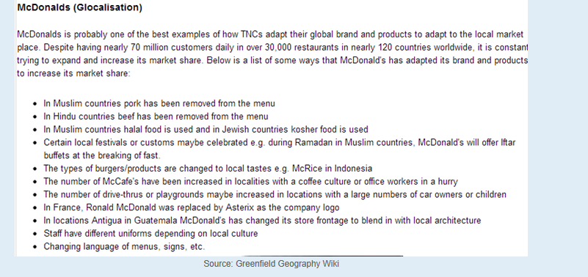

Slide 26
McDonalds and globalisation
A number of questions could be asked of McDonalds:
Does the spread of fast food undermine local producers
Does the spread of fast food undermine local dietary patterns?
Does the spread of fast food create environmental problems such as water shortages?
Does the spread of fast food cause socio-cultural problems such as conflict between different generations.

Slide 27
How fast food restaurants may vary globally….
In China and Vietnam, locals have to dress up and make reservations to dine at Pizza Hut. "When I'm out on a date and want to impress a girl“
In Hong Kong, upscale McDonald's recently started offering wedding packages.
In Japan, Denny's serves dishes with foie gras and truffles.
Also in Japan, Subway, which surpassed McDonald's last month as the world's largest fast food chain, does not just serve fresh ingredients, it grows them in its backyard.
The McDonald's in China is a prestigious place to work. The corporation recently opened a Hamburger University in Shanghai. With an acceptance rate less than 1%, the management training program is harder to get into than Harvard.
In India, Taco Bell and McDonald's are Hindu-friendly, substituting beef for chicken, lamb, potatoes or paneer (Indian cheese). In Muslim countries, Subway, Taco Bell, KFC and McDonald's serve only halal meat.

Slide 28
Read the articles:
McDonald's 'Italianised' menu: the future of fast food?
http://www.theguardian.com/lifeandstyle/wordofmouth/2013/may/27/mcdonalds-italianised-menu-future-fast-food
http://newsfeed.time.com/2012/09/04/mcdonalds-goes-vegetarian-in-india/
Make notes on how McDonalds are adapting their menu items to suit local tastes

Slide 29
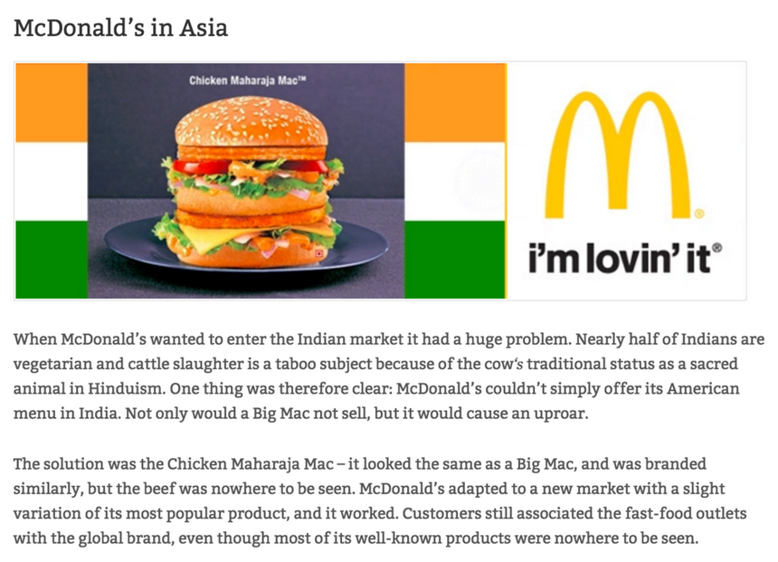

Slide 30
Anti McDonalds sentiments in India
McDonalds has opened restaurants in New Deli and Mumbai.
Environmentalists believe that the fast food industry is destroying not only the Indian environment but also the traditional way of life.
Encourages a diet of meat that the country cannot afford
The animals that give the meal, milk and eggs are fed on the same amount of grain that would feed 5x more people if they ate it themselves.

Slide 31
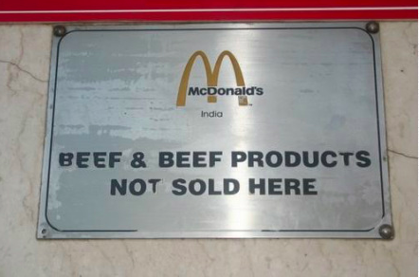
How have McDonalds conquered the Indian Market?
Check out this October 2014 BBC news article about how McDonalds has "conquered" India. How did McDonalds glocalize their product to fit the Indian food market?
Complete the worksheet
You will need to access the global McDonalds site: http://corporate.mcdonalds.com/corpmcd/about-us/around-the-world.html
Extra reading: Kognity 5.2.4
The glocalisation of branded commodities

Slide 32
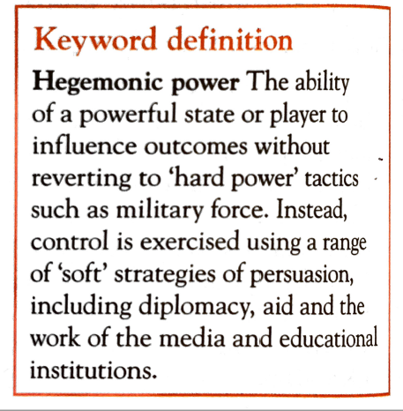
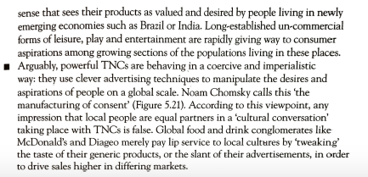
Cultural imperialism?

Slide 33
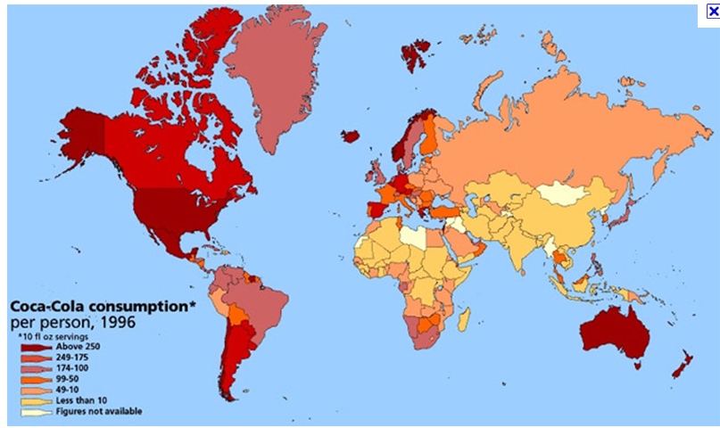
Global coca-cola

Slide 35
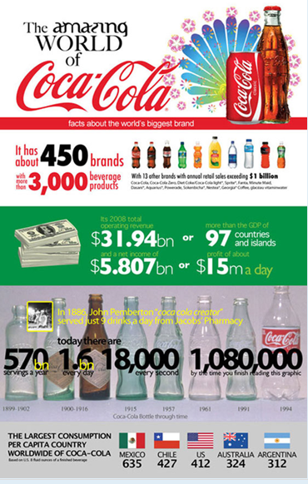

Slide 37
Extra information:
Coca Cola The Real Story Behind the Real Thing : here

Slide 38
Coca cola
Started in Atlanta, USA (this is where its headquarters are still located) in 1896 by John Pemberton .
Around the world, people enjoy Coca-Cola beverages 1.5 billion times a day, and its 450 brands and more than 2,800 products are distributed in 200-plus countries.

Slide 39
Coca cola
The biggest selling drink in history.
Arrived in the UK in 1900 through soda fountain outlets in locations such as Selfridges.
Now the word ‘coca cola’ is thought to be the second most recognized world in the world after “OK”!

Slide 40
Production of coca-cola
Coca cola brands in the UK
Its drinks are produced by local people with local resources. Coca cola produces brands that embrace distinct tastes and preferences.

Slide 41
Read:

Slide 42
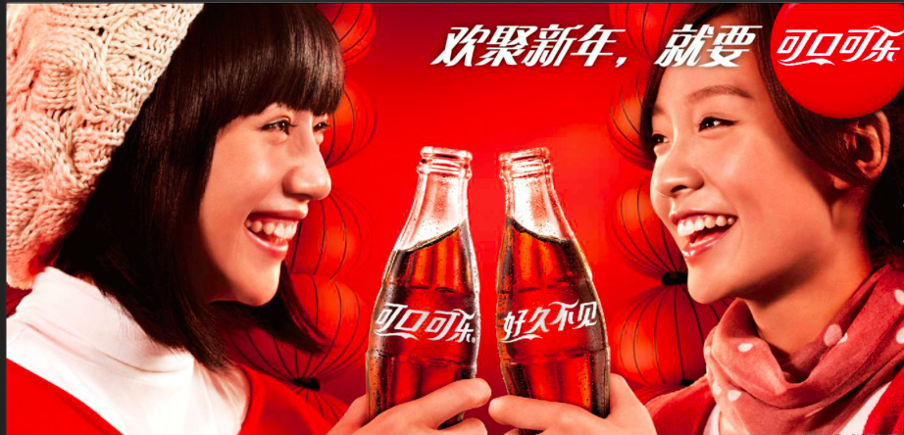
Coca-Cola in China
Worlds biggest market
Coca-Cola has adapted its product range to gain a larger market share e.g. 355ml bottles (half the size of the normal bottle)- makes it cheaper and so more accessible to a larger market.

Slide 43
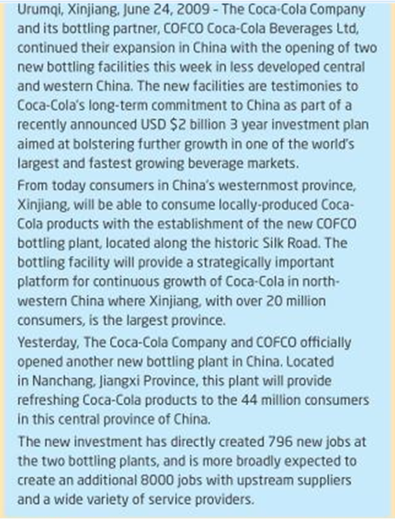

Slide 44
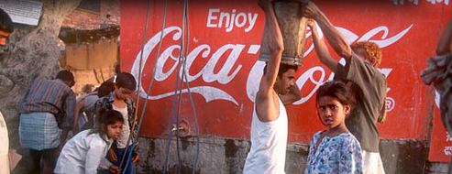
Coca Cola and water issues in India
FEW NEXUS and environmental issues of globalisation : Synoptic links
Coca-Cola established a bottling plant in the village of Kaladera in Rajasthan at the end of 1999. Rajasthan is well known as a desert state, and Kaladera is a small, impoverished village characterised by semi-arid conditions. Farmers rely on access to groundwater for the cultivation of their crops. but since Coca-Cola's arrival, they have been confronted with a serious decline in water levels. Locals are increasingly unable to irrigate their lands and sustain their crops, putting whole families at risk of losing their livelihoods.
http://www.waronwant.org/media/coca-cola-drinking-world-dryhttps://bassaleggeography.wordpress.com/2012/01/18/coca-cola-causes-water-shortages/
https://www.youtube.com/watch?v=tlfMBQGZUvQ&vl=en

Slide 45
Coca-Cola and corporate sustainability
https://www.coca-colacompany.com/water-stewardship-replenish-report/water-in-india
We are also partnering with NGOs, the government, other industries, farmers and local communities, along with our bottling partners, to establish and maintain water programs that replenish the equivalent amount of (or more than) the water we use annually. As a result of these efforts, Coca-Cola India has achieved full balance between total water used in beverage production and that replenished to nature and communities through community water projects in country. This work also supports Coca-Cola’s 100% global water replenishment goal.
Efforts to replenish groundwater in India are focused on rainwater harvesting, groundwater aquifer recharge, constructing check dams, restoring ponds and other natural bodies of water, and supporting agricultural improvements.

Slide 46
Cultural- Hybridity
When a new culture develops, whose traits combine two or more different sets of influences.
’Mash-up’ of global and local cultural elements.
When locals interact with different cultural flows they do not necessarily lose their own unique identity. Instead a hybrid culture results that combines elements of the traditional with modern/ global aspects.

Slide 47
Examples of Cultural hybridity and tribes
Rainforest tribes traditionally wore few clothes. Today many have adopted western clothes such as t-shirts and drink Coca-cola- this does not mean their culture has been lost. Modern brands can be adopted without important customs being abandoned.

Slide 48
Cultural hybridity and tribes
Positive
Negative
The Brazilian Kuikuro tribe enjoyed the country hosting the world cup (tribe of 600 in Xingu region). They really enjoyed watching the matches on TV and 15 of the tribe obtained tickets for Russia v South Korea
The traditional culture of the Jarawa tribe have been affected by global flows such as tourism. Cultural dilution and the adoption of alcohol are viewed as threats to the traditional way of life.

Slide 49
Exam question
'Wealth is drained out of local economies into the hands of a very few, very rich elite.’ Discuss this statement in terms of TNCs and consumer culture. (16)

