Slide 1
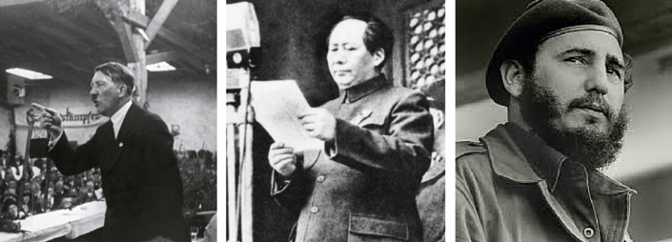
Comparing the Domestic Policies of Authoritarian States
L/O – To research and create a presentation that compares the aims, achievements, and failures of the domestic policies of authoritarian states

Slide 2
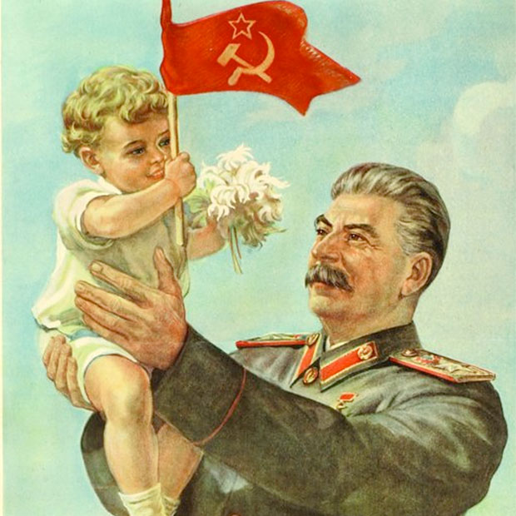
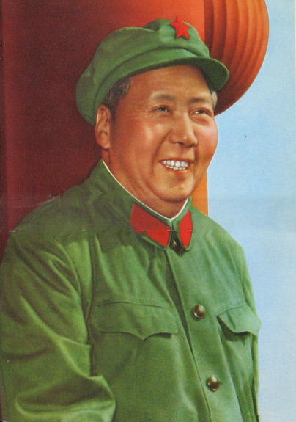
The Role of Domestic Policies
All authoritarian leaders, having taken power, seek to use government structures to enact their policies on society. All leaders hope to shape and recast society according to their political ideologies.
Left-wing Marxist leaders attempt to ‘build communism’ in their states. Right-wing leaders like Hitler usually attempt to ‘return’ their states to a national ideal.
All authoritarian leaders use domestic policies to not only enact their visions for society, but to also strengthen and maintain their power.

Slide 3
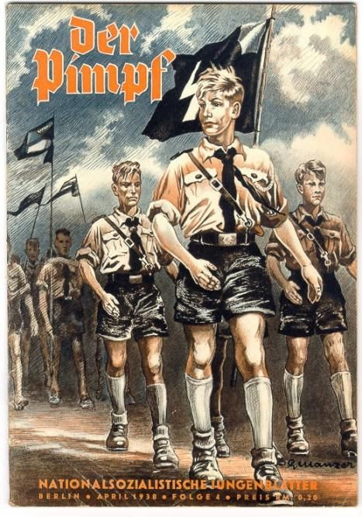
The Role of Domestic Policies
This means that economic, social, cultural and political policies are often used to change society in some way.
But they are also used to maintain power and stamp out opposition by controlling how society thinks and acts and even who belongs in that society.
Foreign policies can also be used to strengthen and enlarge their states, maintain their independence and preserve a leader’s power through foreign achievements that are domestically popular.

Slide 4
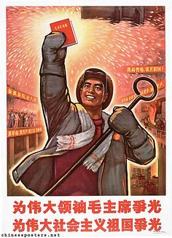
Economic Policies
All authoritarian states seek to direct the economy of their country in an attempt to achieve or support their ideology or political goals.
The development, focus and direction of the economy is crucial to fulfilling the broader objectives of the regime. Economic goals are state orientated and in some measure state directed.
This may include improvements in living standards, modernisation, industrialisation, or improved defence.

Slide 5
Economic Policies
To support this, some form of planning of economic activity is developed which is overseen by a party or government agency.
Obvious examples are the Five Year Plans used in Communist states, the Four Year Plan of Nazi Germany or the Great Leap Forward of Mao’s China.
The goals of these plans vary but they all seek to direct economic activity to serve the needs of the state and the political and ideological goals of the party in power.

Slide 6
Economic Policies
Economic policies are also the means by which authoritarian regimes seek to fulfil economic promises made during their rise to power. This may include land reform, or employment opportunities.
These plans can impact society hugely. Standards of living may suffer if resources are diverted into areas that do not serve consumers directly like defence spending.
The success or failure of economic policies largely determines the ability of the regime to retain power. The collapse of the USSR is an example of this.

Slide 7
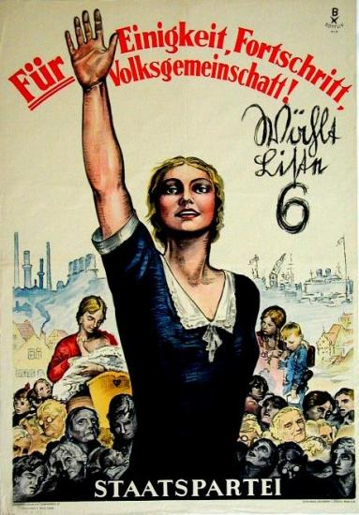
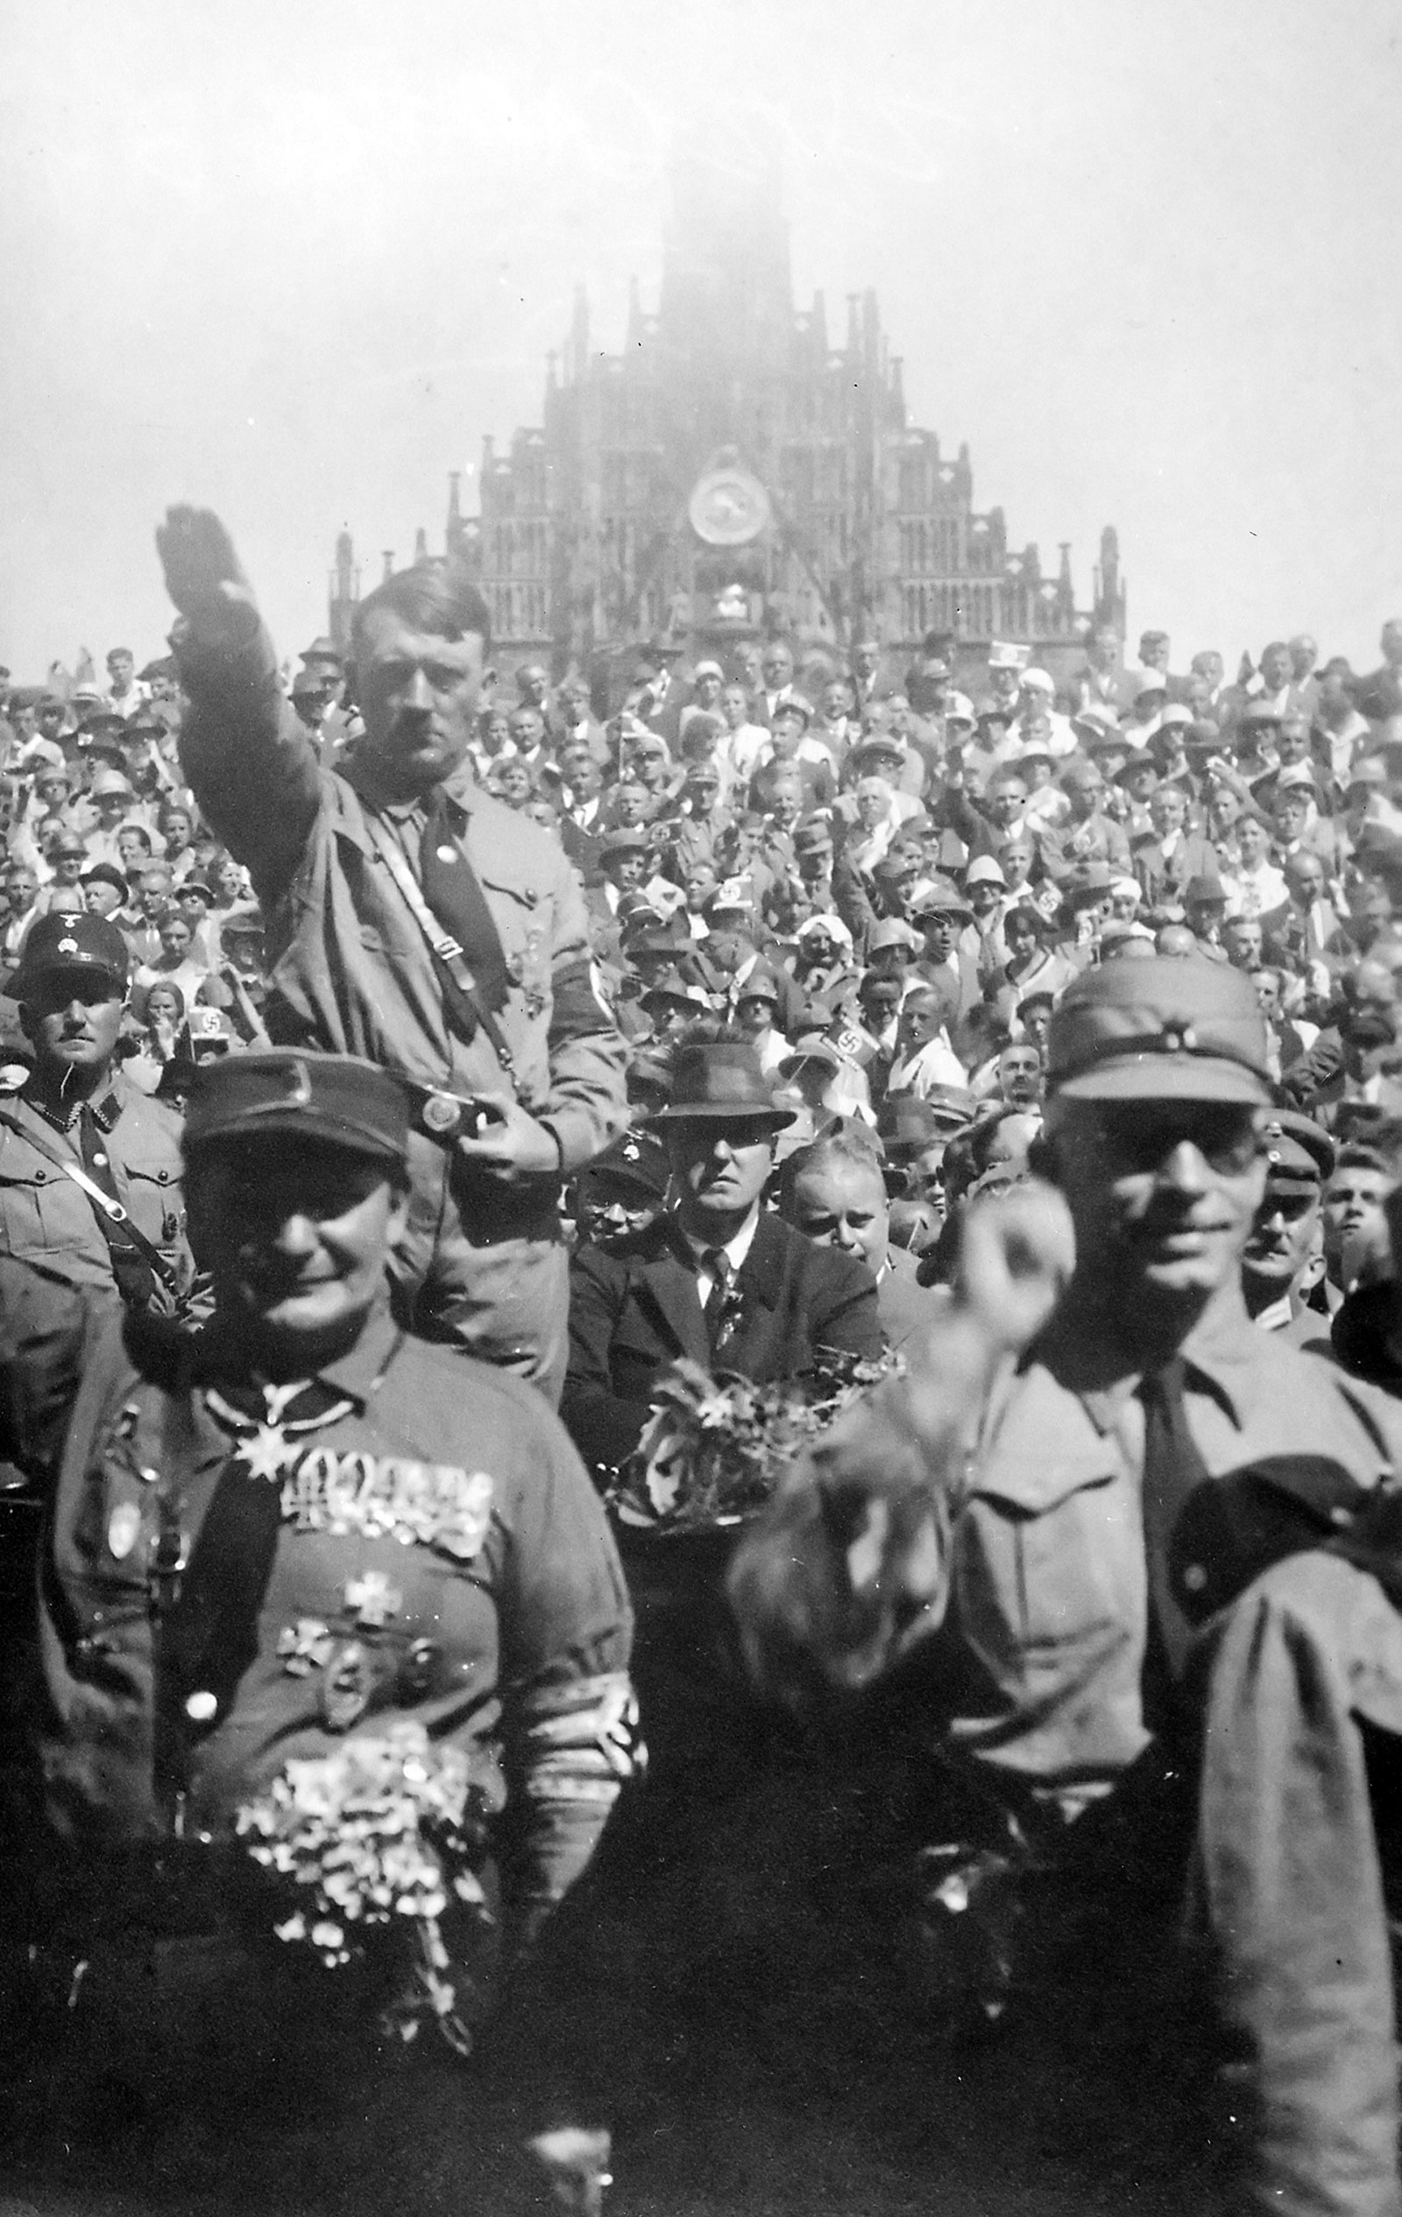
Social and Cultural Policies
All authoritarian states have ideas about the nature, form and direction that society should take.
Right-wing states seek to create or recreate what is seen as a ‘golden age’ of past society. They support traditional values in relation to the status of women, family life, education, moral values, occupations, class structure and hierarchy.
Respect for tradition and authority, nationalism, racism and suspicion of liberal or progressive ideas are common.

Slide 8
Social and Cultural Policies
Left-wing states tend to support more progressive social ideas. This includes gender equality, elimination of classes, looking to the future rather than the past, more liberal treatment of minorities, the poor and others.
Whether traditional or progressive, all authoritarian states engage in extensive social engineering to produce citizens whose values mirror those of the state.
This requires state control over communications, the media, education, culture and the arts in order to ‘condition’ citizens.

Slide 9
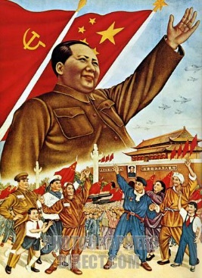
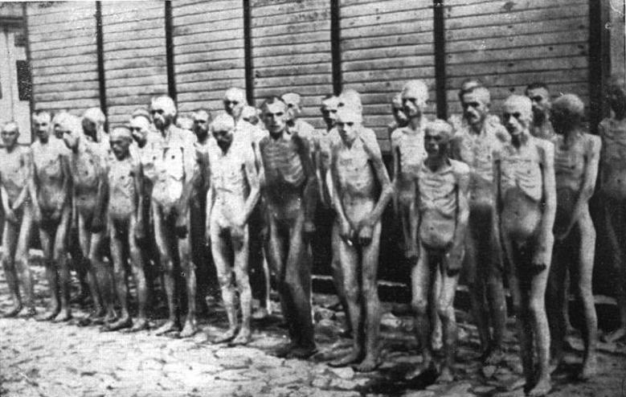
Social and Cultural Policies
In Mao’s China, the GLF and Cultural Revolution attempted to construct a ‘new socialist man’. This man would be a true socialist, always consider others first, and having no desire for personal gain.
In addition to psychological changes, some authoritarian states also try to create a genetically ideal society based on racial or ethnic identity. This can lead to state policies which are intentionally discriminatory or racial.

Slide 10
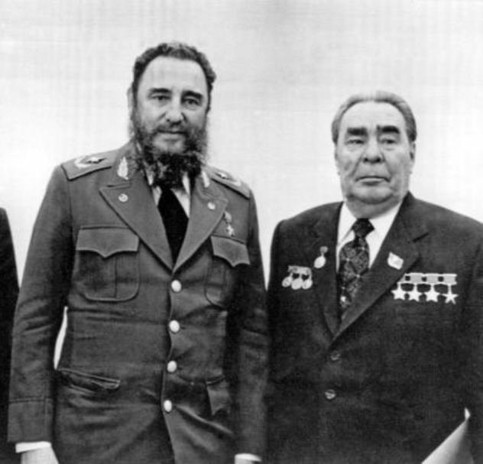
Foreign Policies
For many authoritarian leaders, foreign policy is often used as a way to achieve their domestic objectives.
The success of economic policies relies on access to economic resources. This can be achieved through war, conquest, trade and alliances.
The maintenance of power also requires the state to be secure against invasion, or to meet political promises such as ‘returning’ lands previously taken or righting historic wrongs.

Slide 11
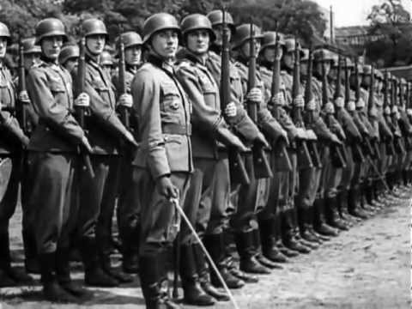
Foreign Policies
For Hitler, this meant using armed force to overturn the Treaty of Versailles, return lost German lands, and creating ‘living space’ in Eastern Europe (lebensraum).
For Mao, armed force was used to prevent foreign domination, consolidate the boundaries of the state and to spread communism.
Clearly, successful foreign policies have the ability to strengthen political power and achieve domestic political aims.

Slide 12
Your Task
Domestic Policies Groups
Economic Policy
Political Policy
Cultural Policy
Social Policy
Policy towards Women
Policy towards minorities
You will research and compare a different aspect of domestic policy for Hitler and Castro.
What were the aims of this policy?
What achievements were there?
What failures were there?
Comparison – What similarities and differences are there between the 2 leaders?
Conclusion – Overall Judgement on Success of policy
Perspectives – At least two rival viewpoints on this policy explained

