Slide 1
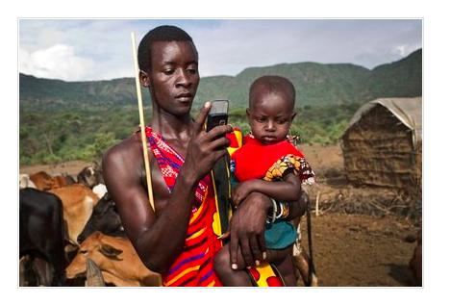
Developments in communications
What: Our “shrinking world” and the forces driving technological innovation:
changing global data flow patterns and trends
patterns and trends in communication infrastructure and use
Why: To explain how a ‘shrinking world’ has been the result of various forces driving technological innovation

Slide 3
Quiz from Oakes reading
What is the internet of things?
Where are many of the internet cables carrying cross border information today?
How many GPS satellites are there?
Name one way in which the development of communication infrastructure has facilitated economic globalisation….
Name one way in which the development of communication infrastructure has facilitated social globalisation….
Name one way in which the development of communication infrastructure has facilitated cultural globalisation….
Name one way in which the development of communication infrastructure has facilitated political globalisation….
What does the term digital divide mean?
How did the amount of mobile phone users in Africa change between 2005 and 2015?
True or False: Are there more mobile phones than people on the planet?
What is the name of the mobile phone service that allows credit to be directly transferred between users?
Name some of the services apps have been developed for in Kenya

Slide 4
The internet of things: connecting any device with an on and off switch to the Internet (and/or to each other). This includes everything from cellphones, coffee makers, washing machines, headphones, lamps, wearable devices and almost anything else you can think of: https://www.forbes.com/video/4609490745001/
Under the sea
24
TNCs expand into new areas, large data files can be moved, self-employed citizens can gain funding through crowdfunding
Migration because of contact with long distance connections, gaining education remotely, remote health care
Cultural traits such as language, or music are adopted quicker than ever before. Small independent music and comic companies can achieve economies of scale to a niche fanbase.
MGOs (i.e. the UN, world bank) can disseminate information more easily. Social networks can be used to spread the news of civil society groups more easily.
The gap between those who have access and do not have access to the internet
From 6% in 2005 to 60% in 2015
True
M-PESA
health care, education, finance, agriculture, retail and government services.

Slide 6
Global patterns of internet
https://global-internet-map-2017.telegeography.com

Slide 7
Extension of Links and Nodes
NODE: In networks, a processing location. A node can be a computer or some other device, such as a printer. Every node has a unique network address.

Slide 8
Extension of Links and Nodes
The extension of links of the internet can be both 'physical' and 'socio-economic'.
'Physical' via the need for submarine cables and infrastructure.
'Socio-economic' via the need for people to be online with computers, mobiles and broadband access to actually be connected to others.

Slide 9
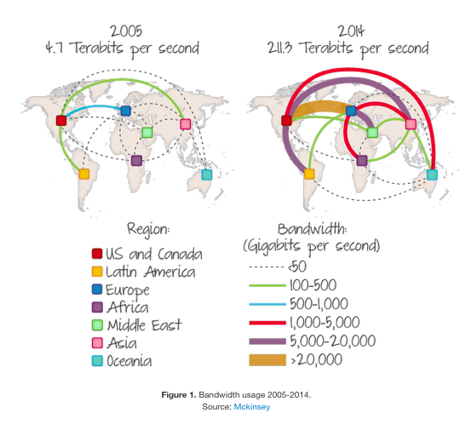
Increase in bandwidth

Slide 10
How data travels

Slide 11
Undersea cables
Cables lying on the seafloor bring the internet to the world. They transmit 99 percent of international data, make transoceanic communication possible in an instant, and serve as a loose proxy for the international trade that connects advanced economies.
The cables are so widely used, as opposed to satellite transmission, because they're so reliable and fast: with high speeds and backup routes available, they rarely fail. And that means they've become a key part of the global economy and the way the world connects.
https://www.youtube.com/watch?v=Ve810FHZ1CQ

Slide 13
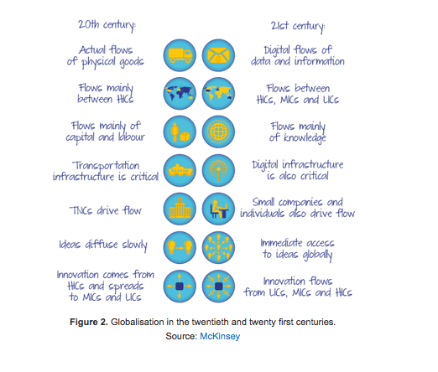

Slide 14
Evaluation
"ICT only has beneficial roles in our shrinking world." Discuss this statement [16 Marks]

Slide 15
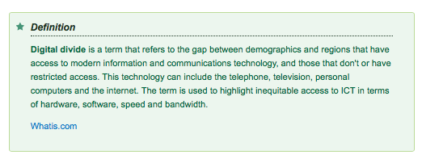
Digital divide

Slide 16
Digital divide amongst household and individuals
Inequality in the ICT network infrastructure and distribution of IT knowledge, skills and resources necessary to access online services and information among different sectors of a modern society.
Two factors: income and education= positive correlation

Slide 17
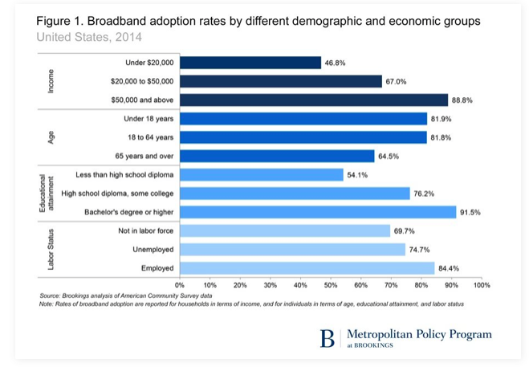
Digital divide in the USA
Based on 2014 Census data, only 75 percent of Americans live in a household with a private high-speed internet connection. This includes an even more obvious digital divide by income, education, age and other demographic factors.

Slide 18
Connectedness and black holes

Slide 19
Some governments seek to censor or control data flows as a matter of policy. The map below shows countries that limit or have limited access to social media at some time in their history.
Synoptic thinking : Could China’s firewall impact its progress to a ‘Superpower’?

Slide 21
Summary: Patterns and trends in the use of communications infrastructure
📚 Use page 35 of Geography - Global Interactions - Simon Oakes (embedded on Weebly) to make notes on the patterns and trends in the use of communication infrastructure.
This will give lots of synoptic links to other parts of the course (economic, social, cultural and political globalisation)

Slide 22
Mobile phone growth

Slide 23
Why has mobile phone growth been so rapid?

Slide 24
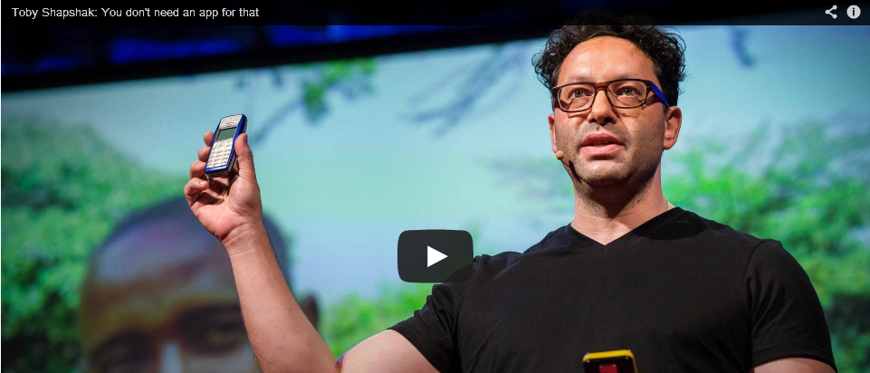
Watch the Ted Talks video below. Make notes on the uptake of mobile phone technology in Africa and how the core & periphery concept is questioned by the speaker.

Slide 25
MPSEA in 60 secs: https://www.youtube.com/watch?v=uygbfBWYMiE

Slide 26
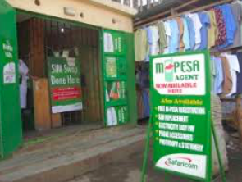
The story of Mobile phones in Africa
Watch the 'Spotlight on Africa' YouTube video below right and make notes on the story of mobile use in Africa, including the key economic data.
https://www.youtube.com/watch?v=zQo4VoLyHe0
https://www.irishtimes.com/news/world/africa/how-the-mobile-phone-changed-kenya-1.2646968
Economist- MPSA and Kenya

Slide 27
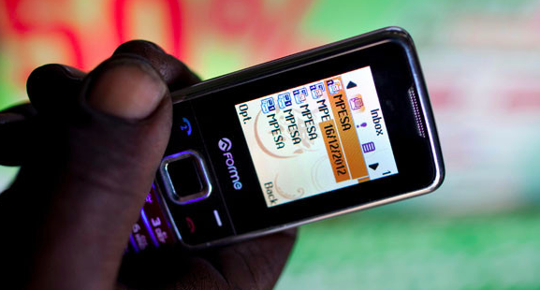
M-PESA notes
M-PESA is a mobile payment solution launched in March 2007 and credited with having a significant impact on economic development in Kenya.
Launched in 2007, named after Swahili for money (pesa), originally a micro finance project
Operated by Safaricom (40% owned by Vodafone)
Less than 10% of Kenyans have access to financial services
But nine out of ten adults have access to a mobile phone in Kenya
By 2009 M-PESA had 6.5 million customers, more recent figure suggests 15.1 million on the system
Around 20% of Kenyan GDP washes through the M-PESA system
Safaricom is not allowed to make a profit on the interest and neither is the customer
Interest earnings go into a charitable M-PESA foundation
M-PESA has been very successful in Tanzania but has had less impact in Afghanistan and India
Airtel is the main domestic rival, formerly called Zain and now owned by India’s Bharti Airtel
M-PESA used in myriad different ways - Kenyans pay school fees, collect their salaries, shop for groceries, they buy everything from drinks in beer shacks to airline tickets thanks to mobile money, sending transfers at the push of a few buttons on a mobile telephone. As per capita incomes rise, people will make savings using the system or might be able to take out loans.

Slide 28
Summary: The mobile phone revolution and electronic banking in developing countries
📚 Use page 35 of Geography - Global Interactions - Simon Oakes (embedded on weebly) to make notes on how the mobile revolution has aided development (particularly in Kenya).

Slide 29
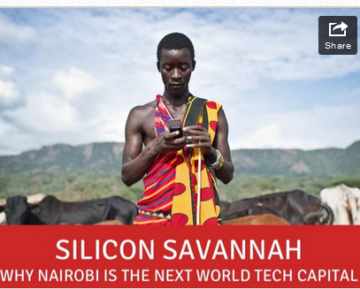
Case study Kenya
Resource 1 - iCow App - Video Resource 2 - Mobile Phone Uptake in Kenya Resource 3 - Apps in Kenya Click here & Most Popular Blackberry Apps in Kenya Click here to read about popular apps for the mobile phone in Kenya. Summarise how Kenyans use their phones.

Slide 30
Possibilities
State and explain 3 potential futures for the internet, it’s usage and the necessary infrastructure to support it.
How China is changing your internet:
https://www.youtube.com/watch?time_continue=146&v=VAesMQ6VtK8

Slide 31
Changing Kenya's education by phone
http://www.bbc.com/news/business-34699190
For many young people across Africa, the education available to them is often both under-resourced and costly to students and their families.
Limited public funds leave classrooms over-crowded, teachers over-stretched, and textbooks in short supply, while private schooling is prohibitively expensive for many.
Eneza's 500,000 users access courses and quizzes almost exclusively by text messages, for a cost of just 10 Kenyan shillings (10 cents; six pence) per week, which is deducted from pre-paid airtime on their mobile phones.
Learners receive questions - both multiple choice and open-ended - by text, and get feedback on their responses, whether right or wrong.
Of the 500,000 users in Kenya - where mobile phone penetration is at one of the highest levels in sub-Saharan Africa - 70,000 are active users on a monthly basis.
Possibilities

Slide 32
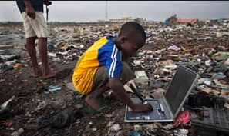
Synoptic thinking
What have been issues of our increasing communication device use?

Slide 33
Exam questions
Using examples, explain how a ‘shrinking world’ has been the result of various forces driving technological innovation. [12]
"ICT only has beneficial roles in our shrinking world." Discuss this statement [16 Marks]

