Slide 1
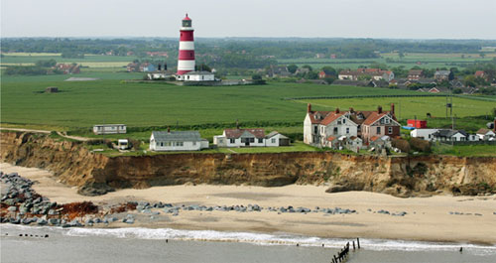
Coasts
Revision
Paper 1, Section 2- The Natural Environment
GET THINKING!
What’s going on in the photograph?
Should we be concerned?
Why might we be concerned?
Do things change at this location?
Do those waves do anything to the coastal environment?
LO: To revise coasts

Slide 2
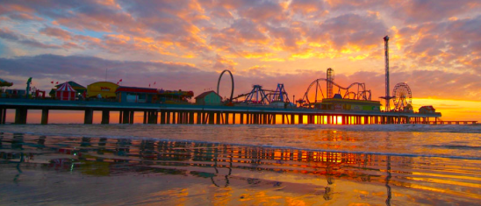
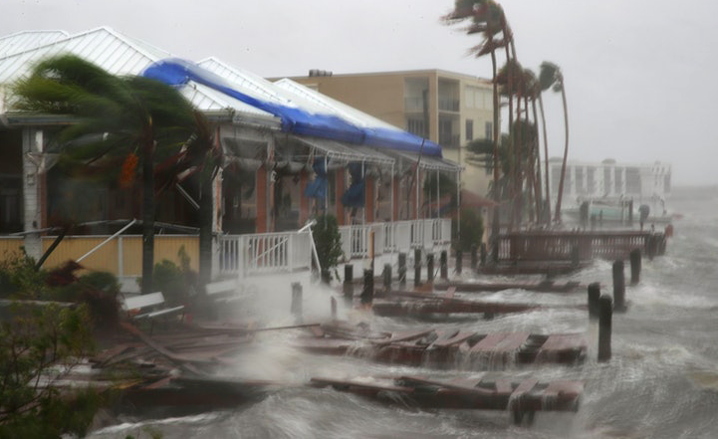
Coasts: The benefits and threats
Revision
Post it note as many points as possible

Slide 3
7 mark exam questions
Explain why people live along a named area of coastline you have studied. (7)
For a named area which you have studied, explain how the natural environment provides opportunities and causes problems for people (7).
How could we write a model answer for these?

Slide 4
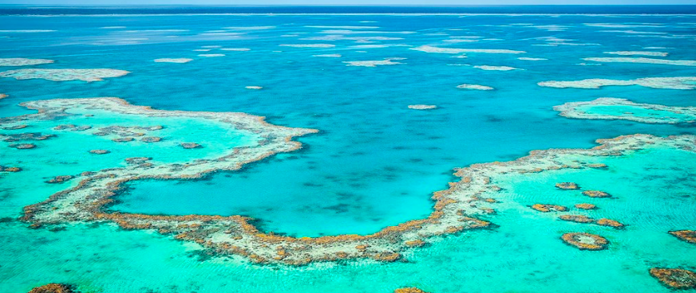
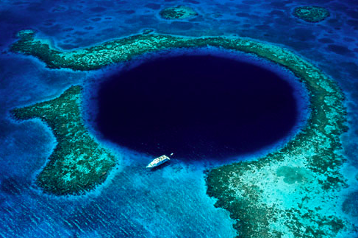
Coral reefs- name the reef type
Atoll
Fringing
Barrier

Slide 5
Coral reefs- formation
How can we add specific case study detail to this to make it a 7 mark answer?
For a named area of coral reef which you have studied, describe the conditions which led to its formation. [7]

Slide 6
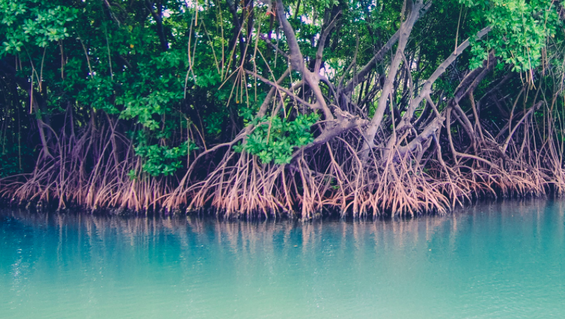
Mangroves

Slide 7
Study Figure 1, which shows how the coastline of an area has changed over time.
Demonstrate
Be READY TO LEARN
Think like a Geographer
Name and describe two processes of erosion that could have caused the coastal change shown in Figure 1. (4)
Process 1: ……………………………………………………………………............ ………………………………………………………………………………………………..
Process 2: ……………………………………………………………………............ ………………………………………………………………………………………………..
LO: To explore the impact erosion, transportation and deposition has on changing coastal environments.

Slide 8
Study Figure 1, which shows how the coastline of an area has changed over time.
Demonstrate
Be READY TO LEARN
Think like a Geographer
Name and describe two processes of erosion that could have caused the coastal change shown in Figure 1. (4)
MODEL ANSWERS:
Hydraulic power (1) is when the waves smash into the cliff. Trapped air is forced into holes and cracks in the rock eventually causing the rock to break apart (1). Abrasion (1) is when waves hurl sand and shingle at cliffs. The sediment scratches and scrapes against the rock surface causing it to become smooth (1). Attrition (1) is when rock fragments carried by the sea knock against one another causing them to become smaller and more rounded (1).
LO: To explore the impact erosion, transportation and deposition has on changing coastal environments.

Slide 9
Question Time
Demonstrate
Be READY TO LEARN
Think like a Geographer
What is the process of transportation of sediment along a beach called?
Write the answer on to your whiteboards.
LO: To explore the impact erosion, transportation and deposition has on changing coastal environments.

Slide 10
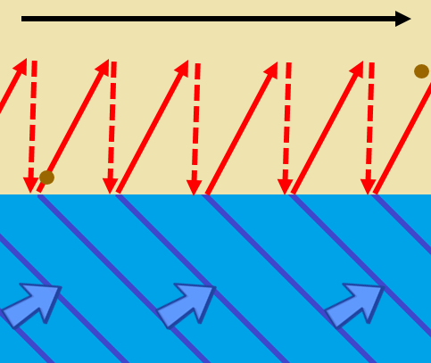
Longshore Drift – transports the eroded material and deposits it (when waves loose energy) further along the beach.
Demonstrate
Be READY TO LEARN
Think like a Geographer
Waves approach the beach at an angle (dependent on wind direction),
Sediment will be moved along the beach in a zigzag pattern. The swash of the wave carries the sediment along the beach.
The backwash carries the sediment back down the beach as the wave retreats to the sea.
2
3
1
Outline the process of longshore drift (3).

Slide 11
Longshore Drift
ACTIVATE
Be READY TO LEARN
Think like a Geographer
Outline the process of longshore drift (3).
MODEL ANSWER:
Longshore drift is the movement of material along the beach (1). It occurs in the direction of the prevailing waves (1). It is comprised of swash – where breaking waves move material up a beach (in the direction of prevailing wind/waves (1), and backwash – where (due to gravity) material is dragged back towards the sea (1). Swash and backwash is repeated leading to movement in a zig-zag movement along beach (1).
LO: To explore the characteristics and formation of coastal deposition landforms; spits and bars.

Slide 12
Question Time
Demonstrate
Be READY TO LEARN
Think like a Geographer
Coastal deposition is when waves drop and leave behind the sediment they were transporting. It happens when the energy in the waves is lost as the flow of water slows down.
True OR False
What type of wave would cause it?
Destructive OR Constructive
LO: To explore the impact erosion, transportation and deposition has on changing coastal environments.

Slide 13
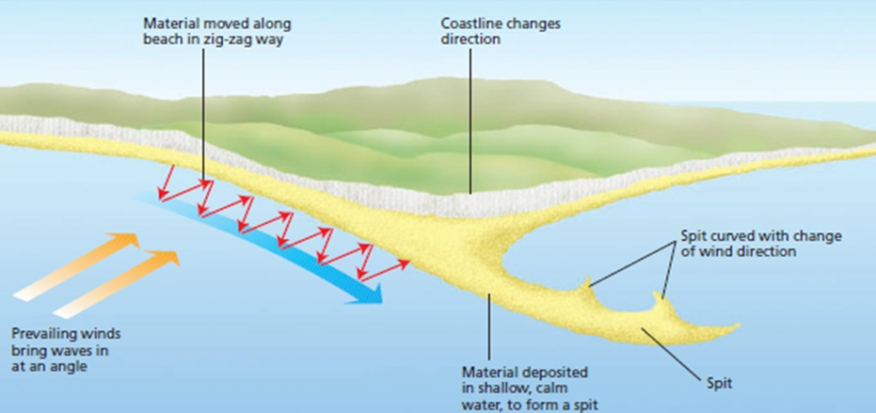
Coastal Deposition
Demonstrate
Be READY TO LEARN
Think like a Geographer
It happens when there is lots of erosion elsewhere on the coast, meaning there’s lots of sediment available.
There’s lots of transportation of material into the area.
LO: To explore the impact erosion, transportation and deposition has on changing coastal environments.

Slide 14
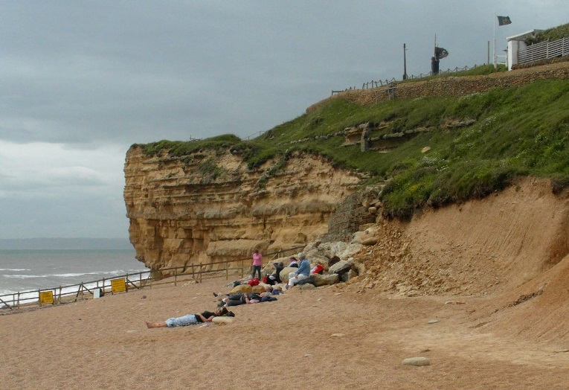
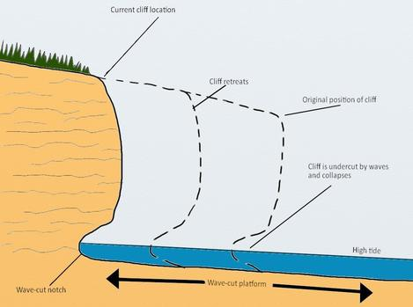
Formation of Cliffs and Wave Cut Platforms
ACTIVATE
Be READY TO LEARN
Think like a Geographer
1. The land slopes down to the sea. Freeze-thaw weathering weakens the rock.
2. Marine erosion is concentrated between the high and low tide level. Wave pounding action by hydraulic action, and abrasion by shingle hurled at the land, erode the base.
3. Continued erosion cause the rock to break away and collect at the base of the cliff. Destructive waves remove this material. The cliff now has a wave cut-notch at its base. The section of cliff above the notch is now unsupported .
4. Eventually, the notch is enlarged to the point where the notch can no longer defy gravity. It breaks away and falls onto the beach. The resulting steep drop off is called a cliff.
5. Through a continual sequence of wave-cut notch formations an cliff collapse, the cliff will gradually retreat. In it’s place will be a gently sloping rocky platform called a wave cut platform. This is typically quite smooth due to the process of abrasion but in some places will be scarred with rock pools.
LO: To explore the characteristics and formation of the erosion landforms; cliffs and wave cut platforms.

Slide 15
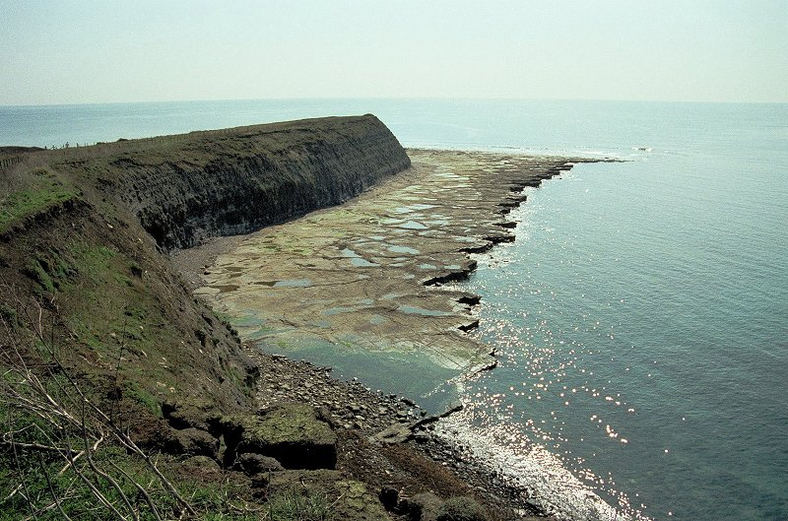
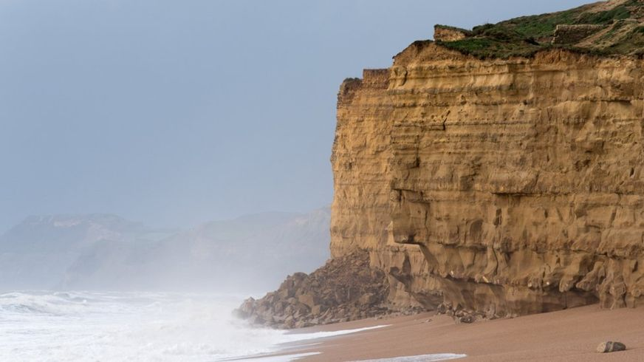
Label the characteristics of cliffs and wave cut platforms.
Demonstrate
Be READY TO LEARN
Think like a Geographer
Characteristics of Cliffs:
45 metres high
Hard Bridport Sandstone
Horizontal Bedding
Layers of harder rock jut out
Near-vertical bare rock cliff face
Wave cut notch at the base
Fallen rocks at the base in some places.
Characteristics of Wave Cut Platforms:
Slopes gently down to the angle of 3-4 degrees.
An overall pitted appearance of bare rock interspersed with rock pools.
Bare rock, smoothed in places by abrasion.
Deep cracks in some places.
Covered at high tide and exposed at low tides.
LO: To explore the characteristics and formation of the erosion landforms; cliffs and wave cut platforms.

Slide 16
Draw a diagram to show the formation of wave cut platforms.
Demonstrate
Be READY TO LEARN
Think like a Geographer
Make sure you label it.
Current position of cliff
Cliff retreats
Original position of cliff
Cliff is undercut by wave and collapses
High tide
Wave cut notch
Wave cut platform
LO: To explore the characteristics and formation of the erosion landforms; cliffs and wave cut platforms.

Slide 17
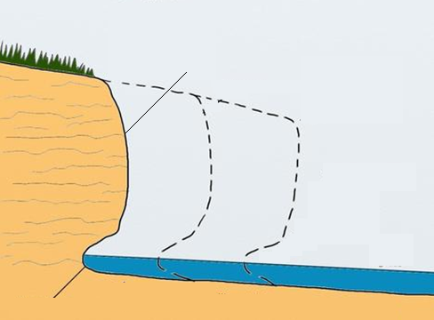
Study Figure 1, which shows the formation of a wave cut platform.
Demonstrate
Be READY TO LEARN
Think like a Geographer
Using Figure 1, explain the formation of wave-cut platforms. (6).
SUCCESS CRITERIA: L1 (1-2) There is a basic explanation of how wave cut platforms are formed.
L2 (3-4) There is a clear explanation of how wave cut platforms are formed.
L3 (5-6) There is a detailed explanation of how cliffs are undercut to form wave cut notches and then wave cut platforms.
Y
X
Figure 1
Maximum 4 marks if they haven’t made reference to X and Y in Figure 1.
LO: To explore the characteristics and formation of the erosion landforms; cliffs and wave cut platforms.

Slide 18
Demonstrate
Be READY TO LEARN
Think like a Geographer
Study Figure 1, which shows the formation of a wave cut platform.
Using Figure 1, explain the formation of wave-cut platforms. (6).
MODEL ANSWER:
Destructive waves cause erosion at the foot of the cliff (1) between high and low tide level (1). This forms a wave cut notch (1) (X on Figure 1). The notch is enlarged as erosion continues until eventually the overhanging cliff (Y on Figure 1) becomes unstable and collapses due to gravity (1). The collapsed rock is washed away leaving a wave cut platform (1).
Y
X
Figure 1
Maximum 4 marks if they haven’t made reference to X and Y in Figure 1.
LO: To explore the characteristics and formation of the erosion landforms; cliffs and wave cut platforms.

Slide 19
Erosion at Headlands
ACTIVATE
Be READY TO LEARN
Think like a Geographer
Despite headlands being hard rock and more resistant to erosion they are still eroded by destructive waves associated with wave refraction. So despite the hardness of the rock, headlands are constantly being re-shaped by the waves.
LO: To explore the characteristics and formation of the erosion landforms; caves, arches and stacks.

Slide 20
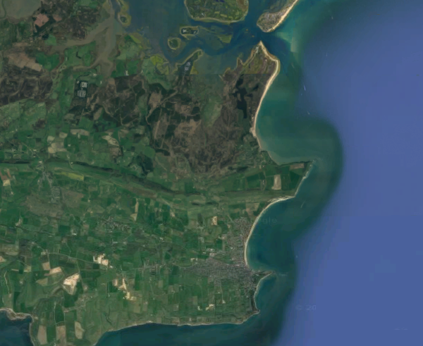
What is a Headland?
ACTIVATE
Be READY TO LEARN
Think like a Geographer
Cliff that juts out to sea so that it is surrounded by water on three sides.
Composed of hard rock such as granite, chalk or limestone which are more resistant to erosion.
Durlston Head, Dorset
LO: To explore the characteristics and formation of the erosion landforms; caves, arches and stacks.

Slide 21
Caves, Arches and Stacks
Demonstrate
Be READY TO LEARN
Think like a Geographer
Characteristics of Caves, Arches and Stacks
Formations of Cave, Arches and Stacks
A large crack in the headland
Unsupported arch
Wave cut notches at the base of the arch
Water goes right through the gap.
The arch is an extension of the headland.
Detached block/pillar of rock located off a headland.
Composed of hard rock.
Wave cut notches at the base of the stack
LO: To explore the characteristics and formation of the erosion landforms; caves, arches and stacks.

Slide 22
Question Time
ACTIVATE
Be READY TO LEARN
Think like a Geographer
Which is correct?
Waves crash into the headland where cracks are enlarged by hydraulic power and abrasion to form a cave. Waves make the cave larger until it cuts through the headland to make an arch. The arch is eroded and the roof becomes too heavy and collapses. This leaves a tall stack.
Waves crash into the headland where caves are eroded by hydraulic power and attrition. Freeze-thaw weathering and waves make the cave bigger until the waves cut through to form an arch. The arch collapses and leaves a stump behind.
LO: To explore the characteristics and formation of the erosion landforms; caves, arches and stacks.

Slide 23
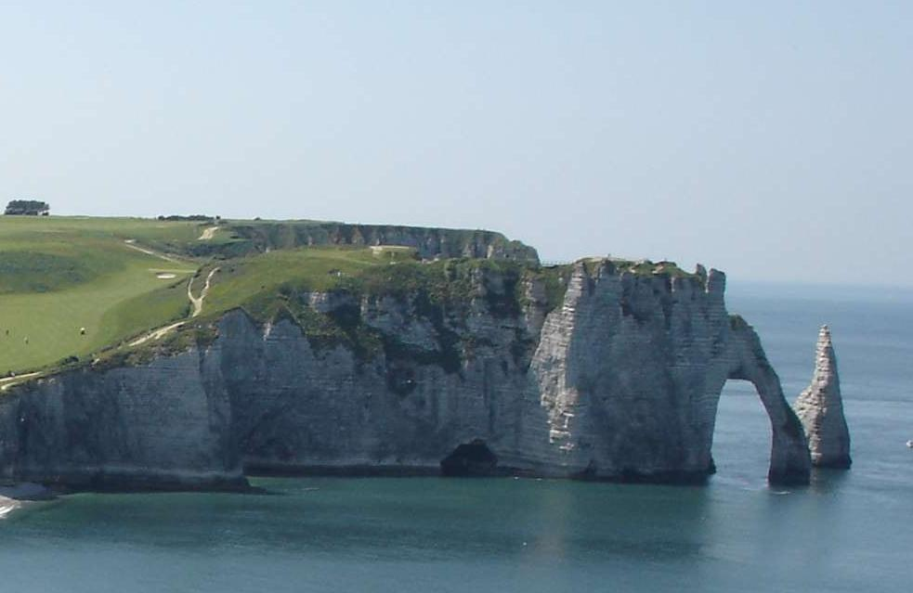
Study Figure 1, a photograph of a coastal area.
Demonstrate
Be READY TO LEARN
Think like a Geographer
Name the type of landform labelled A in Figure 1 and explain how it was formed.
Landform:…………………(1)
…………………………………….
…………………………………….
…………………………………….
…………………………………….
……………………………………………………………………………(2)
A
Figure 1
LO: To explore the characteristics and formation of the erosion landforms; caves, arches and stacks.

Slide 24
Study Figure 1, a photograph of a coastal area.
Demonstrate
Be READY TO LEARN
Think like a Geographer
Name the type of landform labelled A in Figure 1 and explain how it was formed.
Landform: Cave (1)
It is formed when waves
crash into the headland
and enlarging cracks in
the rock (1), mainly by
hydraulic power and abrasion (1).
Figure 1
LO: To explore the characteristics and formation of the erosion landforms; caves, arches and stacks.

Slide 25
Consolidate
Be READY TO LEARN
Think like a Geographer
Write the Learning Objective.
You as the Examiner
Write a 2 mark exam question about caves, arches and stacks on the front of your post-it note. (Use a command word – don’t write a question about a figure – YOU HAVEN’T GOT ONE).
Write the model answer on the back (not on the sticky part).
Give your post-it note to someone on your table.
Answer the question you have been given.
Look at the model answer, assess yourself.
Stick it in your book.
LO: To explore the characteristics and formation of the erosion landforms; caves, arches and stacks.
Notes:
OR if you don’t wish to use play-doh.

Slide 26
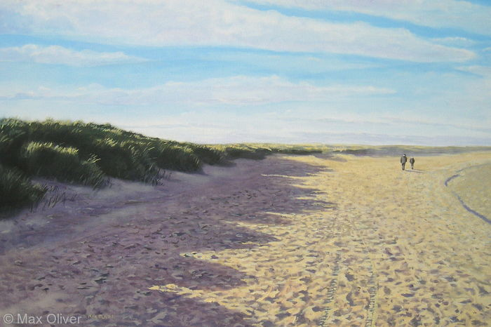
Coastal Deposition Landforms – Sand Dunes
CONNECT
Be READY TO LEARN
Start thinking like a Geographer
Make sure you have your book, write today’s date and title.
1. Name the type of landform labelled A in Figure 1. (1)
2. What part of the beach profile do sand dunes begin to occur in? (1)
Foredune
Interdune
3. Name the section of the beach labelled B in Figure 1. (1)
B
A
Figure 1
LO: To explore the characteristics and formation of the deposition landforms; sand dunes.

Slide 27
Coastal Deposition Landforms – Sand Dunes
ACTIVATE
Be READY TO LEARN
Start thinking like a Geographer
Make sure you have your book, write today’s date and title.
1. Sand Dune (1)
2. Foredune (1)
3. Backshore (1)
B
A
Figure 1
LO: To explore the characteristics and formation of the deposition landforms; sand dunes.

Slide 28
What are Sand Dunes?
ACTIVATE
Be READY TO LEARN
Think like a Geographer
Sand dunes are large heaps of sand that form on the dry backshore of a sandy beach.
Form a sand dune to form, it needs:
A large flat beach,
A large supply of sand,
A large tidal range, so there is time for the sand to dry,
An onshore wind to move sand to the back of the beach,
An obstacle such as drift wood for the due to form against.
LO: To explore the characteristics and formation of the deposition landforms; sand dunes.

Slide 29
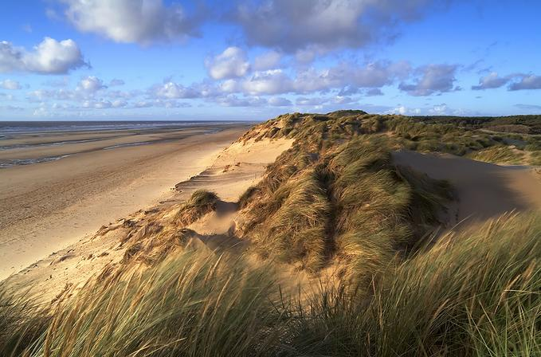
Characteristics of Dunes
ACTIVATE
Be READY TO LEARN
Think like a Geographer
Unstable, steep slip slope (lee slope) on sheltered side
Gentle slope on windward side
Embryo Dune
Berm
Slack
Crests
LO: To explore the characteristics and formation of the deposition landforms; sand dunes.

Slide 30
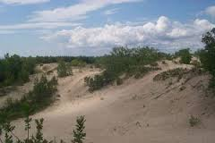
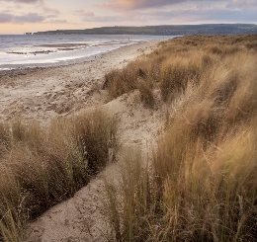
The Formation of Sand Dunes
ACTIVATE
Be READY TO LEARN
Think like a Geographer
Embryo dunes form around deposited obstacles such as pieces of wood or rocks.
These develop and become stabilised by vegetation to form fore dunes and tall yellow dunes. Marram grass has adapted to the windy, exposed conditions and has long roots to find water. These roots help bind the sand together and stabilise the dunes.
In time, rotting vegetation adds organic matter to the sand making it more fertile. A much greater range of plants colonise these ‘back’ dunes.
Wind can form depressions in the sand called dune slacks, in which ponds may form.
Dune Succession
LO: To explore the characteristics and formation of the deposition landforms; sand dunes.

Slide 31
Sand Dune Succession
ACTIVATE
Be READY TO LEARN
Think like a Geographer
Embryo dunes are only a few metres high whereas mature dunes maybe up to 15 metres high.
Size of sand dunes increases inland as long-rooted marram grass binds the sand together. It’s long roots help build up the height of the dunes.
Dunes closest to the beach have a yellow sandy colour and not much vegetation, whereas dunes at the back are grey and less sand like.
Inland the dunes become increasingly colonised by vegetation.
Each line of dunes is separated by a trough called a slack. Slacks are formed by the removal of sediment from the leeward base of one line of dunes and up the windward side of the next line. Sometimes slacks are eroded so much that they reach down to the water table, resulting in the formation of ponds.
LO: To explore the characteristics and formation of the deposition landforms; sand dunes.

Slide 32
Study Figure 2, a photograph showing sand dunes near Studland, Dorset.
CONSOLIDATE
Be READY TO LEARN
Think like a Geographer
Explain how the sand dunes in Figure 2 formed. (3)
SUCCESS CRITERIA:
Start from the beginning of the formation process – what does wind cause?
What happens to trapped sand? What type of dunes are formed first?
What happens to the sand?
Where do sand dunes end? What type of dune?
Figure 2
LO: To explore the characteristics and formation of the deposition landforms; sand dunes.

Slide 33
Study Figure 2, a photograph showing sand dunes near Studland, Dorset.
CONSOLIDATE
Be READY TO LEARN
Think like a Geographer
Explain how the sand dunes in Figure 2 formed. (3)
MODEL ANSWER:
Sand blowing up the beach was trapped by obstacles (1). The trapped sand was colonised by vegetation, forming embryo dunes (1). The embryo dunes grew and migrated inland, forming mature dunes (1).
Figure 2
LO: To explore the characteristics and formation of the deposition landforms; sand dunes.

Slide 34
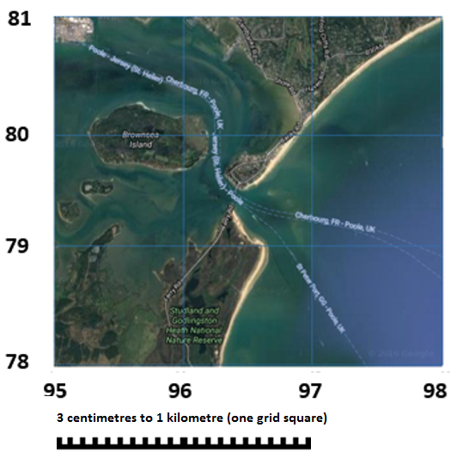
Coastal Deposition Landforms – Spits and Bars
ACTIVATE
Be READY TO LEARN
Start thinking like a Geographer
Make sure you have your book, write today’s date and title.
Study Figure 1, an ordnance survey map of a coastal area in Devon.
The end of the spit is marked X on Figure 1. Give the six figure grid reference for the end of the spit. (1)
964, 794
OR
965, 795
X
Figure 1
LO: To explore the characteristics and formation of coastal deposition landforms; spits and bars.

Slide 35
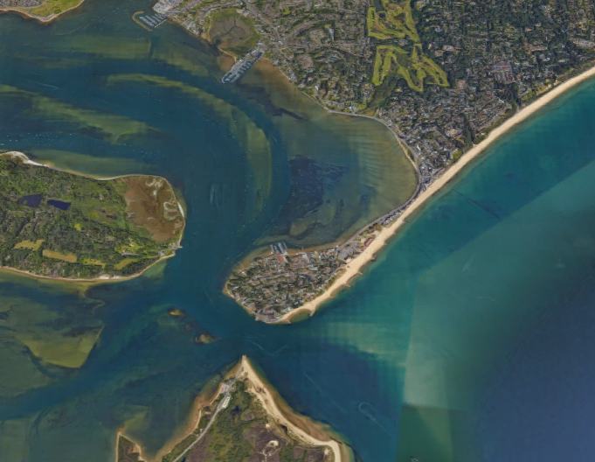
Characteristics of Sandbanks Spit, Dorset
ACTIVATE
Be READY TO LEARN
Think like a Geographer
Proximal end
Lagoon
Distal end
Mudflats and salt marshes
Large hook
Spit
LO: To explore the characteristics and formation of coastal deposition landforms; spits and bars.

Slide 36
Formation of a Spit
ACTIVATE
Be READY TO LEARN
Think like a Geographer
Longshore drift transports sand along the coast.
The coastline changes shape and the waves begin to loose energy.
Deposition starts to build up at the proximal end and the spit grows out into the sea.
The spit is exposed to changes in wind and wave direction which cause the distal end to hook back towards the land.
LO: To explore the characteristics and formation of coastal deposition landforms; spits and bars.

Slide 37
Question Time
ACTIVATE
Be READY TO LEARN
Think like a Geographer
On your whiteboards, write what happens in the stage that is missing.
Longshore drift transports sand along the coast.
Deposition starts to build up at the proximal end and the spit grows out into the sea.
The spit is exposed to changes in wind and wave direction which cause the distal end to hook back towards the land.
LO: To explore the characteristics and formation of coastal deposition landforms; spits and bars.

Slide 38
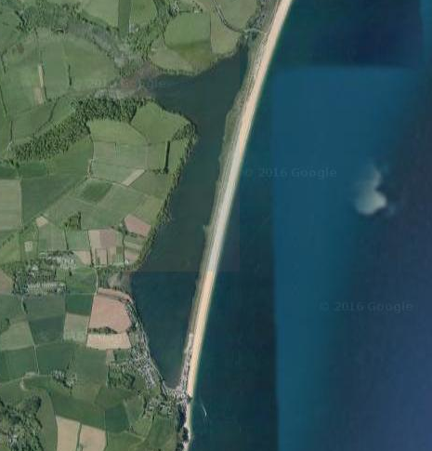
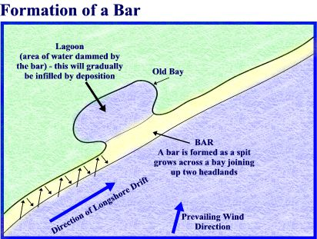
How is a bar formed?
ACTIVATE
Be READY TO LEARN
Think like a Geographer
Slapton Ley Bar, Devon, United Kingdom
1. A spit joins together two headlands.
2. A bar cuts off the bay between the headlands from the sea.
3. A lagoon can form behind the bar.
LO: To explore the characteristics and formation of coastal deposition landforms; spits and bars.

Slide 39
Explain the formation of a Bar (3).
ACTIVATE
Be READY TO LEARN
Think like a Geographer
LO: To explore the characteristics and formation of coastal deposition landforms; spits and bars.

Slide 40
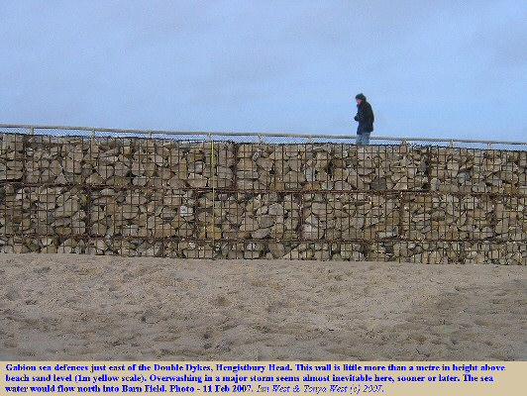
What is Hard Engineering?
ACTIVATE
Be READY TO LEARN
Think like a Geographer
Hard engineering options tend to be expensive, short-term options
They may also have a high impact on the landscape or environment and be unsustainable.
LO: To explore the costs and benefits of coastal management strategies; soft and hard engineering.

Slide 41
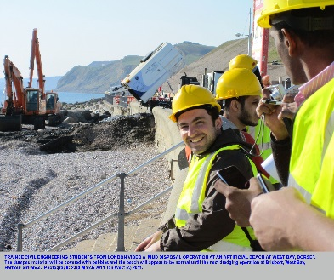
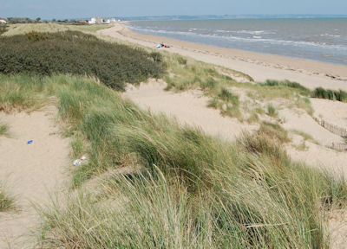
What is Soft Engineering?
ACTIVATE
Be READY TO LEARN
Think like a Geographer
Soft engineering options are often much less expensive than hard engineering options.
They are usually more long-term and sustainable, with less impact on the environment.
What do we mean by “sustainable”?
LO: To explore the costs and benefits of coastal management strategies; soft and hard engineering.

Slide 42
Question Time
ACTIVATE
Be READY TO LEARN
Think like a Geographer
Which of these management methods is an example of hard engineering?
Beach Nourishment
Gabions
Dune Stabilising
Soft engineering tends to be cheaper and less invasive on the environment than hard engineering.
True OR False
LO: To explore the costs and benefits of coastal management strategies; soft and hard engineering.

Slide 43
Sea Wall
Demonstrate
Be READY TO LEARN
Think like a Geographer
A sea wall is a concrete or rock barrier against the sea, placed at the foot of cliffs or at the top of a beach. Has a curved face to reflect the waves back into the sea.
It cost around £5000 - £10000 per metre.
A sea wall gives people a sense of security and often has walkway for people to walk along.
Sea walls are very expensive and encounter high maintenance costs.
Sea walls restrict peoples access to the beach and if waves break over the sea wall (overtopping), coastal flooding may occur.
From the beach, a sea wall is ugly to look at. Sea walls may also destroy habitats.
Sea walls do not impede the movement of sediment down drift, so they do not disadvantage other areas.
If well maintained, they can be effective for many years making the cost worthwhile.
LO: To explore the costs and benefits of coastal management strategies; soft and hard engineering.

Slide 44
Groynes
Demonstrate
Be READY TO LEARN
Think like a Geographer
Groynes are relatively cheap at £5000 each and if well maintained, can last up to 40 years.
Groynes are barriers which impede walking along a beach. They are also dangerous, as they have deep water on one side and shallow on the other. This is a particular hazard to children who might climb on them.
A larger beach, with more space for activities attracts more tourists which boosts the local economy.
Rock groynes at Sandbanks, Poole, have concrete crests for people to walk along to reach a viewing or fishing point. Groynes also act as windbreaks.
Groynes may be considered unattractive, especially old and degraded ones.
LO: To explore the costs and benefits of coastal management strategies; soft and hard engineering.

Slide 45
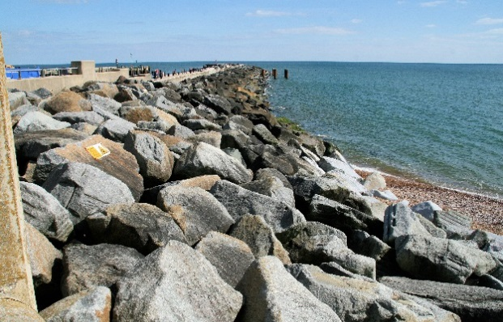
Rock Armour
Demonstrate
Be READY TO LEARN
Think like a Geographer
Rock armour is relatively cheap and costs around £1000-£3000 a metre, compared to £5000 a metre for a sea wall.
Rock armour makes access to the beach difficult as people have to clamber over it or make long detours. People may have accidents when clambering over them as they are unstable and sometimes slippery.
High resistant rocks from Norway and Sweden are often used in preference to rocks from local quarries. This may cause resentment and it inflates the cost considerably. Also, money needs to be spent on regularly maintaining the rocks as during large storms, they may be moved.
Rock armour is ugly and it often covers vast areas of a beach. Driftwood and litter become trapped in the structure.
Imported rocks do not blend in with the local geology.
Rock armour is often used for fishing.
LO: To explore the costs and benefits of coastal management strategies; soft and hard engineering.

Slide 46
Gabions
Demonstrate
Be READY TO LEARN
Think like a Geographer
Gabions are relatively cheap at £110 a metre and they are easy to construct.
For the cost, they are good value for money, as they may last 20-25 years.
In a damaged state, gabions are dangerous. People may trip over them or cut themselves on the broken steel wire mesh.
The use of gabions is restricted to sandy beaches as the shingle and pebbles hurled at them on pebble beaches would quickly degrade them. Gabions are easily destroyed, so regular maintenance is needed. In 2010 it cost £30 000 to repair the gabions damaged by storms.
Damaged gabions are visually unappealing, and seabirds may damage their feet in them.
Although unnatural, they can become visually appealing if vegetated and looked after. This may attract people to the area.
LO: To explore the costs and benefits of coastal management strategies; soft and hard engineering.

Slide 47
Beach Nourishment
Demonstrate
Be READY TO LEARN
Think like a Geographer
A wider beach means more room for beach users. People living along the sea front are more protected from coastal flooding.
Although cheaper than hard engineering options, this has high overheads as it costs around £300 000 to hire a dredger.
A nourished beach is natural and blends in with the environment.
At Sandbanks, the wider nourished beach protects expensive properties.
A broader beach may attract more tourists.
LO: To explore the costs and benefits of coastal management strategies; soft and hard engineering.

Slide 48
Dune Stabilising
Demonstrate
Be READY TO LEARN
Think like a Geographer
Sand dunes protect land uses behind them. Once established they are popular for picnics and walking on.
At Studland sand dunes, regeneration has helped maintain a habitat for rare Dartford warblers and nightjars. Six species of reptiles including lizards and adders inhabit the dunes.
Dune regeneration has to be checked twice a year and have fertilisers applied.
Expensive systems have to be put in place to prevent planted areas from trampling.
While becoming established, regenerated sand dunes are fenced off and signs tell people to keep out. This may deter tourists.
Small planting projects often use volunteer labour and local grass for transplants so costs are minimal.
LO: To explore the costs and benefits of coastal management strategies; soft and hard engineering.

Slide 49
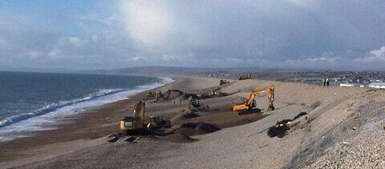
Beach Reprofiling
Demonstrate
Be READY TO LEARN
Think like a Geographer
Beach reprofiling is the artificial re-shaping of a beach using existing beach material. In winter, a beach is lowered by destructive waves. After winter storms, bulldozers move sand and shingle back up the beach. Like beach nourishment, reprofiling ensure that the beach is large enough to be an effective buffer between land and sea.
The residential area behind the beach is now protected so residents feel safe.
A steep, high crested beach may look unnatural and uninviting to tourists.
Major reprofiling costs can be expensive.
By using the material from the beach, it still looks reasonably natural.
The combined cost of beach nourishment and beach reprofiling at Pevensey, East Sussex is £30 million over 25 years.
LO: To explore the costs and benefits of coastal management strategies; soft and hard engineering.

Slide 50
Answer the Question below.
Demonstrate
Be READY TO LEARN
Think like a Geographer
Identify the differences between hard and soft engineering coastal management strategies (4)
L1 (1-2) – Points are general and not developed. No comparative language has been used.
L2 (3-4) – Both soft and hard engineering strategies have been considered. Comparative language has been used.
LO: To explore the costs and benefits of coastal management strategies; soft and hard engineering.

Slide 51
Answer the Question below.
Demonstrate
Be READY TO LEARN
Think like a Geographer
Identify the differences between hard and soft engineering coastal management strategies (4)
Hard engineering strategies such as sea walls and rock armour tend to be more expensive (1) with sea walls costing around £5000 per metre (1) and rock armour is often imported from Sweden or Norway, adding to the cost substantially (1). However soft engineering strategies such as sand dune stabilising is relatively cheap as local grass and volunteer labour is often used (1). Strategies such as dune regeneration tend to be more environmentally friendly (1). At Studland sand dunes, regeneration has helped maintain a habitat for the rare Dartford warblers and nightjars (1) whereas damaged gabions are unsightly and seabirds may damage their feet in them (1).
LO: To explore the costs and benefits of coastal management strategies; soft and hard engineering.

Slide 52
Be READY TO LEARN
Think like a Geographer
Write the Learning Objective.
Exam Question
For a coastal landscape you have studied, outline the management strategy used. (7)
L1 (1-3) There is a basic description of a management strategy.
L2 (4-6) There is a clear description of a management strategy and a basic assessment of its success.
L3 (7-9) There is a detailed description of a management strategy and a thorough description of its success, including advantages and disadvantages. Consideration of hard and soft engineering
LO: To explore the costs and benefits of coastal management strategies; soft and hard engineering.

