Slide 1
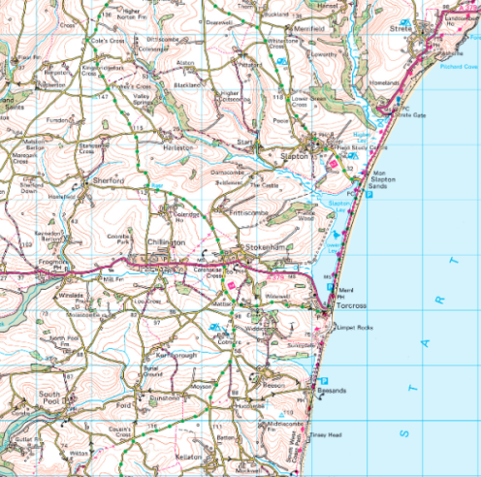
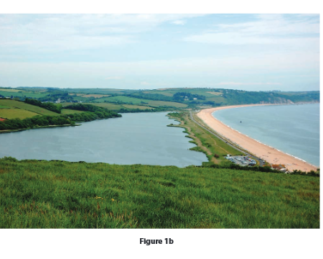
Coastal Skills practice
LO: to apply what you have learnt about coastal processes to paper 1 skills

Slide 2
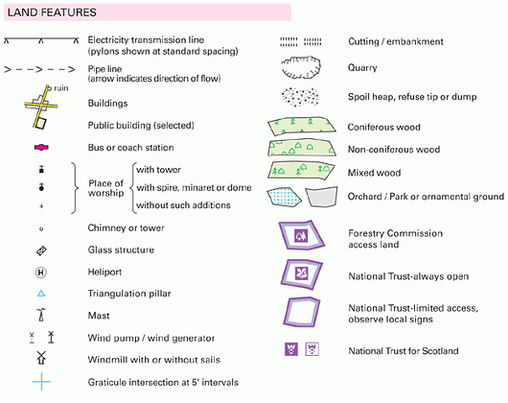
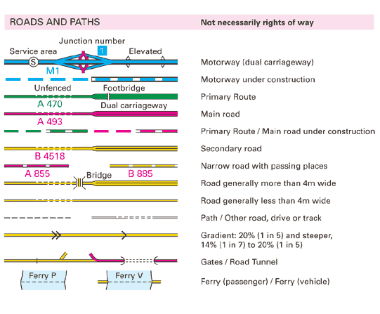
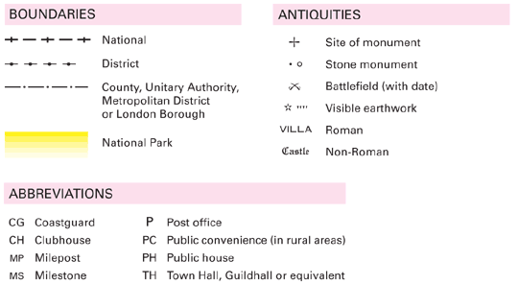
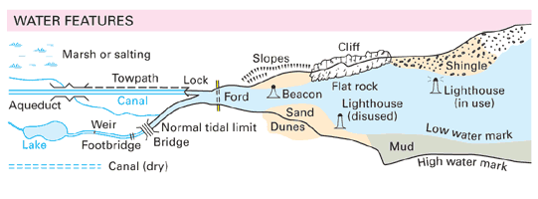
Coasts : Mapwork Skills / Map symbols
59
You don’t need to learn all the map symbols and abbreviations by heart – they will be on any map you are given in the exam, but it saves a lot of time if you are familiar with most of them before the exam – and avoid commonly held errors (like ‘CH’ must be a ‘Church’……IT’S NOT…. It’s a Club House of a golf club!). It’s worth getting to know the ‘Water Features’ section well because any map questions on ‘Coasts’ could well include some of these.

Slide 3
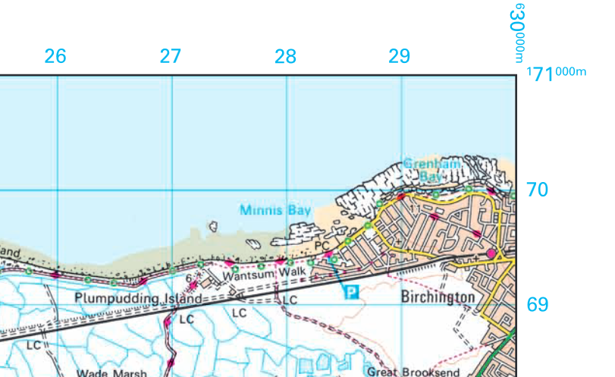
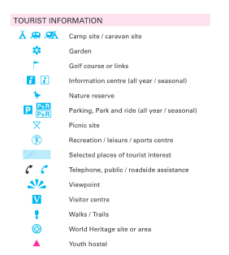
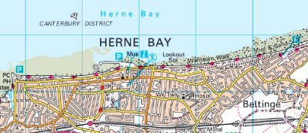
Symbols which may useful

Slide 4
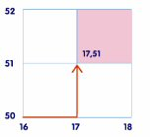
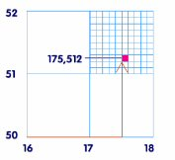
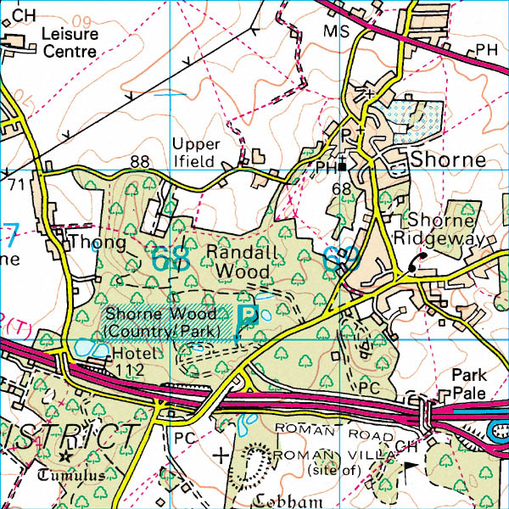
Coasts : Mapwork Skills / 6 figure Grid References
57
6 Figure Grid References
These are to find exact places within squares. They are easy if you follow a few simple rules.
Break the 6 figure number up into two sets of three by putting a line down the middle :
175512 becomes 175I512
Then underline the first pair of numbers in each set of 3 ; that gives you your 4 figure ref grid square and find that first.
175I512 - so find square 17 51
Then you need to look at how many ‘tenths’ to go from the bottom corner of the square where your fingers have come together. In this case go Along 5 tenths (halfway towards the next grid line from 17 to 18) and Up 2 tenths from line 51 towards line 52
175I512
08
07
Check out these 6 figure grid references.
What building is at 197076
(its a PH or Public House – a ‘Pub’ )
Where might people go on a Sunday at
191071
What’s the 6 figure grid reference for the ‘star’ which marks a bronze-age burial site calle a ‘tumulus’ somewhere on the map
06
05
17
18
19
20

Slide 5
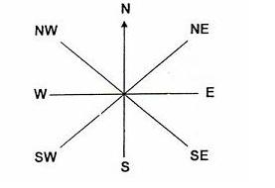
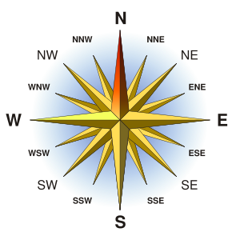
Coasts : Mapwork Skills / Directions and Distance
58
You need to know the 8 direction compass at least. Better still if you can learn the 16 point compass. Make sure you read any exam questions carefully to see if they are asking the direction of something ‘from’ somewhere else, or ‘to’ somewhere else. A memory sequence for the 4 main points going clockwise are
Never Eat Shredded Wheat or
Naughty Elephants Squirt Water
08
To measure the distance between 2 points on a map, use an edge of your answer booklet to make 2 marks for the places you want to measure the distance between (between 2 roads on the map below). Then move the paper to the scale at the bottom of the map. Put one point against the 0 and count how far along the scale the other mark is. ( In this case 1.6 km.) Make sure you know whether you are measuring in miles or kilometres.
07
06
05
17
18
19
20
1 km
TIP: For a quick estimate of distances – remember each grid square on OS maps is 1 km wide and 1 km high.

Slide 6
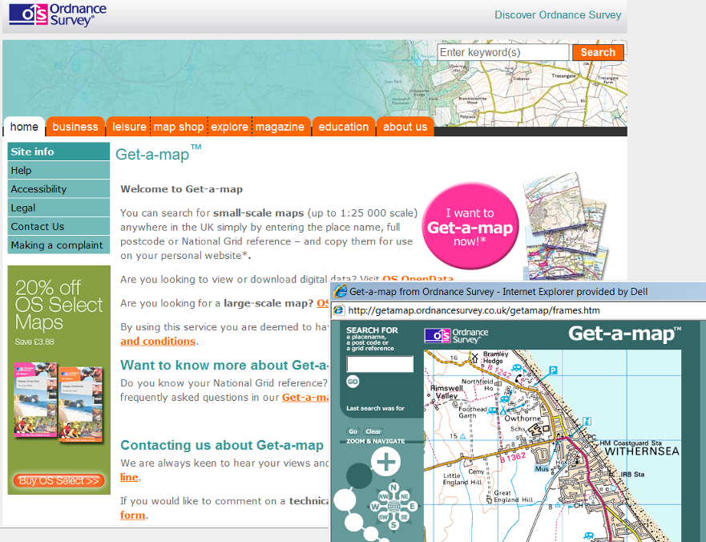
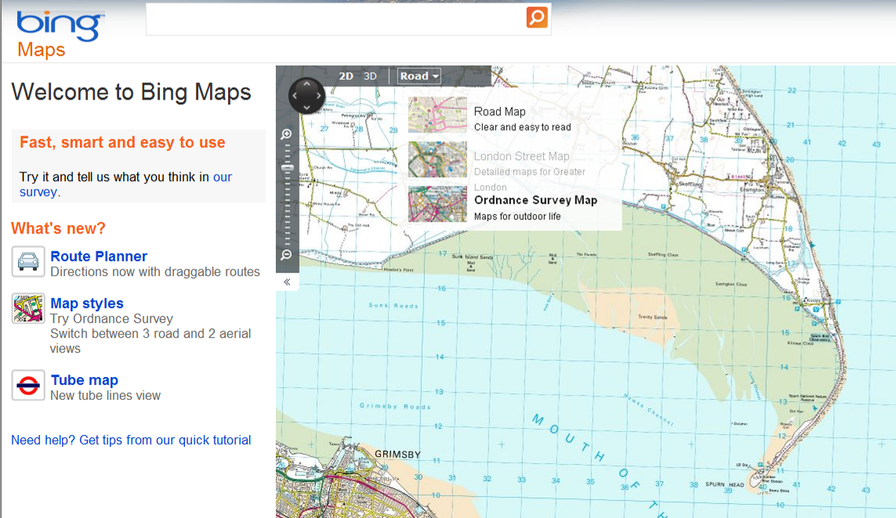
Coasts : Mapwork Skills / Check out your own maps
61
To find some OS maps to practise your mapskills on try these sites :
The Ordnance survey Get-a-map allows you to zoom down to anywhere in the UK. Click on the red Get-a-map button
http://www.ordnancesurvey.co.uk/oswebsite/getamap/
This leaflet from the OS map-makers helps you through the different parts of map-reading:
http://mapzone.ordnancesurvey.co.uk/mapzone/PagesHomeworkHelp/docs/easypeasy.pdf
Alternatively Bing maps allows you to toggle between OS maps and aerial photos of the same place.
http://www.bing.com/maps/
Zoom down to a local level on the place you want an OS map for. To get the OS map you need to click on the ‘Road’ tab at the top – and then select the ‘Ordnance Survey Map’ option from the drop-down menu (dragging the mouse down round the labels or you get the aerial photo options).

Slide 7
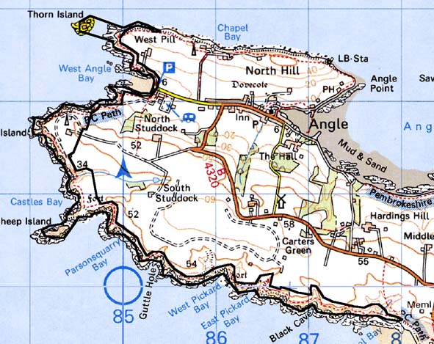
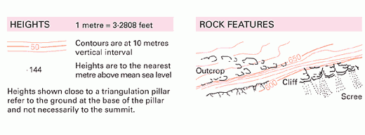
Coasts : Mapwork Skills / Symbols and Height (Relief)
60
Height of land is indicated in 3 main ways on maps:
Contour lines : brown lines drawn along land that is all at the same height. They are drawn every 10 metres, with a thicker brown line every 50m ( 0, 50, 100, 150 …etc)
Spot heights : black numbers with a tiny black dot next to them (often in a road). This gives you the precise height in metres above sea level at that point
Clues : rivers usually flow in the ‘bottom’ of valleys, TV and radio masts are often put on the ‘top’ of high land, triangulation pillars, windmills and ‘viewpoints’ are often high up hills.
The RELIEF of the land is how steep, sloping or flat it is. If contour lines are close together, then the land is changing height a lot in a small distance – so it must be sloping steeply. If the contour lines are far apart – then the land isn’t changing height much, so is flat or gently sloping.
On the map extract above notice how the contour lines indicate a steeper slope at North Studdock, but much gentler at South Studdock. The lowest ‘spot height’ is 6 and the highest is 58 – with a windmill close by. The highest contour line is a 60. There is one village on the map (Angle – look for the ‘inn’ which is a pub/hotel & Post Office ‘P’). Is it on high land or low land – and why?

Slide 8
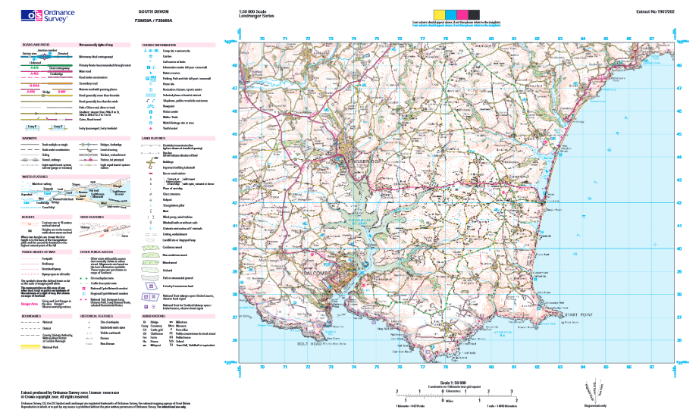
Map we will be using

Slide 9
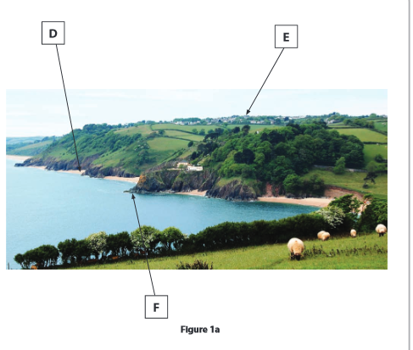
What features are identified on figure 1a?
D:
E:
F:

Slide 10
What features are identified on figure 1a?
D: Bay/ beach
F: Village/ settlement
E: headland/ cliff

Slide 11
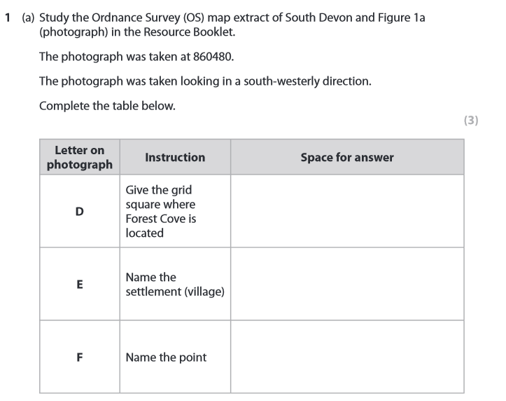

Slide 13
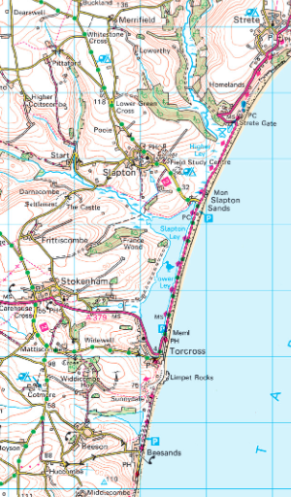
What landform is Slapton Sands? (1)

Slide 14
What landform is Slapton Sands? (1)
Bar

Slide 15
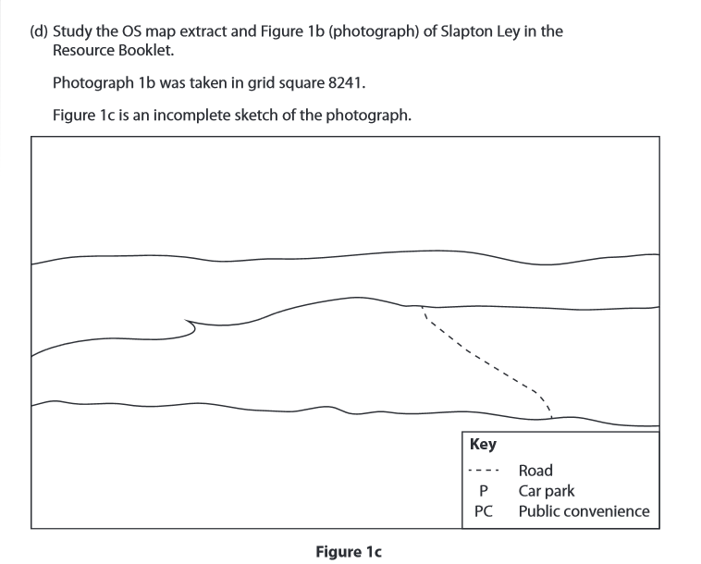
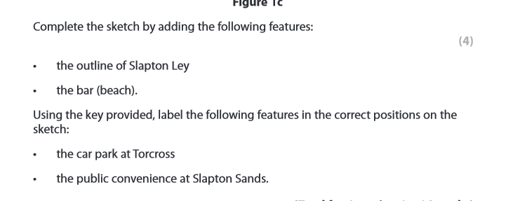

Slide 16
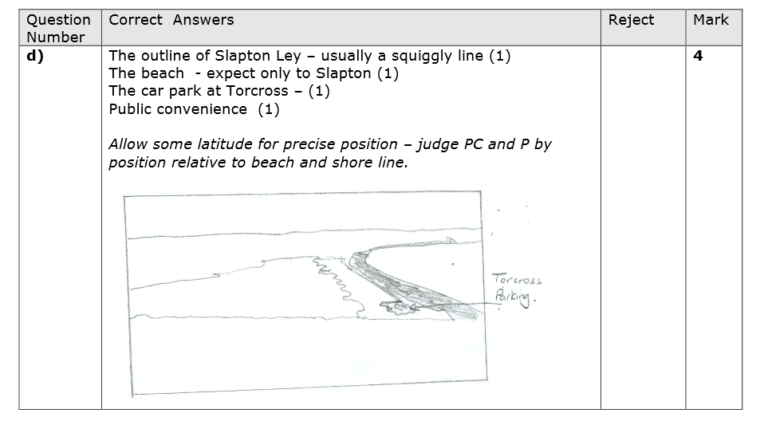

Slide 18
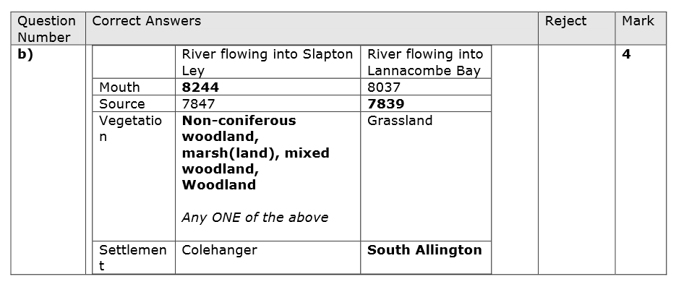

Slide 19
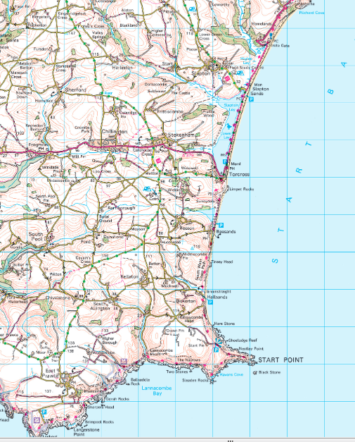
Describe the shape of the coastline between 833450 and 770350 (4)

Slide 20
The coastline is relatively flat Southwards from Slapton Sands to Hallsands. Thers is a bar from 828443 to 824420 with a lagoon called Slapton Ley behind it. After this the coastline becomes more jagged and reaches out to a headland at Start Bay. From this point there is a series of Coves and bays and rocks in the sea. The area seems to consist of steep cliffs, for example Ravens Cove has a spot height of 93 and the contour lines are very close together.

Slide 21
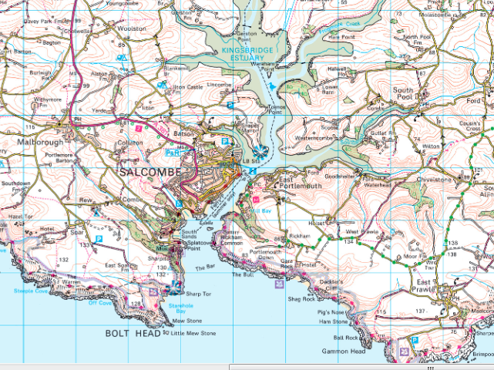
Describe the situation of Salcombe (4)

Slide 22
Model answer…..
Salcombe is situated at the mouth of the Kingsbridge estuary (1) and there is access from Kingsbridge to the North via a ferry or via the A381 (1). It is surrounded by steep land shown by the close together contour lines (1). Bolt Head headland is approximately 1 mile South of the town (1).

Slide 23
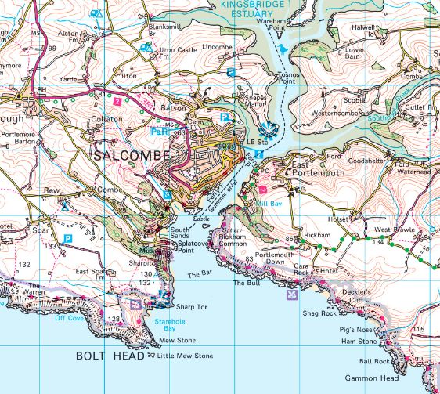
What is the evidence from the OS map that Salcombe may be attractive to tourists (4)

Slide 24
What is the evidence from the OS map that Salcombe may be attractive to tourists (4)
Tourist information
A range
of
accommodations
Viewpoints- meaning it could be an attractive area
Transport links into town- park and ride and ferry service and 4 car parks
Remember to also use as much map evidence as possible such as grid references, distance and map symbols

