Slide 1
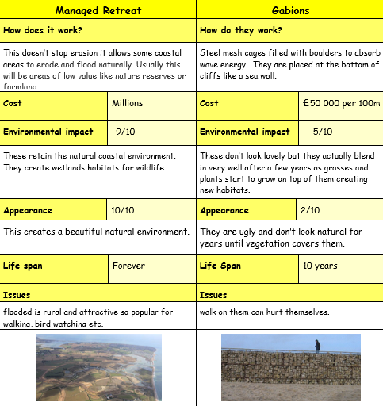
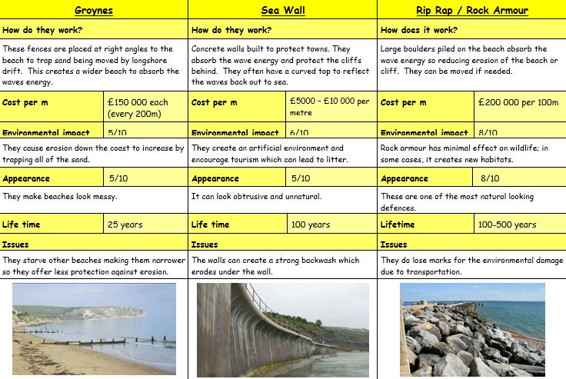
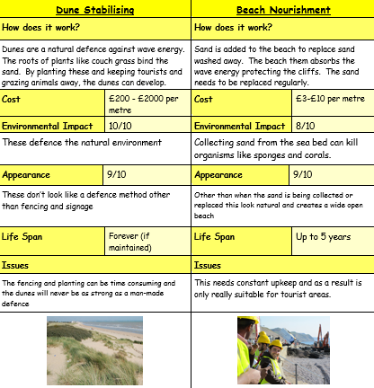
Coastal Management - Soft and Hard Engineering
CONNECT
Be READY TO LEARN
Start thinking like a Geographer
Make sure you have your book, write today’s date and title.
With your partner – play top trumps!
Cost – cheapest wins
Lifetime – longest wins
Environmental impact – lowest number wins
Appearance – highest number wins.
LO: To explore the costs and benefits of coastal management strategies; soft and hard engineering.

Slide 2
LO: To explore the costs and benefits of coastal management strategies; soft and hard engineering.
ACTIVATE
Be READY TO LEARN
Think like a Geographer
Write the Learning Objective.
SUCCESS CRITERIA:
I can describe how coastlines can be managed.
I can compare the different ways in which coastlines can be managed.
I can suggest reasons for and against specific coastal management systems.
Coastal Management – Soft and Hard Engineering

Slide 3
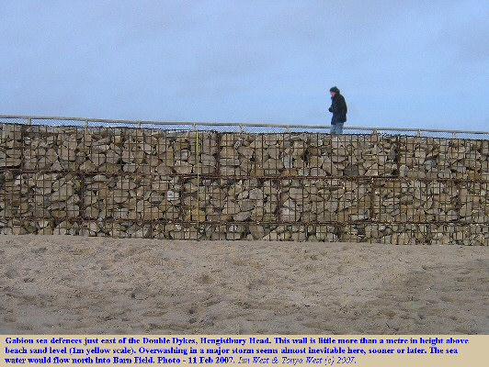
What is Hard Engineering?
ACTIVATE
Be READY TO LEARN
Think like a Geographer
Hard engineering options tend to be expensive, long-term options
They may also have a high impact on the landscape or environment and be unsustainable.
LO: To explore the costs and benefits of coastal management strategies; soft and hard engineering.

Slide 4
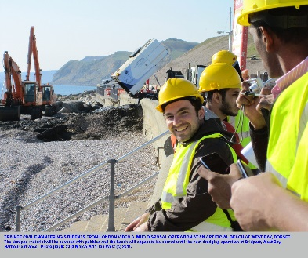
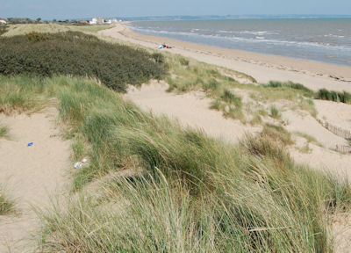
What is Soft Engineering?
ACTIVATE
Be READY TO LEARN
Think like a Geographer
Soft engineering options are often much less expensive than hard engineering options.
They are usually more sustainable, with less impact on the environment. They work with natural processes.
What do we mean by “sustainable”?
LO: To explore the costs and benefits of coastal management strategies; soft and hard engineering.

Slide 5
Question Time
ACTIVATE
Be READY TO LEARN
Think like a Geographer
Which of these management methods is an example of hard engineering?
Beach Nourishment
Gabions
Dune Stabilising
Soft engineering tends to be cheaper and less invasive on the environment than hard engineering.
True OR False
LO: To explore the costs and benefits of coastal management strategies; soft and hard engineering.

Slide 6
Activity
You will have 5 minutes per sheet.
You need to always start at task one and work your way through in the allocated time.
Stretch and Challenge A: If someone had a house that was in danger of falling down due to coastal erosion, what would they think of this defence? | Task1: Write down the type of defence and draw a diagram to show how the defence works | Stretch and Challenge C: Do you think this defence is value for money?
Task 2: State whether the defence is hard or soft engineering | Coastal Defences | Task 4: Write down the positives and negatives of the defence
Stretch and Challenge D: Write a paragraph explaining what you think of this defence? | Task 3: Explain how the defence works | Stretch and Challenge B: What would an environmentalist point of view be on this defence?

Slide 7
Researching and comparing methods of defence
DEMONSTRATE
Be READY TO LEARN
Think like a Geographer
Type of engineering method |  | Advantages | Disadvantages
Hard engineering | Sea wall
 | Groynes
 | Rock armour
 | Gabions
Soft engineering | Beach Nourishment
 | Dune Stabilising
 | Beach Reprofiling
LO: To explore the costs and benefits of coastal management strategies; soft and hard engineering.

Slide 8
Sea Wall
Demonstrate
Be READY TO LEARN
Think like a Geographer
A sea wall is a concrete or rock barrier against the sea, placed at the foot of cliffs or at the top of a beach. Has a curved face to reflect the waves back into the sea.
It cost around £5000 - £10000 per metre.
A sea wall gives people a sense of security and often has walkway for people to walk along.
Sea walls are very expensive and encounter high maintenance costs.
Sea walls restrict peoples access to the beach and if waves break over the sea wall (overtopping), coastal flooding may occur.
From the beach, a sea wall is ugly to look at. Sea walls may also destroy habitats.
Sea walls do not impede the movement of sediment down drift, so they do not disadvantage other areas.
If well maintained, they can be effective for many years making the cost worthwhile.
LO: To explore the costs and benefits of coastal management strategies; soft and hard engineering.

Slide 9
Groynes
Demonstrate
Be READY TO LEARN
Think like a Geographer
Groynes are relatively cheap at £5000 each and if well maintained, can last up to 40 years.
Groynes are barriers which impede walking along a beach. They are also dangerous, as they have deep water on one side and shallow on the other. This is a particular hazard to children who might climb on them.
A larger beach, with more space for activities attracts more tourists which boosts the local economy.
Rock groynes at Sandbanks, Poole, have concrete crests for people to walk along to reach a viewing or fishing point. Groynes also act as windbreaks.
Groynes may be considered unattractive, especially old and degraded ones.
LO: To explore the costs and benefits of coastal management strategies; soft and hard engineering.

Slide 10
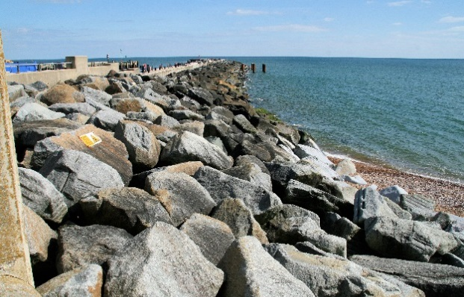
Rock Armour
Demonstrate
Be READY TO LEARN
Think like a Geographer
Rock armour is relatively cheap and costs around £1000-£3000 a metre, compared to £5000 a metre for a sea wall.
Rock armour makes access to the beach difficult as people have to clamber over it or make long detours. People may have accidents when clambering over them as they are unstable and sometimes slippery.
High resistant rocks from Norway and Sweden are often used in preference to rocks from local quarries. This may cause resentment and it inflates the cost considerably. Also, money needs to be spent on regularly maintaining the rocks as during large storms, they may be moved.
Rock armour is ugly and it often covers vast areas of a beach. Driftwood and litter become trapped in the structure.
Imported rocks do not blend in with the local geology.
Rock armour is often used for fishing.
LO: To explore the costs and benefits of coastal management strategies; soft and hard engineering.

Slide 11
Gabions
Demonstrate
Be READY TO LEARN
Think like a Geographer
Gabions are relatively cheap at £110 a metre and they are easy to construct.
For the cost, they are good value for money, as they may last 20-25 years.
In a damaged state, gabions are dangerous. People may trip over them or cut themselves on the broken steel wire mesh.
The use of gabions is restricted to sandy beaches as the shingle and pebbles hurled at them on pebble beaches would quickly degrade them. Gabions are easily destroyed, so regular maintenance is needed. In 2010 it cost £30 000 to repair the gabions damaged by storms.
Damaged gabions are visually unappealing, and seabirds may damage their feet in them.
Although unnatural, they can become visually appealing if vegetated and looked after. This may attract people to the area.
LO: To explore the costs and benefits of coastal management strategies; soft and hard engineering.

Slide 12
Beach Nourishment
Demonstrate
Be READY TO LEARN
Think like a Geographer
A wider beach means more room for beach users. People living along the sea front are more protected from coastal flooding.
Although cheaper than hard engineering options, this has high overheads as it costs around £300 000 to hire a dredger.
A nourished beach is natural and blends in with the environment.
At Sandbanks, the wider nourished beach protects expensive properties.
A broader beach may attract more tourists.
LO: To explore the costs and benefits of coastal management strategies; soft and hard engineering.

Slide 13
Dune Stabilising
Demonstrate
Be READY TO LEARN
Think like a Geographer
Sand dunes protect land uses behind them. Once established they are popular for picnics and walking on.
At Studland sand dunes, regeneration has helped maintain a habitat for rare Dartford warblers and nightjars. Six species of reptiles including lizards and adders inhabit the dunes.
Dune regeneration has to be checked twice a year and have fertilisers applied.
Expensive systems have to be put in place to prevent planted areas from trampling.
While becoming established, regenerated sand dunes are fenced off and signs tell people to keep out. This may deter tourists.
Small planting projects often use volunteer labour and local grass for transplants so costs are minimal.
LO: To explore the costs and benefits of coastal management strategies; soft and hard engineering.

Slide 14
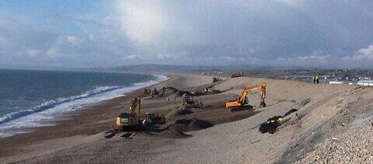
Beach Reprofiling
Demonstrate
Be READY TO LEARN
Think like a Geographer
Beach reprofiling is the artificial re-shaping of a beach using existing beach material. In winter, a beach is lowered by destructive waves. After winter storms, bulldozers move sand and shingle back up the beach. Like beach nourishment, reprofiling ensure that the beach is large enough to be an effective buffer between land and sea.
The residential area behind the beach is now protected so residents feel safe.
A steep, high crested beach may look unnatural and uninviting to tourists.
Major reprofiling costs can be expensive.
By using the material from the beach, it still looks reasonably natural.
The combined cost of beach nourishment and beach reprofiling at Pevensey, East Sussex is £30 million over 25 years.
LO: To explore the costs and benefits of coastal management strategies; soft and hard engineering.

Slide 15
What may influence decision?
Choosing which methods of coastal protection is most appropriate for an area of coastline may take into account the following:
COST : concrete sea wall is expensive. Wood revetments are cheaper
LIFETIME : rock groynes may last decades. Beach rebuilding will have to be carried out every few months
ENVIRONMENTAL IMPACT : offshore reefs will not affect the look of the beach but concrete will look awful and put tourists off using the coastline
SUSTAINABILITY : using hardwood from tropical rainforests for timber groynes is not sustainable – they will deteriorate and need replacing faster than new hardwood trees grow. Beach rebuilding is sustainable as you are moving sand from where it has been deposited, to where it has been eroded from.

Slide 16
Answer the Question below.
Demonstrate
Be READY TO LEARN
Think like a Geographer
Identify the differences between hard and soft engineering coastal management strategies (4)
L1 (1-2) – Points are general and not developed. No comparative language has been used.
L2 (3-4) – Both soft and hard engineering strategies have been considered. Comparative language has been used.
LO: To explore the costs and benefits of coastal management strategies; soft and hard engineering.

Slide 17
Answer the Question below.
Demonstrate
Be READY TO LEARN
Think like a Geographer
Identify the differences between hard and soft engineering coastal management strategies (4)
Hard engineering strategies such as sea walls and rock armour tend to be more expensive (1) with sea walls costing around £5000 per metre (1) and rock armour is often imported from Sweden or Norway, adding to the cost substantially (1). However soft engineering strategies such as sand dune stabilising is relatively cheap as local grass and volunteer labour is often used (1). Strategies such as dune regeneration tend to be more environmentally friendly (1). At Studland sand dunes, regeneration has helped maintain a habitat for the rare Dartford warblers and nightjars (1) whereas damaged gabions are unsightly and seabirds may damage their feet in them (1).
LO: To explore the costs and benefits of coastal management strategies; soft and hard engineering.

