Slide 1
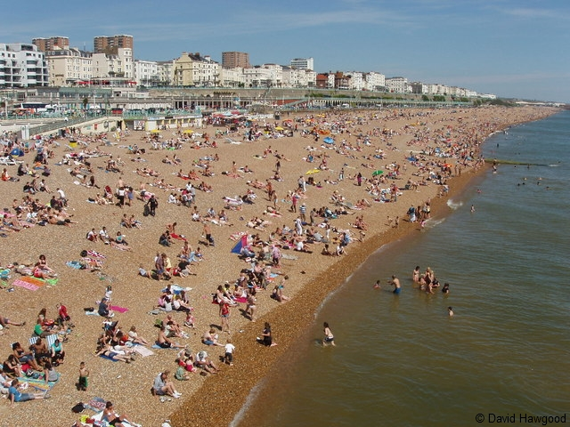
Coastal transportation and deposition
CONNECT
Be READY TO LEARN
Start thinking like a Geographer
Make sure you have your book, write today’s date and title.
Can you stand on the same beach twice?
LO: To explore the characteristics and formation of the deposition landforms.

Slide 2
Question Time
Demonstrate
Be READY TO LEARN
Think like a Geographer
What is the process of transportation of sediment along a beach called?
Write the answer on to your whiteboards.
LO: To explore the impact erosion, transportation and deposition has on changing coastal environments.

Slide 3
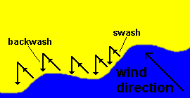
Transportation along a coastline
To know how Longshore Drift (LSD) moves material along a coastline.

Slide 4
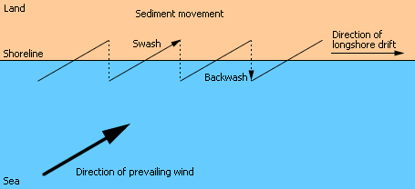
What is long-shore drift?
http://www.youtube.com/watch?v=U9EhVa4MmEs&feature=player_embedded

Slide 5
Longshore drift

Slide 6
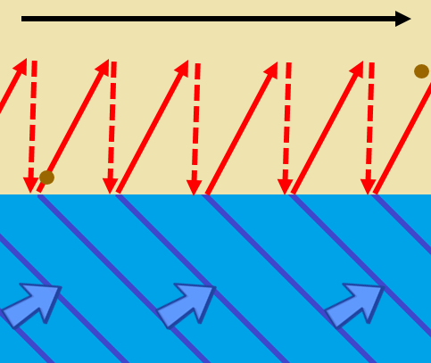
Longshore Drift – transports the eroded material and deposits it (when waves loose energy) further along the beach.
Demonstrate
Be READY TO LEARN
Think like a Geographer
Waves approach the beach at an angle (dependent on wind direction),
Sediment will be moved along the beach in a zigzag pattern. The swash of the wave carries the sediment along the beach.
The backwash carries the sediment back down the beach as the wave retreats to the sea.
2
3
1
LO: To explore the impact erosion, transportation and deposition has on changing coastal environments.

Slide 7
Longshore Drift
Waves can approach the coast at an ________ because of the direction of the ____________ ______. The _______ carries material up the beach at an angle. The ____________ then flows back to the sea in a straight line at 90 degrees. Continual swash and backwash __________ material sideways along the coast. This movement of material is called longshore drift and occurs in a __________ motion.
In normal conditions more material is _____________ on a beach than is removed. However, during storms _____________ waves can remove more material than is deposited. To limit the amount of material that is transported along a coastline we can use coastal defences called _____________ that trap material on the beach.

Slide 8
Draw a diagram to show the process of longshore drift
Demonstrate
Be READY TO LEARN
Think like a Geographer
REMEMBER - Use a ruler and pencil!
SUCCESS CRITERIA:
Show wind direction/waves approaching the beach.
Show swash.
Show backwash.
Show sediment moving along the beach.
Label it.
LO: To explore the impact erosion, transportation and deposition has on changing coastal environments.

Slide 9
WAGOLL
Demonstrate
Be READY TO LEARN
Think like a Geographer
Sediment moves along the beach
2
3
Swash
Backwash
1
Wind Direction
LO: To explore the impact erosion, transportation and deposition has on changing coastal environments.

Slide 10
Longshore Drift
ACTIVATE
Be READY TO LEARN
Think like a Geographer
Outline the process of longshore drift (3).
SUCCESS CRITERIA:
What does longshore drift mean?
What is needed from the beginning (wind/waves)?
How do the waves move?
How is material transported?
What direction does material move in?
LO: To explore the characteristics and formation of coastal deposition landforms; spits and bars.

Slide 11
Longshore Drift
ACTIVATE
Be READY TO LEARN
Think like a Geographer
Outline the process of longshore drift (3).
MODEL ANSWER:
Longshore drift is the movement of material along the beach (1). It occurs in the direction of the prevailing waves (1). It is comprised of swash – where breaking waves move material up a beach (in the direction of prevailing wind/waves (1), and backwash – where (due to gravity) material is dragged back towards the sea (1). Swash and backwash is repeated leading to movement in a zig-zag movement along beach (1).
LO: To explore the characteristics and formation of coastal deposition landforms; spits and bars.

Slide 12
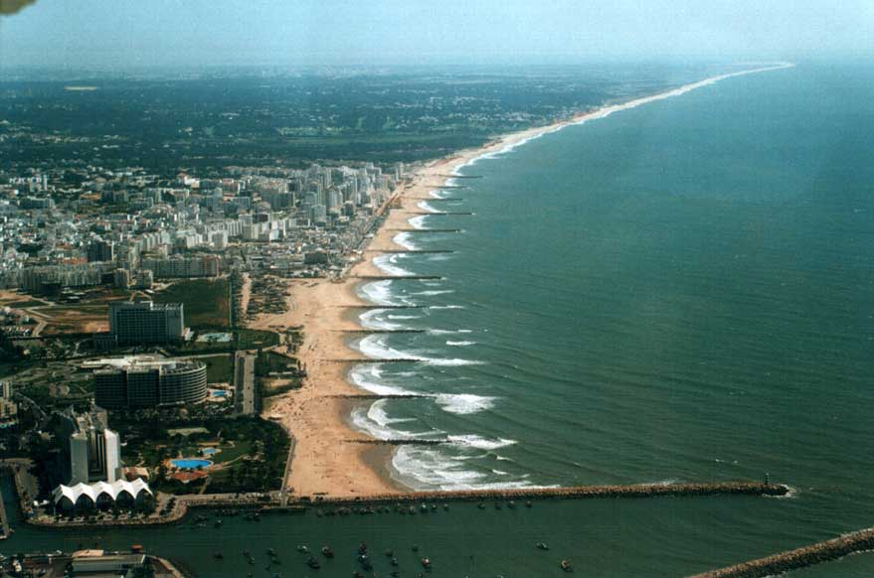

Slide 14
Model answer
Describe and explain the process of longshore drift
Longshore drift is a method of coastal transportation and it refers to the movement of sediment along the coastline.
Waves usually approach the coastline at an angle, which is dictated by the direction of the prevailing wind.
The swash (incoming wave) carries sediment up the beach and the backwash then pulls material back to sea at a 90 degree angle, this is due to the force of gravity pulling the water back down the slope of the beach.
Continual swash and backwash transports material sideways along the coast in a zigzag motion.
Constructive waves (in normal conditions) result in more material being deposited than is removed by longshore drift.
Finer particles, such as sand, are transported further along a coastline than heavier material such as shingle.

Slide 15
Question Time
Demonstrate
Be READY TO LEARN
Think like a Geographer
Coastal deposition is when waves drop and leave behind the sediment they were transporting. It happens when the energy in the waves is lost as the flow of water slows down.
True OR False
What type of wave would cause it?
Destructive OR Constructive
LO: To explore the impact erosion, transportation and deposition has on changing coastal environments.

Slide 16
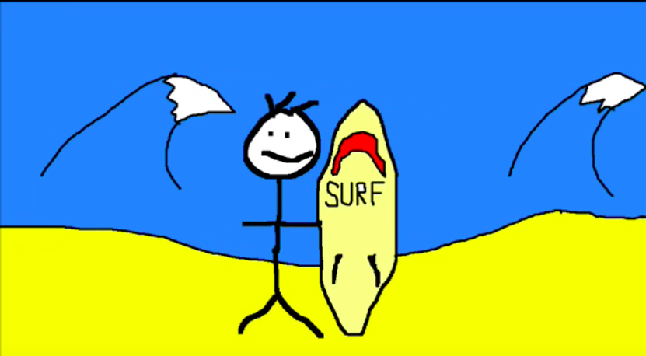
Methods of transportation
There are four ways that waves and tidal currents transport sediment. These can then contribute to the movement of sediment by longshore drift.
Solution - Minerals are dissolved in sea water and carried in solution. The load is not visible. Load can come from cliffs made from chalk or limestone, and calcium carbonate is carried along in solution.
Suspension - Small particles are carried in water, e.g. silts and clays, which can make the water look cloudy. Currents pick up large amounts of sediment in suspension during a storm, when strong winds generate high energy waves.
Saltation - Load is bounced along the sea bed, e.g. small pieces of shingle or large sand grains. Currents cannot keep the larger and heavier sediment afloat for long periods.
Traction - Pebbles and larger sediment are rolled along the sea bed.
Watch: Sticky does coastal erosion
Task: Make your own sticky video, showing the 4 methods of coastal transportation

Slide 17
LO: To explore the characteristics and formation of the deposition landforms; beaches.
ACTIVATE
Be READY TO LEARN
Think like a Geographer
Write the Learning Objective.
SUCCESS CRITERIA:
I can describe the characteristics of beaches.
I can draw a diagram of a beach profile.
I can explain the formation of beaches.
I can outline the reasons for change in beach profiles.
Coastal Deposition Landforms

Slide 18
Coastal Deposition Landforms - Beaches
CONNECT
Be READY TO LEARN
Start thinking like a Geographer
Make sure you have your book, write today’s date and title.
You can stand in the same location twice, but the beach will have changed in character.
WHY?
LO: To explore the characteristics and formation of the deposition landforms; beaches.

Slide 19
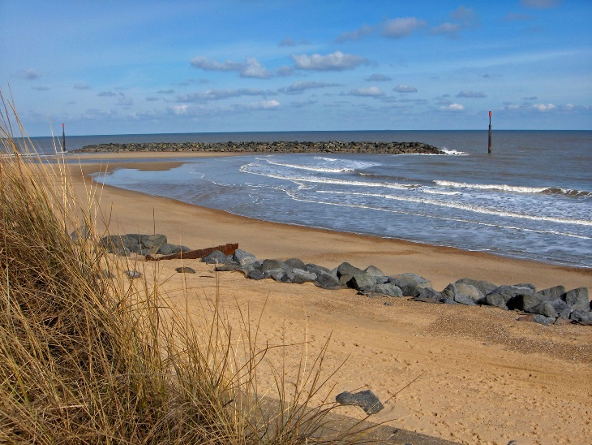
What is a beach?
ACTIVATE
Be READY TO LEARN
Think like a Geographer
Beaches are found on coasts between high and low tide level. Beaches are deposits of sand that lies between the high and low tide levels. Most beaches are formed of sand and shingle (pebbles) as well as mud and silt. They are mainly found in bays because the waves that enter the bay are constructive waves that have a strong swash and build up the beach.
LO: To explore the characteristics and formation of the deposition landforms; beaches.

Slide 20
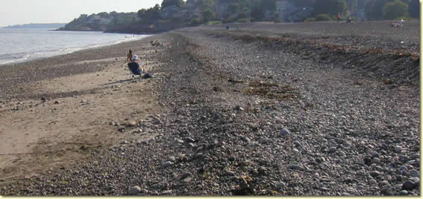
Pebble Beach Profiles
DEMONSTRATE
Be READY TO LEARN
Think like a Geographer
Berms
Created in stormy conditions
Increasing particle size
Smaller sediment particles
Large material thrown high onto the beach
LO: To explore the characteristics and formation of the deposition landforms; beaches.

Slide 21
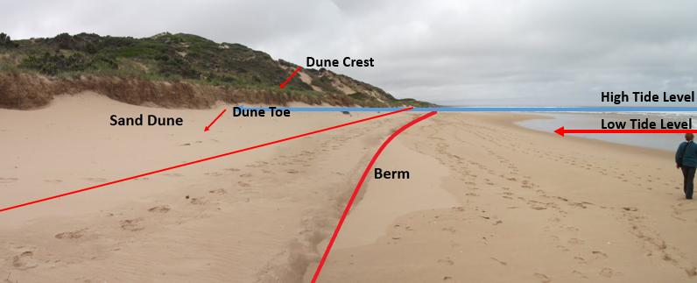
Sand Beach Profiles
DEMONSTRATE
Be READY TO LEARN
Think like a Geographer
LO: To explore the characteristics and formation of the deposition landforms; beaches.

Slide 22
https://timeforgeography.co.uk/videos_list/coasts/Explain-how-a-beach-is-formed/

Slide 23
Beach formation
Beaches are made up from eroded material that has been transported from elsewhere and then deposited by the sea. For this to occur, waves must have limited energy, so beaches often form in sheltered areas like bays.
Constructive waves build up beaches as they have a strong swash and a weak backwash.
Sandy beaches are usually found in bays where the water is shallow and the waves have less energy.
Pebble beaches often form where cliffs are being eroded, and where there are higher energy waves.
A cross-profile of a beach is called the beach profile. T
he beach profile has lots of ridges called berms. They show the lines of the high tide and the storm tides.
A sandy beach typically has a gentle sloping profile, whereas a shingle beach can be much steeper.
The size of the material is larger at the top of the beach, due to the high-energy storm waves carrying large sediment.
The smallest material is found nearest the water as the waves break here and break down the rock through attrition.

Slide 24
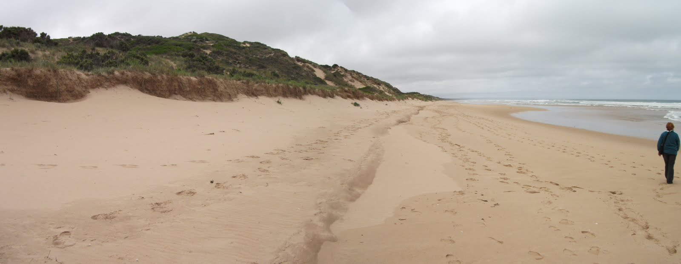
Study Figure 1, a photograph of a beach.
DEMONSTRATE
Be READY TO LEARN
Think like a Geographer
Figure 1
LO: To explore the characteristics and formation of the deposition landforms; beaches.

Slide 25
Study Figure 1, a photograph of a beach.
DEMONSTRATE
Be READY TO LEARN
Think like a Geographer
MODEL ANSWER:
Beaches are formed when constructive waves deposits its load (1) as it looses energy (1).
LO: To explore the characteristics and formation of the deposition landforms; beaches.

Slide 26
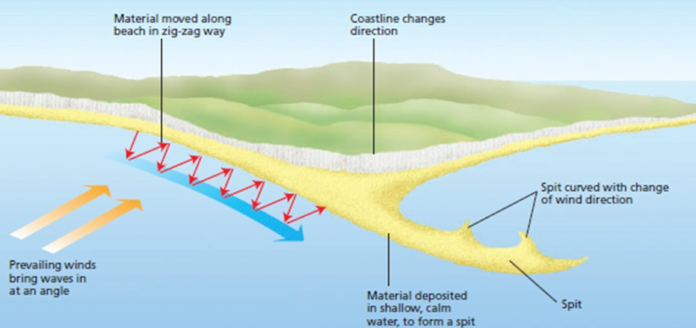
Coastal Deposition
Demonstrate
Be READY TO LEARN
Think like a Geographer
It happens when there is lots of erosion elsewhere on the coast, meaning there’s lots of sediment available.
There’s lots of transportation of material into the area.
LO: To explore the impact erosion, transportation and deposition has on changing coastal environments.

Slide 27
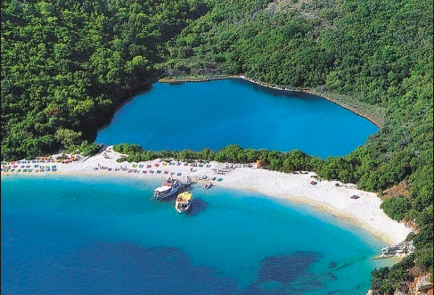
Spits, bars and tombolos
https://www.youtube.com/watch?v=3XBqEbPzgds
https://www.youtube.com/watch?v=Bs-G57JaQm4

Slide 28
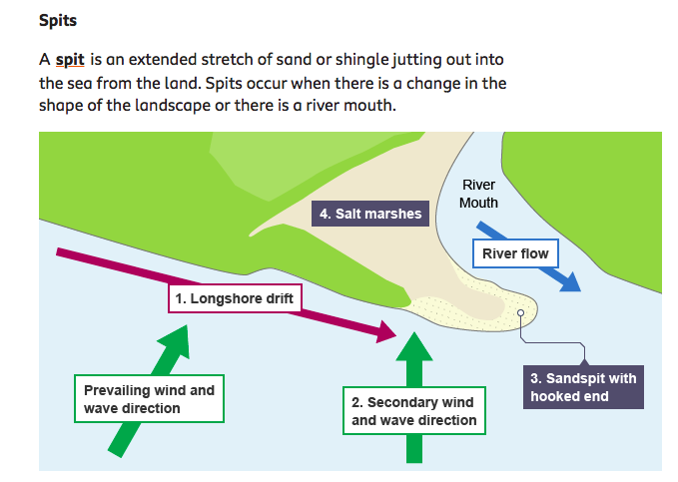
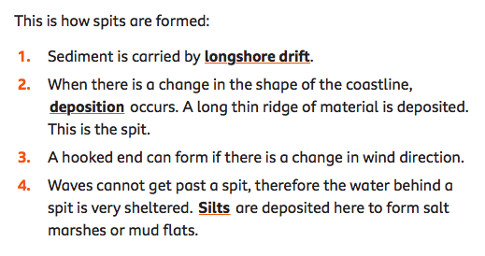

Slide 29
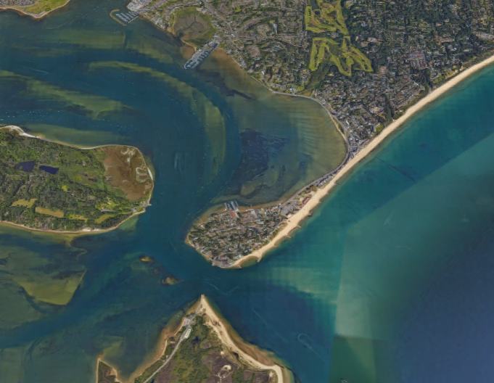
Characteristics of Sandbanks Spit, Dorset
ACTIVATE
Be READY TO LEARN
Think like a Geographer
Proximal end
Lagoon
Distal end
Mudflats and salt marshes
Large hook
Spit
LO: To explore the characteristics and formation of coastal deposition landforms; spits and bars.

Slide 30
Formation of a Spit
ACTIVATE
Be READY TO LEARN
Think like a Geographer
Longshore drift transports sand along the coast.
The coastline changes shape and the waves begin to loose energy.
Deposition starts to build up at the proximal end and the spit grows out into the sea.
The spit is exposed to changes in wind and wave direction which cause the distal end to hook back towards the land.
LO: To explore the characteristics and formation of coastal deposition landforms; spits and bars.

Slide 31
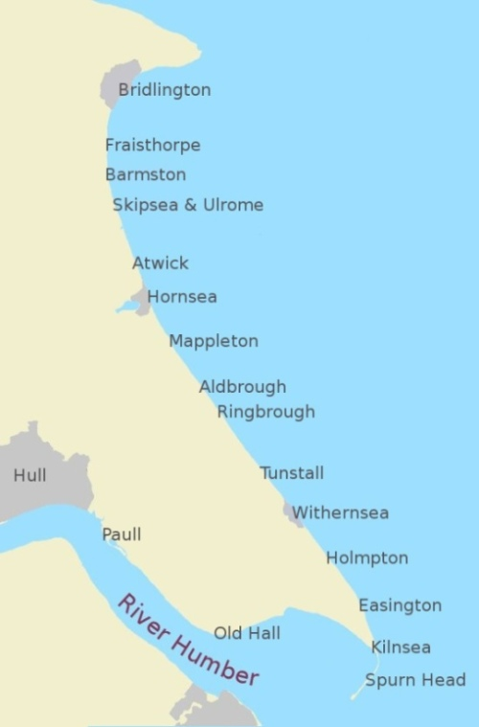
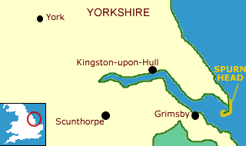
Landform: Spit (deposition)
Example: Spurn Point (Head), Holderness Coastline, East Riding, North-East England.

Slide 32
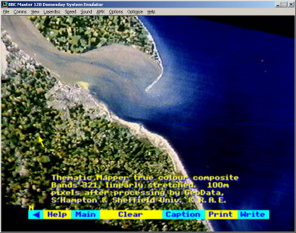
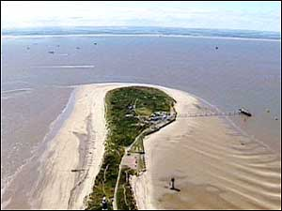
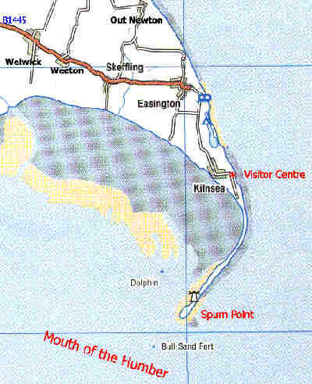
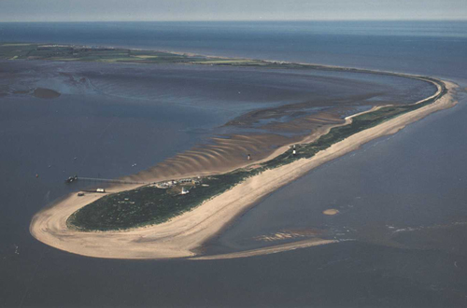

Slide 33
Description
Spurn point is a long narrow ridge of sand and shingle, known as a spit.
It is located at the southern most point of the Holderness coastline in East Riding, Yorkshire.
One end of the spit is attached to the land and sand and shingle then extends out into the sea in the direction of the coastline.
Spurn point is over 3 miles long, although in some places it is only 50 metres wide.
It is like a beach that goes out into the sea instead of hugging the land.

Slide 34
Formation
The soft and easily eroded boulder clay, that forms much of Holderness, provides plentiful material for longshore drift.
Prevailing winds approach the Holderness coast from the north-east and move material along the coastline from north to south. This movement is known as longshore drift.
The energy in the waves transporting the material is reduced where the North Sea meets the Humber Estuary. As a result the material is deposited. This process is known as deposition.
As more and more material is deposited it builds upwards and outwards forming a spit (a beach that sticks out to sea).
Waves cannot get behind the spit and this has created a sheltered area where silt is deposited and mud flats have formed.

Slide 35
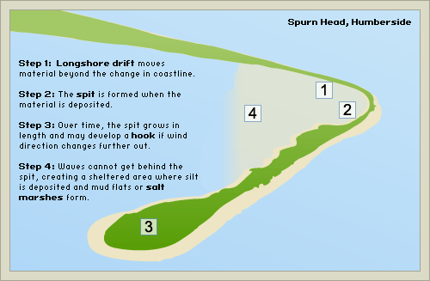
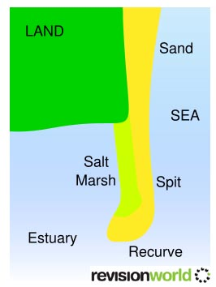

Slide 36
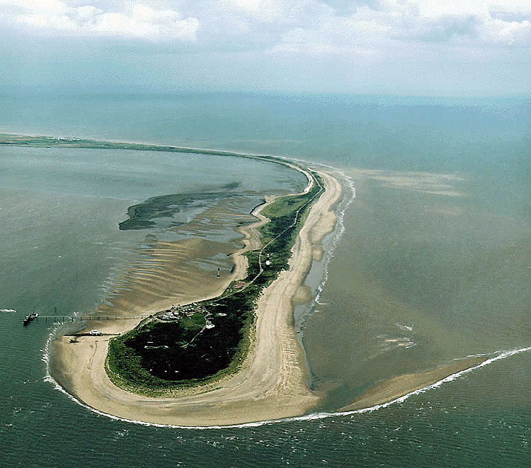
Eroded material is deposited where the coastline changes direction
Groynes have been built here to stop Spurn point being washed away
The old lighthouse
The second lighthouse
The lifeboat crew’s houses
Docking facilities
The Vessel Traffic Services tower

Slide 38
Management
In the middle of the 19th century a series of groynes were built on the shore to check the erosion. This was later found to be a bad idea as it stopped the natural movement of the sand around the point, and it also failed to stop the erosion.
There is a policy of managed retreat at Spurn Point today, this is a soft engineering technique and it means that nature is being allowed to take its course.
Human management north of Spurn Point is having an impact though. Groynes that have been built to protect settlements along Holderness e.g. Hornsea and Withernsea reduce the amount of beach material arriving at Spurn Point. The point has already been breached several times in the past and sections of it today are only 50 m wide.

Slide 39
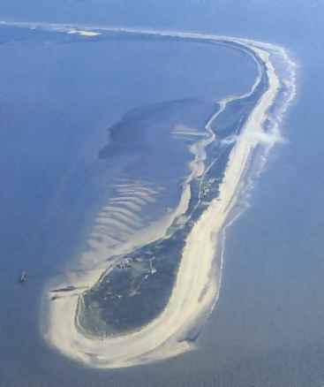
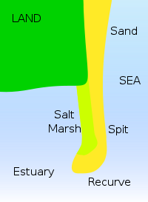
Coasts : Features of Deposition: Spits
12
As cliff and beach material is transported along a coast by longshore drift, if the flow is interrupted or slowed down, the material is deposited to form a range of coastal features.
A SPIT is unable to extend right across an estuary due to the force of the river current finding a route out to the sea.
It is RECURVED at the end in the direction of the strongest of the two currents.
In Spurn Point’s case, the North Sea current is more powerful than the River Humber current, so the spit curves in towards the estuary.
SPIT:
A linear beach that extends from the shore across a river estuary or along the coast – but doesn’t join on to any other feature.
e.g. Spurn Point, E. Yorkshire
Possible Questions :
Describe and explain the formation of a coastal spit (7)
Is this a
SPIT
TOMBOLA or
BAR ?

Slide 40
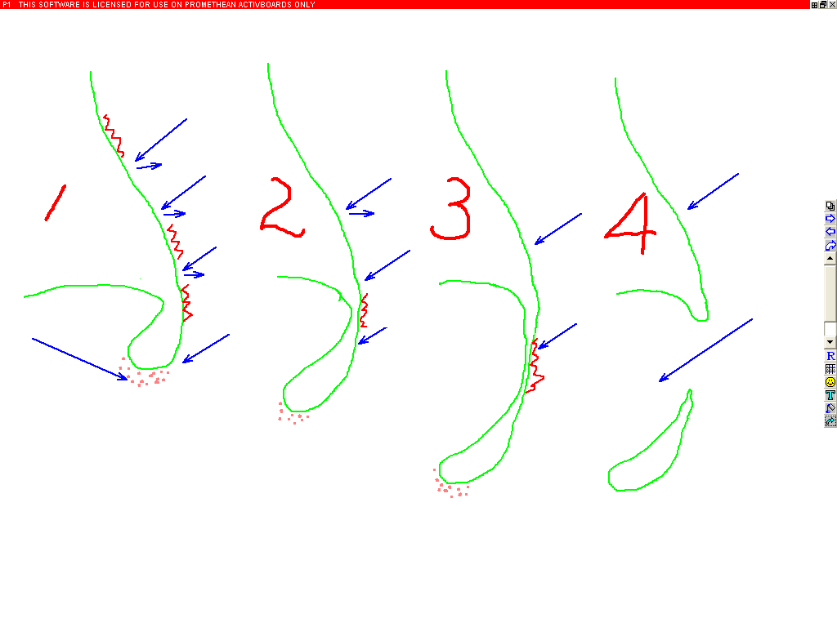
Coasts : Features of Deposition / Evolution of Spurn Head, E. Yorkshire – A SPIT
14
A : Sea erodes the coast and Longshore Drift transports material down the coast
B : The North Sea and R. Humber currents meet, slow down & deposit their material. The N.Sea current is stronger so the recurved spit bends in to the Humber channel.
A
C
River Humber Current
North Sea Current
D
B
E
C : As the Spit head grows southwards, erosion still takes place up-coast
D : The neck of the spit has more erosion than deposition – so gets thinner
E : The sea breaks through the neck, the spit head is an island and is eroded away

Slide 42
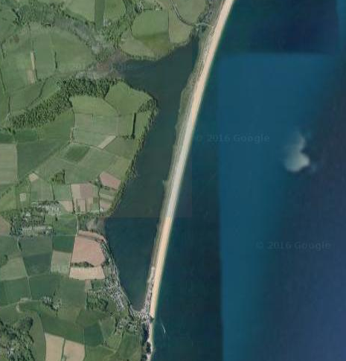
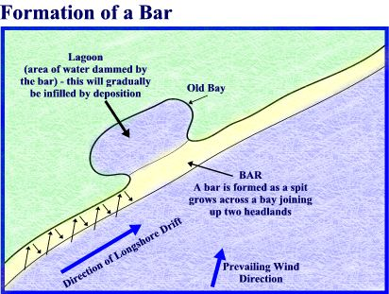
How is a bar formed?
ACTIVATE
Be READY TO LEARN
Think like a Geographer
Slapton Ley Bar, Devon, United Kingdom
1. A spit joins together two headlands.
2. A bar cuts off the bay between the headlands from the sea.
3. A lagoon can form behind the bar.
LO: To explore the characteristics and formation of coastal deposition landforms; spits and bars.

Slide 44
On your worksheets, label the characteristics of Sandbanks Spit, Dorset. Using the photograph of Slapton Ley Bar, draw a diagram to show a bar.
Demonstrate
Be READY TO LEARN
Think like a Geographer
Sandbanks Spit
Slapton Ley Bar
Large hook
Distal end
Spit
Lagoon
Mudflats and salt marshes
Proximal end
LO: To explore the characteristics and formation of coastal deposition landforms; spits and bars.

Slide 45
On your worksheet, explain the formation of Spits and Bars.
ACTIVATE
Be READY TO LEARN
Think like a Geographer
LO: To explore the characteristics and formation of coastal deposition landforms; spits and bars.

Slide 46
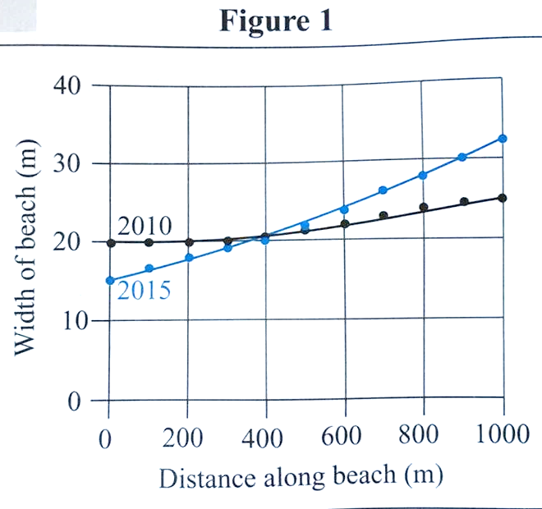
Study Figure 2, a graph showing how the width of a beach varied along its length in the years 2010 and 2015.
Demonstrate
Be READY TO LEARN
Think like a Geographer
Figure 2
The total volume of material on the beach in Figure 2 increased between 2010 and 2015 because large amounts of material, carried by sea water, were deposited on the coast. (2)
Reason 1:………………………....
…………………………………………
Reason 2:………………………….
…………………………………………
LO: To explore the impact erosion, transportation and deposition has on changing coastal environments.

Slide 47
Study Figure 2, a graph showing how the width of a beach varied along its length in the years 2010 and 2015.
Demonstrate
Be READY TO LEARN
Think like a Geographer
Figure 2
The total volume of material on the beach in Figure 2 increased between 2010 and 2015 because large amounts of material, carried by sea water, were deposited on the coast. (2)
MODEL ANSWER:
There’s lots of erosion elsewhere on the coast, meaning there’s lots of sediment available (1).
There’s lots of transportation of material into the area (1).
LO: To explore the impact erosion, transportation and deposition has on changing coastal environments.

Slide 48
Complete the skills worksheet

