Slide 1
Clouding Your Judgement!
LO: To be able to describe the main types of cloud and be able to estimate the extent of cloud cover.

Slide 2
LO: To be able to describe the main types of cloud and be able to estimate the extent of cloud cover.
ACTIVATE
Be READY TO LEARN
Think like a Geographer
.
SUCCESS CRITERIA:
I can describe the different types of clouds
I can identify the different types of clouds in our local environment
I can sketch the main features of the different types of clouds
Types of clouds

Slide 3
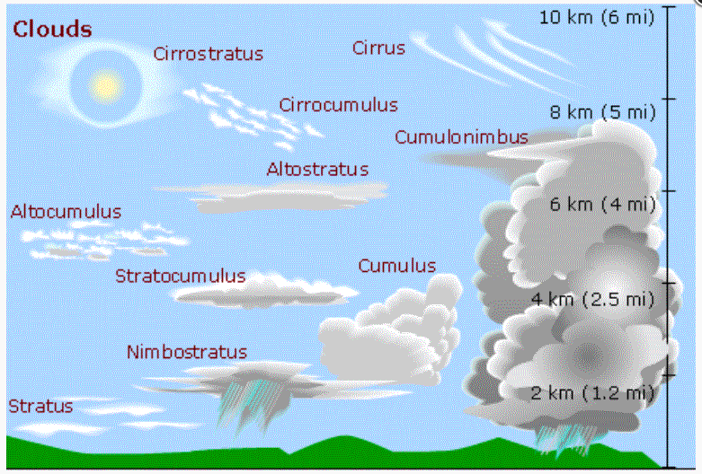
LO: To be able to describe the main types of cloud and be able to estimate the extent of cloud cover.
The types of clouds

Slide 4
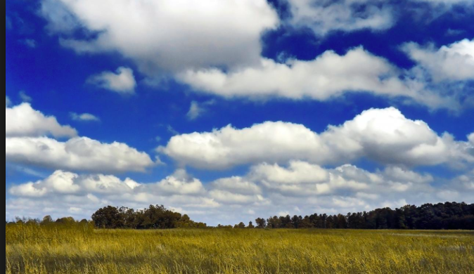
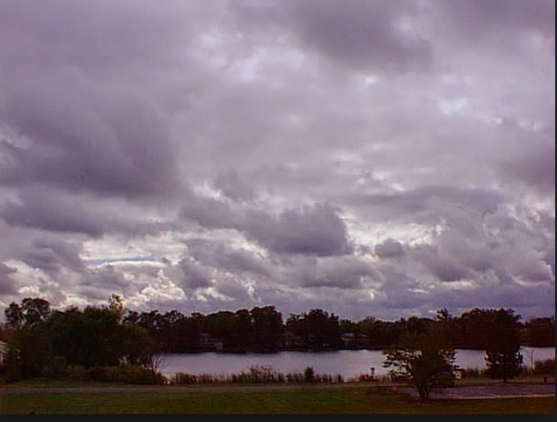
Watch the video: https://www.youtube.com/watch?v=FMagDRCpJ14 Make notes on the main types of clouds:
Task
Be READY TO LEARN
Think like a Geographer
Cirrus
Cumulus
Stratus
LO: To be able to describe the main types of cloud and be able to estimate the extent of cloud cover.

Slide 5
Message in a Cloud
ACTIVATE
Be READY TO LEARN
Think like a Geographer
You are going to be producing a fact sheet that details each of the main types of clouds and the associated weather conditions. Using the information in the diagram, this weblink and this one and video, to fill in the work sheet to answer:
What do they look like?
What are their characteristics?
What weather do they create?

Slide 6
Cloud research:
Conduct independent research to draw sketches or print photographs of different cloud types and write a description for each one.
Keep a daily record of cloud type and cover from observations

