Slide 1
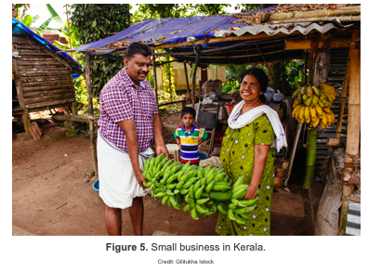
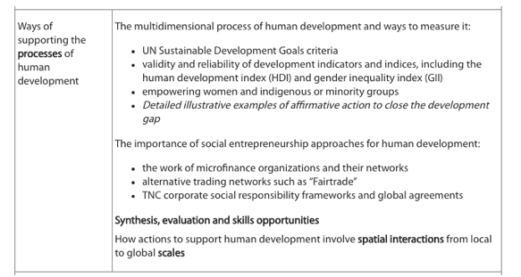
Ways of reducing gender disparities through micro credit
Closing the development gap
Why:
How actions to support human development involve spatial interactions from local to global scales

Slide 3
What does affirmative action mean?

Slide 4
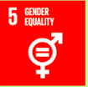
Empowering women

Slide 5
Recap: What are the barriers facing women?
Read kognity: 5.1.3
Empowering women and indigenous groups and recap some of the barriers women face

Slide 6
How could these barriers be reduced?
https://www.youtube.com/watch?time_continue=1&v=bpSNM625LFU

Slide 7
Microfinance
About 2.5 billion adults have no access to financial services, and 80 % of people living on less than $2 per day have no access to a bank account so microfinance has grown to meet the needs of these people.
Microfinance schemes aim to reduce poverty, address social issues including gender discrimination, and enable market access for the poor.
Most people who use microfinance are in rural areas- many farmers.
Microfinance schemes often focus on women, who in some societies are unable to own land or borrow money.

Slide 9
http://datatopics.worldbank.org/sdgatlas/SDG-05-gender-equality.html
Links to SDGs

Slide 10
Case study: Micro credit in Kerala, India
What do we already know about Kerala, India?

Slide 11
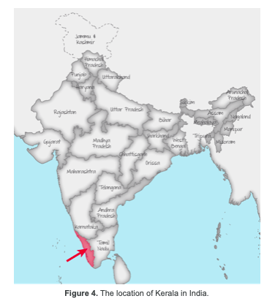
Kerala case study information
Kerala is a state in south-west India. Women have a high status and female literacy is one of the highest in India at 87%. As a result Kerala has one of the lowest fertility rates in the country (1.67 children per woman), infant mortality is low (12 compared to a national average of 40 per 1000 live births) and life expectancy for women is 74 years. Despite this, female participation in the labour force is low (16%) and 150,000 families live in poverty.

Slide 12
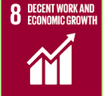
Kudumbashree Mission: case study of micro loans
Kudumbashree Mission is a government-backed scheme providing microloans. Funding for the scheme comes from both the Indian government and the local Kerala state government. It is the largest organisation in South Asia focusing on the social and economic empowerment of women. More than 50% of families in Kerala take part in the scheme.
Read Kognity 5.1.4
The work of microfinance organisations and their networks and make on how the Kudumbashree Mission has helped reduce gender equalities and help with development processes.
How is this an example of affirmative action?
Are there any issues with microloans?
https://www.youtube.com/watch?v=Mr2G7IJAY34

Slide 13
Issues with microfinance
Their interest rates are higher than those of commercial banks- but lower than loan sharks
Some people use the loans to pay for food or health care rather than for starting or improving their business
Not all poor people are entrepreneurs and so the loans may be wasted
Microfinance loans may be used to pay off other loans rather than for business purposes
A study in Bangladesh revealed that microfinance in the form of microcredit can place considerable pressure on women. As only women are able to access loans they are often forced to act as agents for their husbands. Women are then left to repay the loan despite the fact that the husband has spent the money.

Slide 14
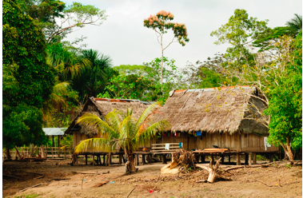
Empowering indigenous and minority groups

Slide 15
Empowering indigenous and minority groups
There are approximately 370 million indigenous people spread over 70 countries. These people make up about 5% of the global population but account for about 15% of the world’s poor. Indigenous groups often lack access to basic services.

Slide 16
Empowering indigenous groups
The Penans are one of the indigenous tribes of Borneo. They are believed to be the last nomadic hunter-gatherers in Malaysia, calling the rainforest their home.
As hunter-gatherers, they rely heavily on the rainforest to supply their needs – from food to shelter. Today, many have embraced modernity and live in resettlement communities though some still remain semi-nomadic. However, it has been challenging for the Penan in their transition to modern life.

Slide 17
How have the Penan been impacted by global interactions?

Slide 18
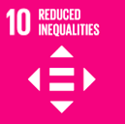
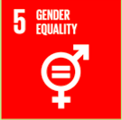
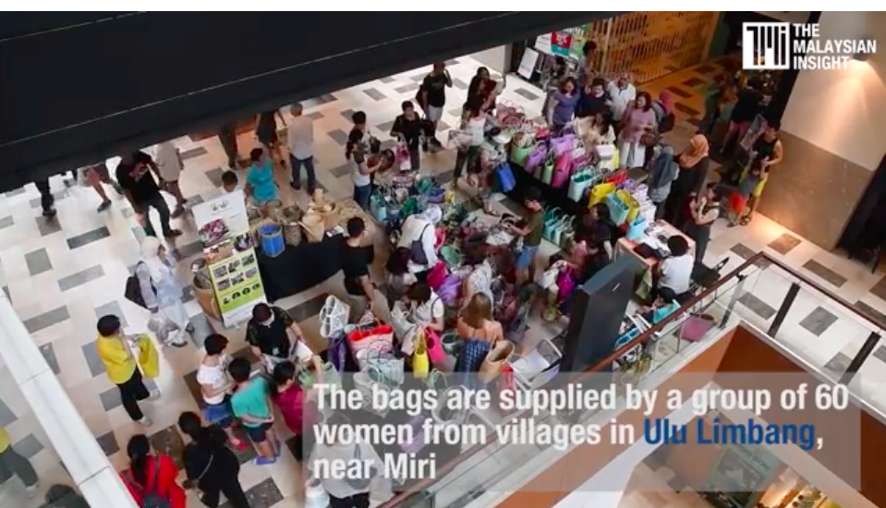
Empowering indigenous groups
http://penanwomenproject.org
Watch:
Sales from the bags helps the Penan with medical and maternity care (paying medical bills, provide milk, food and clothes for mothers, and babies). Other projects include teaching them to grow vegetables (supplying them with seeds and farming tools), collecting and distributing donations and visiting Penan families and students in schools.
Task: Use the resources to make notes on the quality of life of the Penan population
Describe ways in which the Penan Women’s project is empowering the group?
Evaluate the successes
http://www.theborneopost.com/2016/06/26/penans-weaving-their-life-to-modernity/

Slide 19
Example question
Using examples, analyse various affirmative actions taken to close the development gap. [12]

