Slide 1
Climate change – the spatial distribution of the effects and the uncertainty of the impacts
Synthesis, evaluation and skills opportunities The uneven spatial distribution of effects and uncertainty about their timing, scale and impacts for individuals and societies

Slide 2
Essay questions (10 mks):
Examine the effects of global climate change on communities and natural systems
Climate change is a vast global experiment with very uncertain outcomes for human and biological communities. Discuss this statement.

Slide 3
Why are the impacts uncertain?
Read pages 436-450 of the IB textbook – comment on the uncertainty on the future impacts of climate change (including timing, scale and impacts for individuals and societies)

Slide 4
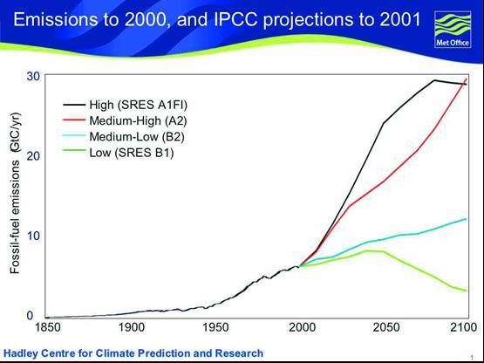
What may the climate be like in the future?
LO:
To use evidence to explain what will the climate be in the future
To evaluate the sources of evidence that scientists use to predict the future climate

Slide 5
How do we know about the changes?

Slide 7
Storyline A1
a future world of rapid economic growth
global population that peaks in mid-century and then declines
rapid introduction of new and more efficient technologies
convergence among regions
increased cultural and social interactions
reduction in regional differences in per capita income

Slide 8
Storyline A2
a future world of self-reliance
preservation of local identities
increasing population
economic development dependent on region
technological change is slower than other scenarios

Slide 9
Storyline B1
global population that peaks in mid-century and then declines
rapid change in economy towards a service and information economy
introduction of clean and resource efficient technologies
global solutions to economic, social and environmental sustainability

Slide 10
Storyline B2
Emphasis on local solutions to economic, social and environmental sustainability
Continuously increasing global population
Slow economic development
Less rapid and more diverse technological change

Slide 11
Use the information to complete the worksheet

Slide 12
More on climate change uncertainty
Part 1: http://www.wri.org/blog/2017/03/embracing-unknown-understanding-climate-change-uncertainty
Part 2: http://www.wri.org/blog/2017/03/how-do-we-tackle-climate-change-uncertainty

Slide 13
Summarise the text opposite from the IPCC on the impacts of climate change on coastal areas.
What are the key observations?

