Slide 1
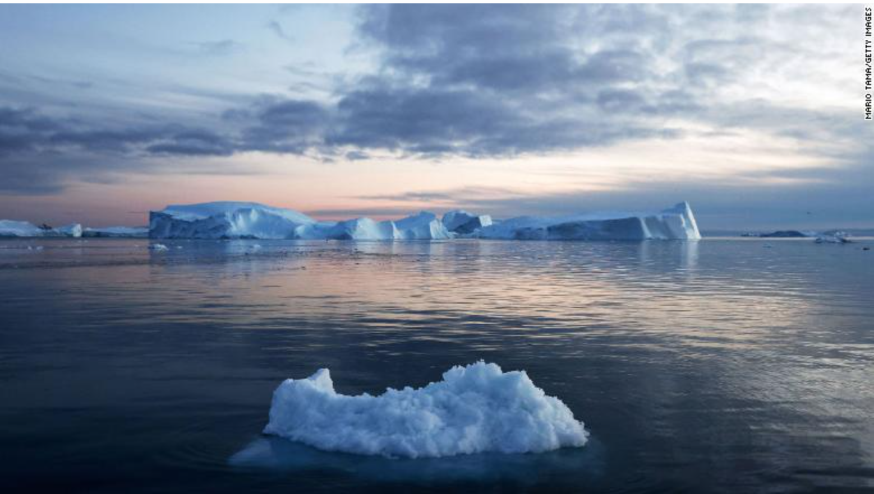
Climate chat
What do you think are the best ways to tack climate change? Does your partner agree?
Read each card and decide where to place it on the board
Talk about your decisions with your partner

Slide 2
Strongly disagree
Disagree
Agree to disagree
Agree
Strongly agree

Slide 3
Climate change is unlikely to directly affect me | People should avoid air travel, because airplanes use large amounts of fossil fuels. It’s a luxury the world can’t afford. | Rich people should make most of the effort to use less resources since they consume the most.
We should talk seriously to the younger generation about climate change and how the planet is threatened | People shouldn’t eat meat because raising livestock plays a large role in climate change. | I recycle, use sustainable forms of transport, and turn off any unused lights so I am already doing enough.
Less developed countries should be able to catch up with more developed ones, even if that means making climate change worse | Living the simpler life necessary to limit climate change may make us happier. | The more developed countries need to invest in the less developed countries to help them adapt to climate change.

