Slide 1
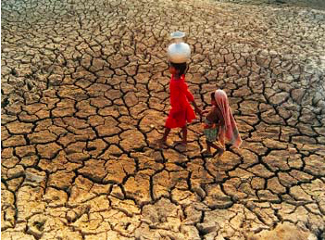
The human impacts and risks of global climate change
Enquiry question: What are the disparities in exposure to climate change risk and vulnerability?

Slide 2
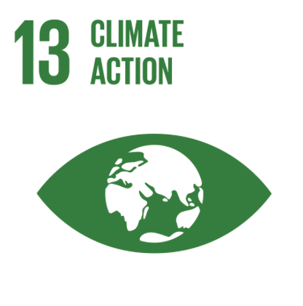
IB learning objective:
Disparities in exposure to climate change risk and vulnerability, including variations in people’s location, wealth, social differences (age, gender, education), risk perception
Detailed examples of two or more societies with contrasting vulnerability

Slide 3
IB learning objective: Disparities in exposure to climate change risk and vulnerability, including variations in people’s location, wealth, social differences (age, gender, education), risk perception Detailed examples of two or more societies with contrasting vulnerability
What: The factors that determine Climate Change Vulnerability/ Resilience
Why: To analyse the disparities in exposure, risk and vulnerability
How:
Learn how in theory how Climate Change risk/ vulnerability can be calculated/ measured
Apply this theory to 2 contrasting case studies
Understand how within a country demographics can have an impact on vulnerability

Slide 4
Vulnerability
Vulnerability refers to the degree to which people or the things they value are susceptible to, or are unable to cope with, the adverse impacts of climate change. Thus, vulnerability determines how severe the impacts of climate change might be.

Slide 6
Resilience
Resilience refers to the ability of a human system to withstand contemporary shocks and to anticipate and plan for future shocks.
Resilient systems have the ability to learn from past experiences and to use that knowledge when confronting problems. Systems with high adaptive capacity are therefore resilient and able to reconfigure themselves to deal with climate change. Systems with low adaptive capacity are much less resilient and much more vulnerable to climate change.

Slide 7
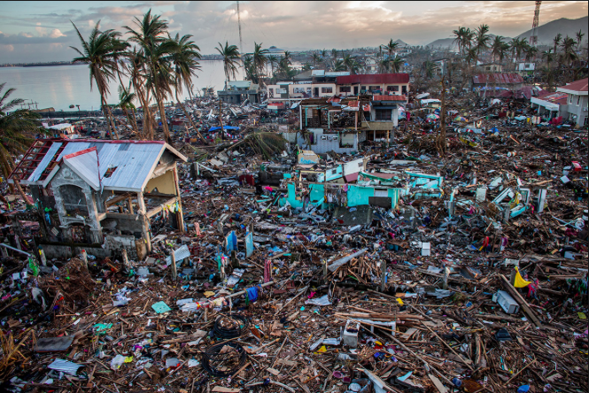
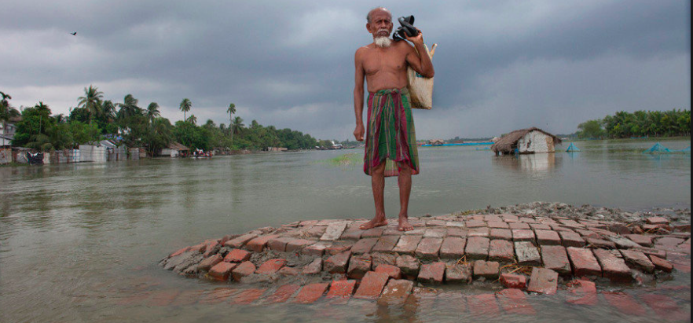
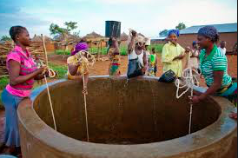
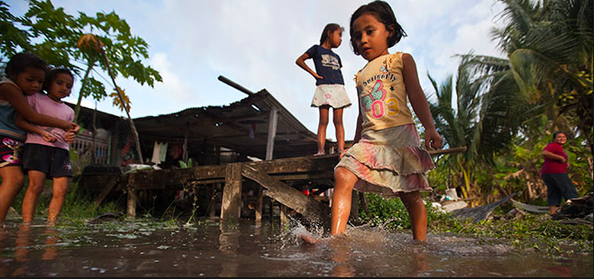
Measuring vulnerability/ Resilience
The Arctic
London
Philippines
Bangladesh
Kiribati
Ghana

Slide 8
Climate Change Vulnerability (CCVI)
A composite indicator that combines three simpler composite indices:
The Climate Change Exposure Index: the exposure to climate- related natural disasters
The Climate Change Sensitivity Index: Population patterns, economic development etc..
The Climate Change Adaptive Capacity Index: The government’s capacity to adapt

Slide 9
Climate Change Vulnerability (CCVI)
A risk score of 0-10 is given.
A score of 10 means the country is highly resilient to the impact of climate change
A score of 0 means the country has minimal resilience and so is highly vulnerable
Extreme risk: (a CCVI of 0.00 to 2.50)
High risk: (a CCVI of 2.50 to 5.00)
Medium risk: (a CCVI of 5.00 to 7.50)
Low risk: ( a CCVI of 7.50 to 10.00)

Slide 10
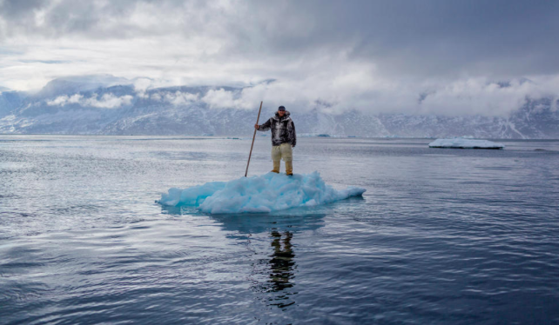
What: The factors that determine Climate Change Vulnerability/ Resilience
Why: To analyse the disparities in exposure, risk and vulnerability
Low Risk
Highly resilient
10
7.5
Medium Risk
Based on:
Exposure
Sensitivity
Adaptivity
5
High Risk
2.5
Extreme Risk
Minimal Resilience
0

Slide 11
Measuring vulnerability
Inuit culture in the Arctic
Risk of flooding in London
Typhoons in The Philippines
Flooding in Bangladesh
Sea level change in Kiribati
Drought in Ghana or Turkmenistan

Slide 12
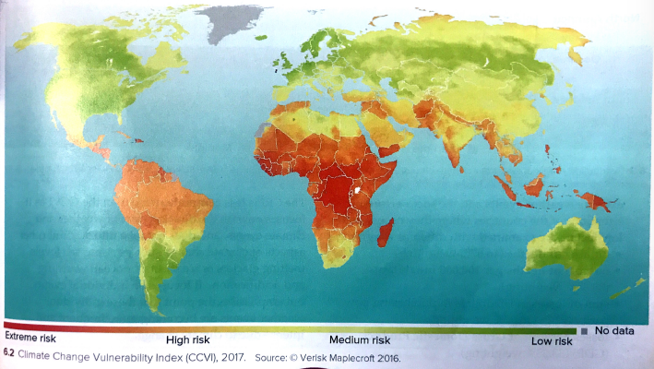
Most resilient countries are in Europe. (Denmark (CCVI 10, UK 9.96)
Haiti also extremely vulnerable with a CCVI of 0.24)
Five most vulnerable countries in Sub- Saharan Africa (I.e. Central African Republic CCVI 0.1 and DRC 0.20)

Slide 13
Climate change vulnerability by location
Questions to consider:
What is the pattern shown in the CCVI and the CRI? What are the similarities? Why are they different?
Why are there so many different methodologies for examining the risk to a particular location?
What are the factors that are connected to location which affect the extent to which populations are vulnerable to climate change (SEEP)?
What do they all have in common in terms of overall conclusions

Slide 15
Measuring vulnerability- alternative theory

Slide 16
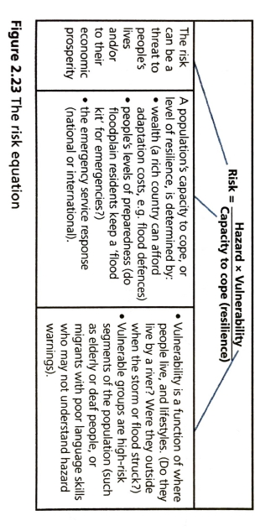
Task
Apply vulnerability theories to 2 contrasting case studies:
Use the resources on the weebly/ texbook to apply the aspects of the theory to this case study…
What is the risk? What exposure are people going to have to climate change disasters? How is climate change going to impact peoples lives?
How vulnerable is the population? To what extent are the peoples lives connected to the extreme environment. Do the demographics of the population lead to a heightened vulnerability?
What is the capacity to cope? Are they/ the government going to be able to adapt to the changes?

Slide 17
Measuring vulnerability
Inuit culture in the Arctic: Weebly
Risk of flooding in London: Weebly
Typhoons in The Philippines: Weebly
Flooding in Bangladesh: Textbook
Sea level change in Kiribati: Weebly
Drought in Ghana or Turkmenistan: Textbook

Slide 18
The UNDP states that “99% of the casualties from climate change will be in developing countries”.

Slide 19
Disparities in Vulnerability to Climate Change due to demographic factors
Using the information on the Weebly and textbooks explain how the following demographic groups within those countries will be disproportionately affected by climate change:
​Poorer people (3 reason)
Women (8 reasons)
Old people (2 reasons)
Children (1 reason)
What: The factors that determine Climate Change Vulnerability/ Resilience
Why: To analyse the disparities in exposure, risk and vulnerability

Slide 20
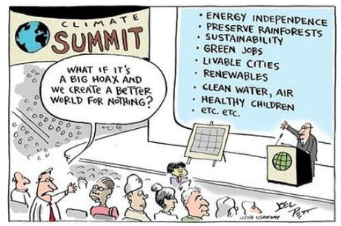
Risk perception
What is it? Why is risk perception important? How do you rate your own perception of the risks from climate change? Can you explain this using the factors which affect risk perception? ​ Factors affecting risk perception: Extent of factual knowledge/data Level of personal threat Immediacy of the risk Extent to which the risk can be controlled Extent to which person/community is open to changing ideas.

Slide 21
Example question
’The world’s poorer countries are least responsible for climate change and have the most to lose because of it.’ To what extent do you agree with this statement? (10 marks)

