Slide 1
The causes and consequences of forced migration:
1. Environmental factors

Slide 2
IB Objectives
I can evaluate the causes and consequences of forced migration and internal displacement.
I can examine detailed examples of two or more forced movements, to include environmental and political push factors, and consequences for people and places.

Slide 3
Why, why, how???
What…. is forced migration?
Why: So that we can understand the concept of “refugee” and the impacts that refugee movements have on people and places
How: Analyse at least two examples of forced migration using case study evidence

Slide 4
Concepts in context
Why are we studying migration?
Population change is a dynamic process. Populations change due to variations in birth and death rates and migration. This may lead to a change in population structure, which in turn contributes to the process of population change.

Slide 5
Key terms
What is your understanding of the following terms:
Forced migration, refugee, internally displaced person (IDP), stateless person, asylum seeker.
https://www.unrefugees.org/refugee-facts/what-is-a-refugee/
Also take note of important institutions/agreements for refugees i.e. UNHCR, 1951 Convention for Refugees
Look at the article below regarding possible climate change refugees from the South Pacific. How might you re-word the UNHCR definition of a refugee in light of this?
https://nypost.com/2017/10/31/new-zealand-might-create-visa-for-climate-change-refugees/

Slide 6
"Asylum seeker"
Means a person who has applied for asylum under the 1951 Refugee Convention on the Status of Refugees on the grounds that if they are returned to their country of origin they have a well-founded fear of persecution on account of race, religion, nationality, political belief or membership of a particular social group. That person remains an asylum seeker for so long as their application or an appeal against refusal of an application is pending.

Slide 7
"Refugee"
In this context means an asylum seeker whose application has been successful. In its broader context it means a person fleeing e.g. civil war or natural disaster but not necessarily fearing persecution as defined by the 1951 Refugee Convention. During mass movements of refugees (usually as a result of conflicts or generalized violence as opposed to individual persecution), there is not - and never will be - a capacity to conduct individual asylum interviews for everyone who has crossed the border. Nor is it usually necessary, since in such circumstances it is generally evident why they have fled.

Slide 8
Environmental refugee definition from Kognity
Extension Task: Watch the TED talks on environmental refugees https://www.youtube.com/watch?time_continue=135&v=vdeyz_1gNSA

Slide 9
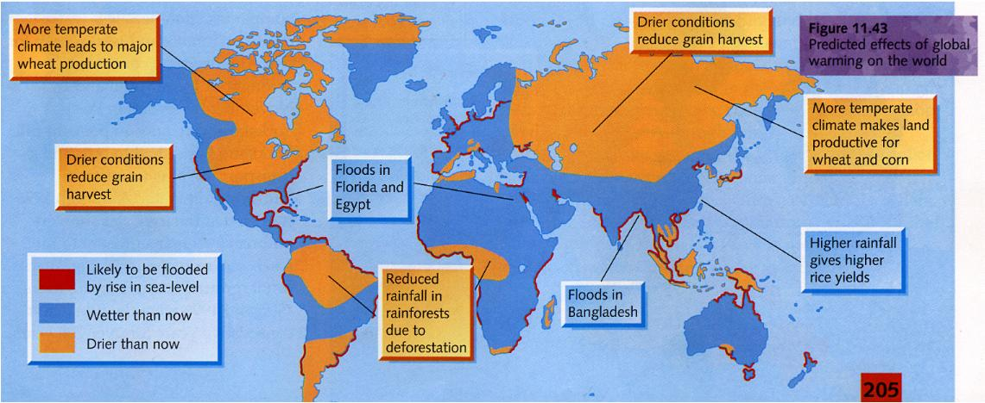
Explanation of the effects of global warming in
both MEDCs and LEDCs

Slide 10
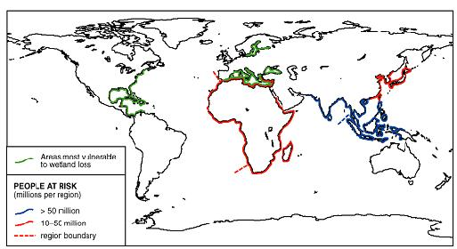
People at risk from sea level rise

Slide 11
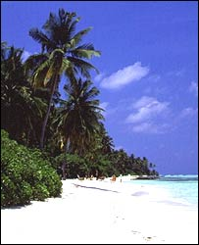
Small low rise Islands
Sea level rise is likely to worsen floods, storm surges and coastal erosion, with impacts on the socio-economic wellbeing of island communities.
Beach erosion and coral bleaching are likely to reduce tourism.
There is strong evidence that water resources in small islands are likely to be seriously compromised.
Increased invasion by non-native species is likely.
https://www.youtube.com/watch?v=kyzJgaUX6cM

Slide 12
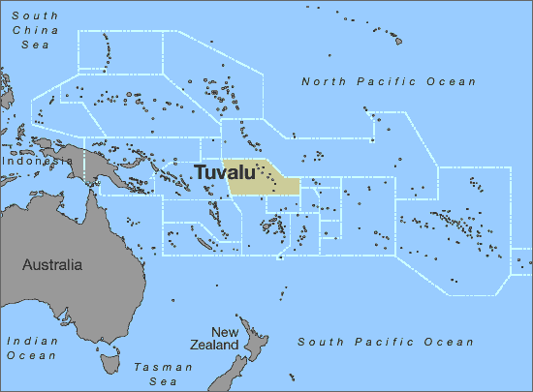
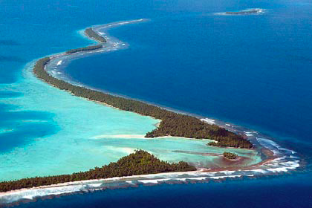
Adaptation to climate change on Tuvalu island in the South Pacific
Why is Tuvalu so vulnerable to climate change?
What is the island’s adaptive capacity like?
How are Tuvalu adapting to the threat of climate change?
http://www.youtube.com/watch?v=BrT0pNiXYJo

Slide 13
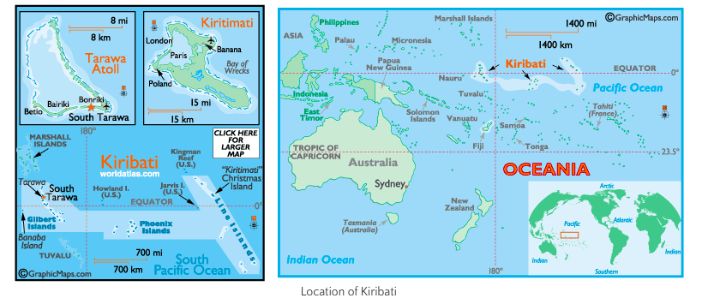
Kiribati, South Pacific – Under Threat

Slide 14
Kiribati, South Pacific – Under Threat
Read the picture essay from the Guardian Newspaper from Oct 2017:
https://www.theguardian.com/world/2017/oct/23/waiting-for-the-tide-to-turn-kiribatis-fight-for-survival
Use it to complete the case study sheet for forced migration in Small Island States.

