Slide 1
Human Health, Migration & Transport
Impacts of Climate Change

Slide 2
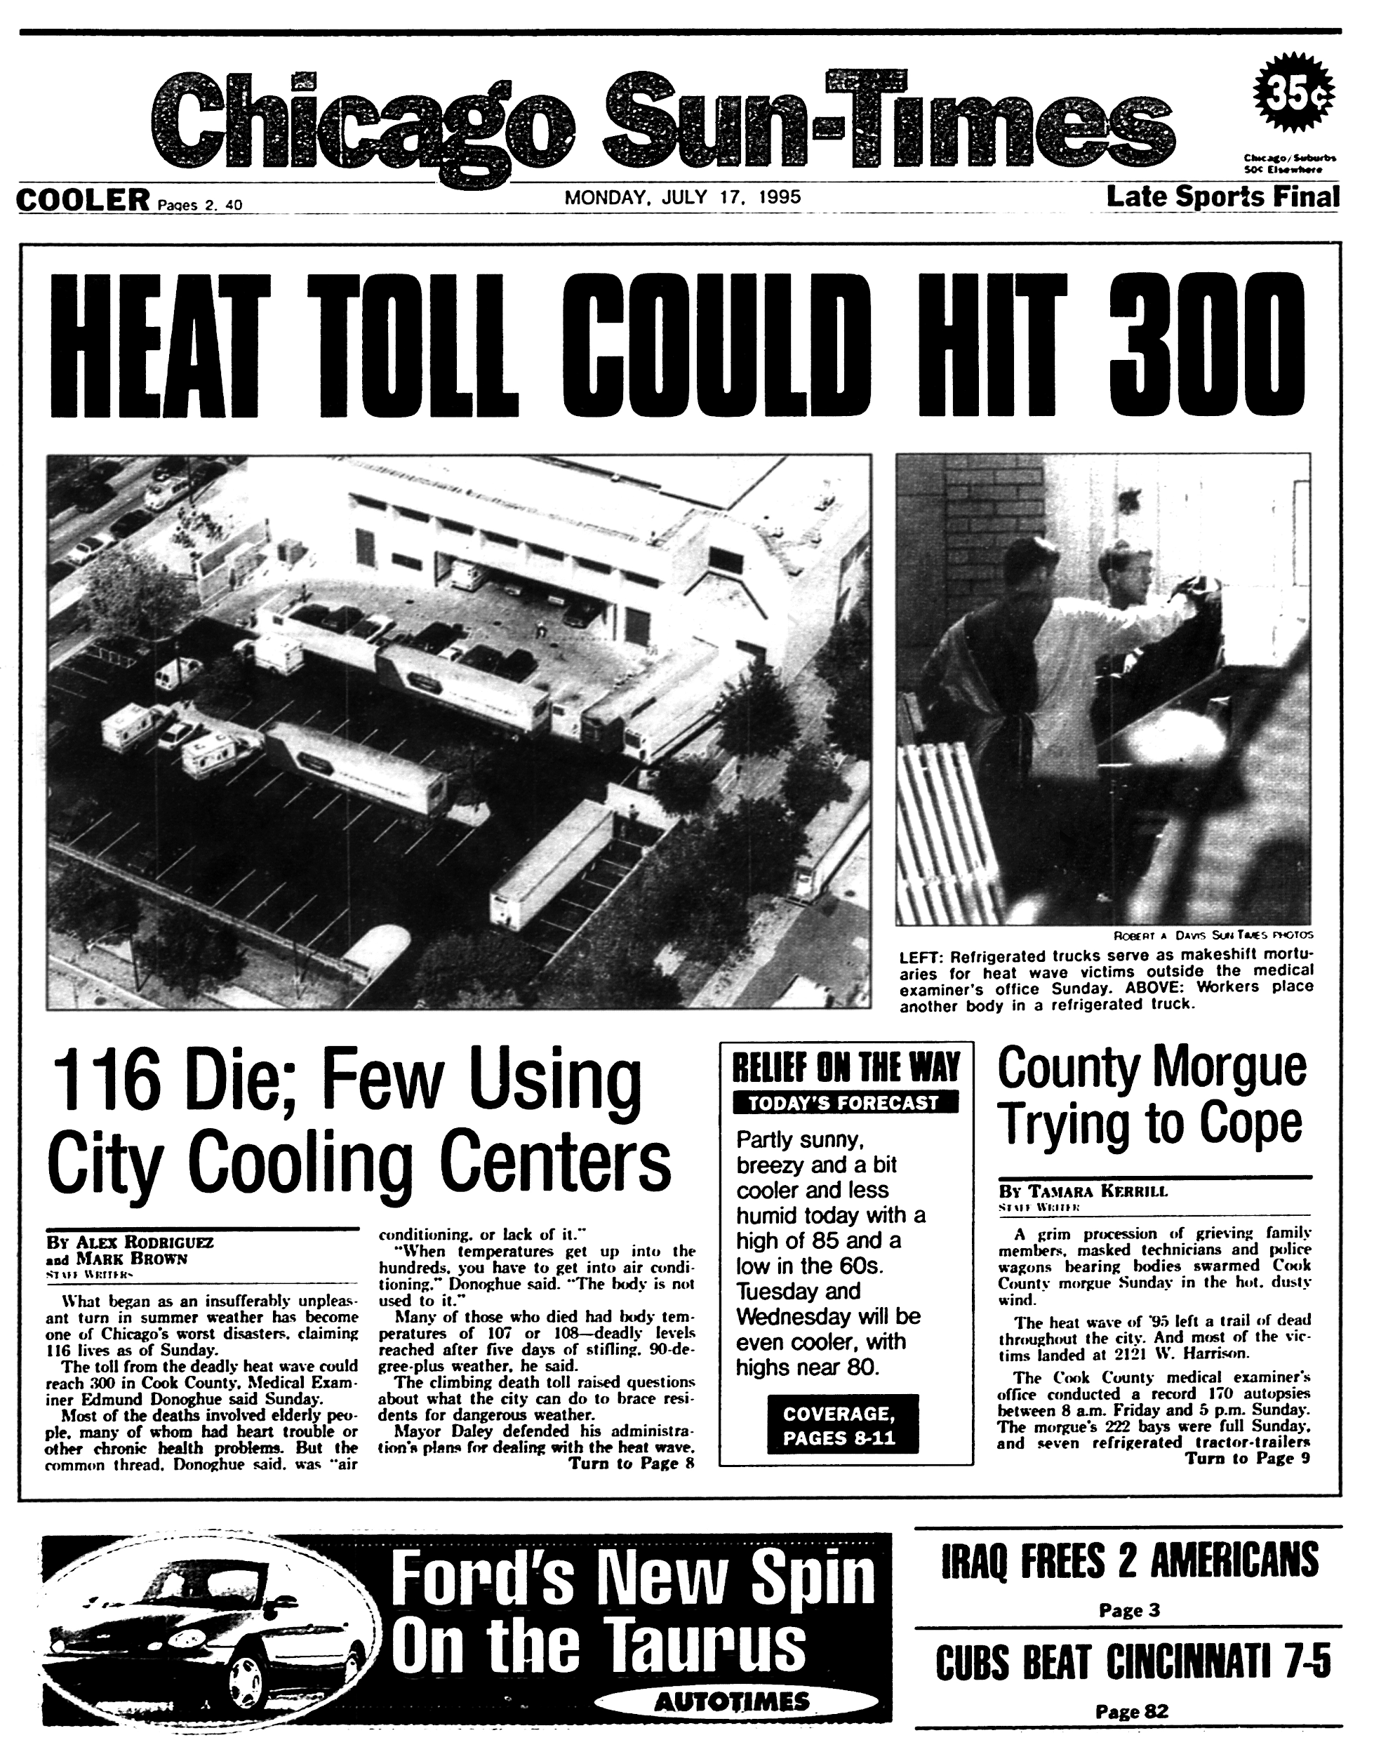
Temperature
Warmer average temperature = more frequent, longer heat waves
Increase in heat-induced deaths
Adaptive responses reduce death toll
Vulnerable populations in LEDCs
Notes:
Temperature:
- Warmer average temperatures leads to hotter days and more frequent, longer heat waves
- Leads to more heat-induced deaths in USA, predicted to reach as much as thousands to tens of thousands of additional death annually by 2100 during the summer months
- Not offset by small reduction in cold-related deaths projected in winter months
- Adaptive responses, including wider use of AC expected to reduce projected increased in death from extreme heat
- Exposure to extreme heat can lead to heat stroke and dehydration, cardiovascular respiratory and cerebrovascular disease
- Excessive heat is more likely to affect population in northern latitudes where people are less prepared to cope with excessive temperatures
- Most vulnerable populations: outdoor workers, student athletes, homeless people (as they spend time outdoors)
- Low-income households may lack air conditioning, increasing heat exposure
- Young children, pregnant women, older adults, people with certain medical conditions less able to regulate their body temperature and can therefore be more vulnerable to extreme heat
- Urban areas warmer than rural surroundings
- Large metropolitan areas, such as St Louis, Philadelphia, Chicago and Cincinnati have seen notable increases in death rates during heat waves
- Climate change projected to increase vulnerability of urban populations to heat-related impacts in the future – heat waves often accompanied by periods of stagnant air, leading to increases in air pollution and associated health effects

Slide 3
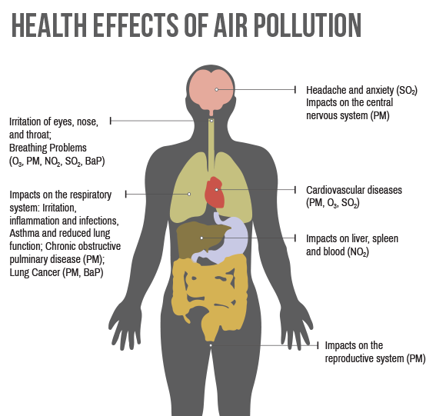
Air Quality
Warmer temperatures and shifting weather patterns = worsened air quality
Increase in asthma attacks, respiratory and cardiovascular health effects
Increase in wildfires = smoke & air pollutants
Rising CO2 and warmer temperatures affect airborne allergens
Notes:
Air Quality:
- Changes in climate impact the air we breathe indoors and outdoors
- Warmer temperatures and shifting weather patterns worsened air quality, can lead to asthma attacks and other respiratory and cardiovascular health effects
- Wildfires projected to increase in number and severity of climate changes, create smoke and other unhealthy air pollutants
- Rising carbon dioxide levels and warmer tempeatures also affect airborne allergens (e.g. ragweed pollen)
- Despite signifcnat improvement in US air quality since the 1970s, as of 2014 57 million Americans lived in counties that did not meet national air quality standards
- Climate change may make it even harder for states to meet these standards in the future

Slide 4
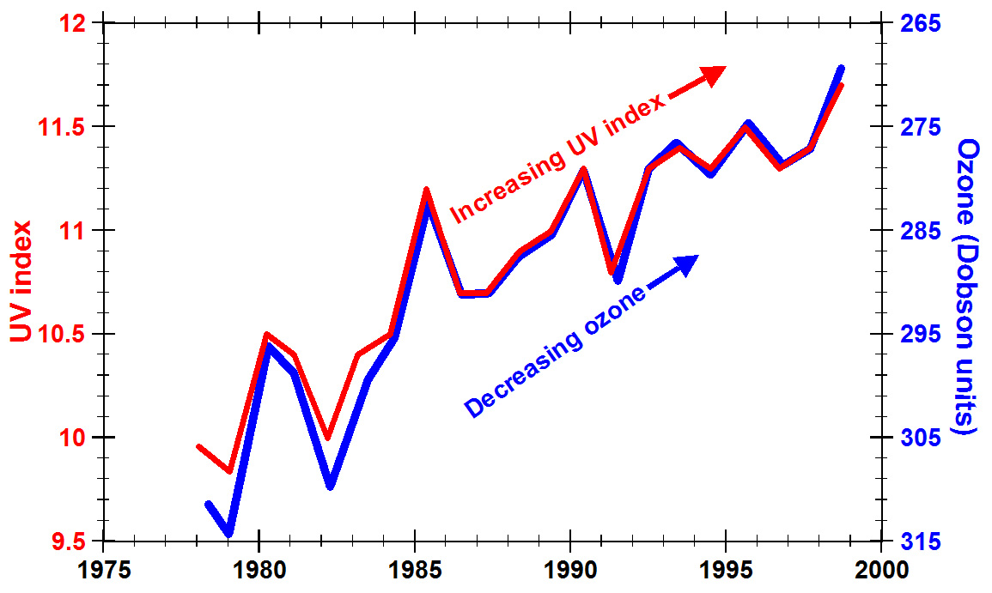
Increases in Ozone
Warmer temperatures = unhealthy levels of ground-level ozone = more smog
Increased risk of premature death and respiratory problems
Notes:
Increases in Ozone:
- Scientists project that warmer temperatures from climate change will increase frequency of days with unhealthy levels of ground-level ozone, a harmful air pollutant and a component in smog
- People exposed to higher levels of ground-level ozone are at greater risk of dying prematurely or being admitted to the hospital for respiratory problems
- Ground-level ozone can damage lung tissue, reduce lung function and inflame airways
- Higher concentrations of ozone due to climate change may result in tens to thousands of additional ozone-related illnesses and premature deaths per year by 2030 in the USA, assuming no change in projected air quality policies

Slide 5
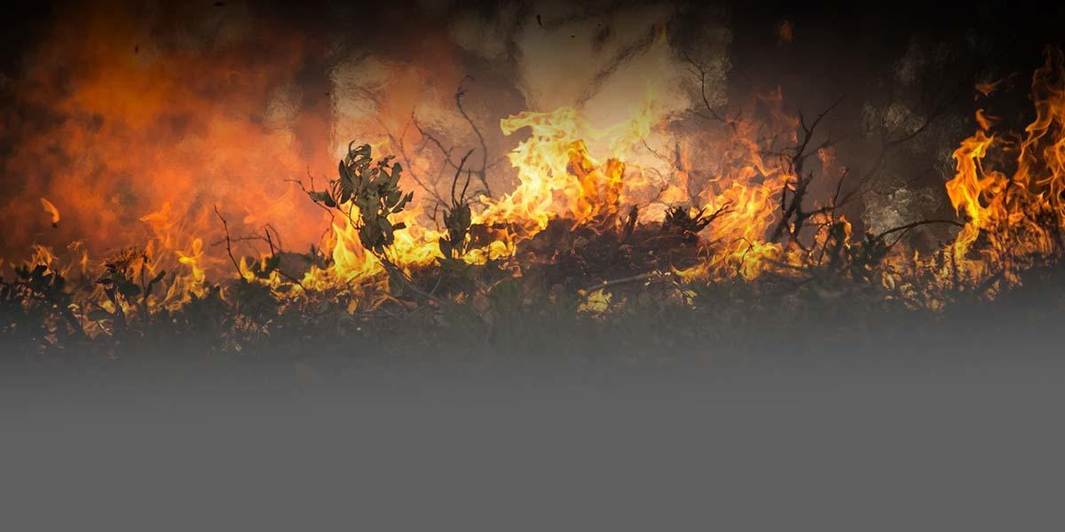
Changes in Particulate Matter
Inhaling fine particles leads to respiratory and circulatory diseases
Increased severity and frequency of wildfires
Dependent population most vulnerable
Notes:
Changes in Particulate Matter:
Some particulate matter such as dust, wildfire smoke and sea spray naturally occure, while some is created by human activities such as burning fossil fuels to produce energy.
- Inhaling fine particles can lead to a variety of health effects, including lung cancer, chronic obstructive pulmonary disease (COPD) and cardiovascular disease
- Climate change is expected to increase the number and severity of wildfires – particulate matter from wildfire smoke can often be carried long distances by the wind, affecting people who live far from the wildfire
- Older adults are particularly sensitive to short-term particle exposure, with a higher risk of hospitalization and death; outdoor workers (e.g. firefighters) can also have high exposure.
However, scientists are unsure of whether atmospheric particulate matter levels will increase or decrease with climate change; particulate matter can be removed from the air by rainfall, and rainfall is expected to increase in intensity, but not necessarily happen more often.

Slide 6
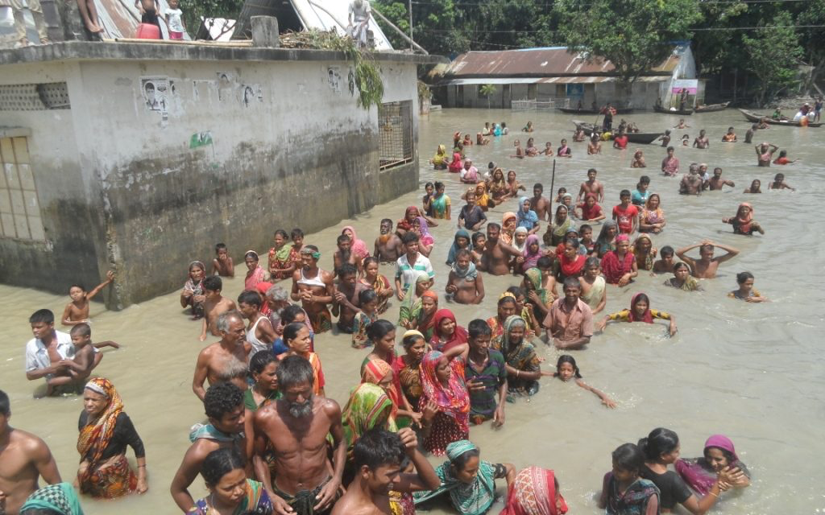
Extreme Weather Events
Increased heavy rainfall, flooding, droughts and storms
Reduced availability of resources
Damaging infrastructure and accessibility
Carbon monoxide poisoning
Mental health impacts (e.g. depression and PTSD)
Notes:
Impacts from Extreme Weather Events
Projected increase in frequency and severity of extreme weather events including heavy rainfall, flooding, droughts and storms
- Reducing the availability of safe food and drinking water
- Damaging roads and bridges, disrupting access to hospitals and supplies
- Interrupting communication, utility and health care services
- Contributing to carbon monoxide poisoning from improper use of portable electric generators during and after storms
- Creating/worsening mental health impacts including depressions and PTSD
are particular risks for young children, older adults, people with disabilities or medical conditions and the poor at risk due to limited mobility for evacuation, communication skills or access to resources.

Slide 7
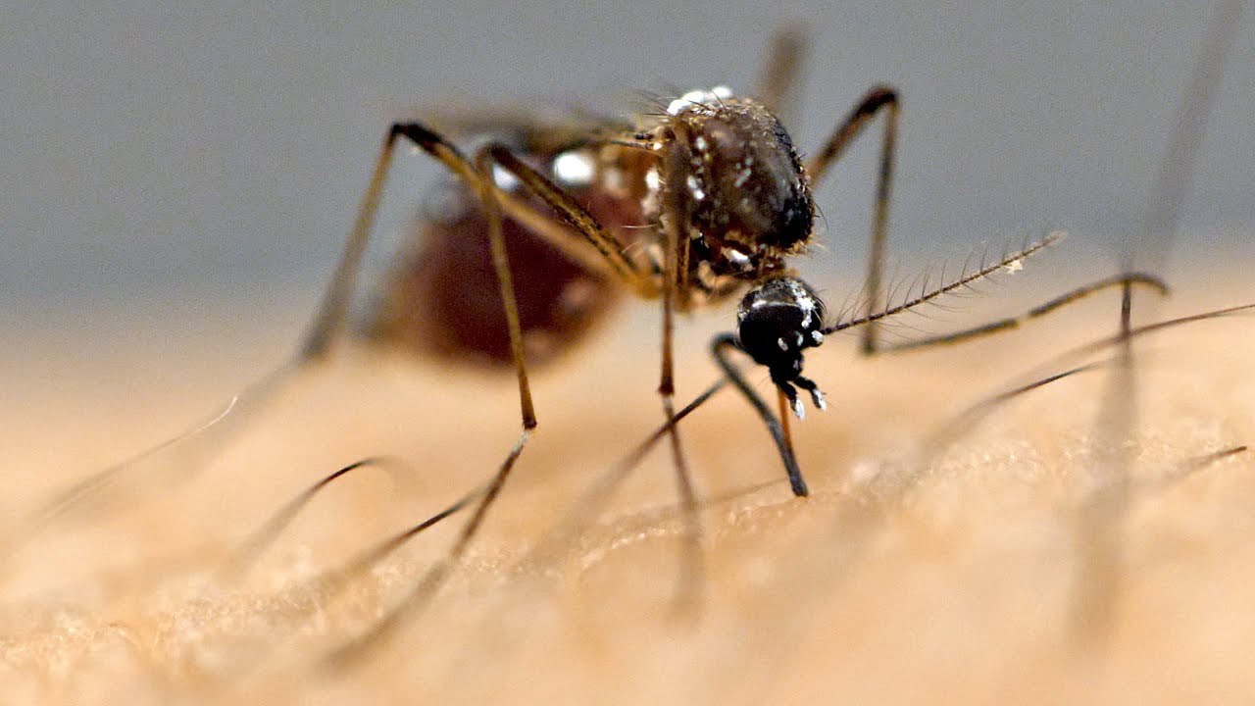
Vector-borne Diseases
Increased heat and humidity increases mosquitoes, ticks and flea populations
Geographic range of ticks impacted
Notes:
Vector borne diseases are illnesses that are transmitted by disease vectors, including mosquitoes, ticks and fleas, and are more common in changes in temperature and precipitation, increasing the risk of catching disease.
- Geographic range of ticks that carry Lyme disease is limited by temperature
- As air temperature rises, ticks become active earlier in the season
- Mosquitoes thrive in hot, humid climates, spreading disease including the West Nile virus. More than 3 million people were estimated by infected with West Nile virus in the United States from 1999 to 2010.

Slide 8
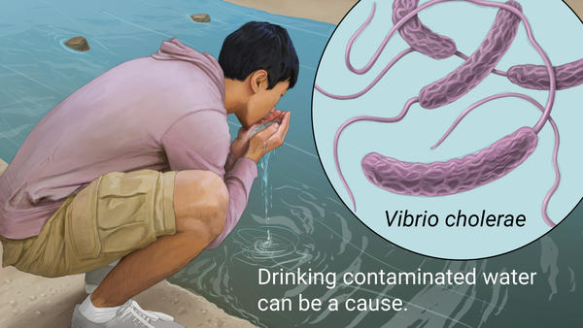
Water-related Diseases
Increase in contaminated water
Gastrointestinal illnesses
Nervous and respiratory systems
Liver and kidney damage
Notes:
Water-related illnesses
People can get sick from exposure or consumption of contaminated water. Climate change increases the risk of water contamination through increasing temperature, more frequent heavy rains and runoff, effects of storms. Health impacts may include gastrointestinal illnesses like diarrhea, effect the body’s nervous and respiratory systems or liver and kidney damage.

Slide 9
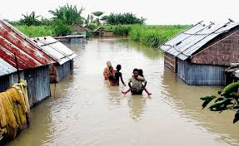
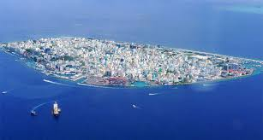
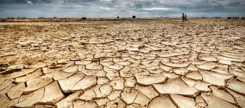
Migration
Increase of floods force people to move
Temperature increase lead to more frequent and longer droughts
Increase in Sea level force people to move from their home countries
Bangladesh
Maldives, Kiribati, Tuvalu
Notes:
Bangladesh
They said 8 million people in 32 districts had been affected by floods, with 307,000 people staying in emergency shelters and 1,945 medical teams deployed. In addition, 103,855 houses had been destroyed, with a further 633,792 partially damaged, and 4,636 schools – and several hundred thousand acres of farm land – had been flooded.

Slide 10
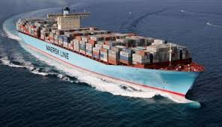
Transportation
Notes:
Climate change is projected to increase the frequency and intensity of some extreme weather events. Specifically, heat waves will likely be more severe, sea level rise could amplify storm surges in coastal areas, and precipitation will likely be more intense. These changes could increase the risk of delays, disruptions, damage, and failure across our land-based, air, and marine transportation systems.

Slide 11
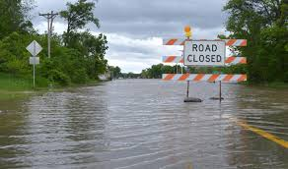
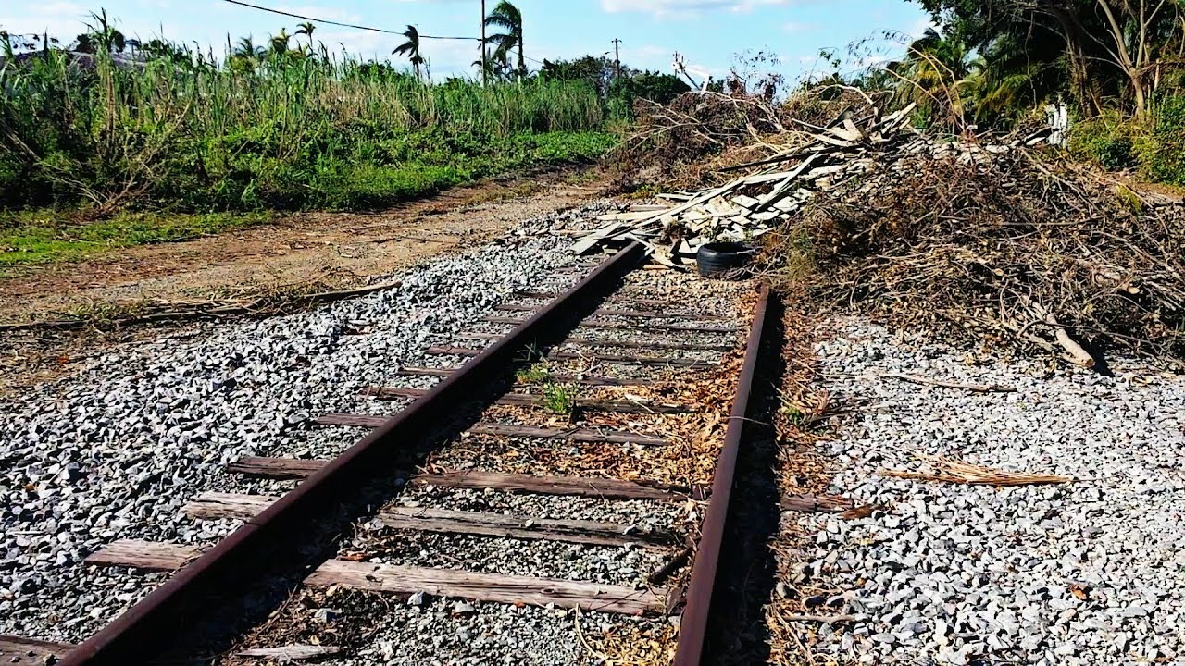
Land Based Transportation
High temperatures expand concrete and rails damaging roads and railways
Cooler area benefit as less snowfall decreases need for maintenance
Increase in storms cause flooding and landslides which block roads and rails.
Vehicles become more susceptible to overheating and will deteriorate quicker
Less damage to vehicles from cold weather
Notes:
Roadways: The increase in temperatures can cause the pavement in roadways to soften and expand. This can create potholes and stress on bridge joints specially in high traffic areas. Heat waves limit construction activities which would make the construction and maintenance of roadways costlier. Cooler areas would benefit from this as the increasing temperatures would reduce snowfalls and leads to reduction in snow and ice removal.
Climate change is projected to concentrate rainfall in more intense storms which may cause flooding and landslides affecting national roadways, this would delay traffic, construction activities and weaken the soil on which the roads are supported.
In Alaska ice roads depend on freezing temperatures to connect northern communities. Transportation in these areas is limited to periods in which the ground is frozen because the tundra beneath is fragile. The reduction of ice seasons would decrease the periods of time in which these roads are frozen, this would limit access to these areas.
Vehicles: due to the temperatures increasing many types of vehicles will become more susceptible to overheating and tires will deteriorate more quickly. However, the damage caused my cold weather would be reduced as well. (normal weather – negative) (cold weather – positive).
Railways: High temperatures cause rails to expand and buckle. More frequent heat waves will require more frequent trach repairs to prevent derailment. Heavy precipitation will lead to disruption and floods which may leave debris on top of rails blocking transportation.

Slide 12
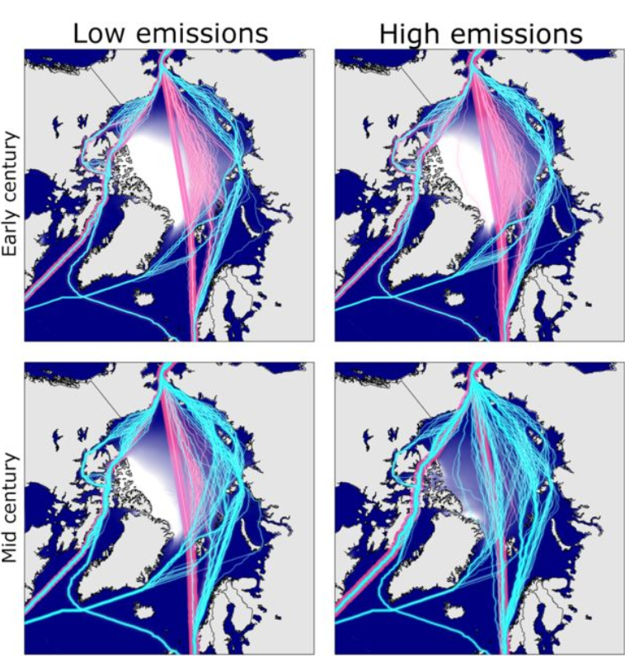
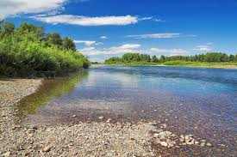
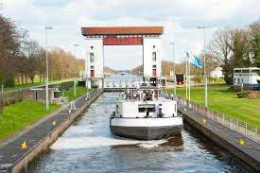
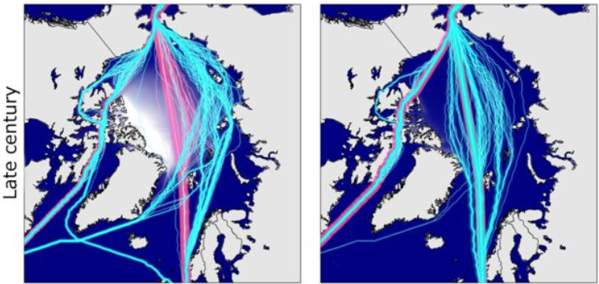
Water Based Transportation
Arctic ice melts creating new waterways
Quicker transport
Waterway stays open for longer
Normal ships able to transit arctic
Canals become deeper allowing bigger vessels to transit
- Inland waterways become shallower
- Canals affected by debris deposited by floods
Notes:
- Northwest Passage:
Due to the increasing global temperatures causing the reduction of the arctic ice new oceanic routes are opening. Presently only ice strengthened ships are able to transit the Arctic, this means that normal ships are incapable of withstanding the ice. By 2050, the reduction of the ice will be great enough that new routes will be opened enabling non-specialized ship transport.
As the temperatures increase the time of the year in which the ice is not formed increases, this would lead to an ice-free season for a part of the year.
- Saving Time:
If vessels are able to freely transit the Arctic their transcontinental routes would be reduced in time which leads to economical benefits as the vessels save fuel and more routes are completed in less time than normal. As the century goes by more opportunities open as the ice keeps melting which would eventually lead to as much as 17 days in transit time saved with the new Arctic routes. Routes not only open up, but they also increase in duration. Routes that could only last a couple of weeks could open up for months in the future further increasing the savings using these future routes.
High Emission Scenario:
For a high emissions scenario, trans-Arctic shipping could be potentially commonplace by late century, with navigable routes available even to open water vessels for perhaps 4-8 months a year.
Low Emission Scenario:
For a low emissions scenario, where global temperatures are stabilized at less than 2 degrees above pre-industrial levels, the frequency with which open-water vessels can make the transits is much wider than today at 2-4 months.
Channels experiencing floods will be able to accommodate larger vessels reducing shipping costs. However, the increase in sea levels will decrease the clearance under waterway bridges. In land waterways are expected to decline affecting shipping as channels become too shallow.
Flooding could close shipping canals as debris can build up creating shallower and less accessible channels.

Slide 13
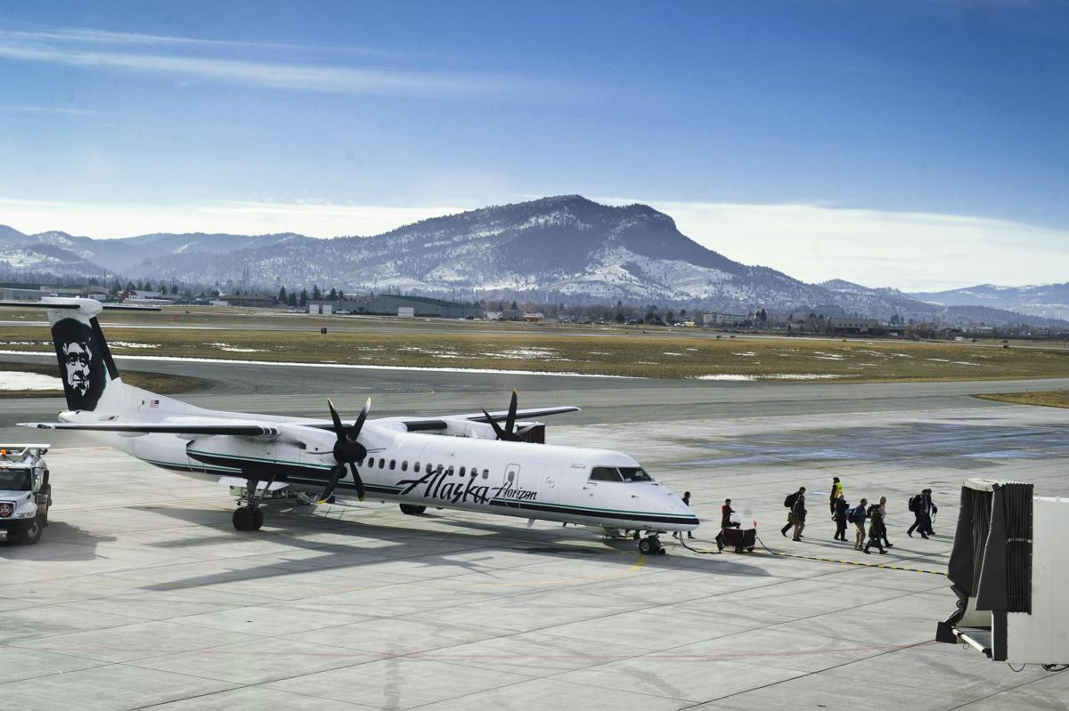
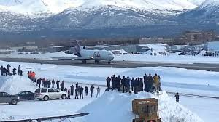
Air Based Transportation
Airports built on permafrost ground will be forced to relocate or rebuild due to permafrost melting causing structural damages
Increase in storms will force airports to close more frequently especially in areas susceptible to tropical storms.
Notes:
- Periods of extreme heat can affect aircraft performance and may cause airplanes to face cargo restrictions, flight delays, and cancellations. Increasing in precipitation can also disrupt air travel as storms can force airports to close, specially those located in areas susceptible to tropical storms. Airports located in areas that experience permafrost will be forced to rebuild or relocate airports as the once frozen soil settles creating damage to the foundations.

