Slide 1
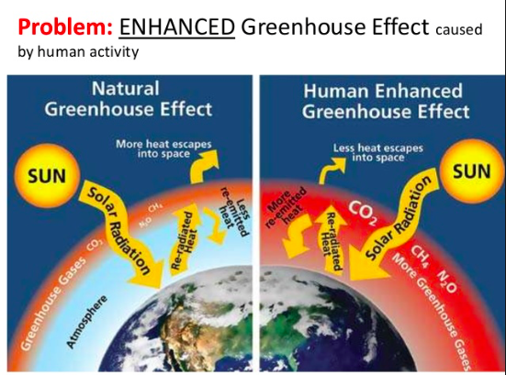
Global warming
LO: To explain the natural causes of climate change
To explain the human causes of climate change
To use previous learning to explain the impacts of climate change

Slide 2
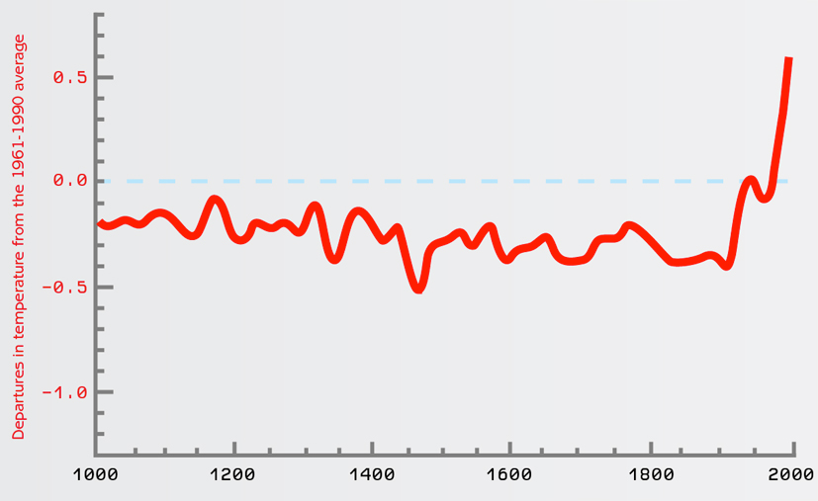
How has the Earth's average surface temperature changed in the last 1000 years?

Slide 3
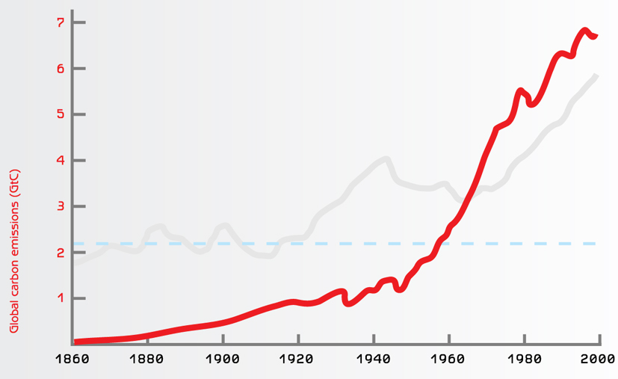
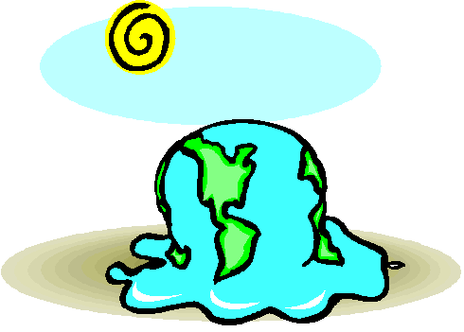
What's the cause?
Total emissions of CO² from fossil fuel burning

Slide 4
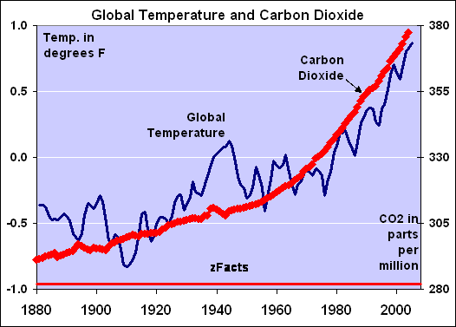
What's the evidence?
Global Warming

Slide 5
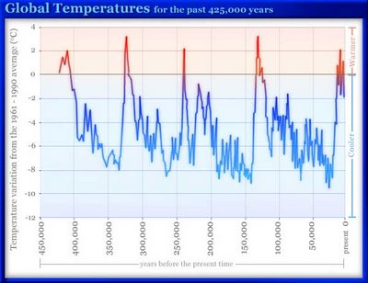
But isn't this natural...
Industrialisation
Global Warming
Homo Sapiens

Slide 6
Key terms:
Radiation- energy that is radiated or transmitted in the form of rays or waves or particles
solar radiation - radiation from the sun (short wave)
Longwave radiation- Radiation emitted from Earth is called longwave radiation
https://www.youtube.com/watch?v=DOAqECd70Ww

Slide 7
Watch the video clip….
LO: To explain the natural causes of climate change
To explain the human causes of climate change
Using the information complete a table to explain the human and natural causes of climate change
Video- Climate change the causes: https://www.youtube.com/watch?v=RHrFBOUl6-8

Slide 8
Reflected by the atmosphere into space.
Solar Energy
Heat lost to space
GREENHOUSE GASES
Heat is retained by greenhouse gases and warms the atmosphere-
Global Warming
Global Warming
Earth radiates heat.
Solar energy heats Earth.
Greenhouse effect

Slide 9
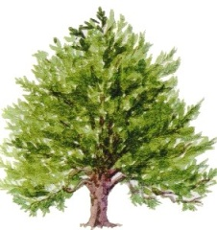
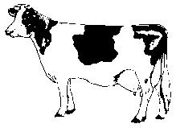
Farming rice and cattle releases methane.
Greenhouse gases increase.
GREENHOUSE GASES
Burning fossil fuels releases Carbon Dioxide.
More heat is trapped, warming the Earth.
Global Warming
Deforestation means less Carbon Dioxide is taken in, some trees are burnt releasing Carbon Dioxide.
Human impact...

Slide 11
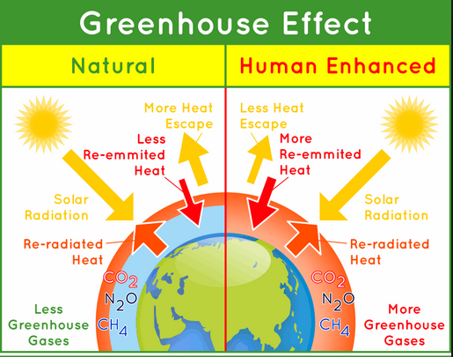
Task: use the information on the previous slides to construct a diagram of the enhanced greenhouse effect

Slide 12
Complete summary card sort
Causes
Positive Impacts
Global Warming
Negative Impacts
Solutions

Slide 13
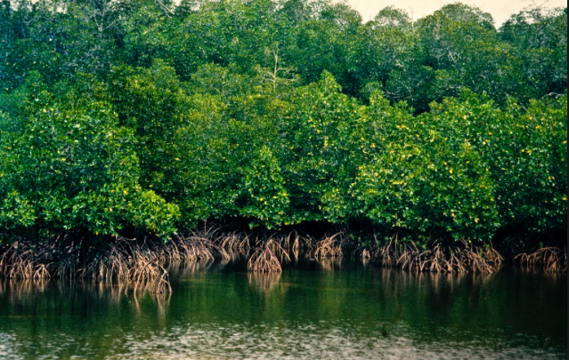
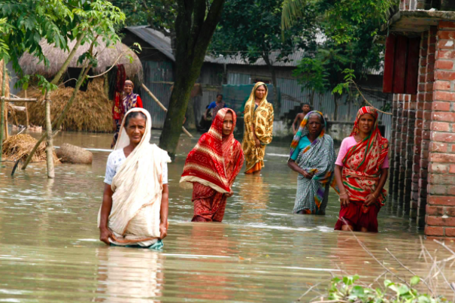
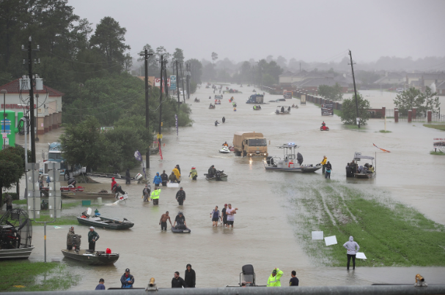
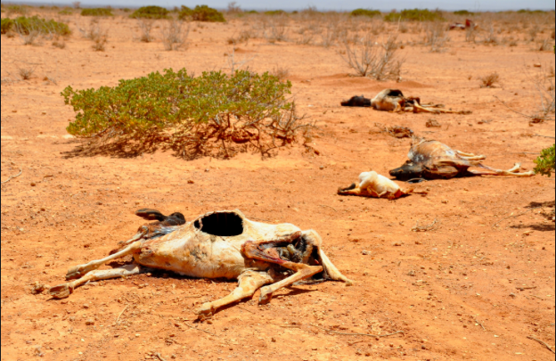
Impacts-what previous learning can we use?
What other case studies could we use?

Slide 14
SOLUTIONS TO GLOBAL WARMING
Mitigation is where you try to reduce the effects of global warming RENEWABLE ENERGY
REDUCE, REUSE, RECYCLE
AFFORESTATION
CARBON SEQUESTRATION (capturing carbon dioxide before it is released into the atmosphere)
INTERNATIONAL AGREEMENTS (Kyoto Protocol meant countries promised to attempt to limit the amount of greenhouse gases released)
HYBRID CARS
Adaptation is where you change your lifestyle to suit the new conditions BUILD MORE SEA DEFENCES
IMPROVED METEOROLOGY
DISEASE TREATMENT (many diseases will become more prevalent so we could research new cures and treatments to reduce their impacts)
DESALINATION (removing salt from salt water to create water which is fit for human consumption)
RESETTLEMENT
AIR CON OR HEATING

Slide 15
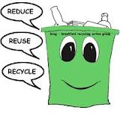
Solutions? Reduction of consumption
Reduce: This refers to using less of a product e.g. less packaging, less energy. Reuse: This means using a product more than once. This might be returning it to a manufacturer e.g. coke bottles or selling/passing onto another consumer e.g. charity shops Recycling: The re-processing of industrial and household waste so that materials can be reused. Currently materials like paper, card, plastics, glass and some metals are recycled.
https://www.youtube.com/watch?v=EWxjFLDoIDA

Slide 16
Conservation
The protection of natural or man made resources for later use

Slide 17
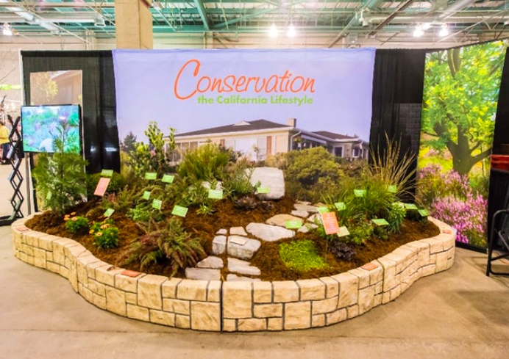
Link to California drought/ water use- conservation of water
Residents are asked to conserve water. It is forbidden to:
Wash cars
Water lawns
Fill swimming pools
Farmers are having to leave thousands of acres of land to fallow (no crops, being left wild).
People have to pay private companies to drill private wells to extract precious groundwater supplies of water.

Slide 18
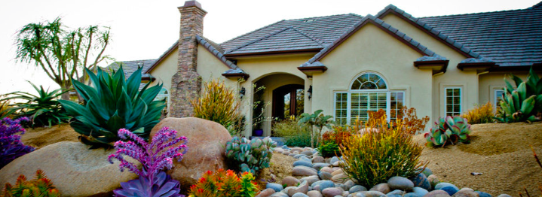
Xeriscaping
Xeriscaping refers to the conservation of water through creative landscaping. Originally developed for drought-afflicted areas.
https://www.youtube.com/watch?v=ELAutJpNj9w

Slide 19
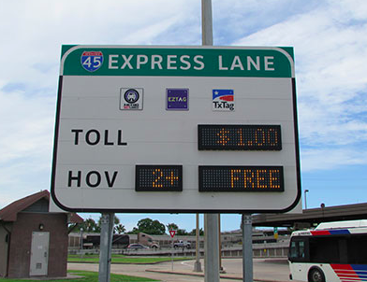
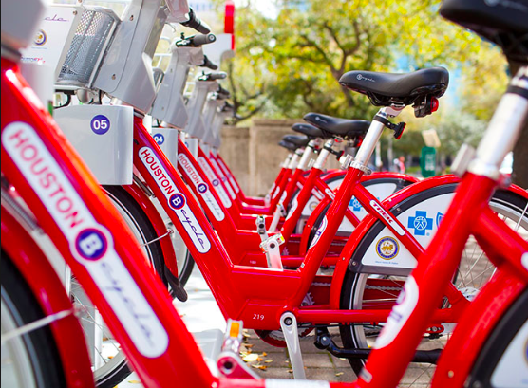
Sustainable development: transport

