Slide 1
What Is CLASPPE and How Do I Use It?

Slide 2
What Is CLASPPE And How Do I Use It?

Slide 3
Conclude

Slide 4
Long Term/Short Term

Slide 5
Assumptions

Slide 6
Stakeholders

Slide 7
Pros And Cons

Slide 8
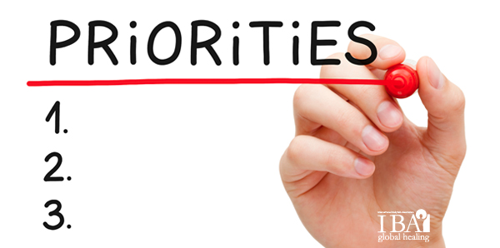
Priorities

Slide 9
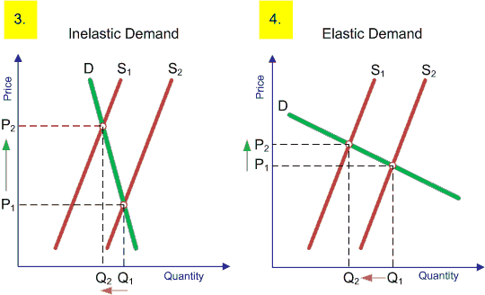
Elasticity

