Slide 1
Part 1: The Level of Overall Economic Activity
WALT:
We cannot evaluate the performance of an economy if we have no measurements available
We cannot determine whether an economy is doing better or worse this year compared to last or even 5 years ago
We cannot compare the performance of one economy against another if we don’t know how out and income behaved

Slide 2
8.1 Economic activity
The circular flow of income model Page 216
Lesson Objectives:
To be able to describe, using a diagram, the circular flow of income between households and firms in a closed economy with no government
Identify the four factors of production and their respective payments (rent, wages, interest and profit) and that these constitute the income flow in the model
Outline that the income flow is numerically equivalent to the expenditure flow and the value of the output flow

Slide 3
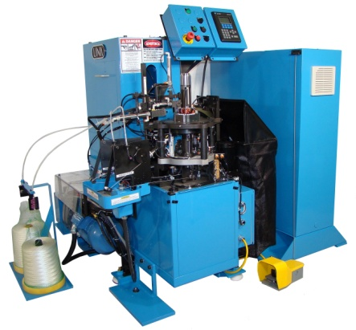
Simulation of the Circular flow of income model

Slide 4
Simulation of the Circular flow of income model
1.) What are the two markets shown in the CFIM? Provide examples of what is exchanged (bought and sold) in each of these.
2.) The CFIM shows that households and firms are both buyers and sellers simultaneously. How is this possible?
3.) What are the 4 factors of production and what are their respective payments?
4.)Draw the diagram of the circular flow of income model
5.) What are the limits of this simple model, what is it missing?

Slide 5
Leakages and injections
Leakages include | Injections include
Savings | Investments
Taxes | Government expenditure
Imports | Exports

Slide 6
How can we represent leakages and injections within our simulation?
Leakages include | Injections include
Savings | Investments
Taxes | Government expenditure
Imports | Exports

Slide 7
Simulation of the Circular flow of income model (amended)
Is this a better model of the circular flow?
What role does government play in the circular flow?
What role do savings and investments play in the circular flow?
How do exports and imports affect the CFIM?
Are there still problems with the CFIM that we have constructed especially when calculating output and incomes?

Slide 8
6.) What are the leakages and injections in the CFIM
7.)Draw a diagram of the circular flow of income model to illustrate how the three pairs of leakages of and injections are linked together
8.) What is the difference between and open and a closed economy?
9.) What happens to the size of the income flow when a) leakages are larger than injections? b.) injections are larger than leakages?

Slide 9
Now complete the gap filler for your notes
The inner circle of the diagram illustrates economic links between ________ and ________. There is a flow of _________ from households to firms and, in the opposite direction, a flow of from firms to households. These are considered flows whereas in the opposite direction there is money flow which refers to the paid by firms to households for use of factors supplied. The factors of production include and their rewards or payments are the sum of

Slide 10
GDP is a measure of the total of an economy in a year. More specifically it is the
Of all goods and services produced within the of an economy over a period of time typically a year.

Slide 11
Phillips Water machine
https://www.youtube.com/watch?v=aT-Tmr4VtTQ
https://www.youtube.com/watch?v=nfDfcPywjHg

Slide 12
Measuring Economic Activity To understand how economists measure economic activity and why it is important to know.
Why measure:
Assess an economy’s performance over a period of time.
Make comparisons of income and output performance with other economies
Establish a basis for making policies that will meet the economic objectives

Slide 13
The Output, Income and Expenditure approach
Think back to the simulation…
how would you calculate national income.
If you stopped the circular flow at the end of one cycle with injections and leakages how could you measure National Income?
In pairs develop your own Equation to respresent: NI =
C= ? I= ? G= ? NE = X-M

Slide 14
Exercise 1 - Explain why, if GDP of country A is double that of country B, it is potentially very misleading to conclude that living standards are twice as high as living standards in country B
Must be divided by population in order to allow for different sizes e.g. ‘per capita’
Some countries may have much larger ‘non marketed’ income than others – A firm providing a creche service provides a similar service to a mother staying at home. One is marketed the other is not.
Even when it is per capita, it is just an average income figure providing no information on its distribution.
It reveals nothing about the composition of national income (History examples?)
It does not include the value of leisure.
It does not include parallel market activity that goes unrecorded.
It does not account for pollution and other negative externalities that the production process often creates

Slide 15
Explain why it is increasingly important for countries to measure green GDP alongside conventional GDP
If an economy has grown rapidly over the past decade, is it safe to conclude that its performance has improved? If the increase in out put has come at a terrible environmental cost then then Green GDP statistics may help in such assessments as the environmental cost is counted for in such a statistic. Still such statistics will still be aggregates (totals) and may not reveal important information so they have to be used with extra care.

Slide 16
The following data represent the GDP of a country at current prices in millions of Euros and a comprehensive price index (a price deflator). Calculate Real GDP for this economy
(The Index Year )2000 = 136,281 / 100 X 100 = 136,281
2001 = 146,428 / 103.12 X 100 = 141,998
2002 = 156,615 / 103.40 X 100 = 151,465
2003 = 172,431 / 103.92 X 100 = 165,927
2004 = 185,266 / 102.95 X 100 = 179,957
2005 = 194,819 / 102.81 X 100 = 189,494
2006 = 156,615 / 103.40 X 100 = 151,465
2007 = 225,539 / 103.06 X 100 = 218,842
2008 = 235,679 / 103.20 X 100 = 228,371
2009 = 233,046 / 101.20 X 100 = 230,283

Slide 17
Some points on the data…
As the general rise in prices occurs (inflation) it is tempting to see this as actual growth in output (which it is not, it’s just a lessening in the buying power of money)
By using an Index figure of 100 we can compare a base year with all subsequent years and account for Inflation
This is why economists use an Index figure so often when comparing economic performance over a number of years for a country
Sometimes it may just say that the figure has been adjusted to take into account inflation.

Slide 18
1.) Why are the terms ‘national income’ and ‘aggregate income’ often used interchangeably?
2.) Why is it useful to know the value of aggregate output?
3.) Explain why:
a.) we measure aggregate output in value terms
b.) we count only the value of final goods and services when measuring the value of output
4.) What are the four expenditure components of GDP? Explain each of these.
5.)
a.) Explain 3 ways that GDP can be measured.
b.) Why do they give rise to the same result.

Slide 19
Assessment Tuesday
You will complete an assessment based on exam style questions:
It will include all of the content from Chp. 8 at Standard Level:
You need to know in detail:
The Circular flow of income model
Measuring economic activity
Evaluating national income statistics
The Business Cycle
The grade you get will be the grade that will appear on your October report – nothing else!!!

Slide 20
The Business Cycle
L/O – To be able to identify the cyclical patterns and phases of the business cycle
To be able to explain what happens to employment during each phase of the business cycle
To evaluate growth within the UK over the past 25 years

Slide 21
Key terms:
Increase/Decrease in GDP:
Overall GDP is growing or falling over a specified period of time
We calculate the rate of growth simply:
End of period GDP minus (-) Start of Period GDP
_________________________________________ = Growth rate
Start of Period GDP
It will not always be a positive value
Increase/Decrease in the GDP growth rate:
The rate of growth is increasing or decreasing

Slide 22
Understanding the Business Cycle
Fluctuations in the growth of real output, consisting of alternating periods of expansion (increasing real output) and contraction (decreasing real output) are called business cycles

Slide 23
The phases of the business Cycle
Expansion = Positive growth in Real GDP, employment of resources rises as does the general price level
Peak= Cycles maximum real GDP, and marks the end of expansion, unemployment of resources has fallen substantially and general prices may be rising rapidly
Contraction = Following the peak, economy begins to experience falling real GDP. If the contraction lasts six months or more, it is termed a recession. Increases in the general price level may begin to slow
Trough = Represents the cycle’s minimum level of GDP, or the end of the contraction. There may now be widespread unemployment of resources. This marks the beginning of a new cycle

Slide 24
The long term growth trend and potential output

Slide 26
The Business Cycle

Slide 27
The long term growth trend and potential output
Firstly economist aren’t too worried by fluctuations. These can be caused by a very of things, some of them fairly trivial (a royal wedding, the Olympics, a rainy November etc)
What economists are really interested in is the potential for long term growth in an economy
The long term growth rate

Slide 28
The Business Cycle

Slide 29
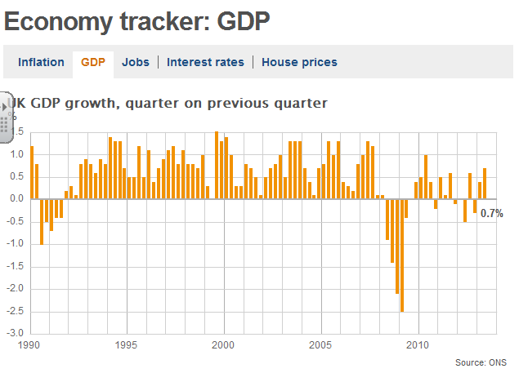
The UK Economy

Slide 30
The Myth of potential output?
This is a TOK issue:
What is potential output?
Can we calculate potential output?
Should macroeconomic policy advisors use potential output when planning the real world economy?
How useful are models anyway?
How useful are concepts that we can’t prove exist or not?

Slide 31
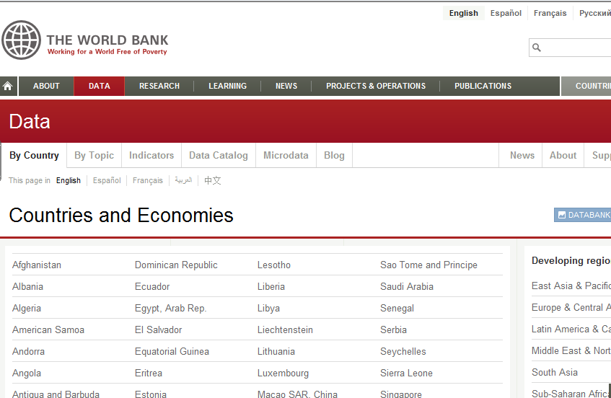
What the data says (1) Visit the World Bank Data site and examine GDP data for your own country over the last 20 years. Using this data, identify the years when the economy was in periods of boom, recession, slump and recovery. Explain why governments might want to predict where a country is in its business cycle?
http://data.worldbank.org/country
What the data says (2)
Import the GDP data for your own country and three others from different continents into a spreadsheet and plot the data. Using this date, comment on whether it is possible to determine a longer term trend in economic activity. If it is possible, construct a trend line to show whether the economy is growing or declining over the longer term.

