Slide 1
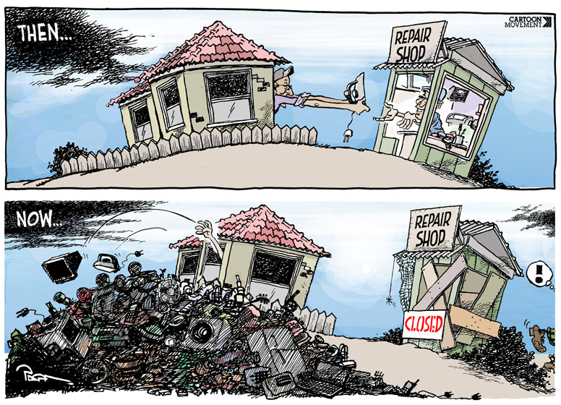
What do you think the message of this cartoon is?

Slide 2
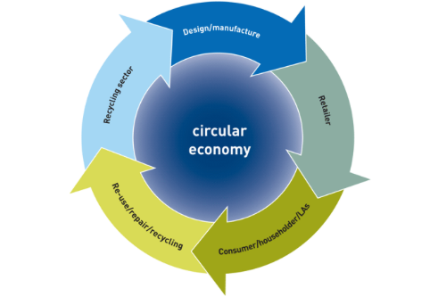
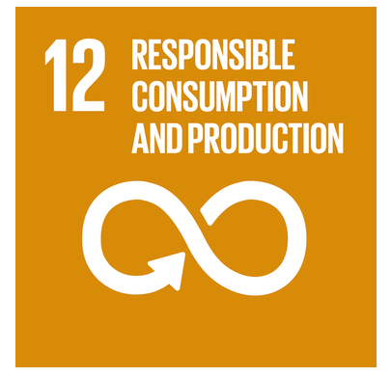
The circular economy
The value of the circular economy as a systems approach for effective cycling of materials and energy

Slide 3
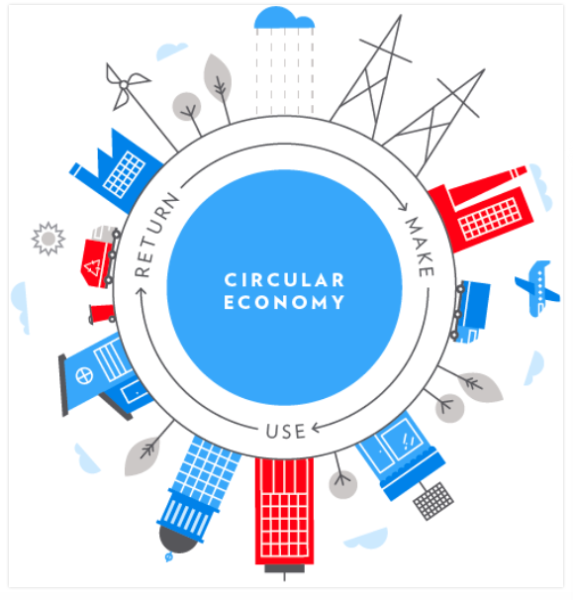

Slide 4
What? The circular economy
Why?
There are different Possibilities for managing resources sustainably

Slide 5
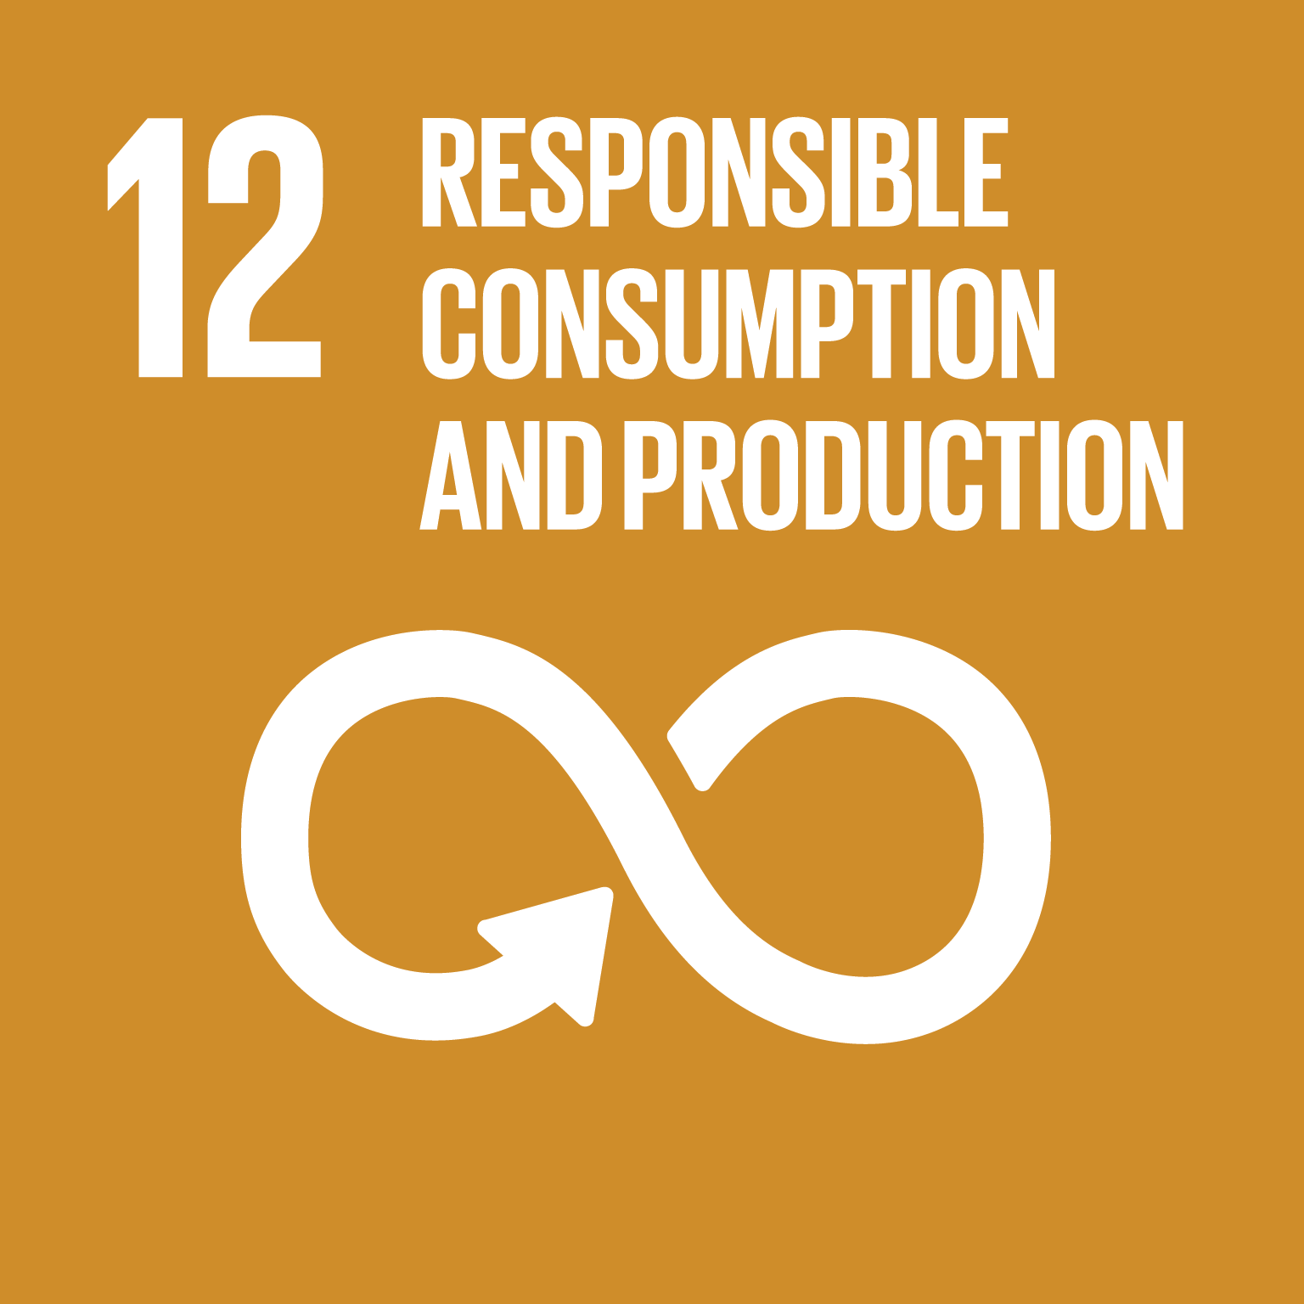
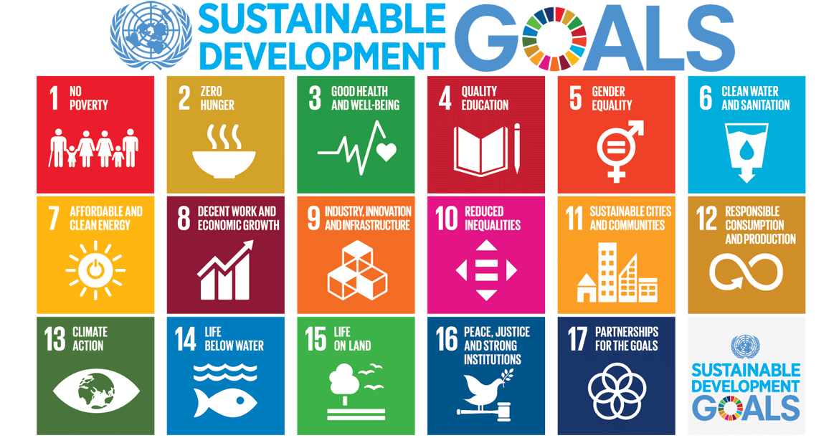
Possibilities/power….who is responsible?
Remember these?
Number 12 is all about responsible consumption!
Explore the interactive resource at the bottom of this web page: https://www.unenvironment.org/explore-topics/sustainable-development-goals/why-do-sustainable-development-goals-matter/goal-12

Slide 6
SDG 12: Responsible consumption and production
Paragraph 28 of the 2030 sustainable Development Goal Agenda reads: “We (Countries) commit to making fundamental changes in the way that our societies produce and consume goods and services. Governments, international organizations, the business sector and other non-state actors and individuals must contribute to changing unsustainable consumption and production patterns, including through the mobilization, from all sources, of financial and technical assistance to strengthen developing countries’ scientific, technological and innovative capacities to move towards more sustainable patterns of consumption and production.
We encourage the implementation of the 10-Year Framework of Programmes on Sustainable Consumption and Production. All countries take action, with developed countries taking the lead, taking into account the development and capabilities of developing countries”

Slide 7
Why is the circular economy important?
Recognising the interconnectedness of our world – the economy, society and the environment – lies at the heart of geography as a discipline. The circular economy applies systems thinking to resources, following flows of materials, energy and information, it also highlights the importance of seeing the bigger picture and understanding the world as a complex system, rather than one that is linear and predictable.

Slide 10
From Linear to Circular

Slide 12
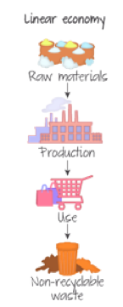
The linear economy
The linear economy is the traditional economy that has operated until very recently:
we dig the natural resources out of the ground
using finite energy resources such as coal or oil we process them and turn them into products that will last a few minutes or a few years (rarely longer)
then we throw them back into the ground in landfills or maybe burn them in incinerators.
This is wasteful of resources and money and detrimental to the environment. Part of the reason for this linear economy is that manufacturers have “designed out repair” particularly in electronics. Many of the electronics around you (tablets, smartphones) are integrated units that are not easy to take apart. Apple is way ahead in this field and the sealed design of the iPhone and iPad make it very difficult to repair anything within them. Something as basic as a battery cannot be easily replaced. This gives built in obsolescence.

Slide 13
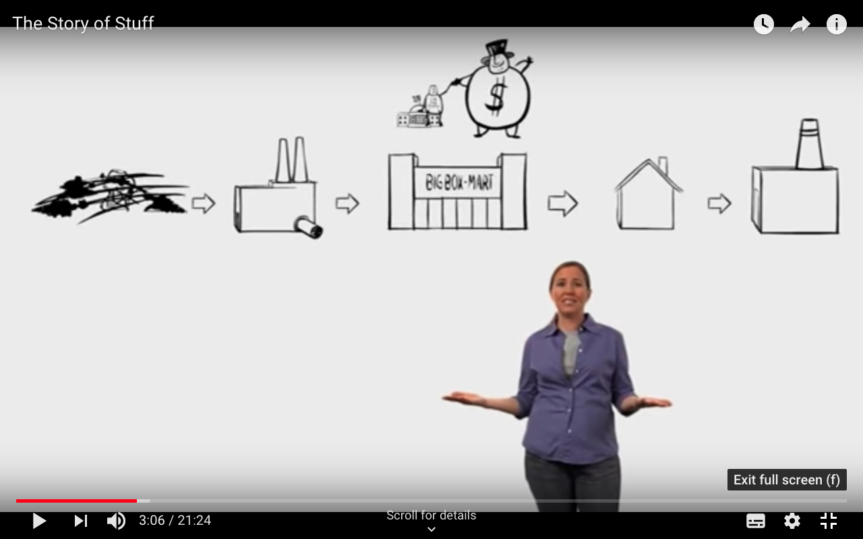
The story of stuff
Let’s explore the linear economy a little more…
https://www.youtube.com/watch?v=Se12y9hSOM0

Slide 14
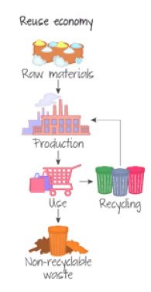
The reuse economy
Reuse economy (part of the 3Rs) is marginally better than the regular linear economy. The problem with this economy is that the materials in the original product were not originally intended to be reused so it is not very efficient (but it does help). For example, waste glass must be collected, broken and re-smelted to release the materials to be made into something else. This consumes a lot of energy.

Slide 15
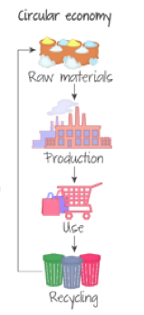
The circular economy
The circular economy is restorative and based on three principles:
Design out waste: products are designed so that they can be disassembled and reused. This stops the loss of embedded energy and labour (and water!).
Consumable and durable components of the products are differentiated Consumable components are biological nutrients: they are non-toxic and can re-enter the biosphere harmlessly. If these nutrients are managed correctly their use is sustainable. The return to the environment may be direct or in a cascade of use (biological materials can go through decomposition or fermentation to release energy and nutrients).
Durable components, such as engines, computers and other electronics, are technical nutrients that cannot go back into the biosphere, so they circulate within the system. Plastics and metals are designed to be reused and rapidly evolving technological items are designed to be upgraded (not dumped and replaced).
All the processes are powered by renewable energy, thus reducing pollution and slowing global climate change.

Slide 17
https://ellenmacarthurfoundation.org
The surprising thing I learned sailing solo around the world | Dame Ellen MacArthur
https://www.youtube.com/watch?v=ooIxHVXgLbc&t=421s

Slide 19
Fast fashion- the issue
In 2015 the fashion industry was responsible for the emission of 1,715 million tons of CO2. It’s about 5.4% of the 32.1 billion tons of global carbon emissions and just second after the oil and gas industry.
Many workers (i.e. in Bangladesh work in poor conditions to make resources for the fast fashion industry

Slide 20
What are the issues with the fashion industry?
How can the circular economy help reduce these problems?
Fashion and the circular economy
Quality pieces
consignment service i.e. thread up
Collection and recycling programs
"RE-s:" repair, reuse, recycle, refurbish to extend the lifetime of an item
Articles to use
The story of a £4 Boohoo dress: cheap clothes at a high cost
The circular economy in fashion
Why The Circular Economy Will Not Fix Fashion's Sustainability Problem

Slide 21
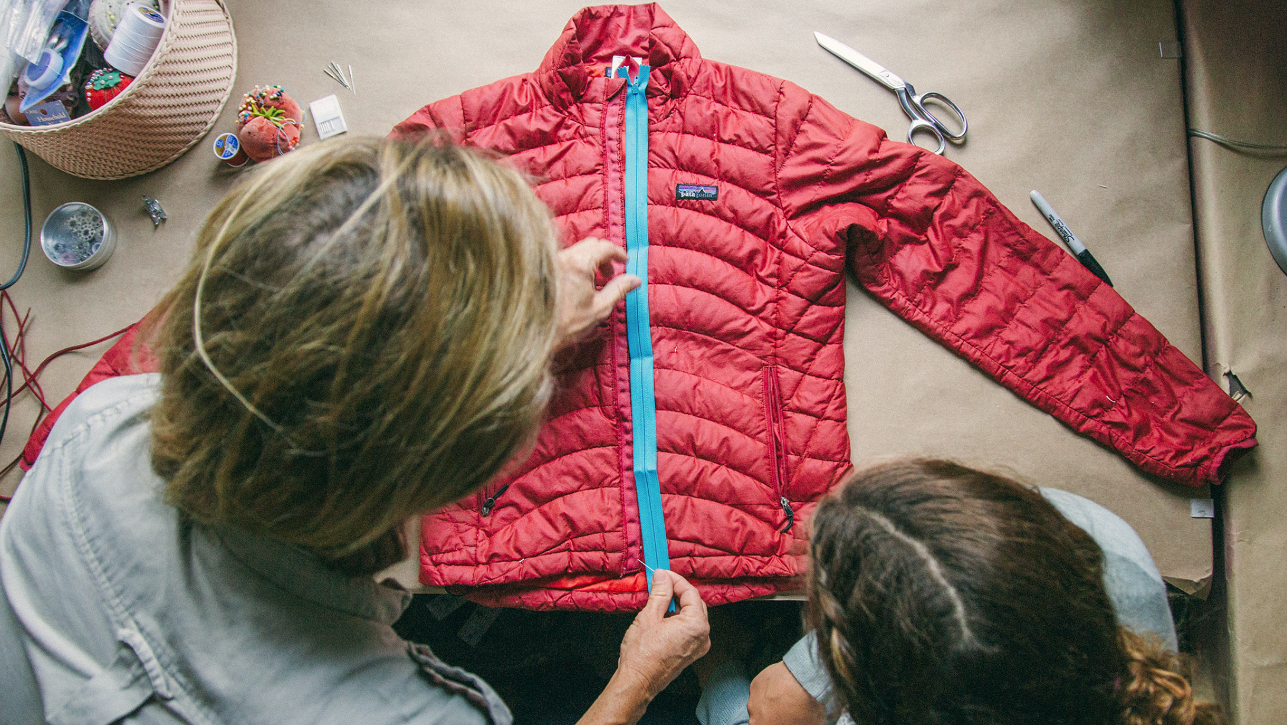
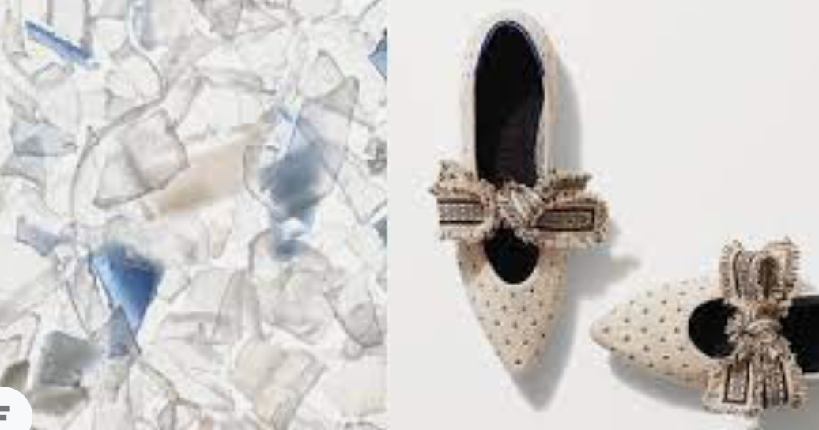
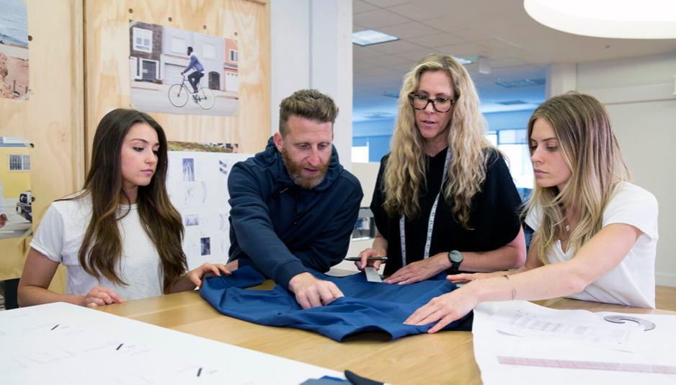
https://www.youtube.com/watch?v=tLfNUD0-8ts&t=322s - The Economist- the true cost of fast fashion
https://www.youtube.com/watch?v=3iKHr-JnWYA- Ellen MacArther foundation
https://www.youtube.com/watch?v=y78UVWd5PHE- FT times
Lululemon: https://www.cnbc.com/2021/04/20/lululemon-to-launch-resale-pilot-for-shoppers-to-sell-buy-used-items.html
https://sustainablebrands.com/read/product-service-design-innovation/lanzatech-lululemon-partner-to-create-first-fabric-made-from-recycled-carbon-emissions
Patagonia: https://www.patagonia.com/stories/our-quest-for-circularity/story-96496.html
Rothys: https://rothys.com/blogs/the-loop/closing-the-loop-at-rothy-s
Gap: https://www.gapinc.com/en-us/values/sustainability/product-1/circularity

Slide 22
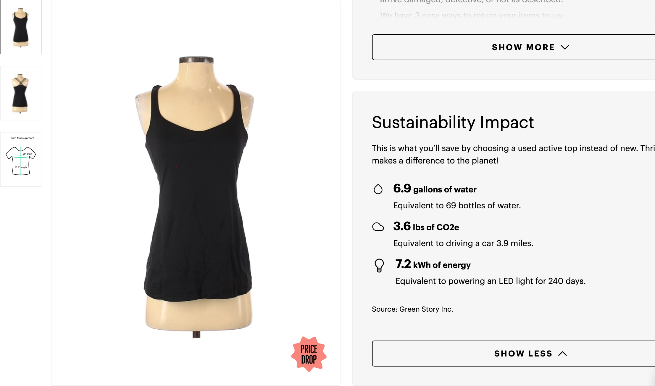
https://www.thredup.com

Slide 23
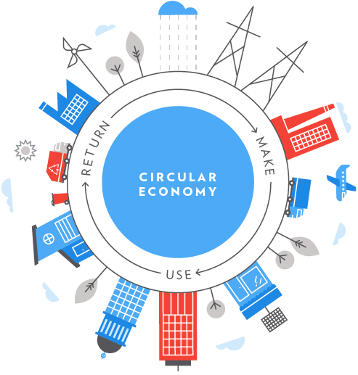
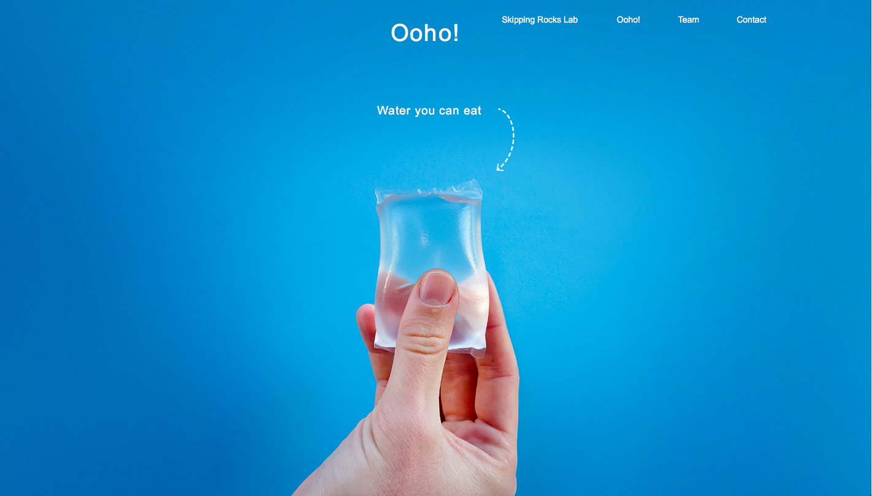
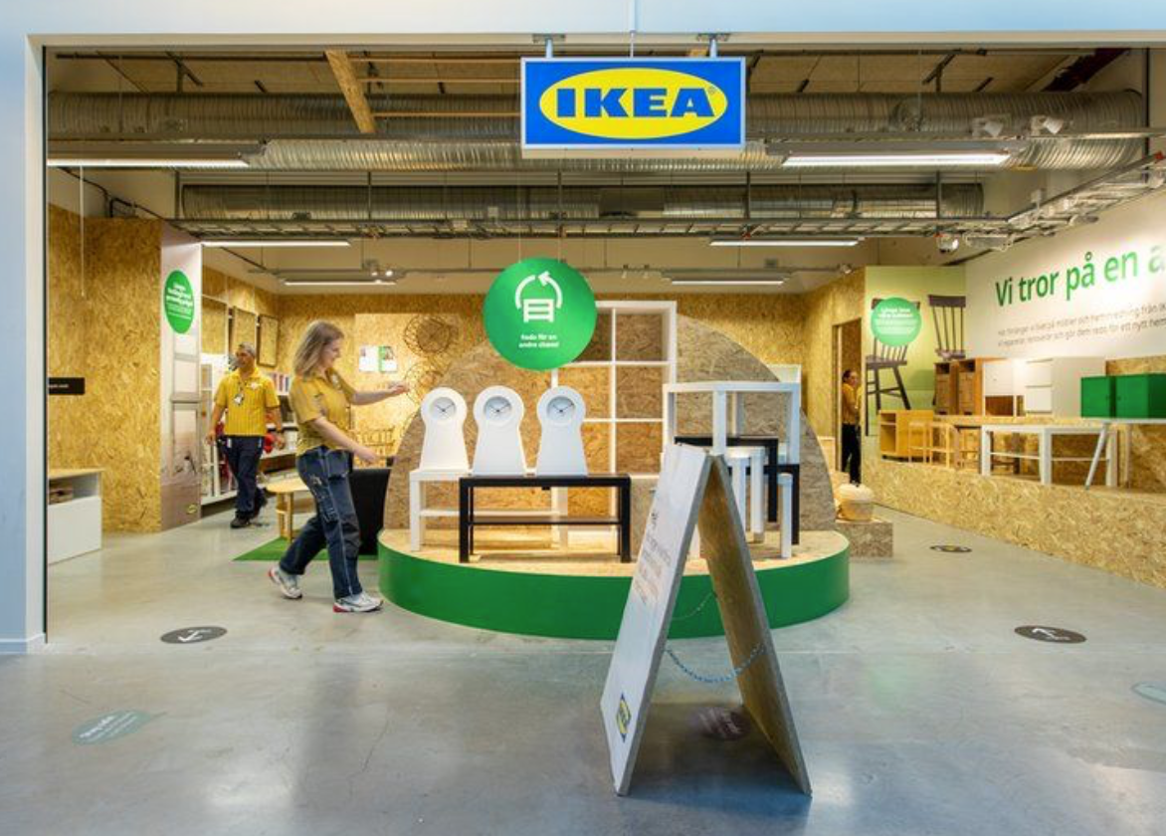
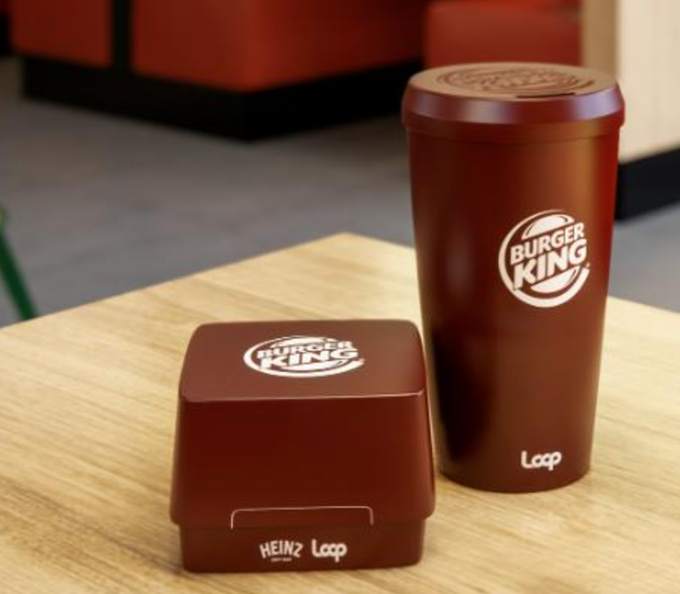
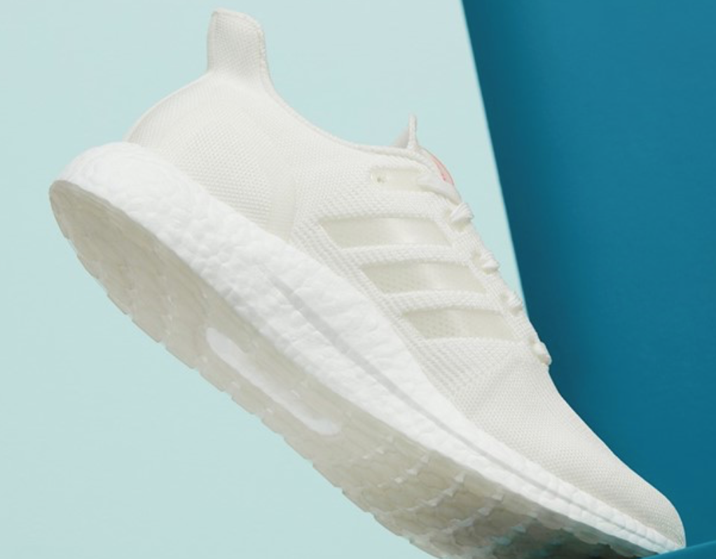
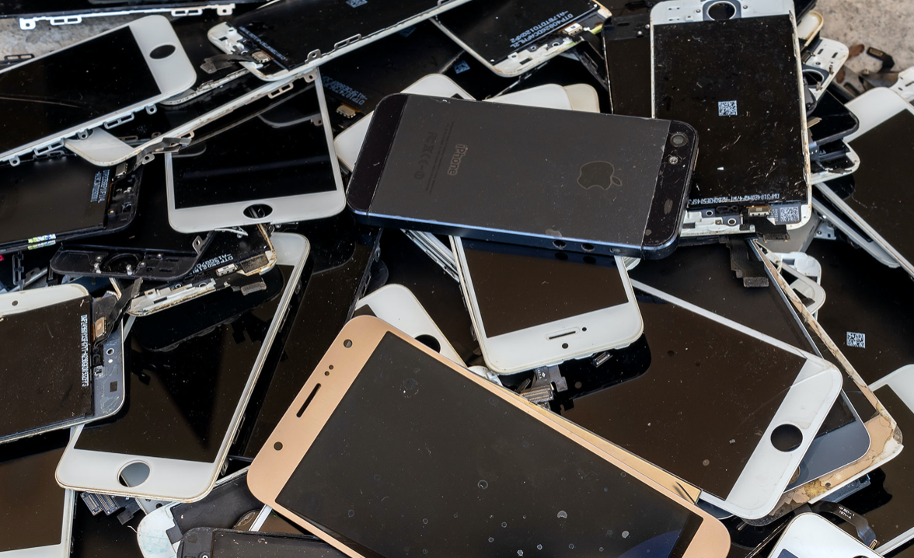
Research task: The Circular Economy
Ooho
Ikea
Research at least one of these companies
Write a description of what the company is doing to become more sustainable
How do these policies reduce the amount of resources being used?
How does this fit into the idea of the circular economy?
Nike grind
Burger king- re useable packaging
Adidas-
UltraBOOST DNA LOOP
Apple

Slide 24
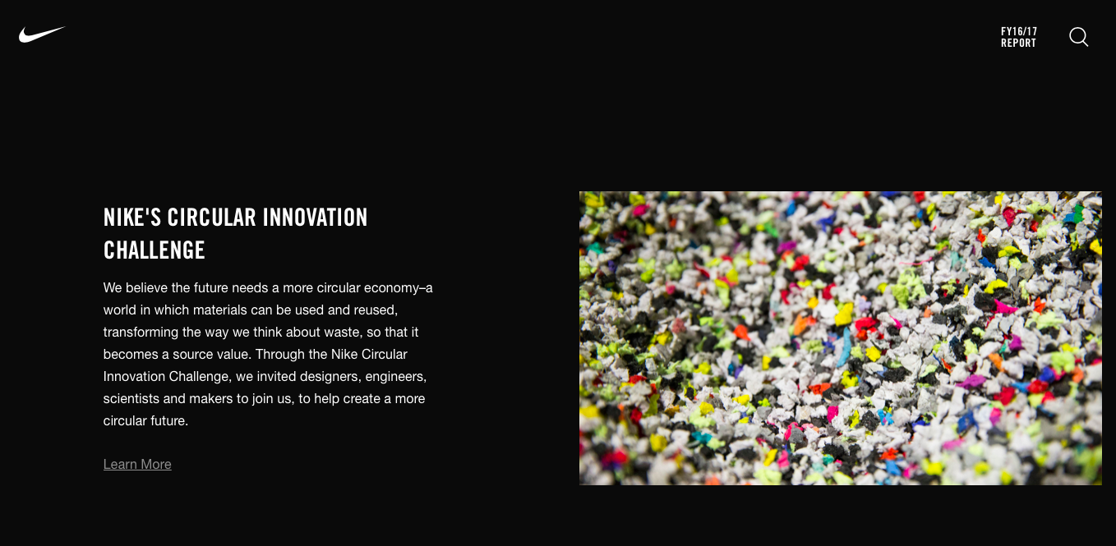
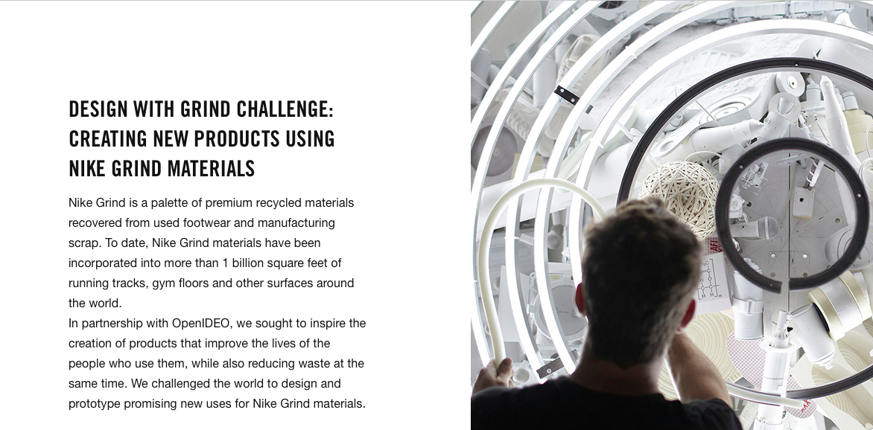
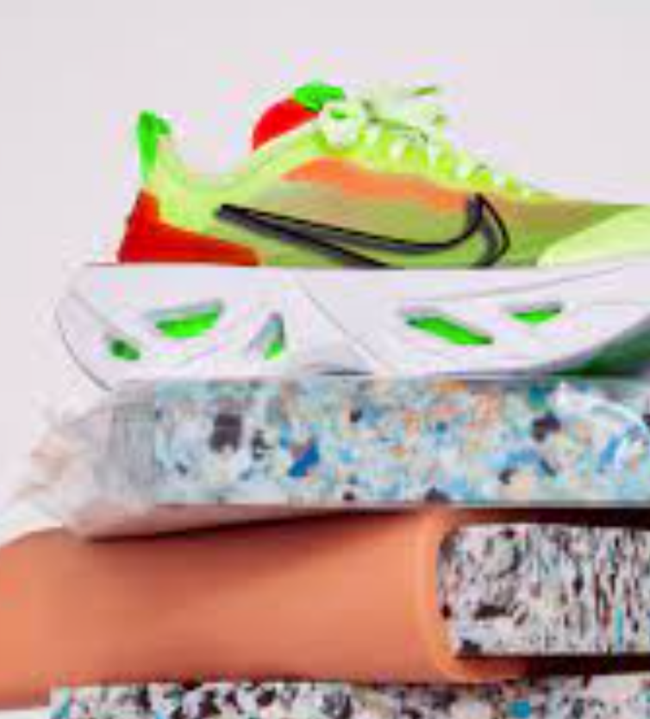
Nike Grind
https://www.youtube.com/watch?time_continue=105&v=AaV9nGyY-9A
https://sustainability.nike.com

Slide 25
Ooho
the ooho! edible water bubble gets set to replace plastic bottles
Is This Edible Blob The New Water Bottle?
This edible water bottle is how you will drink in the future
Ooho
These tiny edible water bottles are almost completely pointless

Slide 26
Ikea
https://www.ikea.com/us/en/this-is-ikea/sustainable-everyday/a-circular-ikea-making-the-things-we-love-last-longer-pub9750dd90
https://www.weforum.org/agenda/2020/10/ikea-opens-pilot-second-hand-store-sweden-circular-economy/
https://www.edie.net/news/5/Ikea-launches-circular-economy-strategic-partnership-with-Ellen-MacArthur-Foundation/
Swedish furniture giant Ikea says it aims to become a purely circular business by 2030. Last November it opened its first second hand-only store in a shopping centre in the Swedish city of Eskilstuna. The "pop-up" shop will be open until May.

Slide 27
Adidas utlraboost
https://news.adidas.com/boost/ultraboost-dna-loop-launches-to-public-as--made-to-be-remade--running-shoes-come-to-creators-club-we/s/38b4b53e-2343-4d9a-9c59-20feda458e2b
https://www.dezeen.com/2020/10/21/adidas-ultraboost-dna-loop-trainer-circular-economy/

Slide 28
Burger king- re useable packaging
https://www.cnn.com/2020/10/22/business/burger-king-reusable-packaging-sustainability/index.html
https://www.timeout.com/usa/news/gross-or-sustainable-burger-kings-new-eco-friendly-packaging-will-be-reusable-102220
https://www.plasticstoday.com/packaging/burger-king-partners-terracycle-pilot-reusable-packaging

Slide 29
Apple
https://www.apple.com/environment/
https://www.reutersevents.com/sustainability/apple-plants-seeds-sustainability
https://www.greenbiz.com/article/apple-dials-its-circular-materials-aspirations

Slide 30
Nike Grind
A collection of recycled materials developed by Nike that is composed of pre-consumer manufacturing scraps, recycled post-consumer shoes from the Reuse-A-Shoe program, and unsellable footwear. The purpose of Nike Grind is to eliminate waste and close the loop on Nike's product lifecycle.
Nike Grind materials are incorporated into some Nike products, including footwear, apparel, and the yarn that composes them. These materials are also used in athletic and play surfaces like running tracks, turf fields, playground surfaces, courts, weight room flooring, and carpet underlay. Since its inception, Nike Grind has been used in over 1 billion square feet of sports surfaces in total.

Slide 31
https://sustainability.nike.com

Slide 32
https://www.youtube.com/watch?time_continue=105&v=AaV9nGyY-9A

Slide 33
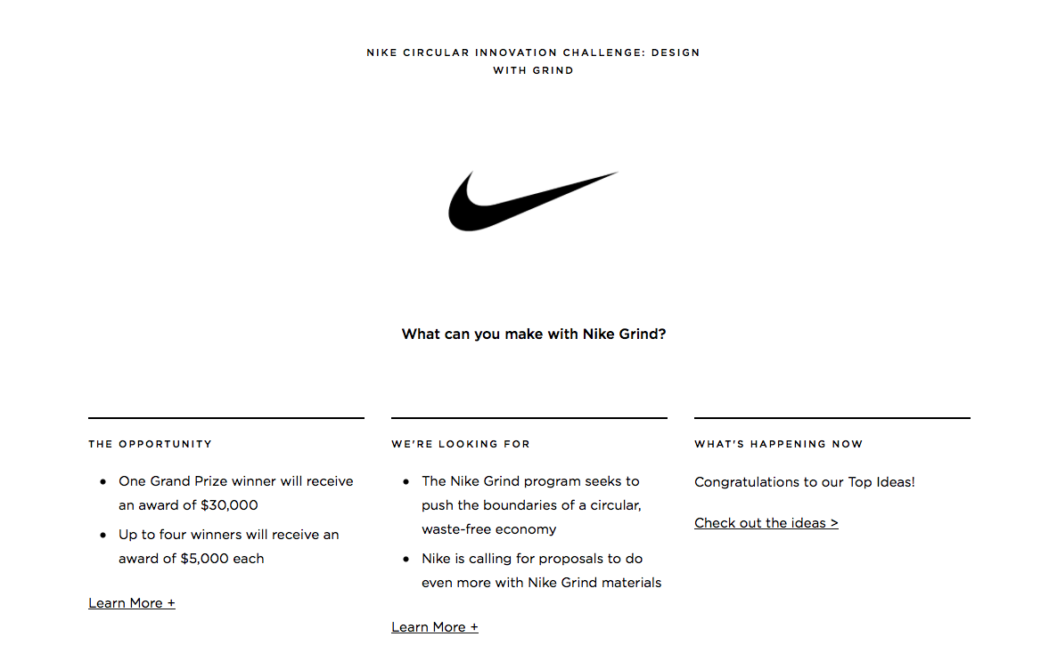

Slide 34
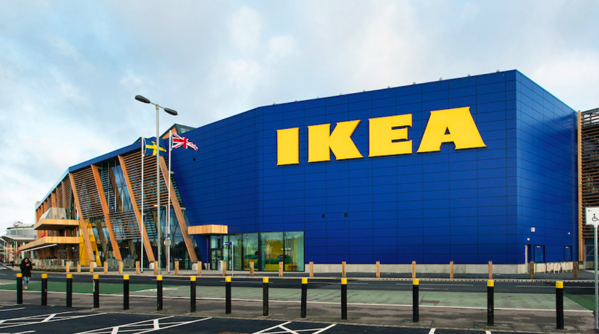
Ikea and the circular economy
IKEA is making a huge change by renting out furniture— and it's a prime example of the kind of thinking more companies need to be doing
IKEA is a shining example of the circular economy and sustainability mega-trend
"We're looking at a change of our total business" says IKEA sustainability chief Lena Pripp-Kovac
Ikea: We’re creating positive changes
The Swedish furniture giant announced last year that it plans to make all its products according to circular principles by 2030, meaning that they can be reused, refurbished or recycled. It will use only renewable or recycled materials across its entire range.

Slide 35
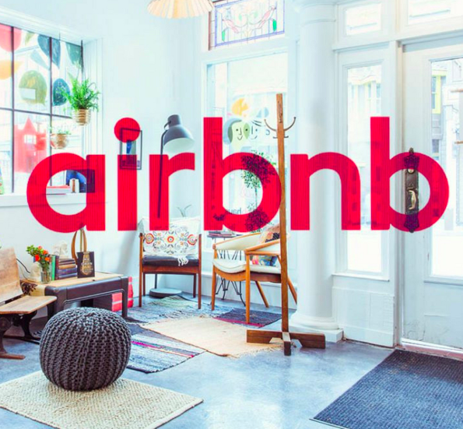
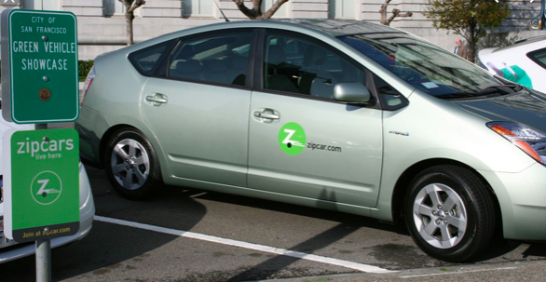
The sharing economy
The sharing economy refers to the sharing of goods or other resources by multiple people. Sharing allows existing goods and resources to be used more fully, rather than letting them lay dormant.

Slide 36
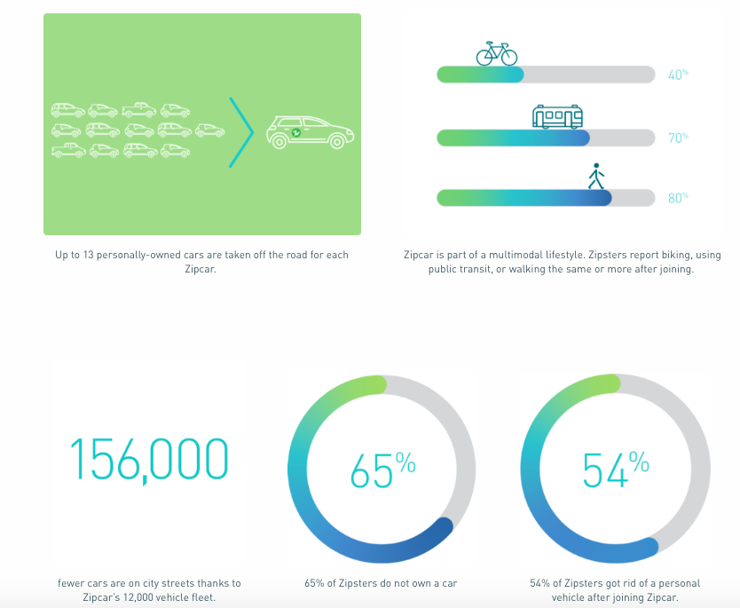
Zip cars
https://www.zipcar.com/impact

Slide 37
Mobile phones
Links to e-waste
Click here to read about the Ellen MacArthur Foundation stance on mobile phone transition. Using a print out of the article, highlight the key changes to the cycling elements of materials and energy. (Also, keep in mind the work we did on e-waste too). Click here for a 2017 Guardian Article on mobile phone development and the 'self healing screen’.
How are Apple embracing the circular economy: https://www.greenbiz.com/article/apple-dials-its-circular-materials-aspirations
To what extent financially will it benefit TNC's such as Apple and Samsung to make their products 'last longer?'

Slide 38
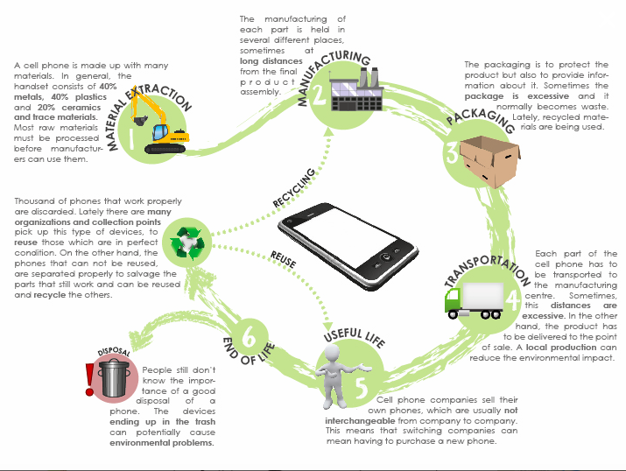
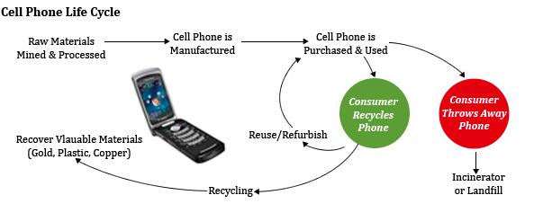

Slide 39
Evaluation: can the circular economy succeed?
Read page 113 of the ‘Global change’ study book and make notes based on pessimistic and optimistic views.

Slide 40
Assessment
Outline two approaches - at differing scales - that have used the circular economy systems approach to address resource sustainability (3 + 3)

Slide 42
“The circular economy is the most effective way of planning resource use for the future”. Discuss the implications of this statement (10)

