Slide 1
Population policy: China

Slide 2
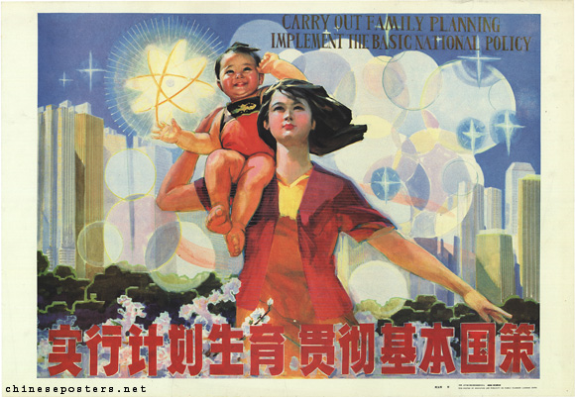
The BIG CONCEPT
In 1979 the chinese central government introduced the one-child policy to control the increase in population which was 970 million at the time.

Slide 3
Key word: anti-natalist
“Antinatalism, or anti-natalism, is a philosophical position that assigns a negative value to birth. Antinatalists argue that people should refrain from procreation because it is morally bad.”

Slide 4
Why was it needed?

Slide 5
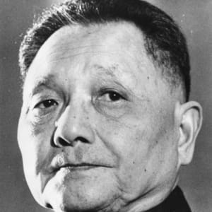
Why was the policy needed?
The policy was put in place due to the fact that China's rapidly increasing population was starting to threaten the countries prospect for economic growth.
It was introduced by chinese leader Deng Xiaoping.

Slide 6
Below 1.2 billion
Was the ideal population that China wanted to have at the end of the 20th century.

Slide 7
How was it enforced?

Slide 8
How was the one child policy enforced.
Forced abortions/ sex-selective abortions
Social compensation fee
Was restricted to ethnic Han chinese living in urban areas, who compromised only 36% of the population.
In most provincial areas couples could only have 2 children if the first one was a girl.
In other provinces parents could only have 2 children regardless the sex of the first child.
Fines were given (could be 4x people salary) and property were taken away.
Propaganda was put in the workplace to support the policy.
Granny police (they would see what contraceptive methods families were using and would coerce pregnant women into having abortions.
Female infanticide.
Forced sterilization.

Slide 9
Was it successful?

Slide 10
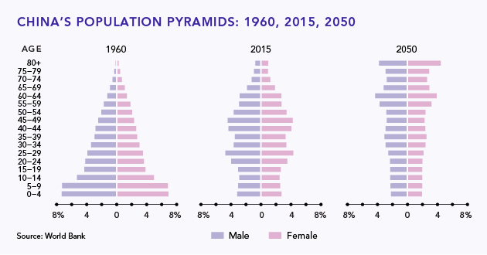

Slide 11
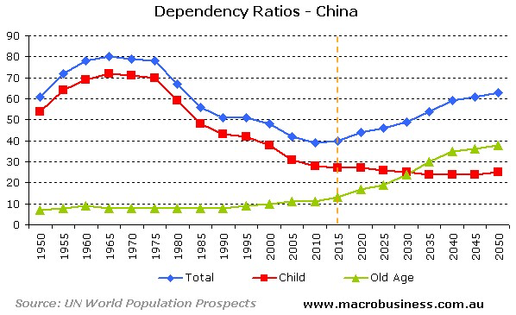

Slide 12
400 million
The policy was credited with preventing from 1979 to 2010 in china.

Slide 13
Was the policy successful? YES
It built a stronger social system due to China’s economy developing so much.
The birth rates dropped from 30% to 10%
The population increase during the policy went down from 40% in 1946 to 11% in 2011.
China's economy improved to one of the best in the world.

Slide 14
Was the policy successful? NO
The policy varied within the many provinces e.g. in rural provinces the couple was allowed to have a second child if the first was a girl.
If you were rich you could evade the policy.
It created a high number of young boys leading to a male dominant population.
There were 34 million more men than women.

Slide 15
What is the situation today?

Slide 16
What is the situation today?
One child policy ended after 35 years (october 2015) also allowing all couple to have two children for the first time since the rule of introduced.
The change of the policy is intended to balance population development and address the challenge of an aging population.
People celebrated the move as a positive step towards greater personal freedom in china.
Human rights still believe that the communist party continues to control the size of Chinese families.
Demographers in and outside china have long warned that its low fertility rate.

