Slide 1
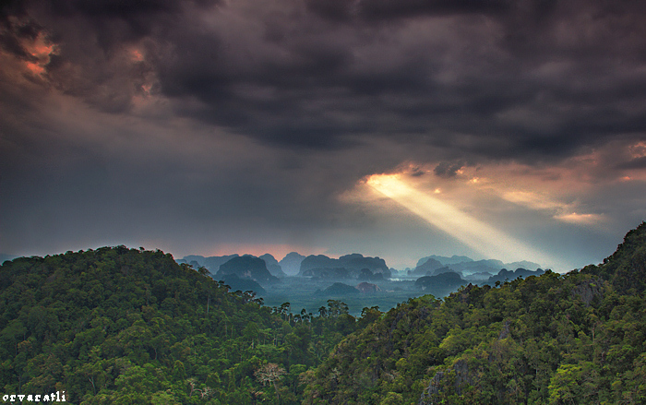
Rainforests
LO : To describe the characteristics of the tropical rainforests
3 countries where Rainforests are located.
2 reasons why the Rainforest should be protected.
1 line of latitude where most Rainforests are found.

Slide 2
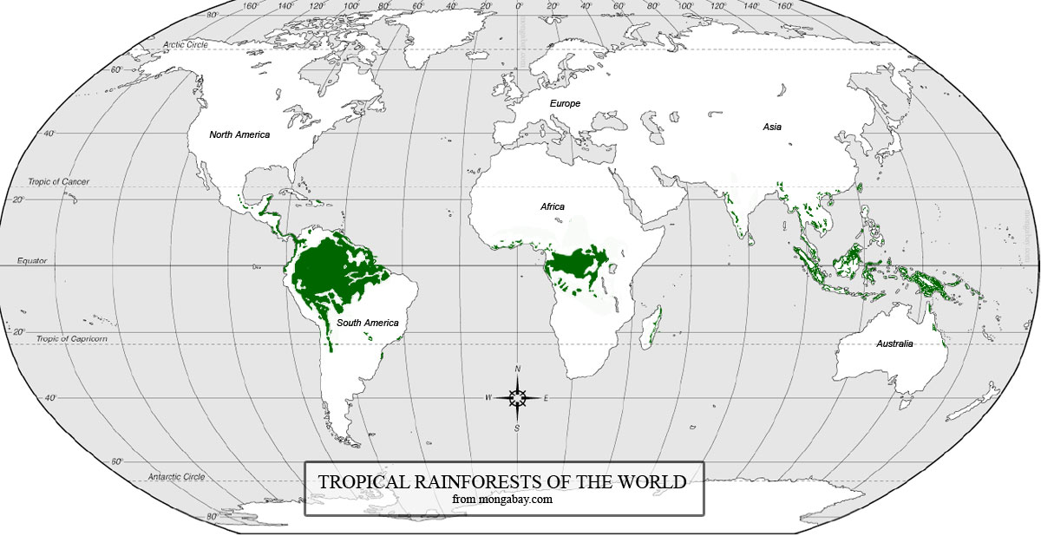
Tropical rainforest of the world
You have got 7 mins to do this. Beat the clock!
Brazil
Ecuador
Peru
Indonesia
Cameroon
Mark on areas of tropical rainforest and
Using your Atlas indicate the location of the countries in the purple box.
Challenge: Describe the distribution of tropical rainforest.

Slide 3
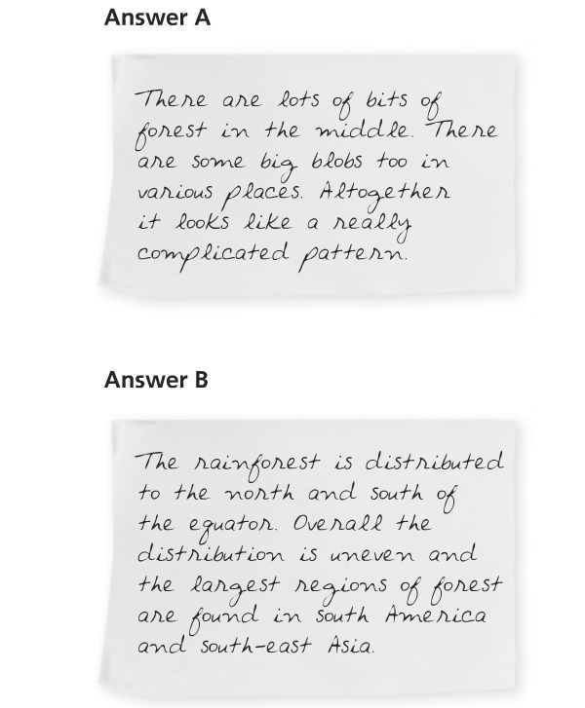

Slide 4
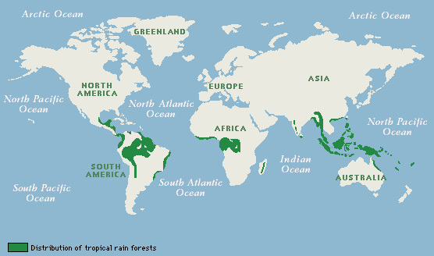
Where are the world’s tropical rainforests located?
The tropical rainforest occupies only seven per cent of the world’s land surface but it contains many useful resources. It is also valuable in the fight against global warming. The main areas of tropical rainforest are in the Amazon basin, Central Africa and South East Asia.
The largest area of tropical rainforest is located in the Amazon. The world’s tropical rainforests are mainly located around the equator, where the Sun’s rays are concentrated, heating moist air which rises which leads to heavy rainfall, with little seasonal variation.

Slide 5
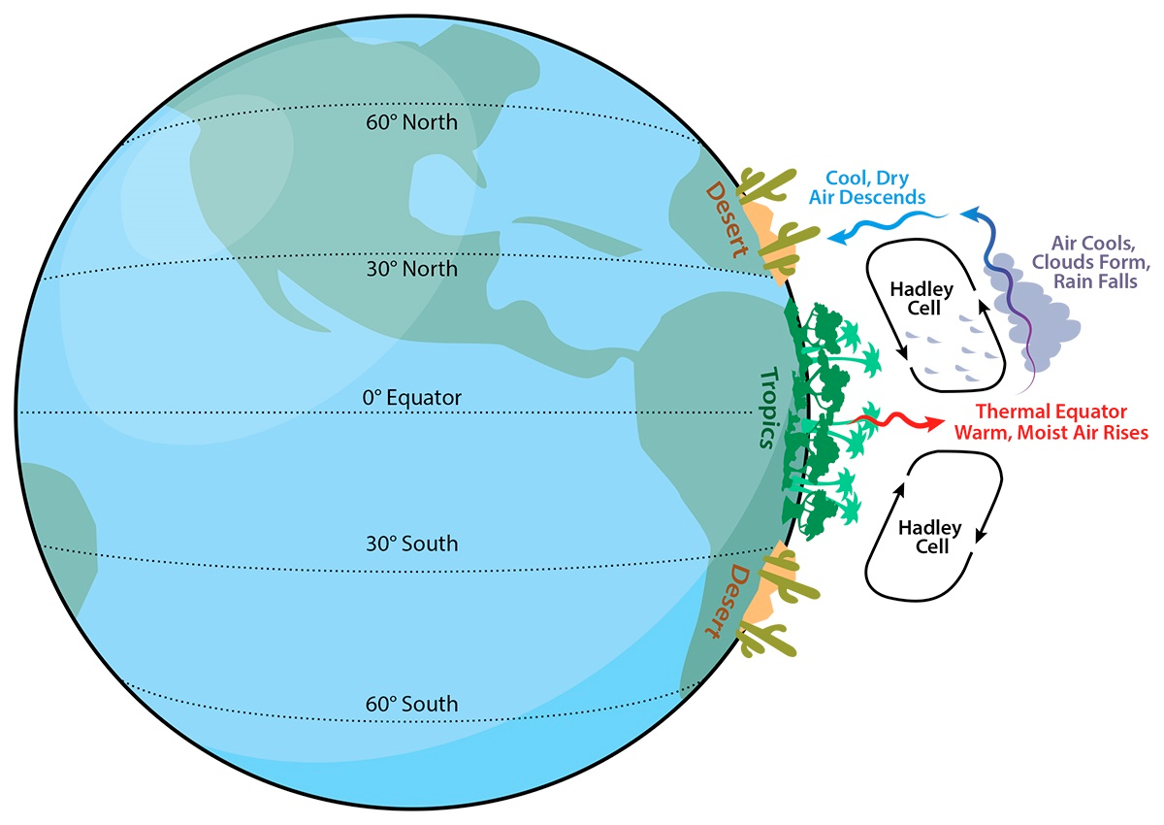
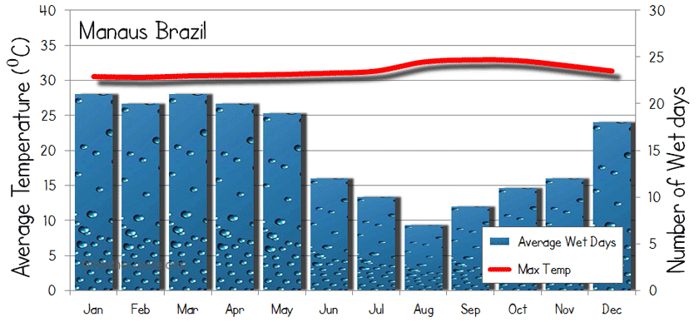
What is the climate of the TRF?
Task: Create a climate graph for the tropical rainforest
Tropical rainforests thrive in warm and wet conditions. The equatorial zone where they are found is characterised by high rainfall (over 2000 mm a year) and high temperatures (averaging about 27°C) throughout the year.
The climate graph below is for Manaus, in the Amazon rainforest in Brazil.
The temperature is high and constant throughout the year. This is because the powerful Sun is overhead for most of the time.
The rainfall is high. This is because the global atmospheric circulation causes an area of low pressure to form at the Equator. The rising air creates clouds and triggers heavy rain.
Rainfall varies throughout the year, with a distinct wet season lasting about six months. This is due to a period of intense rainfall when the equatorial low pressure area is directly overhead.

Slide 6
What is the soil, vegetation and animals of the TRF like?
Tropical rainforest soils are surprisingly infertile. Most nutrients are found at the surface, where dead leaves decompose in the hot a humid conditions. Many trees and plants have shallow roots to absorb these nutrients. Fungi growing on the roots transfer nutrients straight from the air.
Biomass
All living things in the ecosystem, both plants and animals
Heavy rainfall can quickly dissolve and carry away nutrients. This is called leaching. It leaves behind an infertile red, iron-rich soul called latosol.
Nutrients fall to the ground when plants and animals die.
Plants take up nutrients which are dissolved in soil.
Litter
Dead organic material such as fallen leaves or tree trunks and dead animals.
Soil
Developed by the mixing of dead organic material with weathered bedrock.
Nutrients become part of the soil when dead matter decomposes.
Tropical rainforests support the largest number of species of any biome. Over half of all plant and animal species on the planet live on just 7 per cent of the land surface. More than two thirds of the worlds plant species are found in these forests.
Tropical rainforests have a huge biodiversity, providing habitats for an enormous range of species.
Birds living in the canopy feeding on nectar from flowers.
Mammals like monkeys are well adapted to living in the trees.
Animals like deer and rodents live on the forest floor.

Slide 7
How is the tropical rainforest interdependent?
The diagram to the rights shows the main components of the tropical rainforest ecosystem: climate (rain and sunlight), soil, vegetation (trees and plants) and animals.
The arrows show how they interact to create an interdependence. The diagram also shows people. It is possible for native people (indigenous tribes) to live as part of, and in harmony with, the ecosystem. Equally though people can badly upset the ecosystem’s balance.
Human exploitation of the rainforest’s resources is reducing its rich biodiversity. Many species are becoming endangered, some have already become extinct.
The interactions in the tropical rainforest ecosystem
Sunlight
Rain
Evapotranspiration
Animals
People
Animals excreting and dying
Animals eating plants
Harvesting fruits
Trees
Understory plants
Roots taking up nutrients
Leaves falling
Leaves falling and plants dying
Forest floor
Roots taking up water
Roots taking up water
Nutrients leaching into soil
Soil
Nutrient leaching

Slide 8
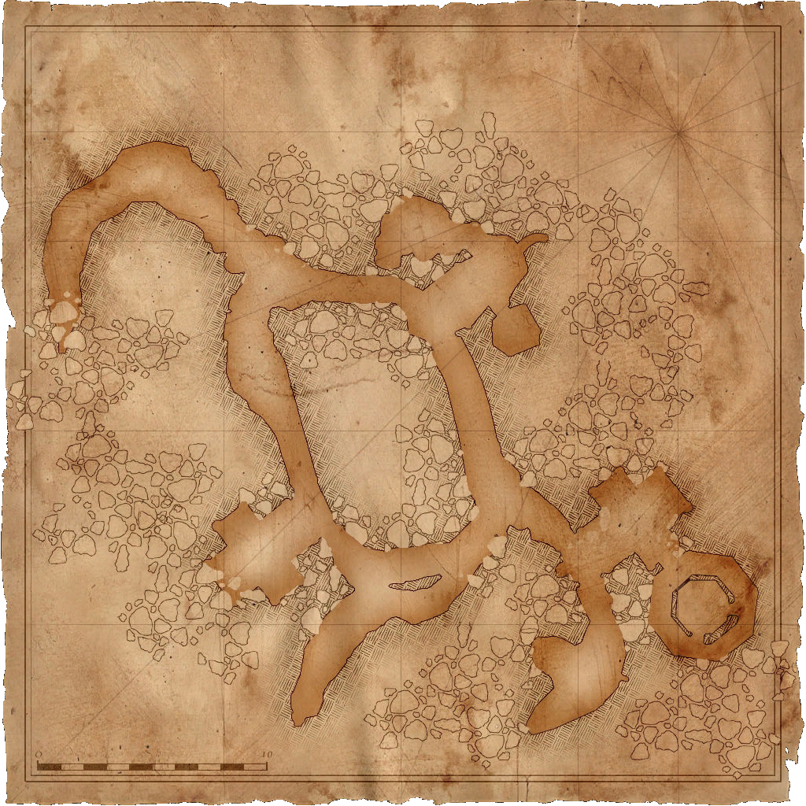
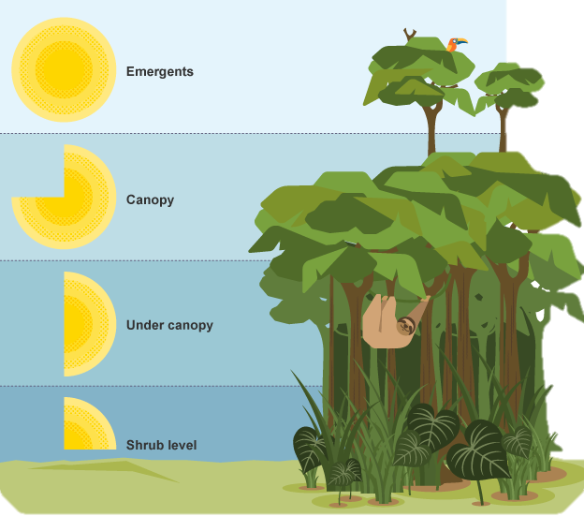
How are the plants and animals adapted to the TRF?
Fast-growing trees such as kapok out compete other trees to reach sunlight- such trees are called emergents
Map from memory
The smooth bark on trees to allow water to flow down easily
Many leaves have a drip-tip to allow the heavy rain to drip off the leaf.
Explain:
Why adaptions are needed in the rainforest
Which adaptation is most important for plants
Which adaptation is most important for animals
Plants called epiphytes can live on branches high in the canopy to seek sunlight- they obtain nutrients from water and air rather than soil
Buttresses- massive ridges help support the base of the tall trees and help transport water. May also help oxygen/ carbon dioxide exchange by increasing the surface area
Many trees have flexible bases so that they can turn to face the Sun
Literacy
Levels 1-3
You are able to describe the adaptations of the plants and animals in the tropical rainforest.
Levels 4-6
You are able to explain why the adaptions that plants and animals have are important in the rainforest.
Levels 7-9
You are able to examine the importance of the adaptations in relation to climate and soil.
Can you use these key terms:
Drip-tip
Nutrients
Buttress roots
Competition
Emergents

Slide 9
Layers of the tropical rainforest
Fast-growing trees such as kapok out compete other trees to reach sunlight- such trees are called emergents
The smooth bark on trees to allow water to flow down easily
Many leaves have a drip-tip to allow the heavy rain to drip off the leaf.
Plants called epiphytes can live on branches high in the canopy to seek sunlight- they obtain nutrients from water and air rather than soil
Buttresses- massive ridges help support the base of the tall trees and help transport water. May also help oxygen/ carbon dioxide exchange by increasing the surface area
Many trees have flexible bases so that they can turn to face the Sun

Slide 11
Key terms
Energy flow:
Food chain:
Food web:

Slide 12
Details:
Producers: Strangler fig, Coconut Trees, Banana Trees, Bamboo Trees, Primary Consumers: Macaws, Monkeys, Fruit Bats, Grasshoppers Secondary Consumers: Vampire Bats, Iguanas, Frogs Tertiary Consumers: Python & Jaguar
Task: Make notes from the textbook (p214) on energy flows, food chains and food webs in the tropical rainforest

Slide 13
Why are the plants and animals adaptation needed?
Use the information from the map from memory to complete the table below about the plant and animal adaptations in the rainforest.
Literacy
Can you use these key terms:
Drip-tip
Nutrients
Buttress roots
Competition
Emergents
Sunlight
Photosynthesis
Humidity
Latosol
Leaching/run off
Recycling
Adaptation | Diagram/Drawing of adaption | Description of the adaption | Explanation of adaption (refer to climate, soils and competition)
Buttress roots
Drip tip leaf
Epiphytes
Levels 1-3
You are able to describe the adaptations of the plants and animals in the tropical rainforest.
Levels 4-6
You are able to explain why the adaptions that plants and animals have are important in the rainforest.
Levels 7-9
You are able to examine the importance of the adaptations in relation to climate, soil and competition.
Extension
Can you;
Explain which is the most important adaptation.
Explain which is the least important adaptation.
In no more than 20 words summarise the main plant and animal adaptations.

Slide 14
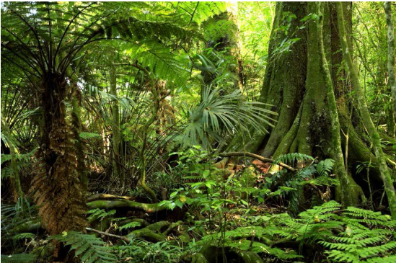
Exam question
Level 1 (basic) 1-2 marks
You demonstrate limited knowledge of vegetation and climate in rainforest areas.
You make limited use of the photograph.
Study figure 1 below showing part of a tropical rainforest in Central Africa
Describe and explain the features of the vegetation shown in figure 1. (6 marks)
Thin and smooth bark
Figure 1
Level 2 (clear) 3-4 marks
You demonstrate accurate knowledge of the features of vegetation and climate to support the explanation.
You make clear and effective use of the photograph.
Level 3 (detailed) 5-6 marks
You apply detailed knowledge of rainforest vegetation to interpret the features identified.
You clearly relate characteristics shown in the photograph to the climate of the tropical rainforest environment.
Drip tip and waxy leaves
Buttress roots

Slide 15
EDIT
REWRITE
IMPROVE
Edit the ‘WABOLL’
Write out the ‘WABOLL’ correctly
Improve and develop the piece further
Circle spelling errors and label with ‘sp’, Circle punctuation or capital letter errors, Wobbly underline for poorly written sentences
Reminders: Capital letters at the start of sentences, geographical key terms and link the adaptations to the conditions in the rainforest. Use because and this means that.
Key Ideas: waxy layer, drip tip, buttress roots, humidity, rainfall, thin and smooth bark, lianas, sunlight, photosynthesis and flexible leaf stems.
The plants in the tropical rainforest have many adaptations to help them survive. Figure 1 shows plants with a drip tip and waxy leaves. The trees also have a thin layer and are smooth. The trees also have strong roots called buttress roots.
Responses should include description and explanation. There should be clear evidence that the photograph has been used, e.g. the buttress roots of the trees, limited undergrowth, straight trunks. No credit for features not observed in the photograph.
Due to the high rainfall, leaves often have drip tips which allow the water to be channeled to the end and fall so the leaf does not break. Leaf stems are also flexible to allow leaves to move with the sun.
The bark on the trees is thin and smooth to allow free flow of water and because the high temperatures mean that there is no need for protection against cold.
The waxy upper surface of the leaves protects against the heat.
Some plants, such as lianas, climb up the trees to reach sunlight for photosynthesis, while others live on branches in the canopy for the same reason i.e. epiphytes.
Buttress roots support the trees as they grow incredibly tall (over 50 m in some cases) as there is great competition for sunlight.
Max level 1 for either description or explanation.
_______________________________
_______________________ ____
____________________________
Level 1 (basic) 1-2 marks
You demonstrate limited knowledge of vegetation and climate in rainforest areas.
You make limited use of the photograph.
Level 2 (clear) 3-4 marks
You demonstrate accurate knowledge of the features of vegetation and climate to support the explanation.
You make clear and effective use of the photograph.
Level 3 (detailed) 5-6 marks
You apply detailed knowledge of rainforest vegetation to interpret the features identified.
You clearly relate characteristics shown in the photograph to the climate of the tropical rainforest environment.

Slide 16
Extra exam questions…
Level 1
You demonstrate limited knowledge of tropical rainforests.
You demonstrate a limited ability to use key terms.
Level 2
You demonstrate a clear knowledge of tropical rainforests.
You are able to use some place specific detail.
You are able to use key terms correctly.
Explain the location of the world’s tropical rainforests.
(4 marks)
Describe the main characteristics of a tropical rainforest soil.
(4 marks)
Describe the main characteristics of a tropical rainforest ecosystem.
(6 marks)
Level 3
You demonstrate detailed knowledge of tropical rainforests.
You are able to use place specific detail thoroughly.
You are able to use key terms consistently correctly.
Advice
Use examples
Use key terminology
Make links between points
Use point, example, explain, link to structure your answer
Key words
Equator
Fungi
Infertile
Hadley cell
Leaching
Biodiversity
Latosol

