Slide 1
Changes in the Hydrosphere

Slide 2
What is the hydrosphere
The hydrosphere is the sum of all water on Earth and the water cycle that distributes it around the planet

Slide 3
Less Ice
Higher temperature causes ice to melt
Water is evaporated into the atmosphere
Floods from melting glaciers threatening 4 million km² of land. Equates to the home of 5% of the world’s population
Lowest volume on record = since 3rd Feb 2016
Methane emissions from tundra due to release of chlorine atoms from the sea = GREENHOUSE GAS

Slide 4
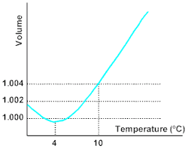
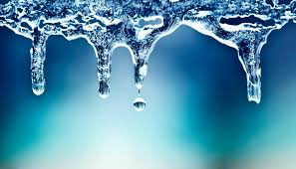
More water
Higher sea levels cause flooding in low lying areas
Ocean water expands when temperature is increased so volume of water is increased. Known as steric effect

Slide 5
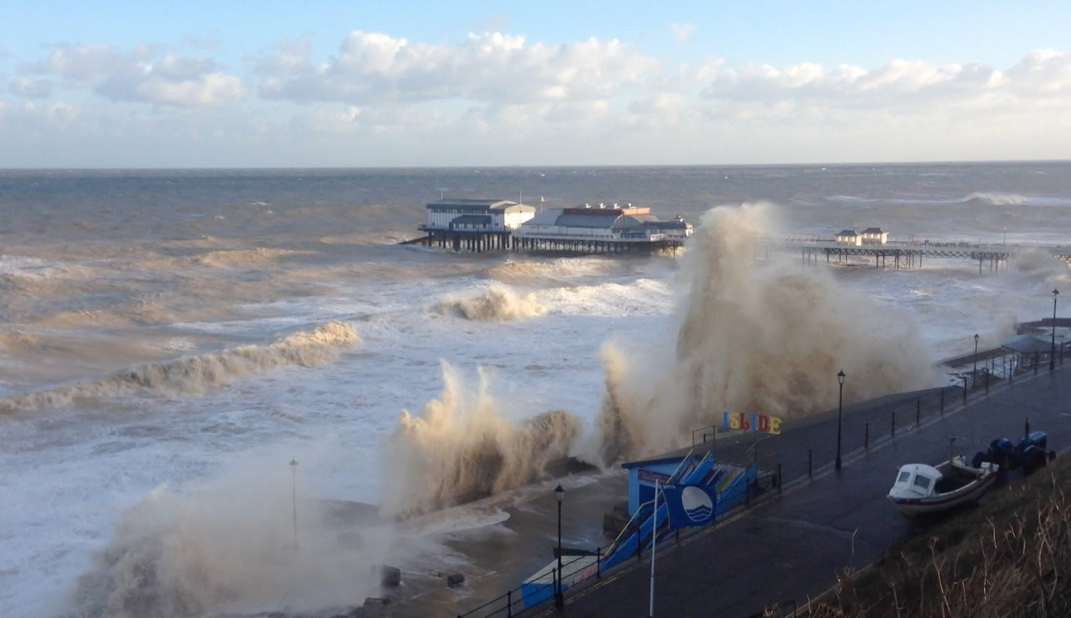
High tide and storm surges from rise in sea temps
Change in hydrosphere = warmer sea temps from albedo
More energy for natural disasters to last longer
Warmest sea temps for 40,000 years
Eg. Hurricane Katrina would not be that bad if not for high energy from increased seas temps
Less phytoplankton, more GG
emissions

