Slide 1
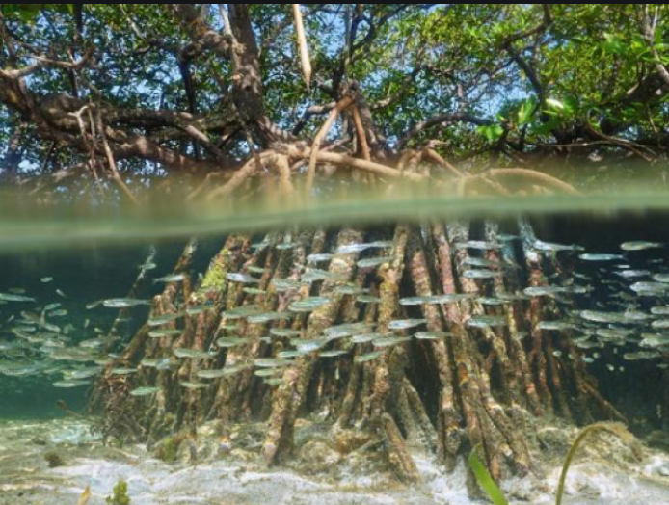
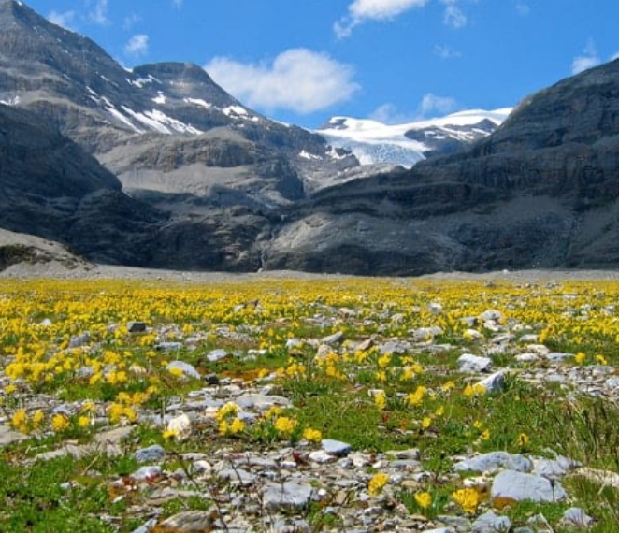
Changes in Biomes

Slide 2
Biome changes
There will be a latitudinal change in biomes
There will be an altitudinal shift as biomes will move up-slope
Low lying biomes such as mangroves may be lost
as they are also going to be impacted by sea level rise
High altitudinal biomes will be lost as they have no
Where to move to.

Slide 3
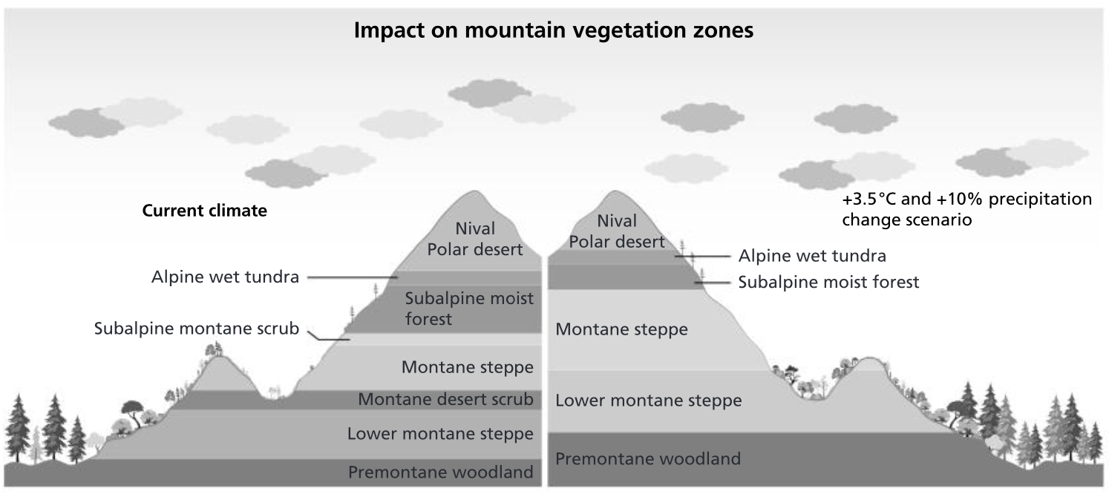

Slide 4
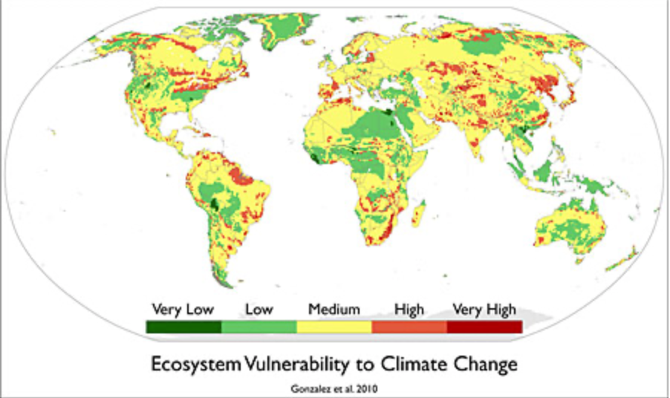
Over the past century, vegetation has been gradually moving toward the poles and up mountain slopes, where temperatures are cooler, as well as toward the equator, where rainfall is greater.
One-tenth to one-half of the land mass on Earth will be highly vulnerable to climate-related vegetation shifts by the end of this century

Slide 5
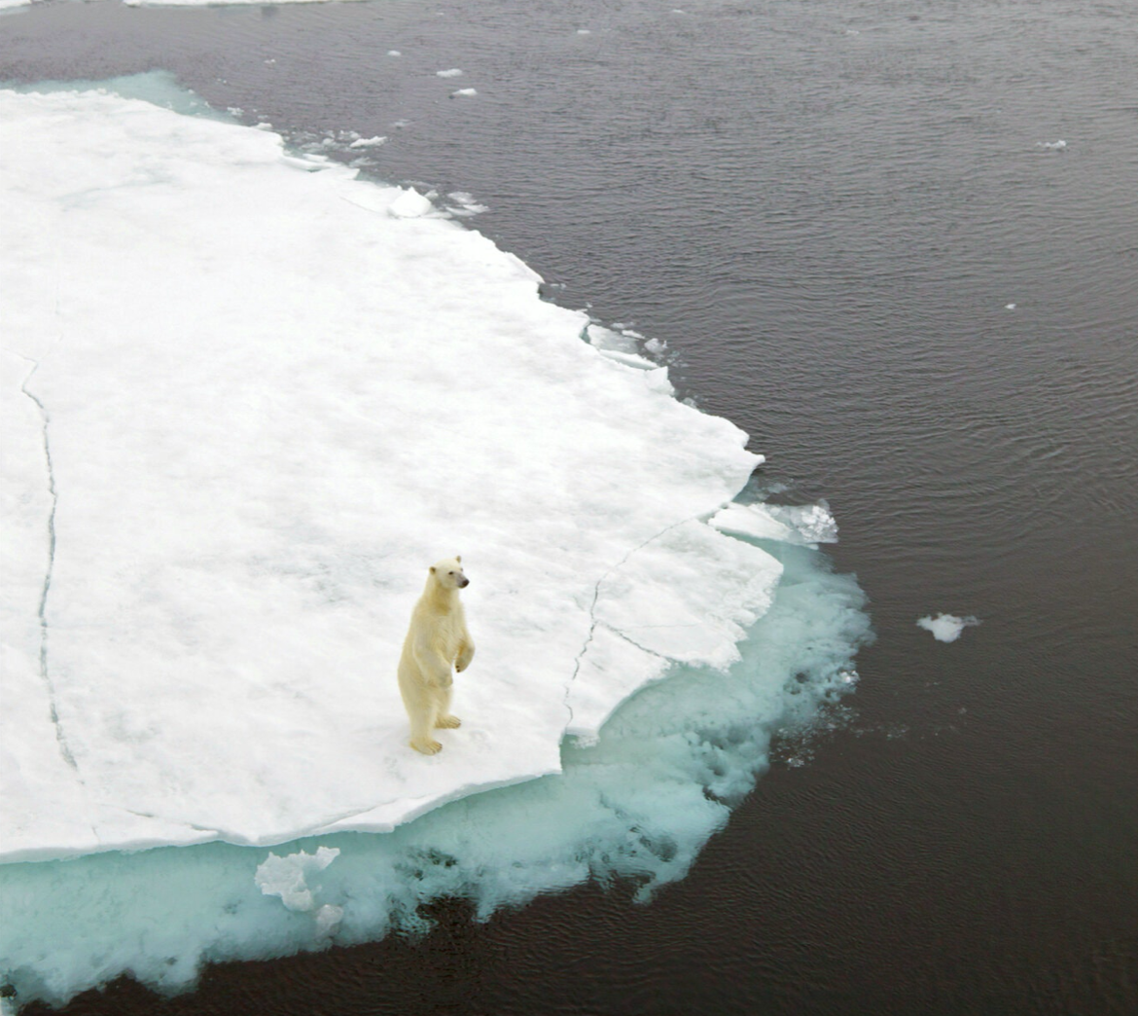
Loss of biodiversity
With past climate changes species have had longer to change and adapt. The current change is so rapid they won’t.
Species at the highest altitudes and highest latitudes will have the fewest options for migration so will be most vulnerable to extinction.
A rise of 2 degrees centigrade could lead to the extinction of 40% of wildlife species.
Can animals adapt to clmate change?

Slide 6
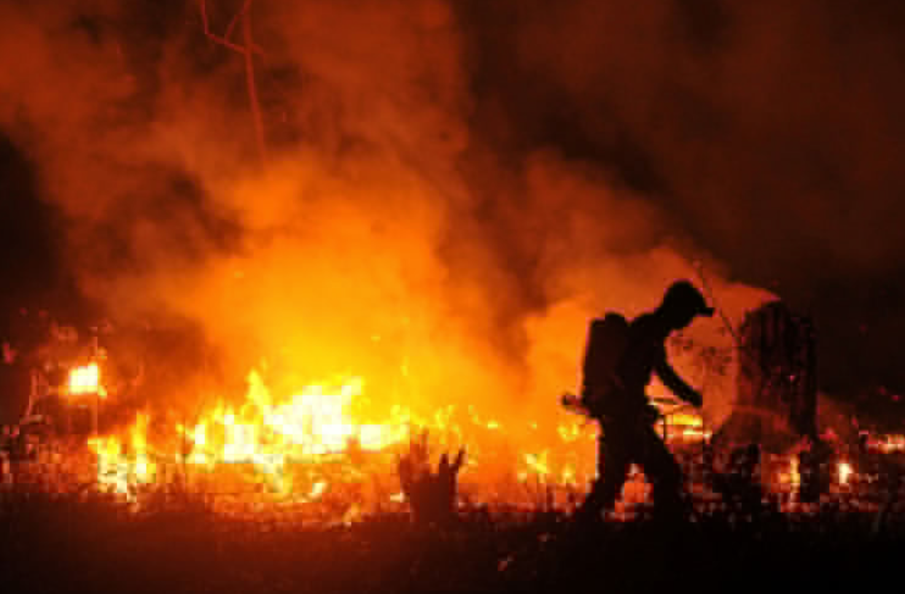
Forest fires
Dense American forests are a carbon sink absorbing about 13% of the greenhouse gases America emits.
Climate change is causing devastation in these forests- due to fire, insect infestations and drought.
In 2015 over 10 million of Americas 766 million acres of forest- costing the government $2 billion.

Slide 7
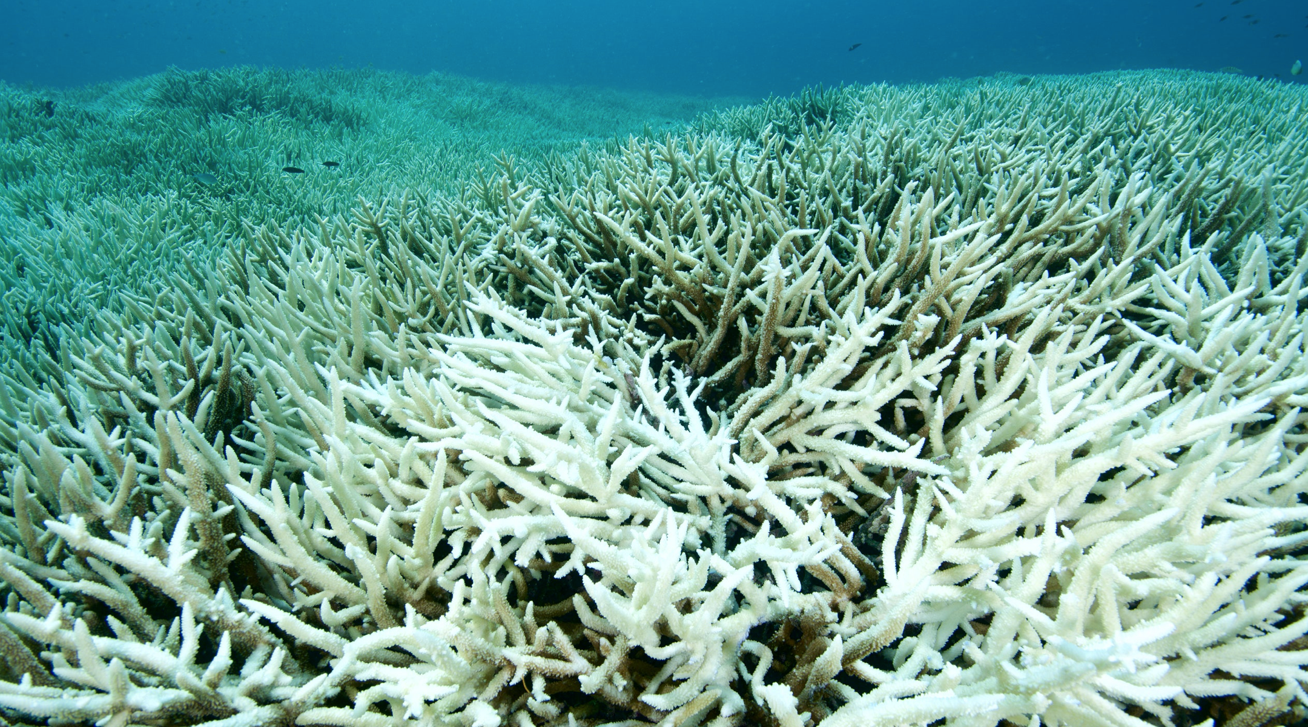
Aquatic ecosystems
Coral reefs are at risk from coral bleaching . Scientists estimate that coral cover in the Great Barrier Reef in Australia could drop to less than 10% from the combined effects of ocean temperature rise of 1–2°C and pollution.

