Slide 1
Starter: How did medieval kings control their kingdom?
Last week you independently researched 3 problems and methods that King William used to control his kingdom. What were they?
You are going to listen to what your partner found out and give them a + = or – for their research. If you learn a new fact from your partner that you don’t have you can write it on your sheet.

Slide 2
Starter: Peer assessment criteria
+ | Detailed notes about all three sections. They have explained HOW each method helped William keep control.
= | Detailed notes about two or three sections They have started to explain how this made the king powerful/keep control
- | Simple notes about all three sections OR detailed notes on only one section. Notes are describing the feudal system rather than explaining how it kept control.

Slide 3
Title: How far was the Christian Church able to limit the power of medieval Kings?
Objective
Success criteria:
Create a judgement about how far the Church was able to limit the power of a medieval King.
Keywords:
Catholic Church ( the institution)
Pope
Archbishop
Bishop
Will be able to describe arguments between King and Church. Can identify common themes in the case studies.
Should be able to explain links between a range of case studies as evidence for their judgement about the power.
Could analyse why both King and Church felt they had the right to ultimate power. Predict the problems to come in future.

Slide 4
Task 1: Hypothesise How might the king’s power be challenged?
Challenges to the king

Slide 5
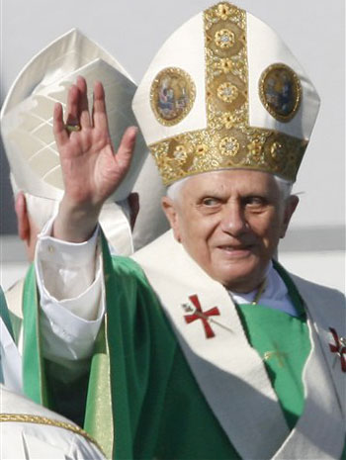
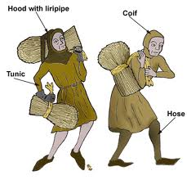
Next steps in your learning...
Over the next few lessons we will be looking at the following challenges to a medieval king’s power:
Medieval Catholic Church
The Barons

Slide 6
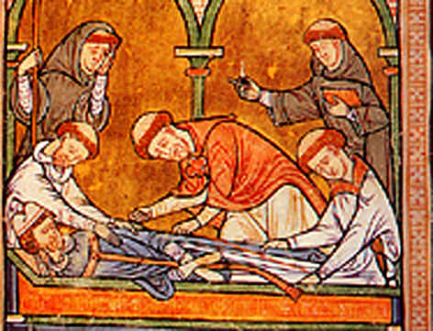
Task 2: Who was more powerful in Medieval England: Church or King?
You are going to investigate a number of famous incidents between Church and King in Medieval England. Some you may have studied before, others are new.
You will be using detail from the case study(s) to answer the key question:
Who was more powerful in Medieval England: Church or King?

Slide 7
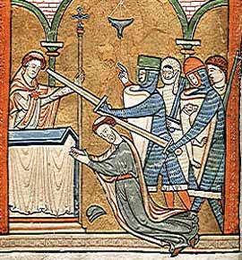
Option A: Group Work: Study and Present
Your teacher will give your group one case to study.
Your group should read it carefully and answer the questions on the sheet in as much detail as possible.
Your job will be to explain the story to the class in your own words. You will teach your peers what to put in the boxes on their sheet.
Your presentation cannot be more than 5 minutes long.

Slide 8
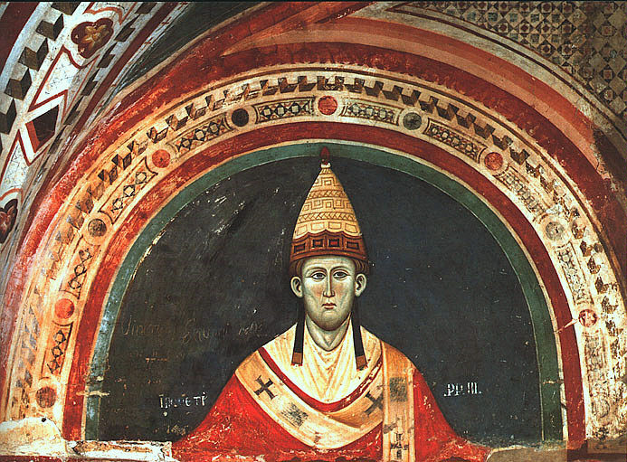
Option B: Rotation
This can be done individually or in pairs.
There are three case studies. You will see them one at a time.
When you have been given a case study read it and try to put notes under the headings on your sheet.
You will have 8-10 minutes per case study.

Slide 9
Option C: Home-Expert Groups
Step 1: Students in groups of 3 – This is your HOME group. Decide who is going to be the expert on:
Case study A: Challenging
Case study B: Easy
Case study C: Moderate
Step 2: Expert groups gather together on a workstation. Read the case study together. Discuss the questions thoroughly. Write up your NOTES on your sheet. Make sure you understand because you will be responsible for teaching the others in your HOME group.
Step 3: Home groups – Students take 5 minutes each to teach the others what to put under each heading on their worksheet. Do not simply copy each others sheet – this defeats the learning challenge of explaining and teaching.

Slide 10
Conclusion – who had more power King or Church?
Look back at the case studies and reflect on the power of the King and Church
You do not have to answer every question – but choose a selection which CHALLENGE you to think hard about what you have learned.
Write the Q chosen and your answer on the lined paper provided.

Slide 11
Plenary: Opinion line ranking activity
You are going to rank the power of the King from 1-10.
6 - 10 = the king was more powerful than the Church.
5 = They were equally powerful.
1-4 = The Church was more powerful than the king.
You must write the score out of 10 in your book and at least a sentence to support your judgement. You will be asked to explain your answer.

Slide 12
Resources below:

Slide 13
Case study A: Henry II and Thomas Becket | Case Study B: King John and Pope Innocent III | Case Study C: William II and Anselm.
Describe (L3-4) Why did the King and Church fall out? | Describe (L3-4) Why did the King and Church fall out? | Describe (L3-4) Why did the King and Church fall out?
Explain (L5-6) Who had the most power King or Church? | Explain (L5-6) Who had the most power King or Church? | Explain (L5-6) Who had the most power King or Church?
Analyse (L6-7) Why did each party (King/Church) feel they ought to have ultimate power? | Analyse (L6-7) Why did each party (King/Church) feel they ought to have ultimate power? | Analyse (L6-7) Why did each party (King/Church) feel they ought to have ultimate power?

